Slide 1
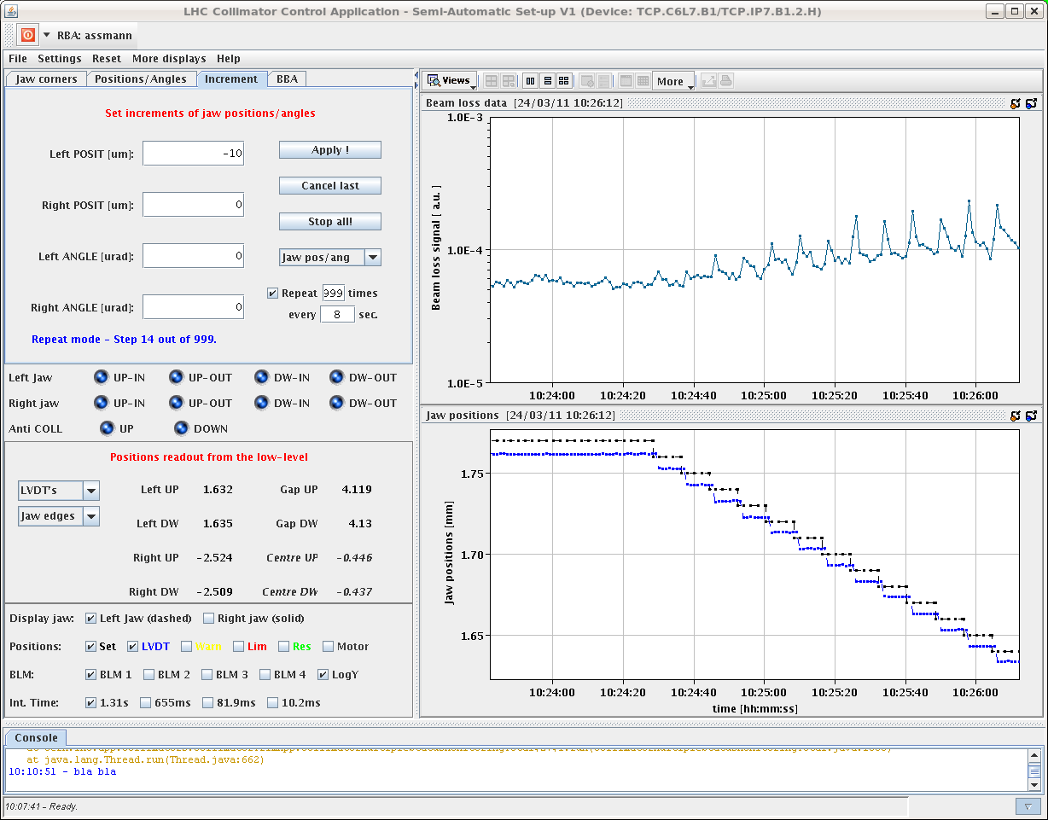
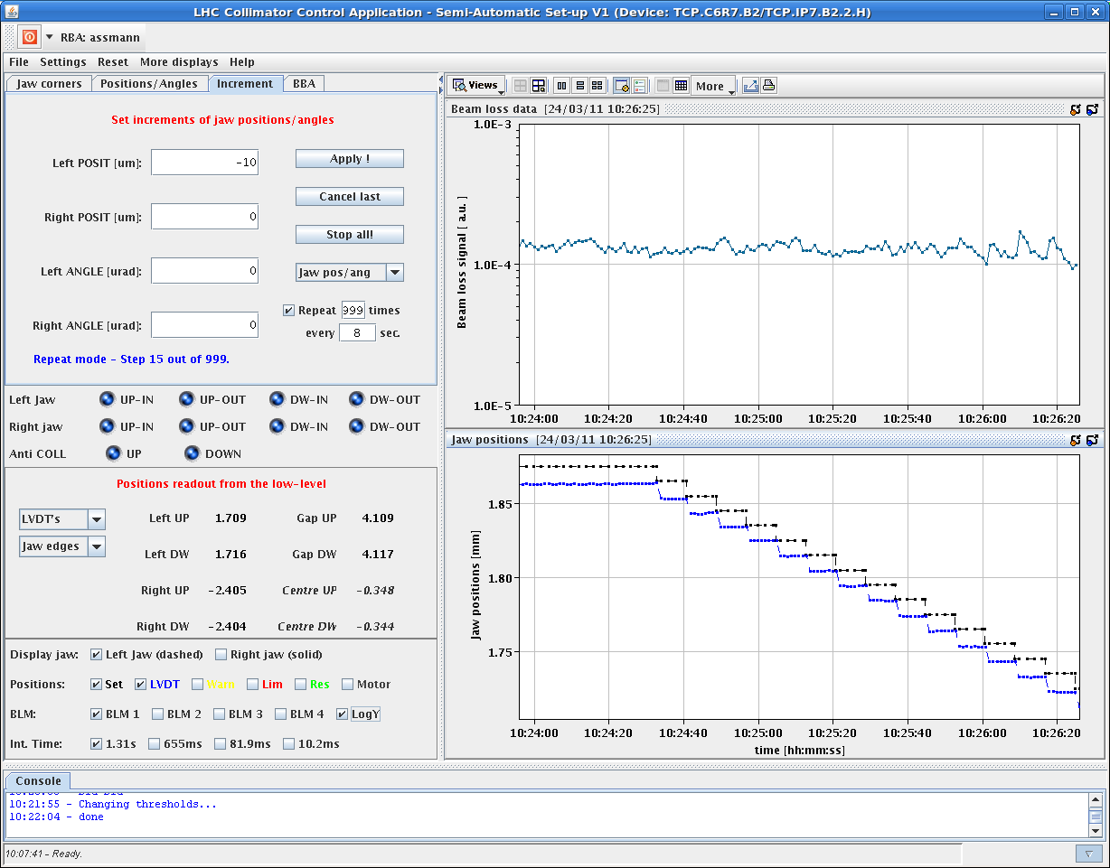
Yesterday morning
Held 1647 for a while – SPS kicker problem
EOF scraping
We have no tails (RA)
10:45 Beams dumped

Slide 2
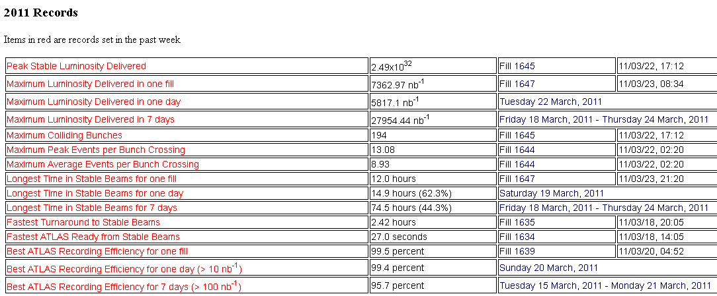

Slide 3
Thursday continued
11:30 access in P1 and P5 for QPS
After the dump we had to let the QPS team accessing in IP1 and IP2 to fix some crates which probably suffered from SEU induced by the high luminosity
15:00 beam in for 1.38 TeV
2 nominals up ramp for collimator set-up
16:46 beam dumped at top pf ramp
energy limit interlock on a TCLA. The functions were changed,
could not restart - problem on the LBDS: two Rogoski coils were giving an error and the IPOC was bad.
18:00 Access
Nicolas Magnin confirmed that they have changed a NI board

Slide 4
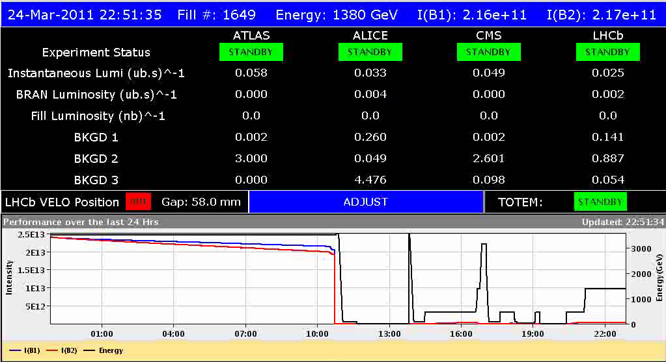
1.8 TeV continued
22:50 All IPs optimized
Separated ALICE by 130 um in H plane.

Slide 5
Summary collimation setup
(R. Bruce, D. Wollmann, G. Valentino, F. Burkart, S. Redaelli, R. Assmann):
Centered all TCT collimators on 1.38 TeV reference orbit. Found up to 2.1mm offsets for zero crossing angle. - Set to agreed 1.38 TeV setting of 14 sigma - Entered interlock threshold values - Setup time: ~1h10. Profited from new parallel movement of both jaws in semi-automatic setup method. - Loss maps done for both beams, H and V. All fine. Cleaning OK. Very small losses in TCT's. - Preparation of operational settings and sequence for collision beam process. - OK for stable beams at 1.38 TeV with 80b from collimation.

Slide 6
Hum..
Async dump
Dry test of TCT functions for collision.
The 1.38 TeV sequence had to be modified to updated the TCT thresholds at the beginning of the collision functions (discrete trim of the end-of-ramp actual).
2:50 pilots in – unclean injection of 4*nominal
BPMS test (JU)
Conclusion: as the BPMS are redundant, crate A and crate B, and the functionality has been tested operation with 80 bunches and its filling pattern can continue. However, this BPMS should be checked tomorrow and the cause of the different reading understood.
Lose handshakes
Lumi optimization with the DIP signals has the BRAN are not giving any data

Slide 7
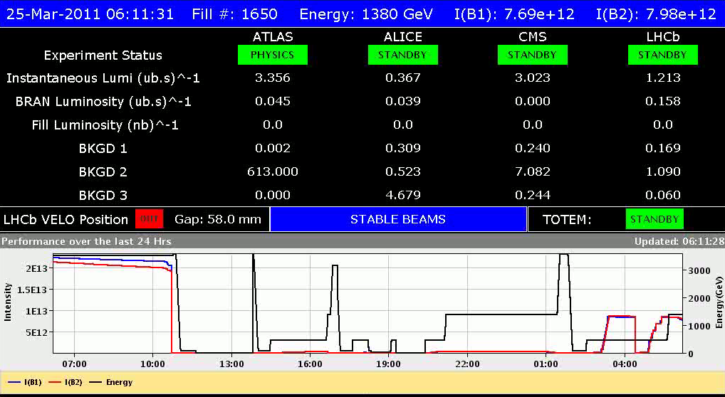
Stable beams
Thanks Laurette & Delphine

Slide 8
Incoming
Fri AM between fills | ADT/AGC | 2 h
Fri PM/night | 1.38 TeV stable beams
Sat between fills | Energy gaps interlock test | 1 h
Sat PM | 1.38 TeV (plus extra ramp for quench test)
Sat night | 1.38 TeV stable beams
Sunday AM | Back to 3.5 TeV, test ramp
Sun AM/PM | Transfer lines tests | 3 h
Sun AM/PM | Aperture measurement TI2/8 | 3h
Sun AM/PM | Intensity increase with 75 ns | 2 h
Sun PM/night | Physics 296 bunches
Mon 06:00 | Dump beams for TS
Note: no 50 ns nor 25 ns required over the weekend

Slide 9
Noted – Per Hagen
Will the “soon to come” fill 1664 be celebrated? with or without crossing angle…

Slide 10
Result of BPMS test: Took BPMSA.B4L6.B1 vertical plane which was given the wrong number of bunches (71 instead of 80). Reading position -0.6 mm with an off-set of -0.7 mm (middle of Limits min and max, reference, is 0.15 mm). When changing the limits from 1.0 to 0.5 mm both beams were dumped, BPMS for B1 and BLM losses on TCDS triggering B2. Conclusion: as the BPMS are redundant, crate A and crate B, and the functionality has been tested operation with 80 bunches and its filling pattern can continue. However, this BPMS should be checked tomorrow and the cause of the different reading understood. JU

