Slide 1
Thursday 17/3
Morning: evaluation of the origin of the timing problem occurred over night and the implication on machine protection
09:00 – 12:00 Dry ramp to validate energy and β* limit functions for collimators
Beam 1 not available from the SPS (steering issue in TT60-TI2) likely due to the remanent field of the HiRadMat/TI2 switching magnet after a test
Beginning of the afternoon: decision to operate the machine with low intensity and progress with commissioning activities while waiting for deployment of new firmware for the timing distribution
14:00 – 19:00 several interruptions:
BST
NFS ➔ concentrators not working (BLM/collimators logging 222 GB of data in 1 day)
PS Booster
19:00 - Setting-up of ramp to 1.38 TeV
04:30 – FIDEL chromaticity and tune corrections at 450 GeV

Slide 2
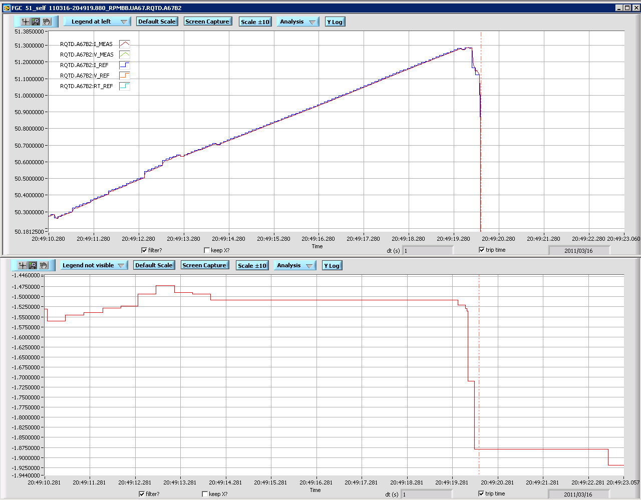
Beam dump on Wed at 22:49
Discovered that RT_REF signal is mis-mapped between devices within the post-mortem logs (S. Page)
Caused by the tune feedback likely reacting to wrong measurement of the tune as a result of the timing problem
Actions: New release of the MTG firmware (tested yesterday after re-production of the error with old firmware)
Update of the BBQ timing receiver firmware

Slide 3
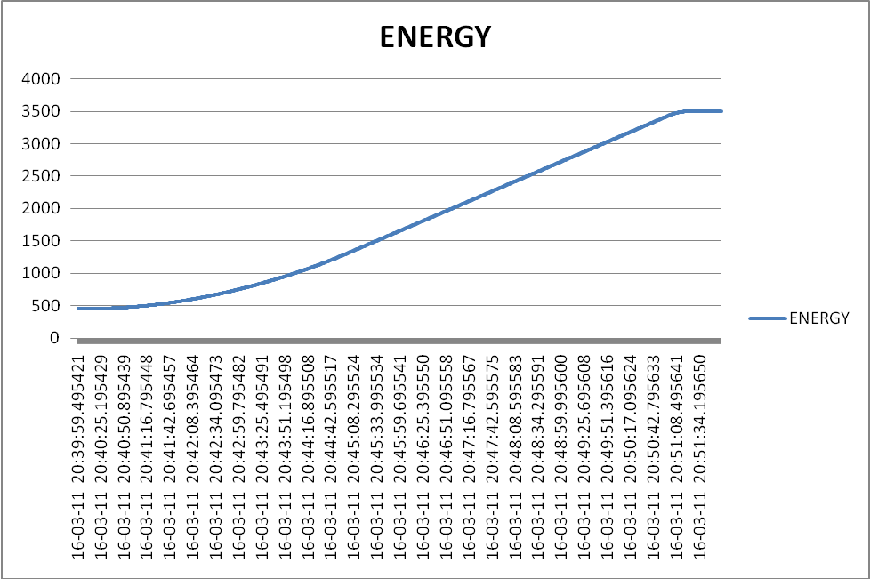
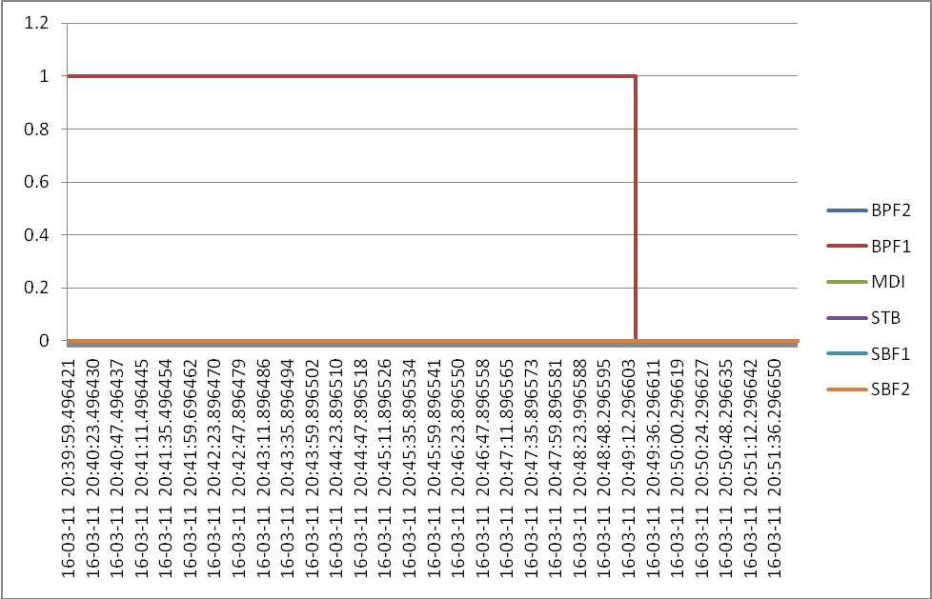
SMP distribution during timing problem
All energy values were correctly sent to the GMT. Energy and flags sent by the SMP during ramp-up
I. Romera

Slide 4
Collimation
- The dump from the TCTH.4L5.B1 is still under investigation. The reason for dump was "Position out of limits" but the position sensors remained well within the limits (even when looking at the fast acquisitions into the PM buffer). More news asap. - We set and tested without beam the energy limit functions for all collimators of type TCP, TCSG, TCLA, TCDQ in all points. This worked well. Limit thresholds are now active for the 3.5 TeV ramp (Settings are validated for operation). Other collimators have constant energy limits around the injection settings (500 um). - We tried a dry test with the TCT betastar limits during the squeeze. This did not work because there is a FESA bug in the interpolation of the gap limits vs betastar. The bug was identified and a solution is found. It will be implemented in the technical stop.

Slide 5
Timing problem
See slide P.Charrue

Slide 6
“Replacement Program”
Prepare ramp and collision for 1.38 TeV operation
2 ramps lost
SIS on collimators not masked
Losses on TCTVB.4R2, when bringing into collision – needs more setting up
Found collisions in all IPs except ALICE
FIDEL studies on chroma and tune decay at 450 GeV
Chroma stable, tune can be improved
Test ramp with pilots
When switching On the radial modulation, with tune feedback still ON, some RQT tripped: RQTF.A81B2, RQTF.A23B2, RQTF.34B2, RQTF.A45B2

Slide 7
Plan
09:00 New firmware will be deployed on the operational timing server A
09:00 – 12:00 Ramp at low intensity (probe) to check timing behaviour (in particular SMP distribution)
Aim for physics with 32 bunches

