Slide 1

Week 48
Summary of ion week 48
Last beam OP summary of 2010
Coordination M.Lamont & J. Wenninger

Slide 2
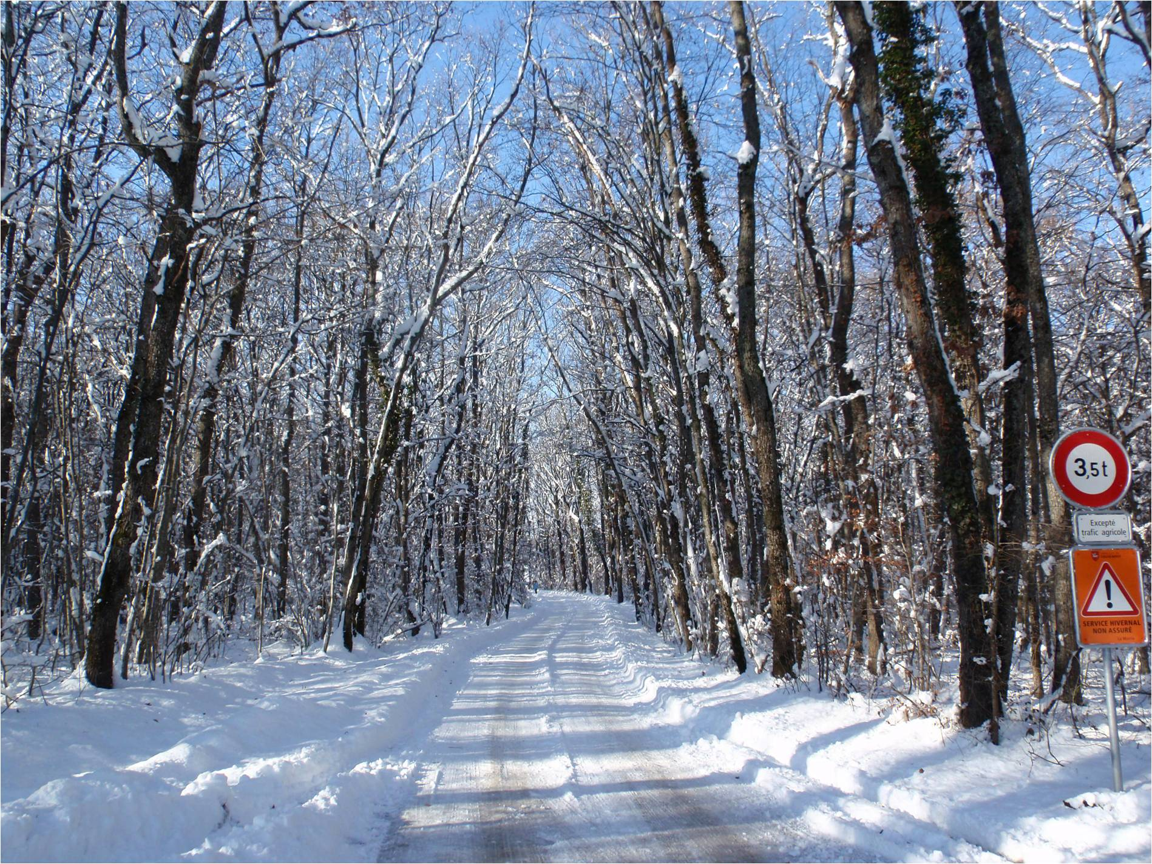
Overview
Aim of the week was
  provide integrated luminosity for ions and miss the target of 1-10 μb⁻¹ ,
  Van de Meer scans,
  complete some remaining MD requests.
But the week got disrupted…
  snow and ice,
  cryo stop Pt4,
  ion source refill.

Slide 3
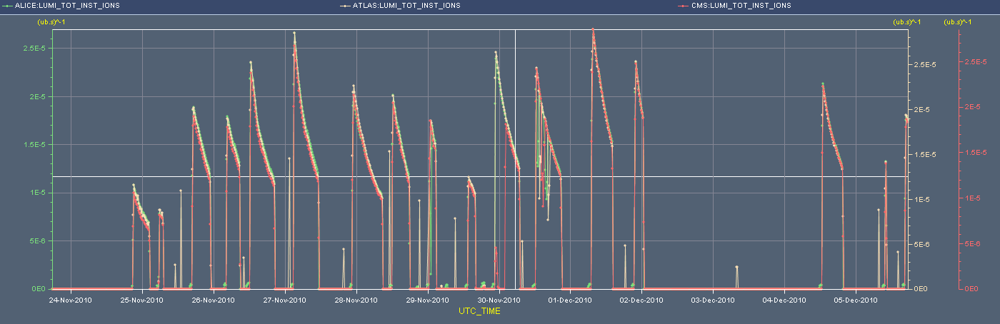
Overview of stable beam periods
Up to cryo/source stop : injection of 4 bunches/transfer
From Saturday : injection of 8 bunches/transfer
  No luminosity record, despite 137 b: smaller b currents + emittance.
After VdM scans, injection with constant RF voltage of 7 MV
  no ghost bunches, mismatch leads to long. emittance growth – beneficial for IBS.
Cryo &
source

Slide 4
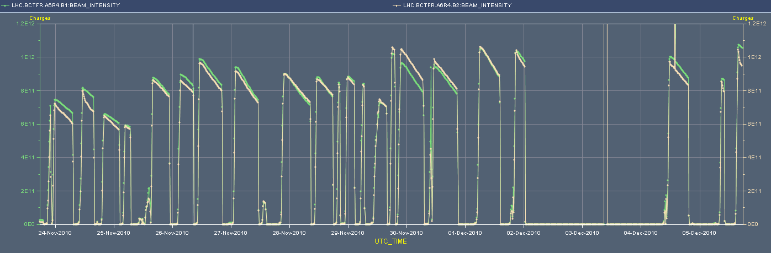
Overview of ion intensity
Note: since Sunday morning the lifetime of B2 has been consistently low (down to 1 hour) in R & S – cause not understood.
121 bunches
137 bunches
Cryo &
source

Slide 5
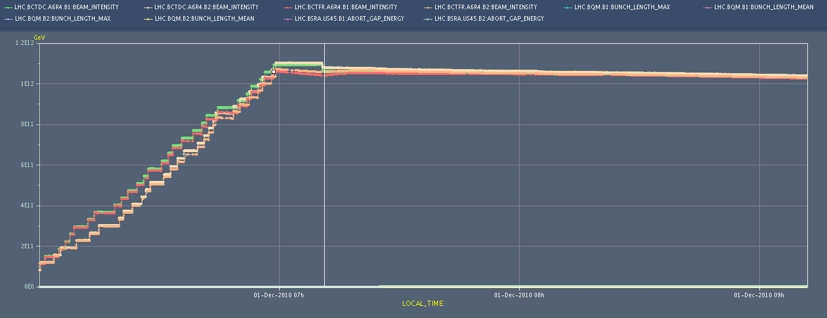
Capture losses
RF capture with constant voltage of 7 MV.
~3% capture losses, little 2.5 ns structure.

Slide 6
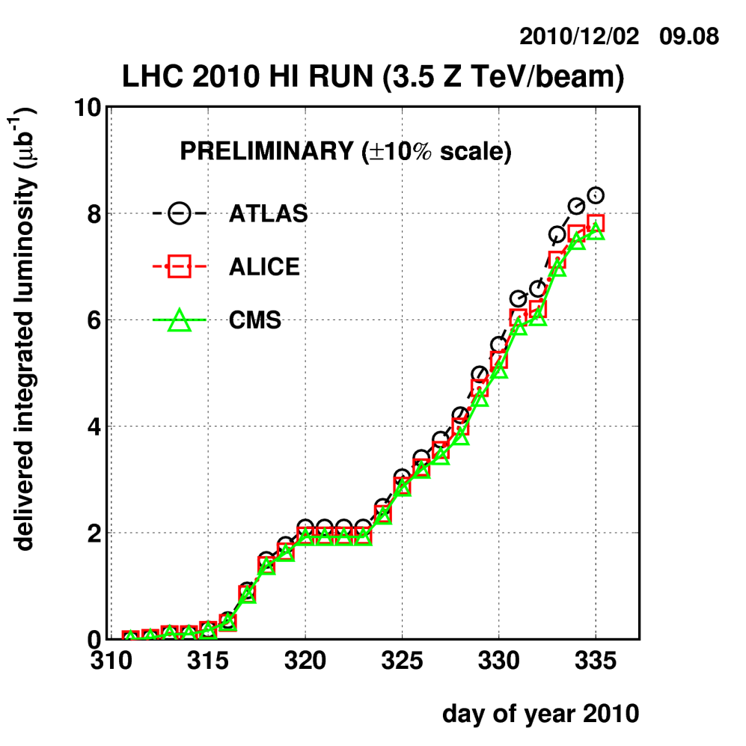
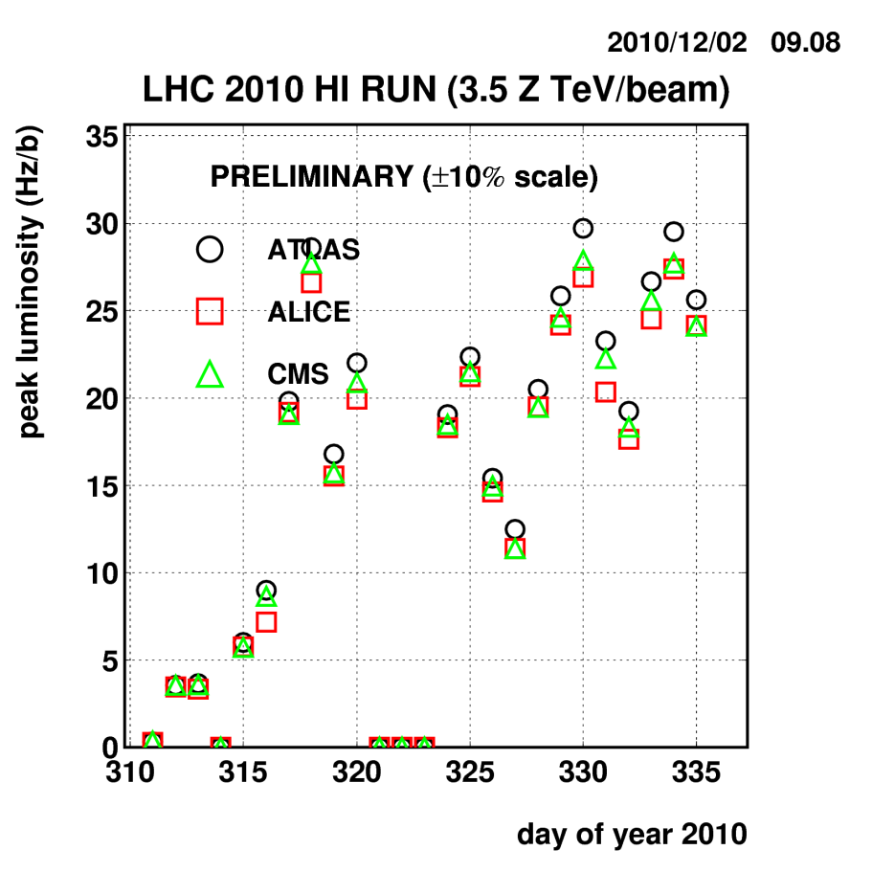
Ion summary
Integrated luminosity last Monday ~6.5 μb-1.
Integrated luminosity now ~9.5-10 μb-1.

Slide 7
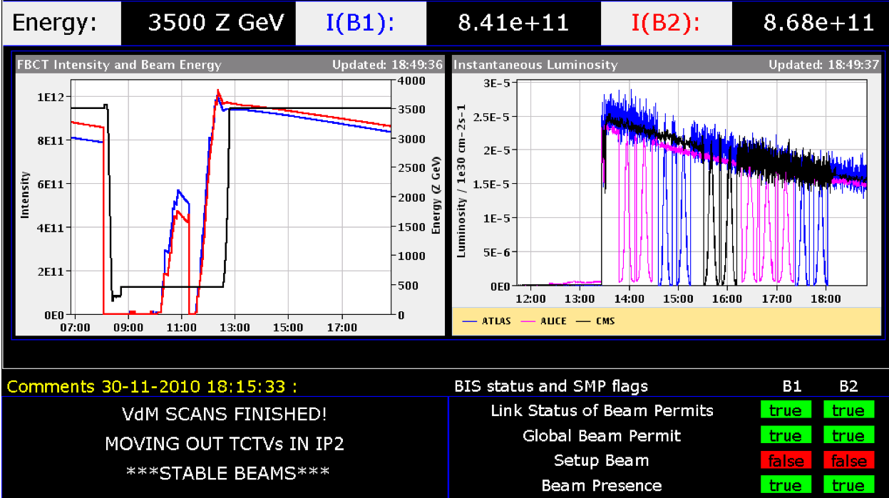
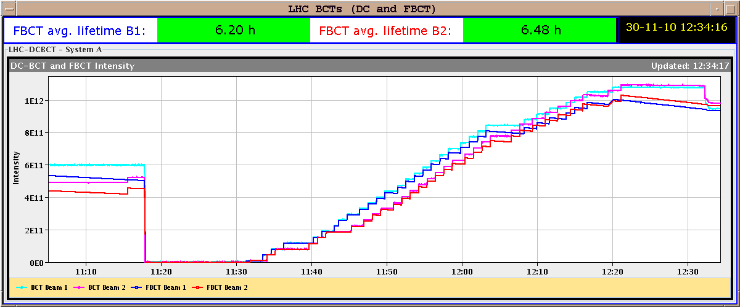
VdM scans – Tuesday 30th November
Good conditions, around 1% ghost bunches.

Slide 8
Cryo stop
Cold compressor stop in Pt4 Thursday around 01:30AM.
Signature of the problem was indicating a possible damage to the cold compressor. Expert intervention required on Thursday morning.
  Eventually the controller for the Magnetic Bearing was replaced.
  Restart of the compressor Thursday around midday.
Cryo conditions in Pt4 were reestablished Friday morning 10:00AM.

Slide 9
LHC Cryo global availability – S. Claudet
Results for 2010 above expectations, thanks as well to periodic technical stops
On tracks for a nice finish !!!
(Text few weeks ago)
Powering tests
Learning spring
Fantastic since summer !
New challenge is to prepare for MASSIVE Helium transfer to storage, maintenance, RRR …

Slide 10
Ion source
In the night from Thursday to Friday the ion source intensity decreased rapidly, indicating the end of the (refill) lifetime.
The 2 ovens were refilled Friday morning. Beam was back in the SPS Saturday morning at 09:30, in the LHC at 10:00.

Slide 11
Powering
In particular after the cryo & source stop, and despite careful checks and pre-cycles, we suffered from a series of powering problems.
Over the weekend, we lost 2 QHPS. In both cases MP3 suggested to continue operation with the missing QHPS, OP being in charge to make sure that no other PS discharges during operation.
  Saturday night: the missing QHPS on MB in 27R5 was eventually fixed in the shadow of another access for RQ6.R5.
  Sunday night: lost one QHPS on MB in 32R8 – we are presently operating without this QHPS.
  This mode of operation will be used in 2011 to reduce number of interventions – with some HW protection.

Slide 12
Today
Last fill 1540 in stable beams since 04:00.
Last refill of the year after this meeting.
And then….

Slide 13
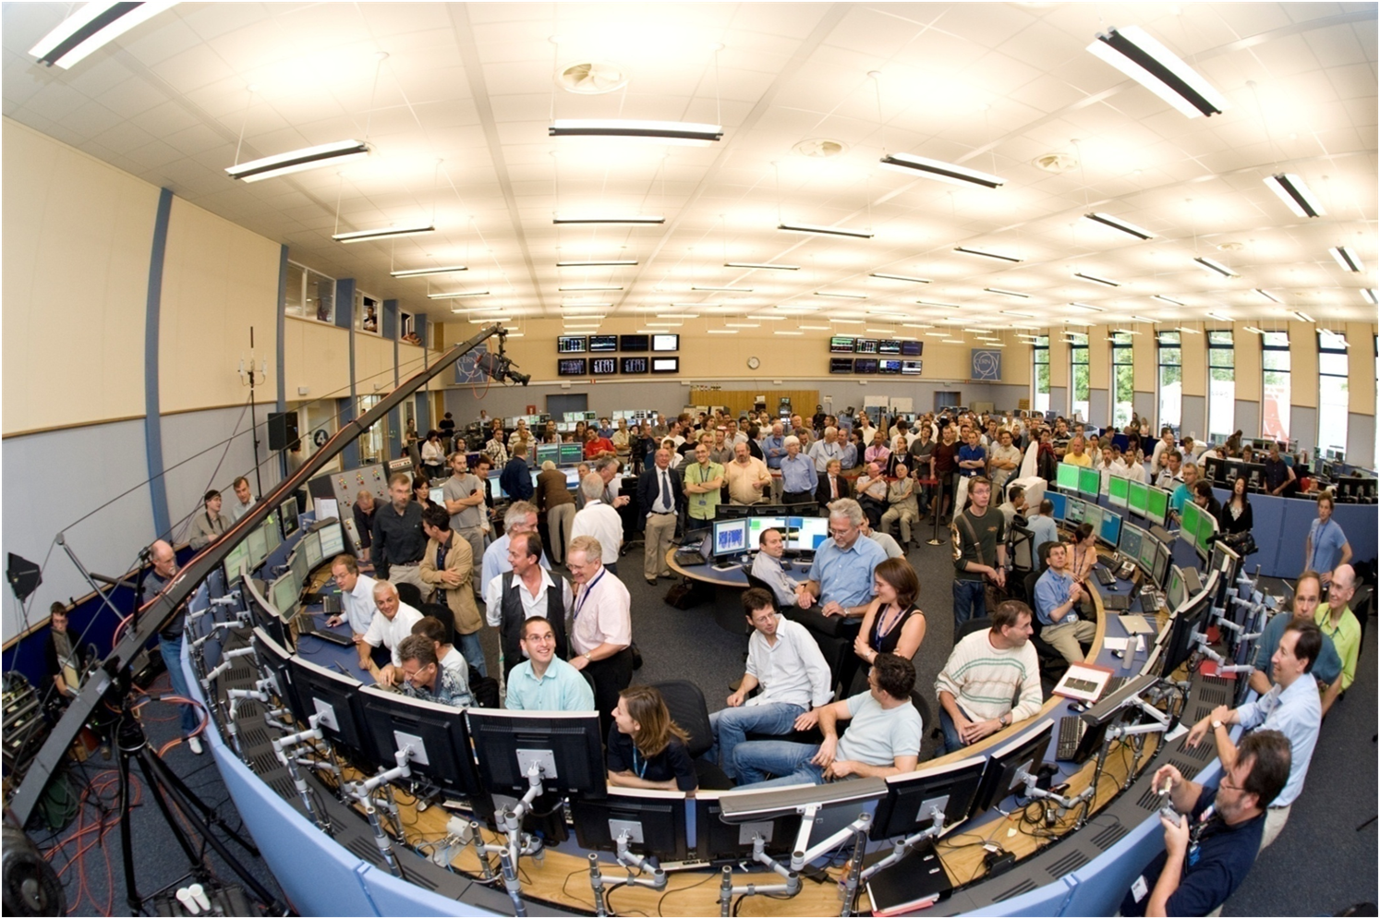



So long and thanks for the fish !
Thanks to all for the hard work !
Today at 18:00 in the CCC we celebrate the last beam of 2010 !
3x10²⁵
No quench !
25 MJ
2x10³²

