Slide 1
Wednesday 1.12
Stable beams fill 1534, L = 3x1025 Hz/cm2.
Capture with constant 7 MV RF voltage gave positive results.3% capture losses.
Beam dump during wire-scan from losses on Q9.
Lost QPS OK for MB.B10L2. Access needed at 16:00.
Followed by a loss of patrol (PAD PM25).
2 Ion pumps in LHCb velo (VPIX.IP431.IP8.VE, VPIX.IP441.IP8.VE) have been switched off.
Pressure from 1E-9 to ~7E-9.
For future beam-gas imaging.

Slide 2
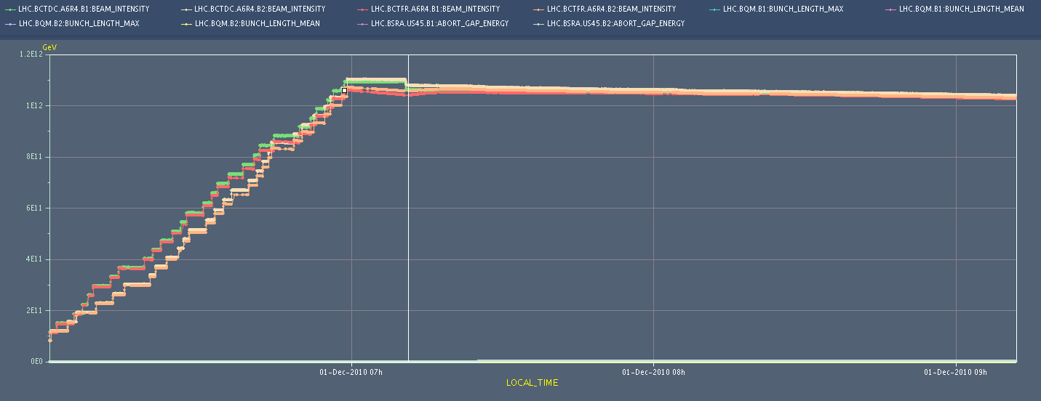
Capture losses
~3% capture losses, little 2.5 ns structure.

Slide 3
Wednesday 1.12
22:45 Stable beams fill 1535, L = 2.5x1025 Hz/cm2.
01:40 Dump – lost cold compressor of Pt4
Fault on magnetic bearing
08:00 Access to Pt4 for cold compressor.
Most likely no beam before tomorrow…

Slide 4
Today
Access…
Injection of 8 bunches into TI2/TI8.
Waiting for cryo

Slide 5
On the list
8 bunch injection from SPS
Thursday (UA9 in action in the SPS today)
Low frequency (few Hz) oscillation on B2V
Rogelio would be ready to take some data with the BPMs to see if we can localize the source. Acquire data during injection parasitically.
Orbit FB tests at injection,
1-2 hours, Jorg
Q’ feedback during a test ramp… R. Steinhagen
IR aperture measurement
Massimo, Stefano et al
Damper investigations at 450 GeV
gain/blow-up/multibunch data acquisition
4 hours

