Slide 1
Tuesday 30th November
08:10 beams dumped – end fill 1532
RF settings to lock the voltage during injection, as requested for the VdM scans. RF fct WITH COUNTERPHASING reloaded
ADT module H1B1 tripped since tonight.
Slow, messy fill attempt
SPS bunch length
PS cavity
Etc
11:20 dump & try again
IQCing un-bunched beam (RF modulation does work)

Slide 2
Tuesday continued
Filled again with almost perfect fill, ramped up and put in collisions without major issues.
13:32 Stable beams
After declaring Stable Beams we waited for few inutes for ALICE to take data with the TCTVs opened,
Then we closed them and started the VdM scans.

Slide 3
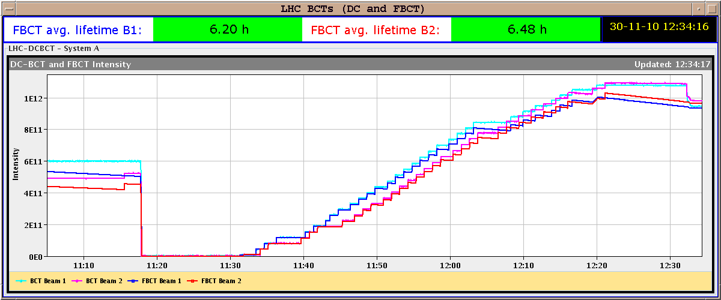
BCTs
capture loss 12% B1 10% B2

Slide 4
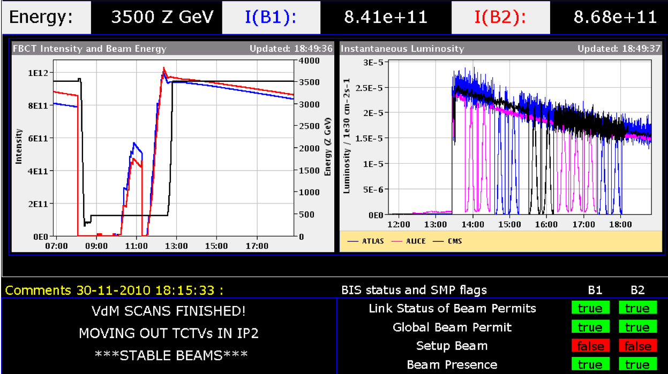
VdM scans
Looked good – around 1% ghost bunches

Slide 5
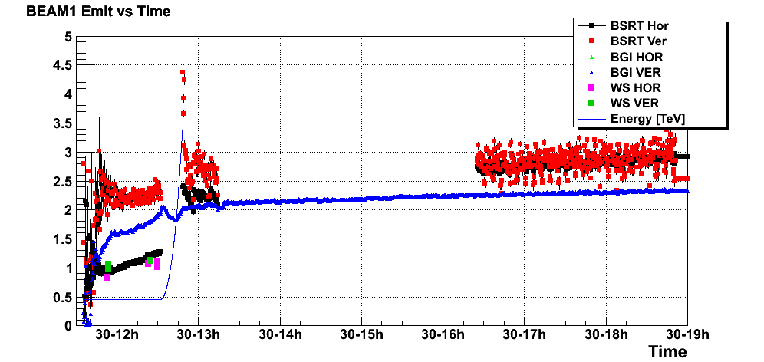
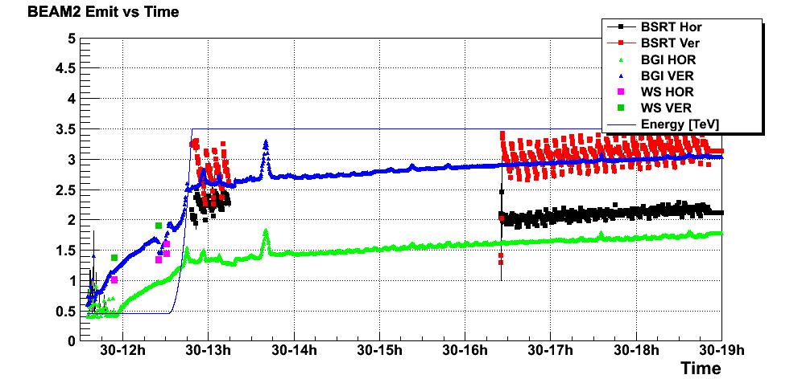
Beam size

Slide 6
Last night
Dump 22:10
Two accesses
point 4 – reset MB.A9.R3 – old QPS – full power cycle (possible radiation induced fault – piquet moved crate)
similar to case in point 7 2 weeks ago
point 4 – RQTF.A45.B2 – internal fault on power converter – EPC piquet
Access finished by 3:30, precycle, etc
injection long, but emittances good and intensity back up
Injecting into fixed 7 MV – looked OK
8:20 Colliding beams – fill 1534 around 2.8e25 cm-2s-1

Slide 7
On the list
8 bunch injection from SPS
Thursday (UA9 in action in the SPS today)
Low frequency (few Hz) oscillation on B2V
Rogelio would be ready to take some data with the BPMs to see if we can localize the source. Acquire data during injection parasitically.
Orbit FB tests at injection,
1-2 hours, Jorg
IR aperture measurement
Massimo, Stefano et al
Damper investigations at 450 GeV
gain/blow-up/multibunch data acquisition
4 hours

Slide 8
Next Monday
18:00 End of run
18:00 – 18:30 vacuum valve tests

