Slide 1
Wednesday 24.11.
02h04: Stable beams #1514. 121b x 121b.
Peak luminosity 1.2e25 cm-2 s-1
08h32: Beams dumped on request.
Length=6h28. Rampdown and precycle.
09h41: Injection.
Energy error (0.8%) from SPS suspected → OK
Emittances ~ 4 um, except B2V: 11 um
12h40: Start ramp.
14h01: Stable beams #1515. 121b x 121b.
Turn-around: 5h29.
Peak luminosity 1.2e25 cm-2 s-1
17h01: Beams dumped on request.
Length=3h00. Rampdown and precycle.

Slide 2
Fill 1515

Slide 3
BCT Comparison
First plot shows a summary of fill 1515 injection. We see again the same thing, i.e. good
agreement between DC and fast in the beginning, then some divergence building. This time, fast BCT sees around 6.5% (resp 2.5%) less than DC for beam 1 (resp beam 2).

Slide 4
Long. Density Monitor
Longitudinal density monitor = LDM (BI Resp: E. Bravin, A. Jeff) measurement integrated over 50 mn (from 15h46 to 16h36) during stable beam. We have a small residual phase shift, the last pulse on the right side is in fact the first bunch. We see that bunch peak is around 80000 counts.

Slide 5
BCT Same Time Window
BCT data during this time window. We see that the difference between the 2 BCTs remained stable to 6.5% and 2.5%.

Slide 6
Zoom Before Bunch 1 → Ghost Bunches
zoom just before bunch 1 (ie the last one on the previous plot). We see there 'islands' of ions. These islands are separated by 2.5 ns. Their peak is around 30 (40-estimated noise baseline), i.e. 2500 time less that real bunch peak.

Slide 7
Bunch in the Middle
zoom before a bunch in the middle (around us 50s). We see also there populated islands every 2.5 ns with peak around 30. Some of these beeing even more populated (~500 less than real bunch)

Slide 8
Last Bunch
surround of one of the last bunch injected. We see there no clear 400 MHz structure with an average level around 10 which is our estimated noise.

Slide 9
Abort Gap
zoom in the middle of the abort gap. Again there, mainly noise.

Slide 10
Ghost Bunches?
these 'islands' wanish but go quite far away when they exit. A simple calculation shows that we would need 2500 * 0.025 = 60 such islands (at 40 peak) around each bunch to justify the 2.5% droop of the fast BCT with respect to the DC. This does not look so impossible.

Slide 11
Jean-Jacques Gras
If we trust BCT measurements, a possible scenario could be:
ions escape slowly around the bunches during injection. The more bunch stays at injection, the more these ions spread.
after some time, some ions escape our 25 ns integration window. This explains that our fast BCT stay in line with DC for a while and then diverge (the cumulated escaped ions are bellow our noise threshold to be taken into account in the neighboring buckets).
finally, the situation seems to 'freeze' after ramping. i.e the difference between DC and fast do not increase anymore during stable beam.
All this has to be analysed more carefuly but, unfortunatly, LDM is today only available on B2 and top energy for ions. This nice tool should be available on both beams next start-up with the protons.

Slide 12
Wednesday 24.11.
17h01: Beams dumped on request.
Length=3h00.
Rampdown and precycle.
18h04: Injection. Correction injection oscillations.
18h40: Trip much of sector 81. Glitch on temperature sensor on RSS.A81.B1 (which is already superlock!).
19h56: Injection.
21h04: Start ramp.
22h03: Stable beams #1517. 121b x 121b.
Turn-around: 3h46 (1h16 subtracted for S8 trip).
Peak luminosity 1.3e25 cm-2 s-1
22h50: Lost QPS-OK on RCS.A45B1.

Slide 13
Yesterday Fills

Slide 14
Yesterday Fills

Slide 15
Something Wrong Here

Slide 16
Thursday 25.11.
03h34: Beams dumped on request.
Length=5h31. Rampdown and precycle.
04h20: Injection.
Losses in SPS flat bottom reduced.
Now losses at acceleration had increased and source went down.
Once again lower bunch intensity
05h54: Start ramp.
06h58: Stable beams #1518. 121b x 121b.
Turn-around: 3h24.
Peak luminosity 1.0e25 cm-2 s-1
07h16: CMS sees cogging problem. Other experiments fine. Suspect threshold effect on BPTX signal (low bunch intensity).
08h06: Beam dump: Q9.R2 → noise on long cables (seen that before).

Slide 17
Today

Slide 18
Today

Slide 19
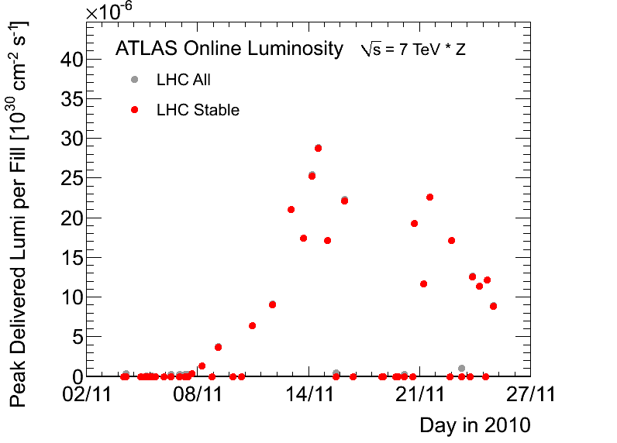
Peak Lumi (ATLAS)

Slide 20
Integrated Lumi: Approaching 4 ub-1

Slide 21
Ahead
Must now sort out injector intensity and transmission: change ion source, …
Soon better to keep LHC beam than to refill (intensity from injectors dropping faster than the intensity of stored LHC beam) → refill does not pay off in luminosity
Ahead: More stable beams
See whether 2e25 cm-2 s-1 can be recovered.

