Slide 1
Saturday 23 October
08:30 – 09:15: Cycling S23
9:30 – Pilots back in the LHC
By 16:00 – Status of the injection studies:
Pilot beam 1 and beam 2 injected ….
4b beam 2 injected
That’s it!
Reasons:
MKE6 not kicking - traced back to crate p.s. dead
Re-phasing when switching to LHC3 – to be understood – was cured by making a recording with SPS mastership (not LHC) and then playing back.
Lost S78 – cryo maintain lost
Cycle sector S78

Slide 2
Saturday 23 October
16:00 – 20:15: Injection studies cont’d – Brennan Goddard and team.
Beam 1 and beam 2 transfer line trajectories, BLM signals and injection oscillations checked – some correction done for beam 1 in the H plane Injection tried with 8b,16b, 24b -> all O.K.
→ MSI aperture restriction was indeed fixed. No more problem there anymore.
Adjusted IQC thresholds for the MKI B1 delays - reduced min and max by 35ns, to follow the trim made earlier - also trimmed a few other values for B1 which were out of tolerance after the PFN changes. Full set of thresholds still to set systematically after some statistics.
Moved to 32b injection. Found that the batch spacing in the SPS was not correct – was 300ns between the batches as 225 ns is required. Was corrected. Injection done with 32b - losses small, all fine.
→ Injection ready for 32b

Slide 3
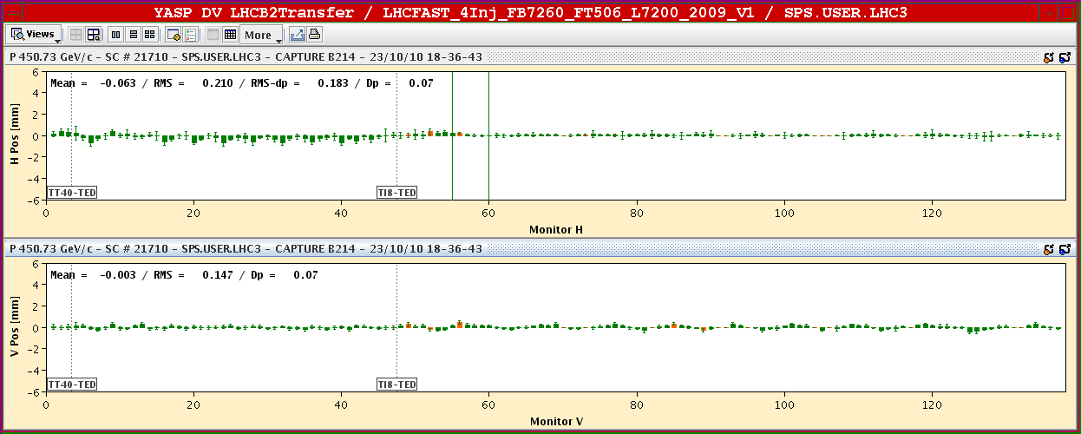
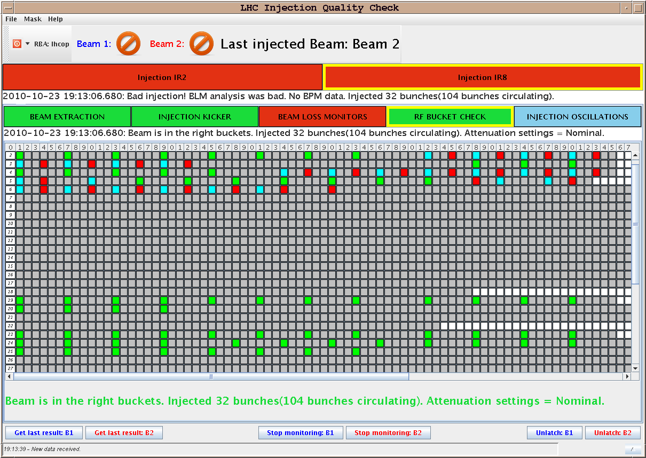
Saturday 23 October

Slide 4
Saturday 23 October
Launched the filling sequence of the 360b scheme to perform the interlocked BPM tests in Pt6. Filled 328b per beam – losses, trajectory and injection oscillations were fine.
Got dumped on the last 32b injection: requested bucket number was in the abort gap keeper region. MKI did not fire (as expected) and the 32b went onto the TDI. SIS interlock did not catch it (surveying still the old AGK limits -> updated).
20:45 : Reversed LHCb spectrometer polarity (from - to +). and orbit corrected accordingly
21:040- 00:00: Launched test ramp with pilots (1bx1b) + squeeze + collide – Check the whole sequence.
00:00 – 01:00- ramp down
01:00 – Inject 2bx2b, nominal intensity – ramp – squeeze- collide – Reduce intensity on the 3rd order resonance – loss maps on momentum (+800 Hz)

Slide 5
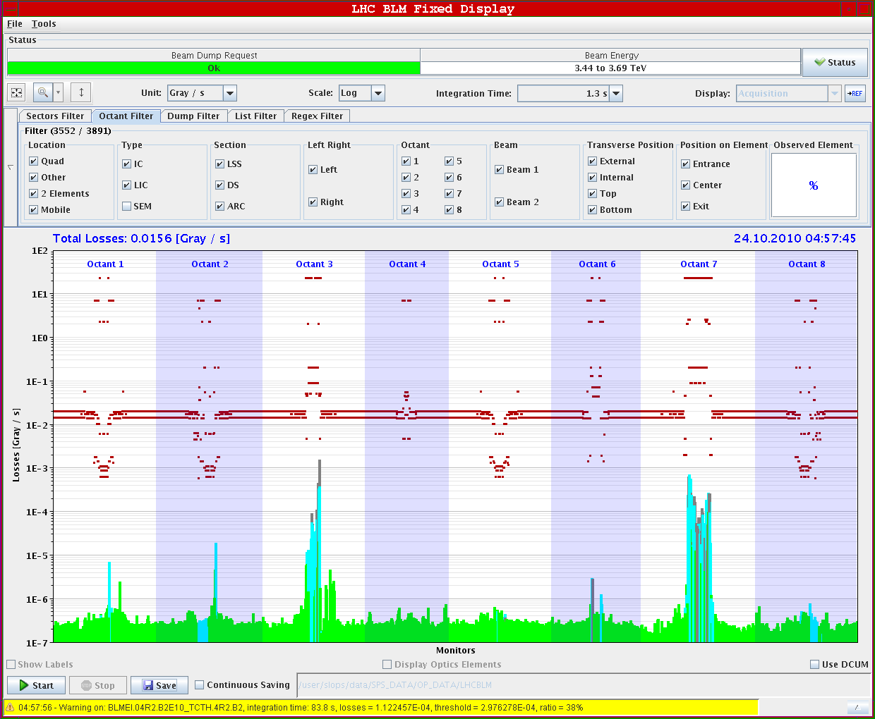
Sunday 24 October

Slide 6
Sunday 24 October
Today: Fill for Physics 312 bunches
Overnight: Fill 360 b - check Interlocked BPM pt6
Fill again 360b for Physics

