Slide 1
Monday 18 October : Collimation system
9:00 – 11:00: Loss maps – Ralph Assmann - Daniel Wollmann
Conditions:
1 bunch per beam (B1: ~9e10p; B2: ~8e10p), 3.5TeV, beams in collisions Performed:
Betatron losses for B1 ver, hor and B2 ver, hor
Could not do off momentum losses - no beam left
Results (preliminary):
Leakage into the IRs in the 0.1% level
No unexpected losses
Cleaning efficiency: B1v : 2.5e-4; B1h: 3.5e-4; B2v: 2.2e-4; B2h: 2.5e-4

Slide 2
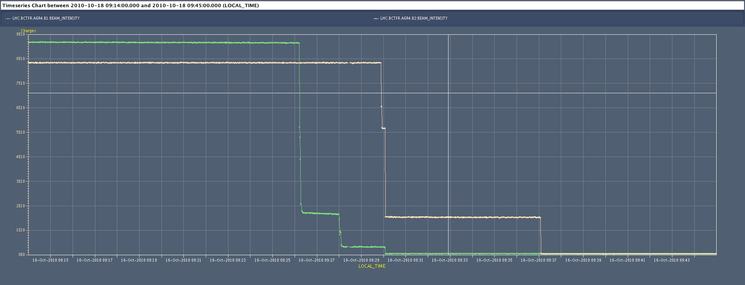
Beam intensity during loss maps
Beam intensity: B1 (green) and B2 (yellow)
Daniel Wollmann

Slide 3
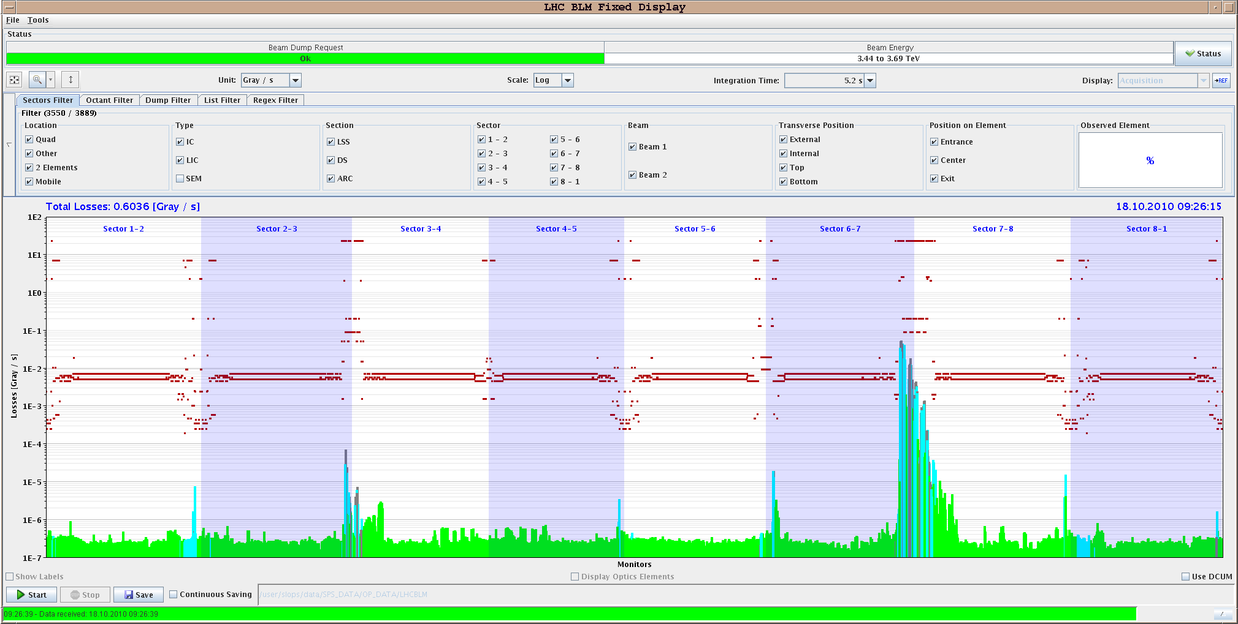
Betatron losses, B1 vertical
Daniel Wollmann

Slide 4
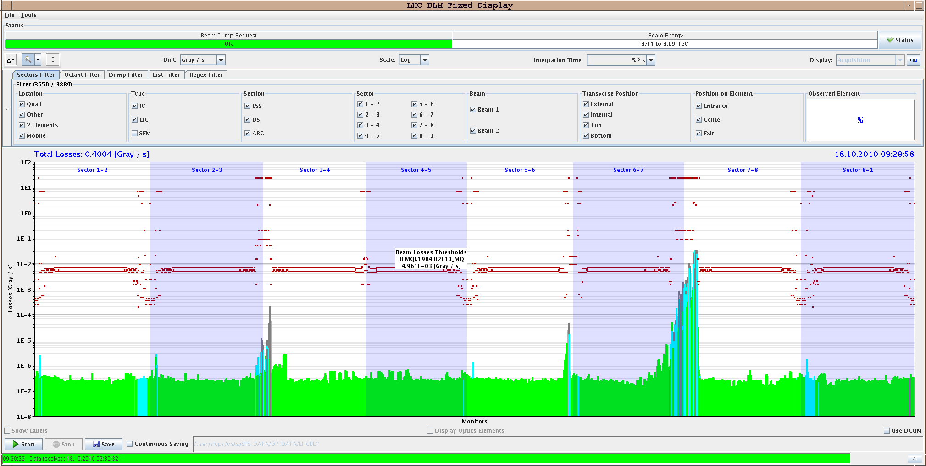
Betatron losses, B2 vertical
Daniel Wollmann

Slide 5
Monday 18 October : Beam commissioning
11:00 – 15:00 : Abort Gap cleaning - Andrea Boccardi, Adam Jeff, Federico Roncarolo, Enrico Bravin, Wolfgang Hofle, Daniel Valuch, Verena Kain, Eliana Gianfelice, Malika Meddahi
Beam conditions: B1: buckets 1 and 31130. B2: buckets 1 and 31140, 450 GeV, 1e11/bunch
AG cleaning was tested using the vertical damper for beam1 and beam 2 (done for beam 1 and beam 2 separately). With the voltage and frequency chosen, no anomalous emittance growth observed, no lifetime problems
RF voltage was decreased in steps and cleaning of the beam leaking into the AG part being actively cleaned was observed
Experiment repeated with both beams in the machine. The beams were injected while the cleaning systems were on
No anomalous observation made → will switch it on for the next Physics injection.

Slide 6
Cleaning and Tune measurements
To note: The coexistence between abort gap cleaning and tune feedback is not obvious. In the vertical plane the tune viewer was jumping around between different peaks within the range of the cleaning. This also does not improve with reduced gains (the one we use for the ramp)
BBQ measurements
with cleaning on.
There are also two
peaks and the
measurement is
jumping around
between them...

Slide 7
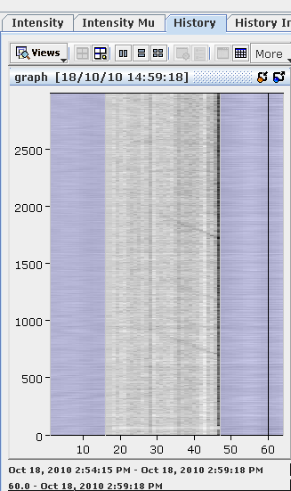
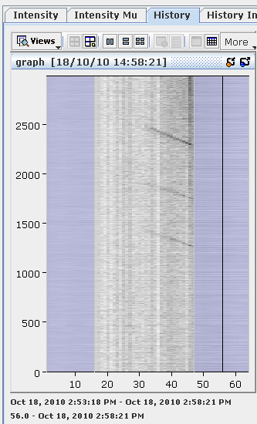
Abort Gap monitor
Adam Jeff – Andrea Boccardi
Beam 1
Beam 2

Slide 8
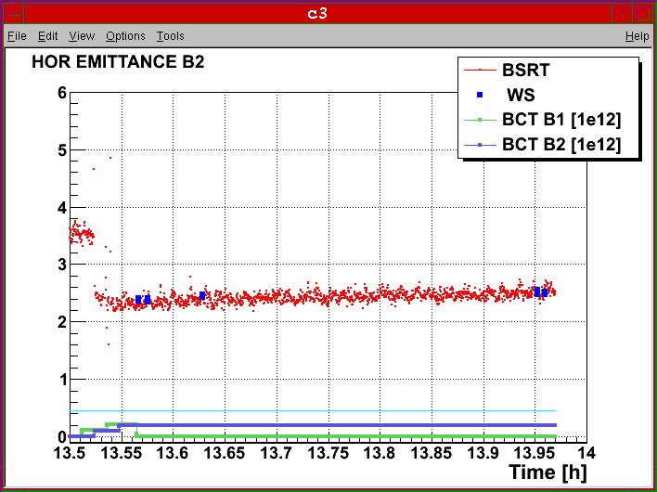
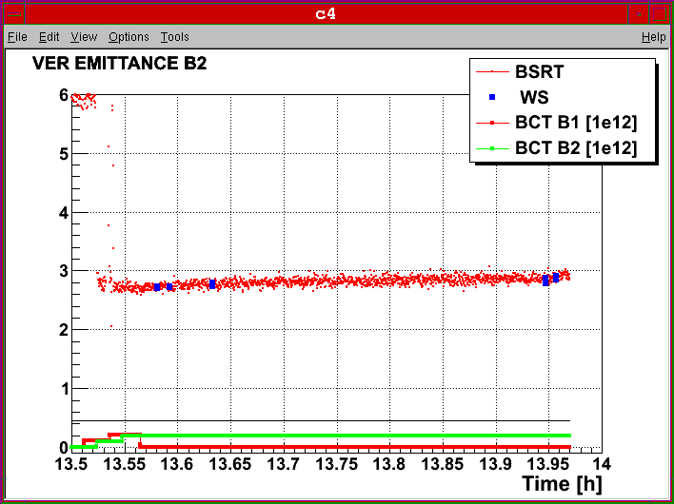
Emittance measurements
Federico Roncarolo

Slide 9
Monday 18 October : Beam commissioning
15:00 – 19:00 : RF noise induced beam diffusion - Philippe Baudrenghien et al.
Beam conditions: 4 x 4 b (1E10/bunch) both beams ramped to 3.5 TeV, no blow-up, no squeeze. Measurements done at 3.5 TeV. Very short (400 ps long) bunches
Time : 2 x 4 hours inject, ramp, excite, measure diffusion
Motivation: Prepare for higher intensity next year when 2 new systems will be introduced: longitudinal damper (active only at inj.) and 1-Turn feedback (active all the time). These will add RF noise. Need to assess the margin.

Slide 10
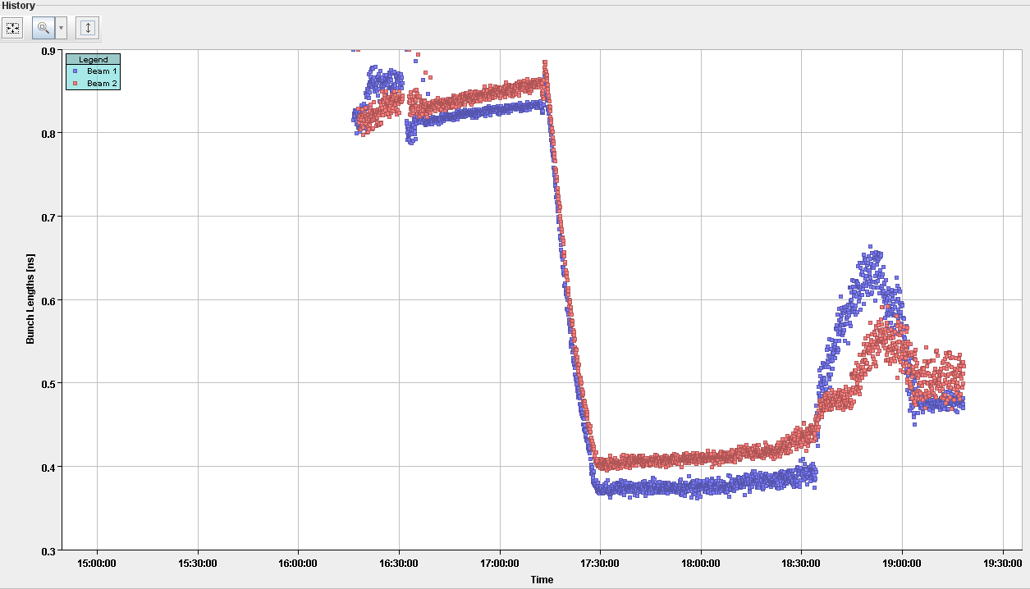
Bunch length evolution
Excite with colored phase noise (spectrum from 0.8 fs to 1.2 fs) and with various excitation levels. Observe Bunch length BQM Acquire Beam 1 Bunch 1 profile every min with 25 ps/sample
excite
ramp

Slide 11
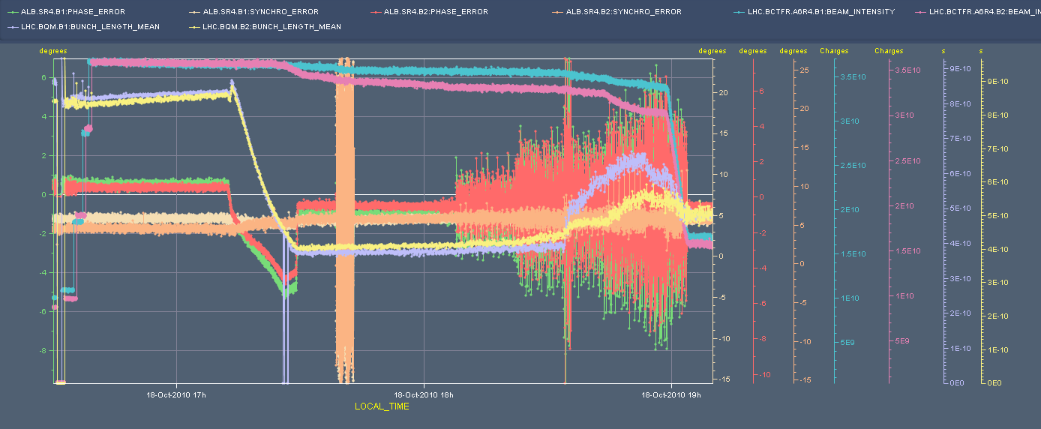
Preliminary results: from observation of BQM only, results are very confusing. The bunch profiles suggest modification of bunch shape that goes from parabolic to triangular with the excitation.
These 92 successive profiles must be analyzed. We also realize that the method for introducing the excitation in the cavity is not ideal.
_{phase} _{error}
_{BFCT}
_{synchro error}
σ_{l}

Slide 12
Monday 18 October: Preparing for Physics
19:00 – 23:00: Ramp-down, inject again, tuning beam parameters (SPS and LHC)
Did 2 attempts and got dumped on Beam 1, injection of 24b.
Injection oscillations in V plane were large, and got caught by the BPM Pt6 before ADT damping them
Would need to perform some more TL+LHC optimisation in V. Was not worth with remaining time and the fact that we are pushing the limits
More beneficial over the long term to provide time to the PLL commissioning

Slide 13
Monday 18 October: System commissioning
23:00 – 06:00: PLL commissioning – Tune Phase Locked Loop - Marek Gasior – Ralph Steinhagen – THANKS for flexibility and enthusiasm for night shift at short notice
This time PLL studies done for both beams at the same time
2 ramps done – first one with low-intensity pilot beam without ADT - had to further reduce the nominal B2-V damper gain to allow PLL locking (-15 -> -21 dB)

Slide 14
Monday 18 October: System commissioning
2nd ramp: PLL kept lock - used as primary input to the Tune-FB
achieved 99% transmission for both beams
PLL operation visible on life-time but always above 25 h
Stable PLL gains depend on the effective ADT settings and varied by more than a factor hundred between ADT 'off' and 'on'
Tune resolution acceptable and in agreement with FFT-based estimate
Needed 5% excitation amplitude (in particular for B2-V) that provided typically 30-40dB signal w.r.t. ADT noise floor
Initial emittances before ramp: B1-H = 1.8, B1-V = 1.6, B2-H = 2.6, B2-V = 2.9
emittances at flat-top: B1-H = 3.3, B1-V = 2.7, B2-H = 3.6, B2-V = 3.2
No further measurable emittance blow-up at flat-top (even with radial modulation)
Q' tracking/scaling notably dependent on PLL bandwidth (to be further investigated/tuned)
Switched PLL and ADT off in the end to get a comparison of the bare tune tracking -> no apparent difference in life-time or beam sizes

Slide 15
Monday 19 October – Friday 22 October
Technical stop – coordination : Katy Foraz
Daily 8:30 meeting chaired by Katy
Beam operation will resume Friday late afternoon – More details as days advance…

