Slide 1
Injection Studies: Losses at the Septum
ABT

Slide 2
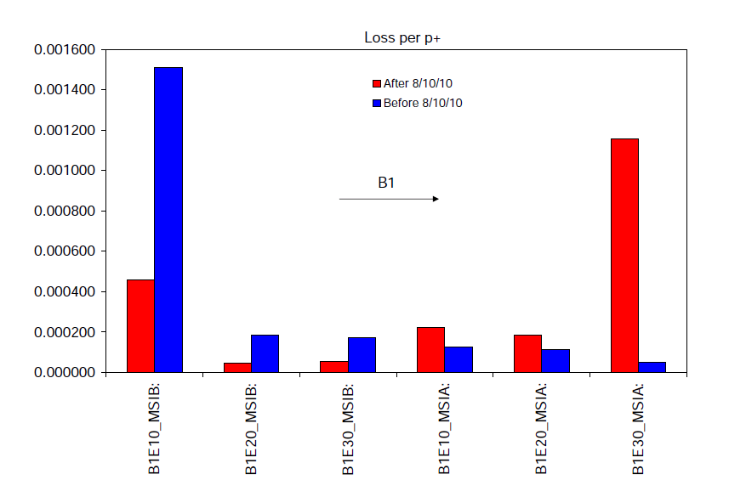
Injection problem B1
The problem: loss pattern change at the MSI
B.Goddard et al.

Slide 3
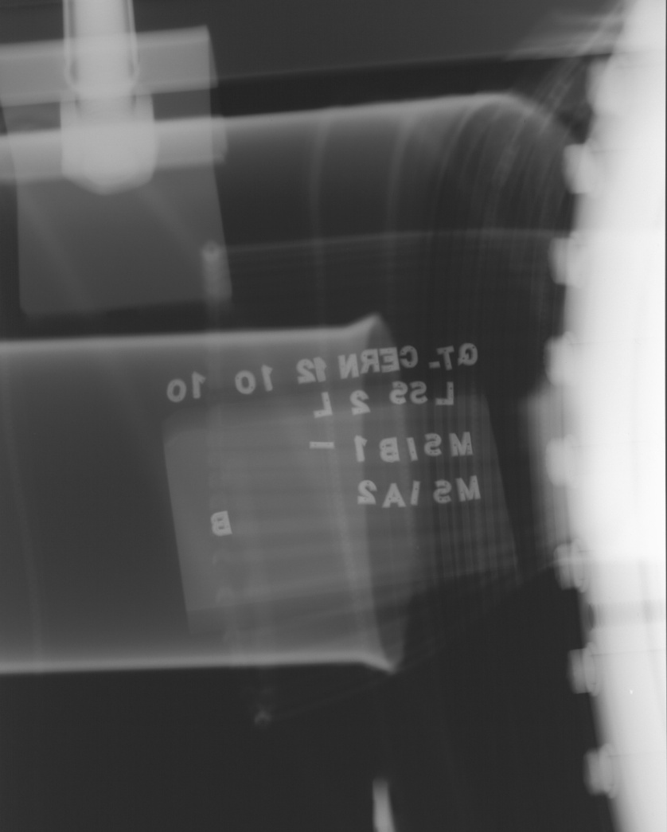
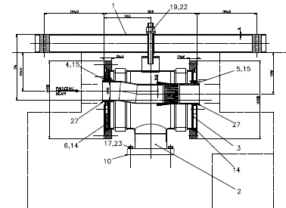
Injection area investigations at the MSI
There is a clear problem with the RF fingers at the transition. Not clear how did it get worse suddenly. Need to find a different injection trajectory, for the time being while preparing an intervention for the technical stop or the Christmas stop
Problem
New setting-up to be done this afternoon after the VdM scan
JM. Dalin
G. Arduini 13/10/2010

Slide 4
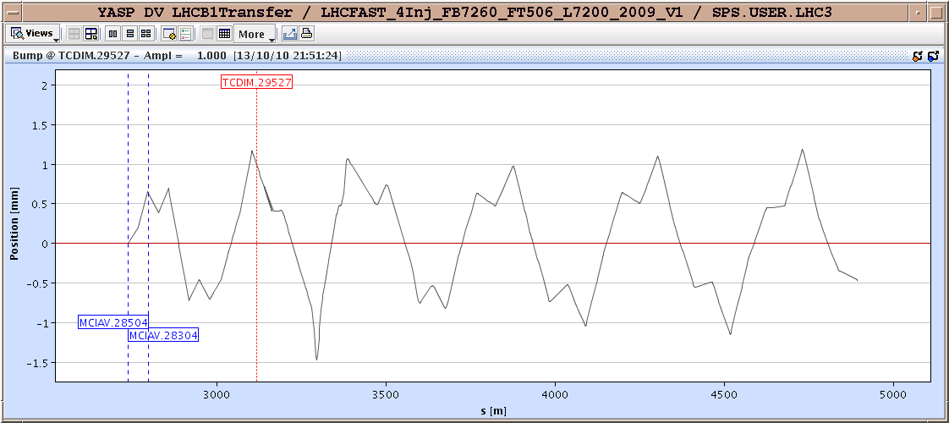
Temporary Solution: Bump around Bottleneck
Horizontal
Bottleneck
LHC
1 unit bump
Vertical
Bottleneck
LHC

Slide 5
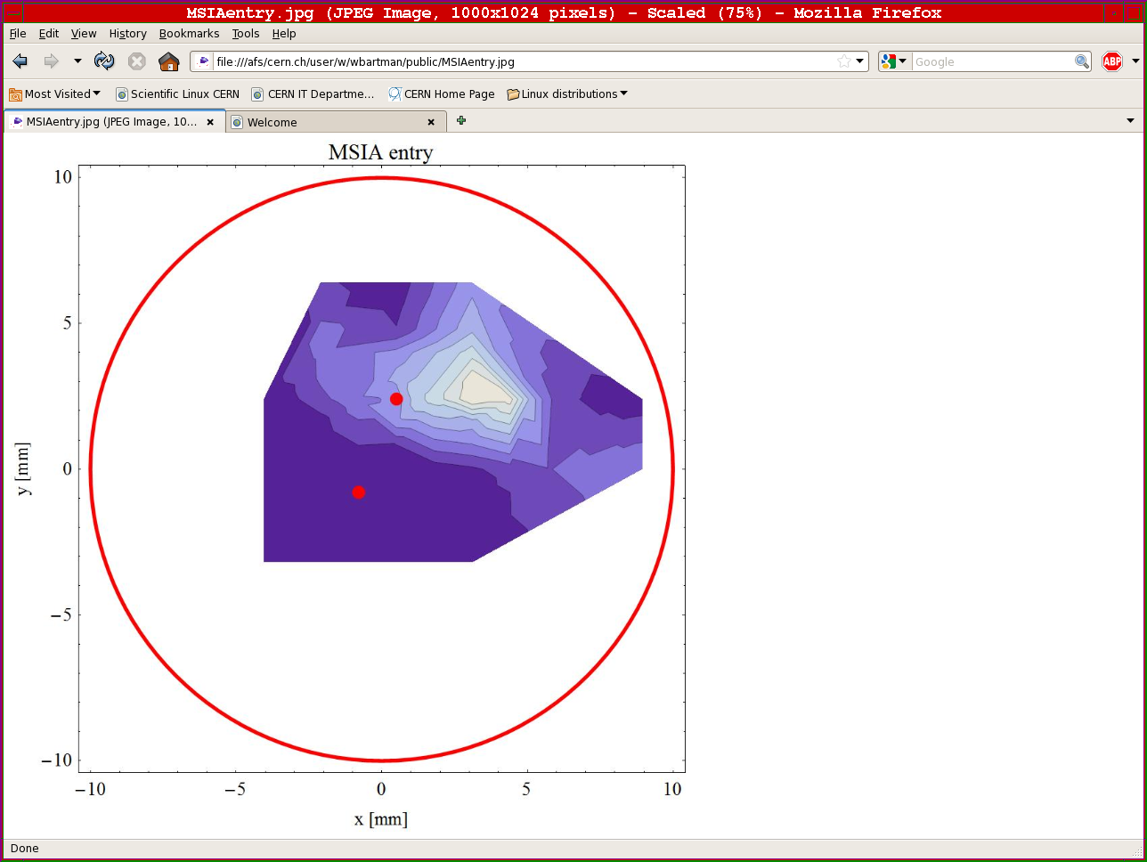
Horizontal & Vertical Scan
monitoring losses at the MSIA, MSIB, MQ5, TCTH.4L2 and TCLIB, with pilot bunches
High losses
High losses
old
old
4 mm Vertical
+1 mm Horizontal
new
new
No losses
No losses

Slide 6
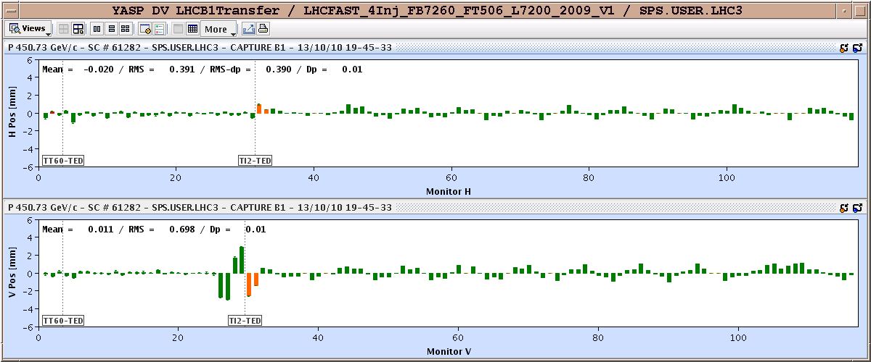
Vertical Orbit Matching in the LHC

Slide 7
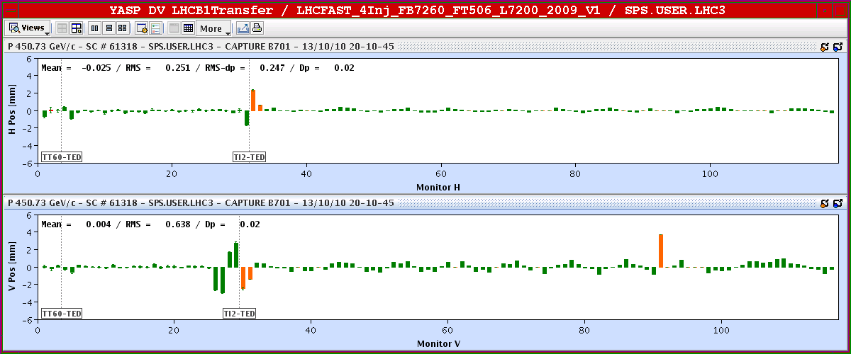
Horizontal Orbit Matching in the LHC

Slide 8
TCDI Collimators Reset wrt New Trajectory
24 bunches

Slide 9
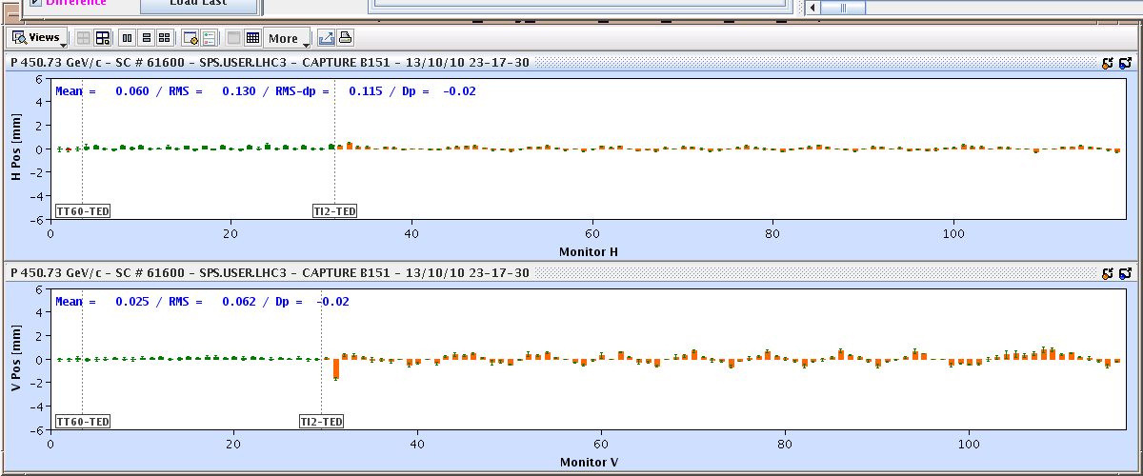
8 Bunches Injection
MSIB
MSIA

Slide 10
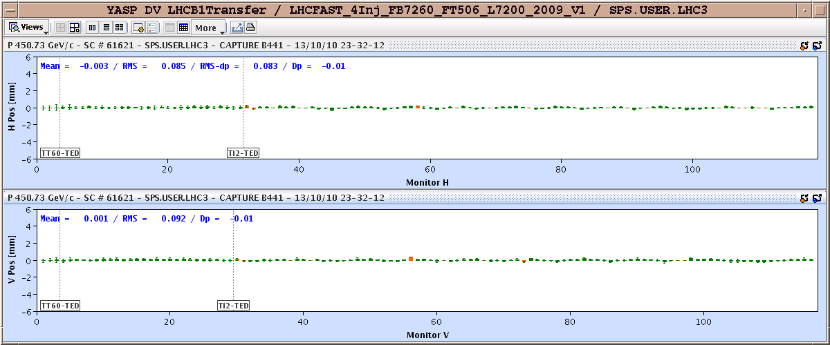
24 Bunches Injection
MSIB
MSIA

