Slide 1
LHC Operation Week 41
Coordination G.Arduini, M. Lamont
Aim for the week
Peak luminosities > 10³² cm⁻² s⁻¹

Slide 2
Statistics
Mon 11/10 at 07:00 to Mon 18/10 07:00
Set-up with beam: 56 %
Stable beams: 21 %
Set-up without beam: 10 %
Faults: 13 %
Delivered luminosity: ~ 7.8 pb⁻¹
Total luminosity delivered so far: ~23.8 pb⁻¹
Major stops:
Access for injection loss investigations, MKI, LBDS

Slide 3
Overview
Tue 12/10 | > 1.3 10³² cm⁻² s⁻¹ but only for 1 minute ➔ fill with XS emittances and XL beam-beam tune spread
Thu 14/10 | 10³² cm⁻² s⁻¹ in stable beams with 248 bunches/beam
Fri 16/10 | VdM scan for the experiments completed Increased number of bunches from 248 to 312
Sun 17/10 | Quench test at 3.5 TeV Peak Luminosity of 1.48 10³² cm⁻² s⁻¹ dumped by UFO after 0.5 h just above threshold
Injection loss issues with us for most of the week

Slide 4
Collisions
Fill | # bunch | N bunch [10¹¹ p] | ε_{H/V B1} _{@inj} [μm] | ε_{H/V B2} _{@inj} [μm] | L_{peak} [10³² cm⁻²s⁻¹] | ε_{H/V} _{@coll. from lumi} [μm] | Stable beams [h] | L_{int} [pb⁻¹] | Reason for dump | ε_{H/V} _{@end of coast} (from Lumi scan) [μm]
1408 | 248 | 1.02 | - | - | 0.94 | 2.5 | 9.5 | >2.4 | Prog. | 3.8/3.9
1410 | 256 | 1.04 | 1.5/1.3 | 1.4/1.6 | 1.3 | 1.8 | 0 | 0 | BLM on MQW | -
1418 | 248 | 1.04 | 1.7/1.6 | 2.1/2.2 | 1.03 | 2.4 | 8.5 | >2.4 | PC IT.R1 | -
1422 | 16 | 0.78 | 2.4/2.6 | 2.6/3.2 | 0.018 | 3.9 | 5.5 | 0.03 | LBDS | -
1424 | 312 | 1.13 | 2.0/1.9 | 2.2/2.4 | 1.35 | 2.6 | 1 | 0.4 | UFO LHCb BCM | -
1427 | 312 | 0.89 | 2.0/1.8 | 2.2/2.4 | 0.86 | 2.6 | 9.5 | 2.3 | Prog. | 3.2/3.1
1430 | 312 | 1.15 | - | - | 1.48 | 2.4 | 0.6 | 0.3 | UFO Pt.4 | -
Typical emittances in collision 2.5 μm
Studies on XS emittances to be continued..

Slide 5
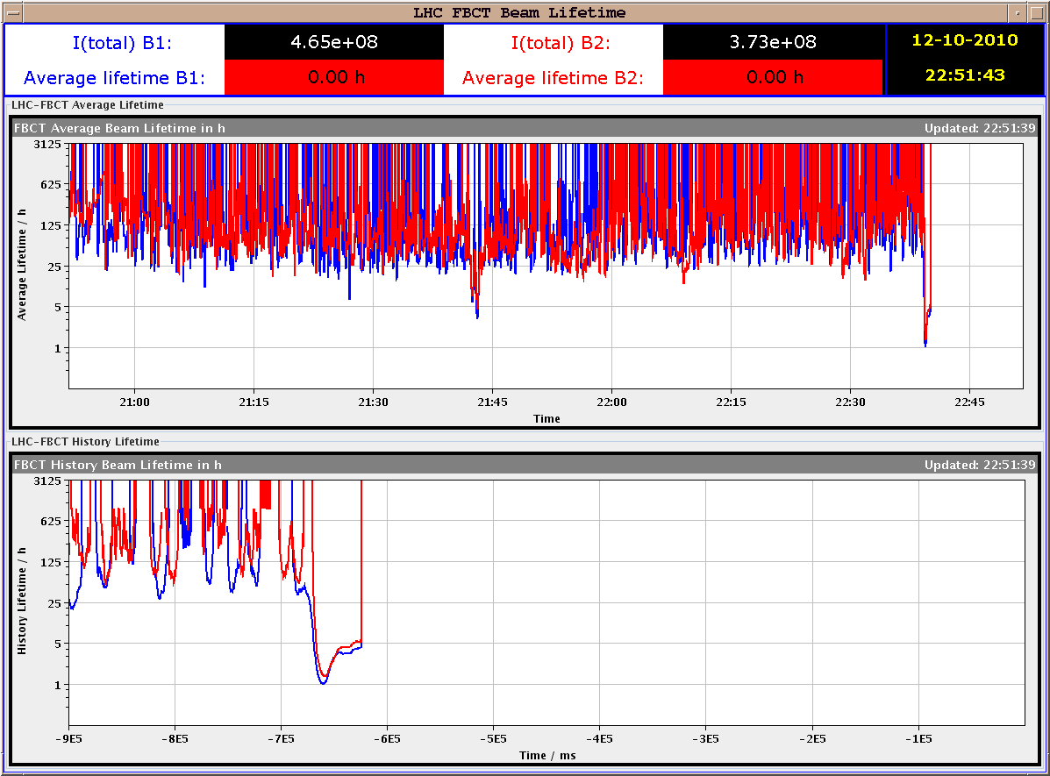
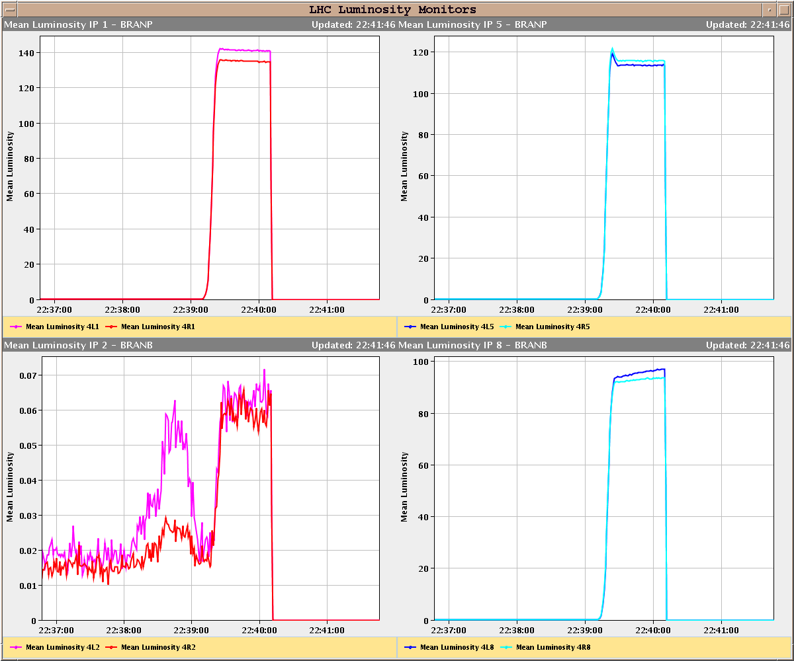
Fill #1410
Lifetime dip to ~1 hour recovering to 5 hours
BLM 83 s running sum triggered the beam dump on MQW (threshold lower by a factor 10 as compared to similar magnets in the same region) ➔ corrected afterwards ➔ to be continued
Luminosities compatible with emittances of ~1.8 μm for a beam-beam tune shift of approximately >0.02 (for bunches seeing 3 collisions)
h

Slide 6
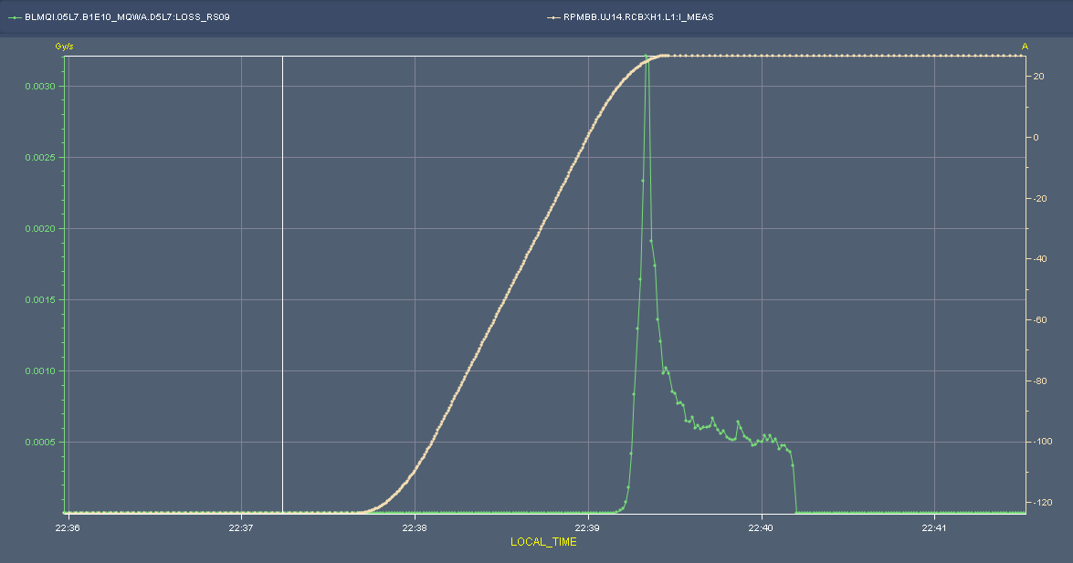
Fill #1410
Separation bump
Beam loss
The LHC beams will cross each other and experience perturbations as a result of the beam-beam effect at the interaction points, which can result in emittance growth and halo creation. The beam-beam force is approximately linear for small offsets and highly non-linear for larger offsets with peaks in growth close to 0.3 and 1.5 σ separation
S. M. White, H. Burkhardt, S. Fartoukh, T. Pieloni
Still cleaning
beam dump
On set of losses at: 6.4 sigma
Peak losses at: 1.4 sigma
M. Lamont

Slide 7
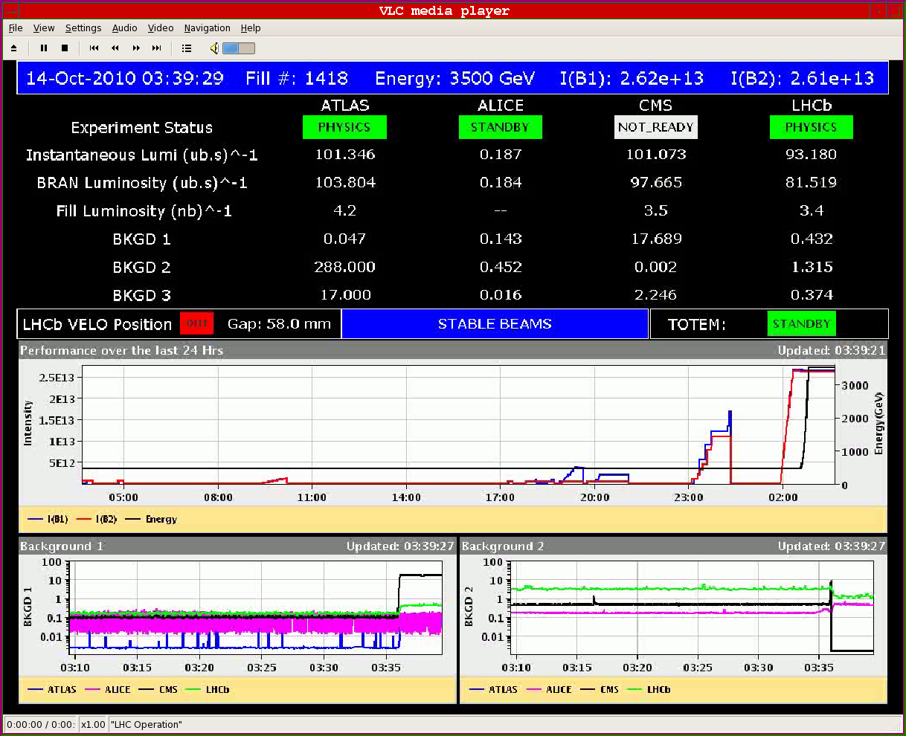
LHC protons 2010: mission accomplished

Slide 8
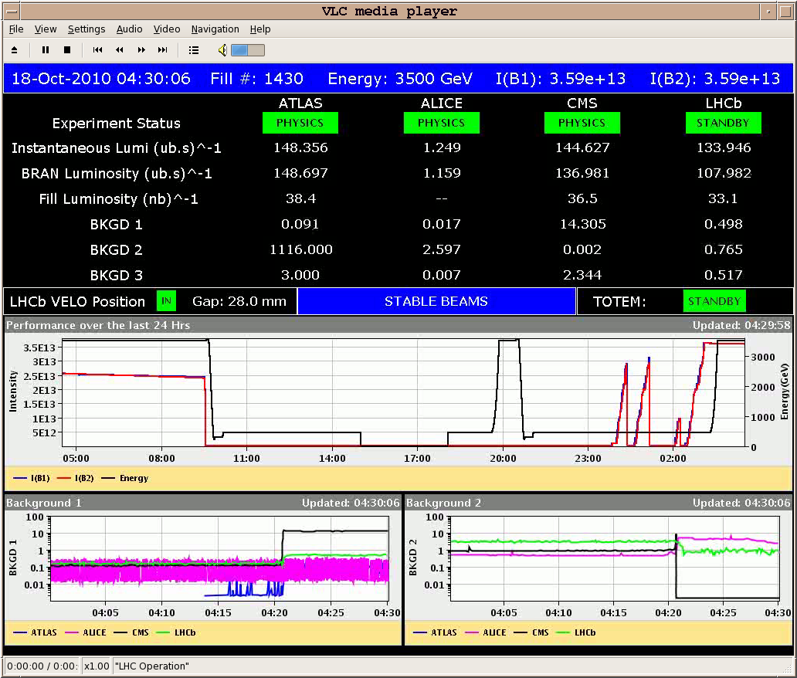
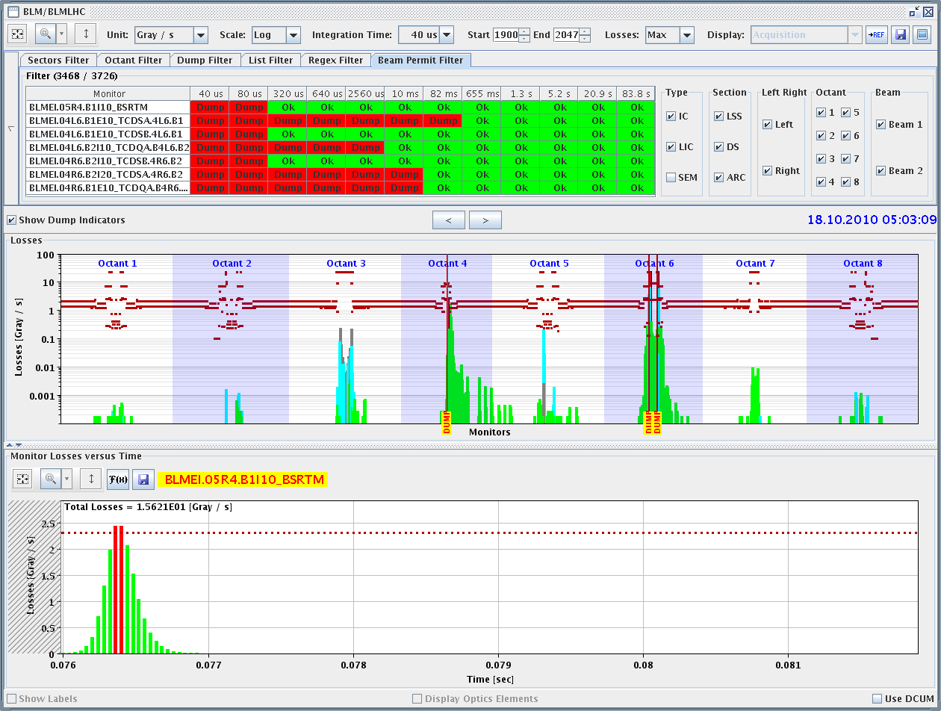
Stable beams #1430
3.6x10¹³ p/beam in collision (~20 MJ/beam)
L₀>1.3x10³² cm⁻² s⁻¹ ➔ Emittance in collision 2.4 um
Damped by UFO event after 0.5 hour (~250 nb⁻¹). UFO event on beam 1 close to BSRT in point 4 (just above threshold)

Slide 9
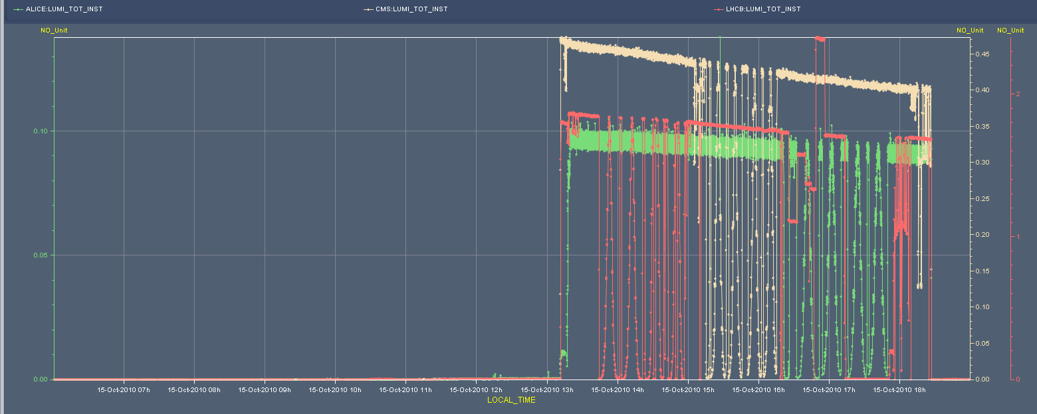
VdM scans (15/10)
3-4h delay due to pt 8 trip. Terminated prematurely by LBDS interlock (MKB fake vacuum reading) ➔ not the first time!! ➔ Redundancy to be added?
Completed all VDM
Still to do:
length scale calibrations in IP5 and IP2
can be done in physics
longitudinal scan tests
can be done in physics, but better test once in a low intensity fill ?
CMS scans
LHCb scans
ALICE scans
M. Ferro-Luzzi

Slide 10
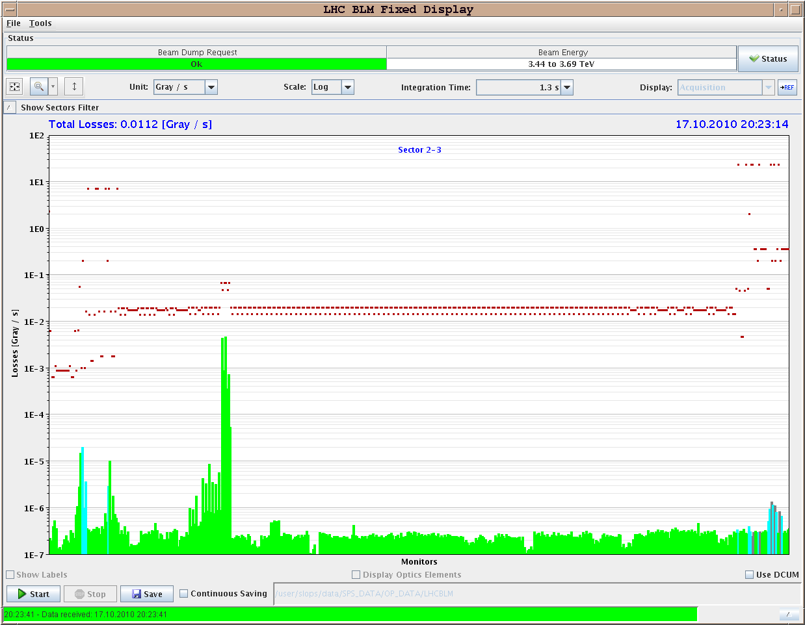
Quench test (17/10)
Quench test:
Beam intensity: B1: 2.38x10¹⁰ p (ε_{H/V}=6/7 μm) B2: 2.05x10¹⁰ p (ε_{H/V}=11/13 μm)
bump at MQ14.R2 vertical positive (B2)
Total loss ~1x10¹⁰ p in 7.3 s
Losses about a factor 10 below the threshold values (see plot). The thresholds were increased by a factor 3 before test.
QPS thresholds exceeded on MQ14.R2
Preliminary conclusion: BLM thresholds should be decreased by a factor 3 (or more) to avoid QPS triggers ➔ to be analyzed in detail
B. Dehning, J. Wenninger et al.

Slide 11
Injection issues - summary
Un-captured beam from SPS
Thursday-Friday night
Swept across TDI by injection kick – dumped by LHCb
Tracked down to 800 MHz in SPS
Obstruction in MSI at IP2 leading to losses at B1 injection
Deterioration observed in 2 occasions: Fri 08/10 and & Sat 16/10
Capture losses in LHC
Very dependent on longitudinal beam quality from the injection (150 ns is not good in that respect)
Very (too?) low tolerances in LHC – general issue with fast losses at 450 GeV – dumping beam after the event

Slide 12
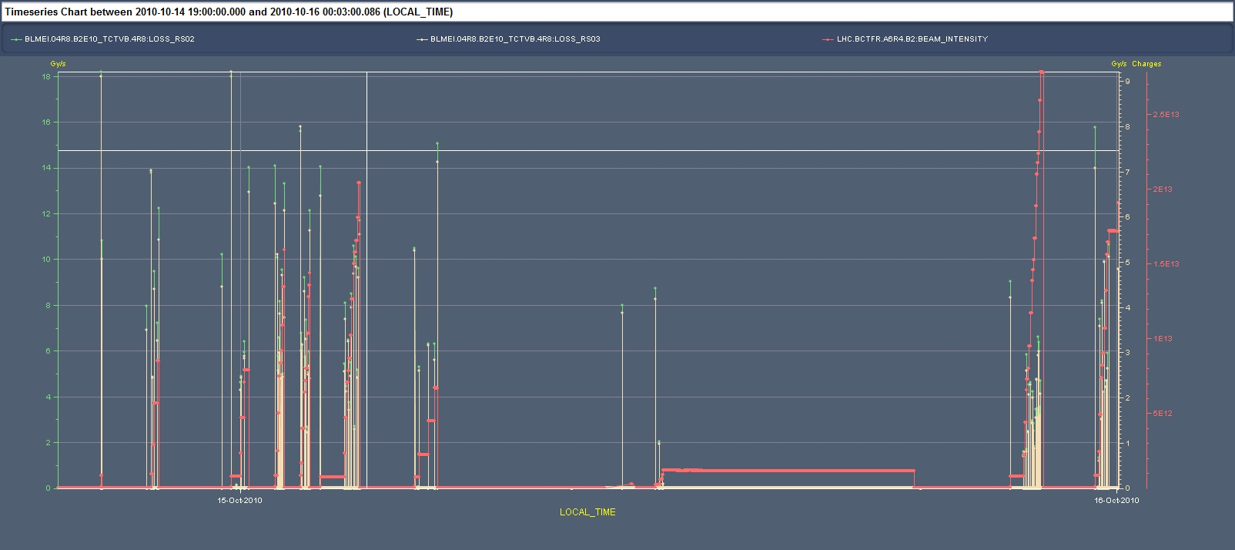
Injection losses Thu-Fri night
Thorough verification of the beam quality in the SPS started in the night and continued during the morning (T. Bohl): found 800 MHz RF frequently not locking to reference (given by main RF system) ➔ source of noise, blow-up and uncaptured beam even at SPS flat-top ➔ corrected ➔ need for remote monitoring of the RF frequency and/or alarms when not correct
Increased the LHCb BCM threshold by factor 3
SPS 800 MHz RF not locking
SPS 800 MHz RF not OK
SPS 800 MHz RF OK

Slide 13
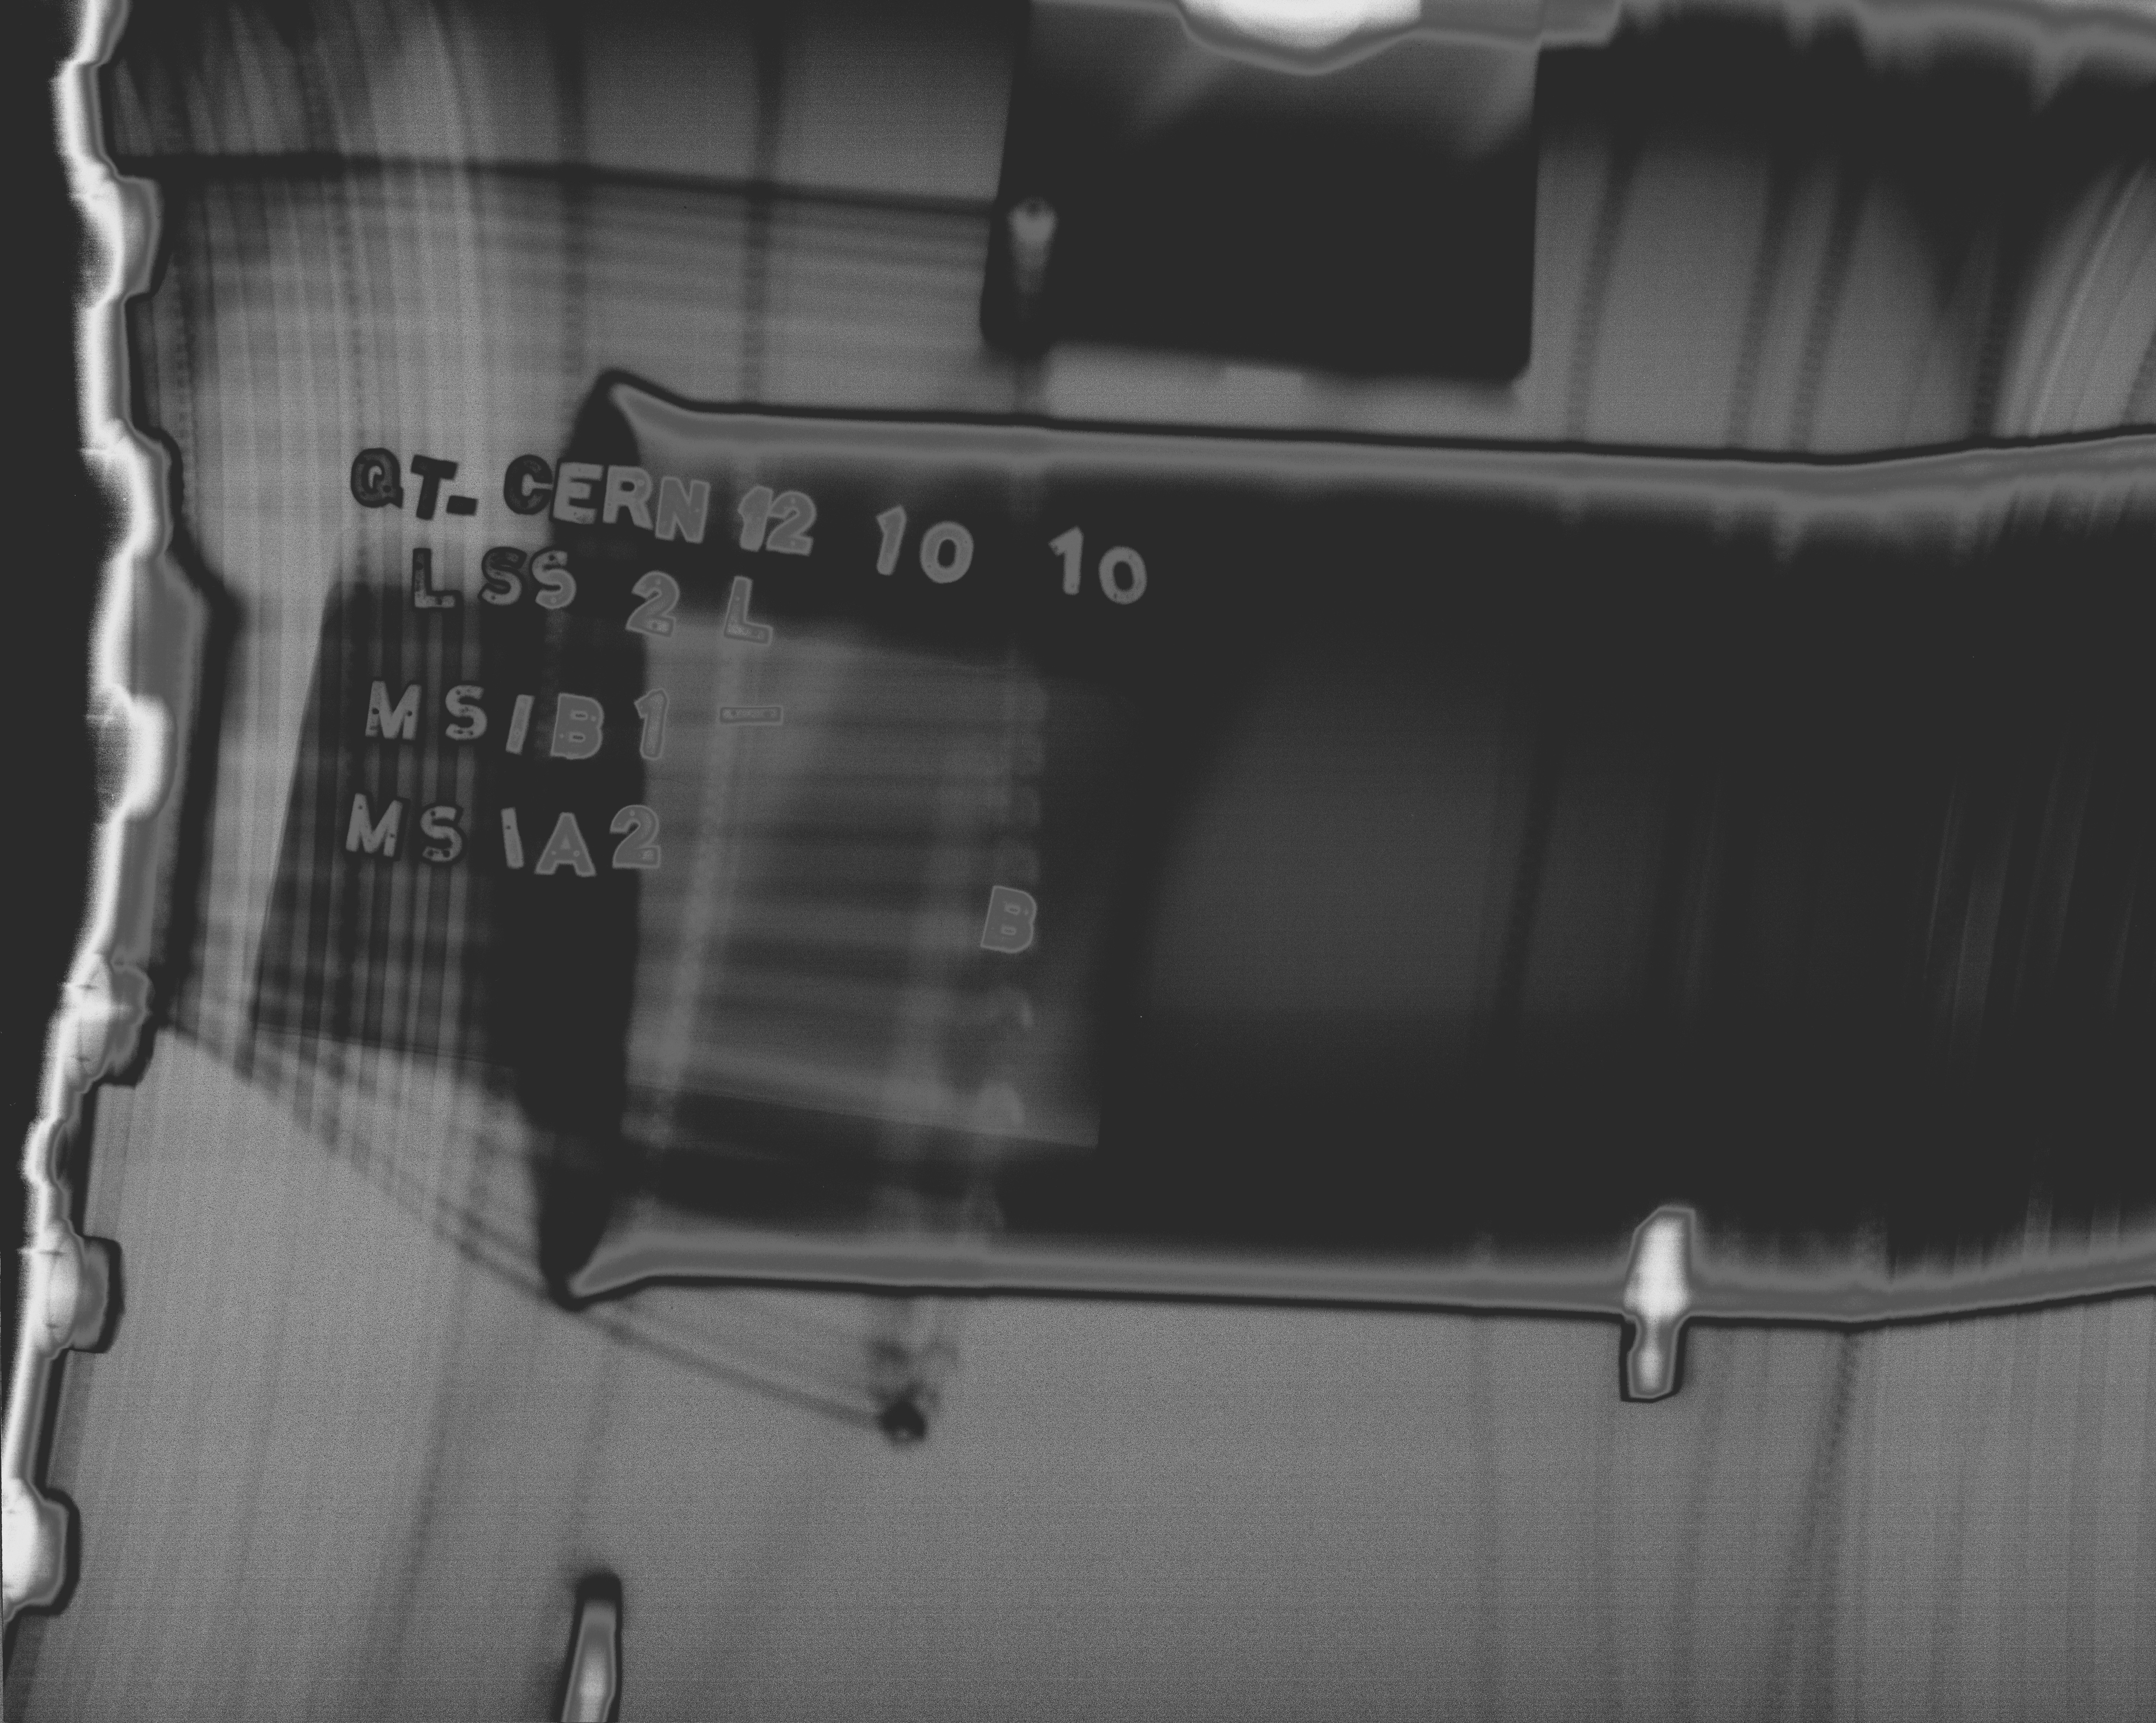
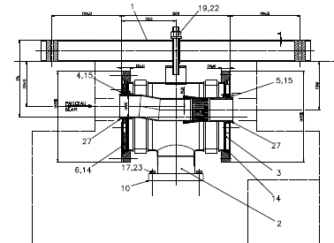
Injection losses B1
Radiation survey and X-ray (Tue 12/10) have evidenced a clear aperture restriction at the transition between the injection septa MSIB/MSIA due to a non-conformity in the mounting of the interconnection
Circulating beam
Injected beam
J-M. Dalin

Slide 14
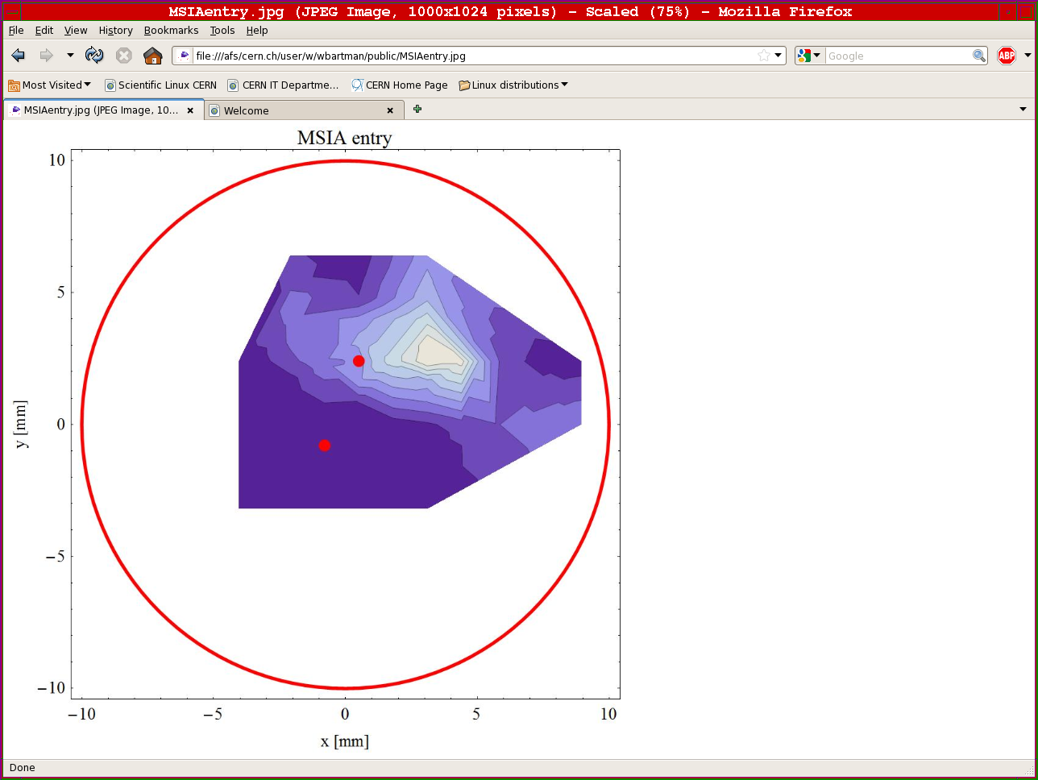
Injection losses B1
Wed 13/10
aperture scans of problematic region in injection septa L2
TL steering and associated correction in LHC
High losses
High losses
old
old
4 mm Vertical
+1 mm Horizontal
new
new
No losses
No losses
C. Bracco, B. Goddard et al.

Slide 15
MSI interconnection repair
MSI solution is not stable: deteriorating with time
Preparing to intervene on the interconnection (3-4 days):
Inject Neon
open and fix: removal of the inserts and RF fingers (to be reinstalled later during Christmas stop)
pump, bake, pump
And move technical stop to Tues-Wed-Thurs next week

Slide 16
Plan for the day
Loss Maps measurements until 11:00
11:00 – 15:00 Abort gap cleaning
15:00 – 20:00 RF studies
Physics overnight, if problems at injection Plan B with studies.

Slide 17
List of Studies
Periodic loss maps
Orbit shift versus TCT check:
collide 1 bunch and check the TCT center change as compared to predicted orbit change.
All in one ramp, squeeze, collide - 1 shift
Plus test of 'dynamic' references for the OFB (varying Xing.separation bump): injection, then test of ramp + first part of squeeze
IR aperture at 3.5 TeV
50 ns – pilot runs
After 3-4 fills with ~400 bunches
Push beam-beam tune shift with 150 ns
one test already performed with #1410
Beta* measurement in IP8

Slide 18
List of Studies
Injection and Dump:
Abort gap cleaning tests B1/B2 at 450 GeV and 3.5 TeV [2 shifts]
Injection gap cleaning deployment tests, 450 GeV, B1/B2 [1 shift]
High intensity 32b injection for B2 - filling and P6 interlock checks for 350 and 400b schemes [4h]
MKI8.B2 fine timing adjustment (1st bunch in train always gets too large a kick), and also synchronisation checks [2 h]
50 ns bunch train injection for B2 [1 shift?]
Studies SPS-LHC emittance preservation at injection, and growth on flat bottom [1 shift]
Asynch dump tests 3.5 TeV for B1/B2, to check stablity [1 ramp]
RF:
RF noise measurements

Slide 19
List of Studies
BI:
Check the linearity of the fast BCT’s in the new configuration for nominal bunches
Tune the High BW/Low Gain fast BCT calibration for the coming ion run
Measure the High BW/Low Gain fast BCT sensitivity limit and linearity for low intensity bunches (ion run)
Re-check BPM sensitivity limit
Calibrate the abort gap over the whole ramp
Check the abort gap acquisition gate timing resolution and stability
Commission BGI in preparation to ions – started…
Check BSRT/BGI/BWS cross-calibration including corresponding emittance logging
Test and compare bunch/bunch profile measurement via BWS and/or BSRT
PLL studies during ramp continued
JJG: for all this, we would need the 2 rings for a few hours at 450 GeV then a ramp and again a few hours at 3.5 TeV. One shift

Slide 20
Massi’s desiderata
50 pb⁻¹ total (24 delivered so far)
9 fills@3 pb-1 ~ 9 good days
Alice – fill without dipole/solenoid
Totem – dedicated fill
Totem – 90 m optics
LHCb – switch polarity – plus test ramp (combine with BI plus map)

Slide 21
Access Requests
Verification of the flange alignment between MSIB and MSIA ➔ 2 hours TE/VSC
Verification MSI transition in point 8 ➔ ½ day (Radiography)
IR1 solenoid (for e-cloud suppression) controls
Intervention on DCBCT ➔ P. Odier (2 hours)
ALICE pixel cooling: 8 h

