Slide 1
Friday
07:00 Power glitch on the EDF network. Point 8 affected.
10:00 Recovered. Injection for Van der Meer scan.
Problem with the UPS status for PIC fixed during the morning (reason for failure not totally clear)
During the morning investigations in the injectors on the beam quality.
13:30 Start of Van der Meer scans
18:27 Beam dump due internal fault on MKB (fake vacuum reading: vacuum pressure ) - End of Van der Meer scans
Intervention on the cryogenics for sector 23: change of a WorldFip receiver done with no stop of the Cryo plant
21:00 Injecting. Beam 2 Losses in the injection area and LHCb OK
22:00 LSS6 BPM Interlock verification with 312 bunches OK
02:30 STABLE BEAMS #1424 with 312 bunches: L₀=1.3x10³² cm⁻² s⁻¹
03:29 Beam dump: UFO event
04:30 Injection. Losses on Beam 1 in the injection area ➔ investigating

Slide 2
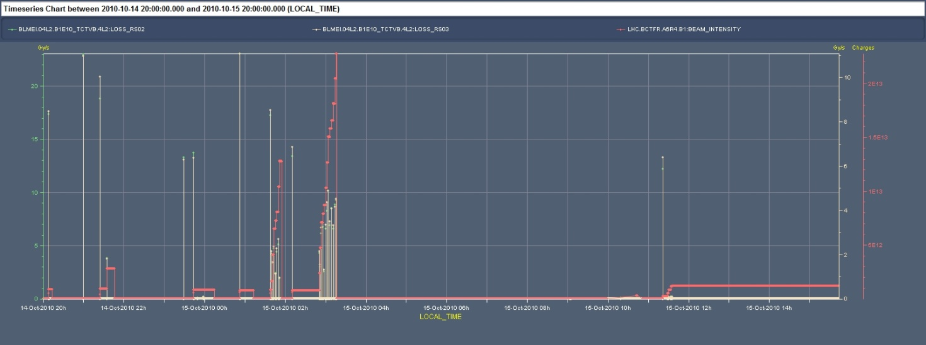
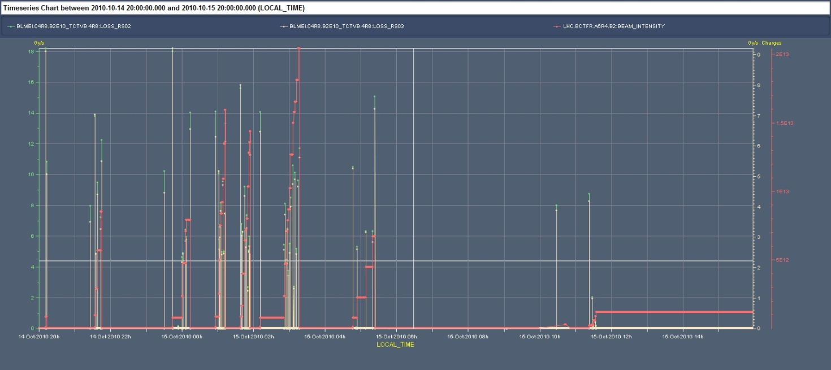
Injection losses Thu-Fri night
Losses at TCTVB comparable for Beam 1 and Beam 2
Beam 1
Beam 2

Slide 3
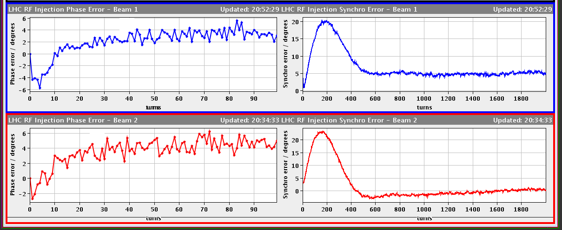
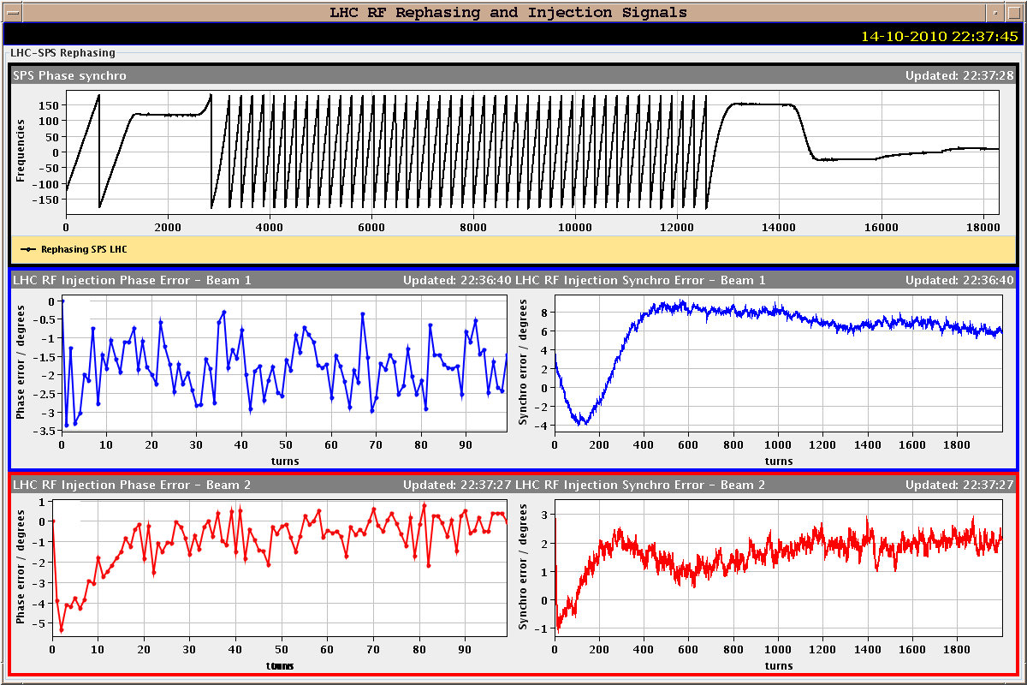
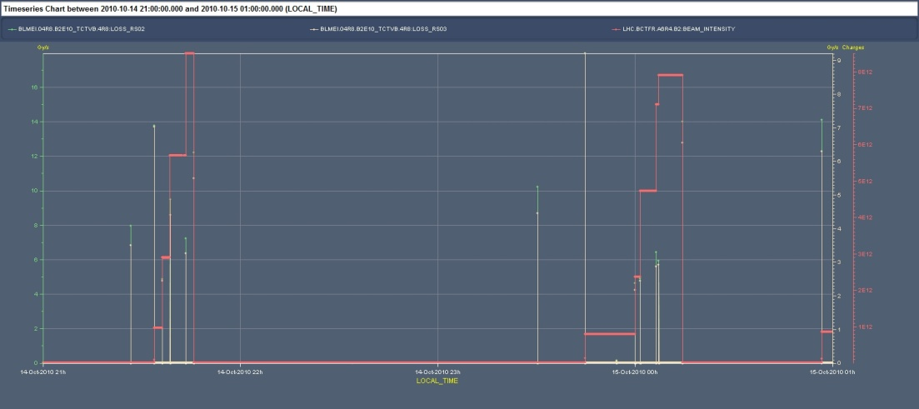
Injection losses Thu-Fri night
No significant improvement after capture optimization in the LHC
Before opt.
After opt.
RF capture opt.

Slide 4
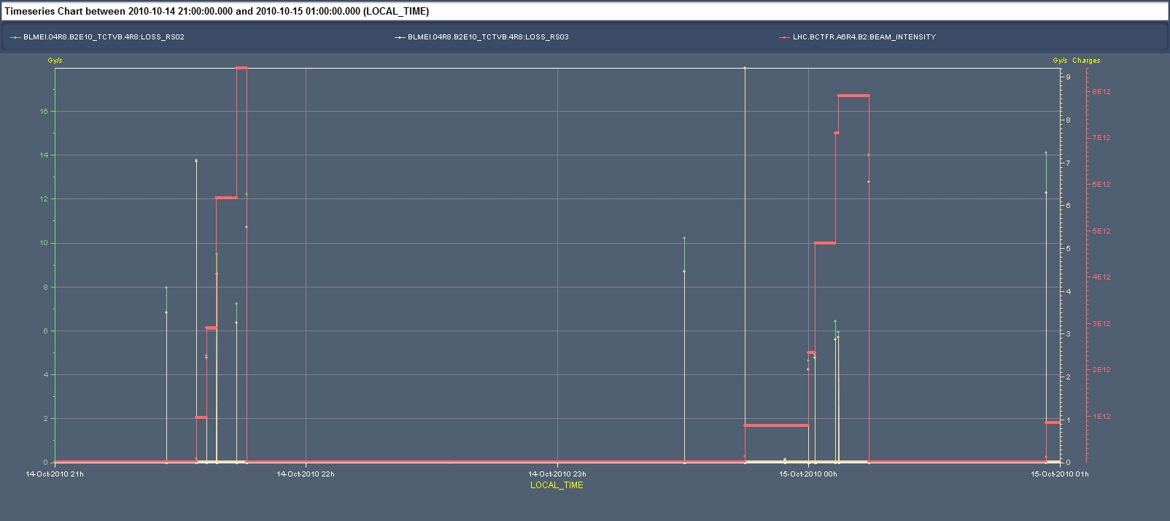
Injection losses Thu-Fri night
No significant losses in LHCb and TCTVB when kicking without injecting beam and no dependence on longitudinal emittance of the extracted beam ➔ RF capture in the LHC not responsible for the observed effect.
Kick without beam

Slide 5
Injection losses Thu-Fri night
From LHCb (R. Jacobsson):
Losses on rising edge of kicker waveform
At -700 ns
At -100 ns
Losses on falling edge of kicker waveform
At +9250 ns
Consistent with satellite/uncaptured beam in the SPS
Thorough verification of the beam quality in the SPS started in the night and continued during the morning (T. Bohl): found 800 MHz RF frequently not locking to reference (given by main RF system) ➔ source of noise, blow-up and uncaptured beam even at SPS flat-top ➔ corrected ➔ need for remote monitoring of the RF frequency and/or alarms when not correct
Increased the LHCb BCM threshold by factor 3

Slide 6
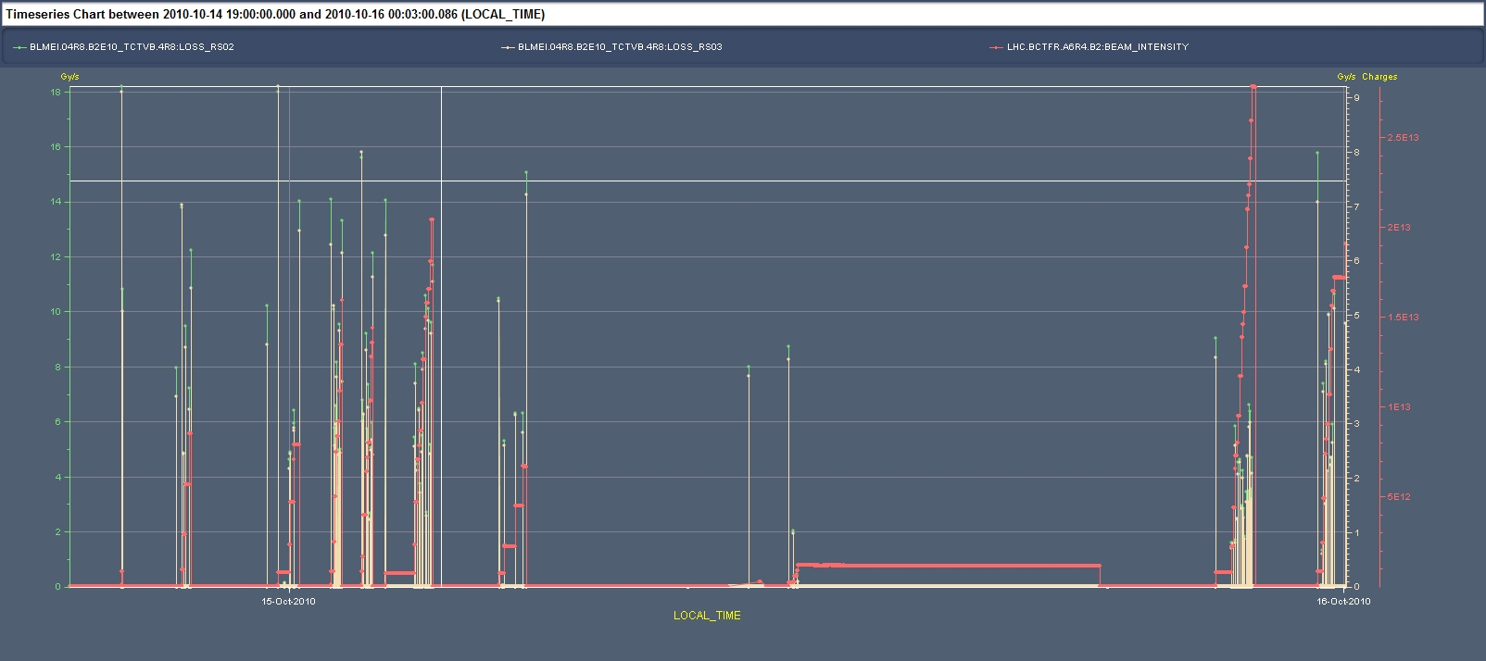
Injection losses Thu-Fri night
Verification that 800 MHz was the origin of the losses observed during the night Thu-Fri. Comparison of the losses at TCTVB.R8 confirmed by LHCb observations (R. Jacobsson)
SPS 800 MHz RF not locking
SPS 800 MHz RF not OK
SPS 800 MHz RF OK

Slide 7
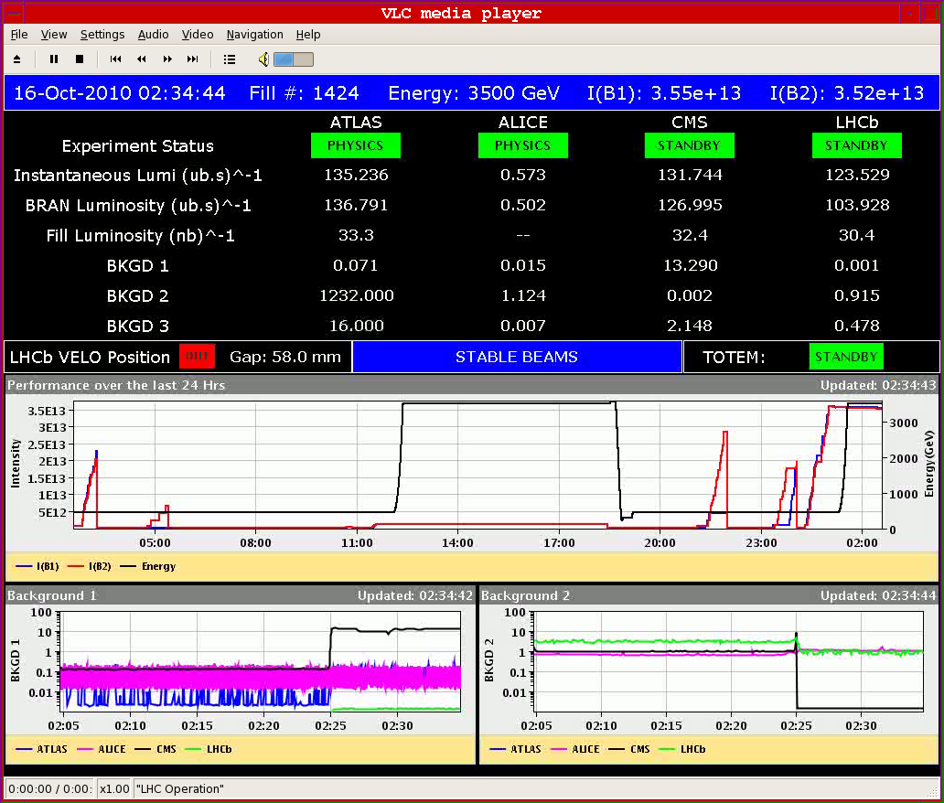
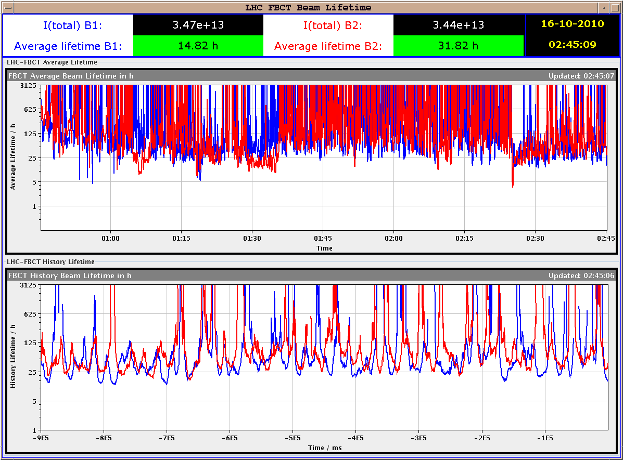
Stable beams #1424
3.5x10¹³ p/beam in collision (~20 MJ/beam)
L₀>1.3x10³² cm⁻² s⁻¹ ➔ Emittance in collision 2.6 um (2 to 2.4 um at injection). Initial lifetime in collision ~4 h rapidly recovering to 20 h
Damped by UFO event after 1 hour (~400 nb⁻¹)

Slide 8
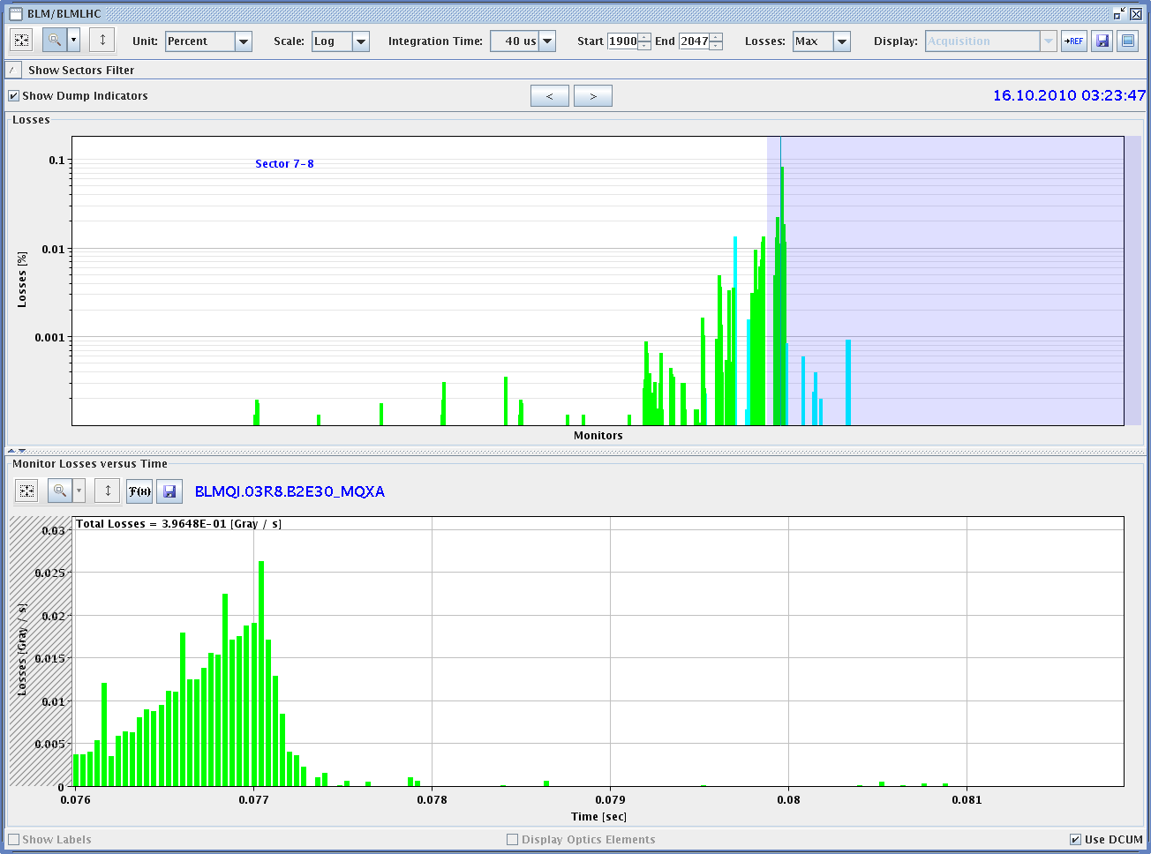
UFO event
UFO event on beam 2 in triplet R8. Beams dumped by LHCb

Slide 9
Plans
Friday overnight | Physics 312b | 12 hour fill
Saturday | Physics 312b | 12 hour fill
Saturday overnight | Physics 312b | 12 hour fill
Sunday | TL BL calibration + Injection checks with 32 bunches | 4 hours
Sunday | Quench test | 6 hours
Sunday overnight | Physics 360b | 12 hour fill
This was the initial plan: to be reviewed on the basis of the results of the investigations for injection B1

Slide 10
OP
^{Periodic loss maps}
Betatron loss map done week 40.
^{Orbit shift versus TCT check:}
collide 1 bunch and check the TCT center change as compared to predicted orbit change.
All in one ramp, squeeze, collide - 1 shift
Plus test of 'dynamic' references for the OFB (varying Xing.separation bump): injection, then test of ramp + first part of squeeze
^{IR aperture at 3.5 TeV}
^{50 ns – pilot runs}
After 3-4 fills with ~400 bunches
Push beam-beam tune shift with 150 ns
one test already performed with #1410

Slide 11
BI studies – list to be updated
Check the linearity of the fast BCT’s in the new configuration for nominal bunches
Tune the High BW/Low Gain fast BCT calibration for the coming ion run
Measure the High BW/Low Gain fast BCT sensitivity limit and linearity for low intensity bunches (ion run)
Re-check BPM sensitivity limit
Calibrate the abort gap over the whole ramp
Check the abort gap acquisition gate timing resolution and stability
Commission BGI in preparation to ions – started!
Check BSRT/BGI/BWS cross-calibration including corresponding emittance logging
Test and compare bunch/bunch profile measurement via BWS and/or BSRT
PLL studies during ramp continued
JJG: for all this, we would need the 2 rings for a few hours at 450 GeV then a ramp and again a few hours at 3.5 TeV. This would be really difficult to fit in a 4 hour slot. 8 would be perfect but we could try with 6.

Slide 12
Other
Abort Gap Cleaning – on at injection for physics
continue testing
Injection studies 32 Bunches when required (344 bunches)
Injection studies with 50 ns
Transfer line collimator cross-talk calibration
Quench test at 3.5 TeV – pilot beam
Bernd & co

Slide 13
Experiments
50 pb⁻¹ total (20 delivered so far)
10 fills@3 pb-1 ~ 10 good days
Alice – fill without dipole
Totem – dedicated fill
Totem – 90 m optics
LHCb – switch polarity – plus test ramp (combine with BI plus map)

Slide 14
Access Requests
Verification of the flange alignment between MSIB and MSIA ➔ 2 hours TE/VSC
Verification MSI transition in point 8 ➔ ½ day (Radiography)
IR1 solenoid (for e-cloud suppression) controls
Intervention on DCBCT ➔ P. Odier (2 hours)
ALICE pixel cooling: 1 h (for preliminary investigations) + 8 h

