Slide 1
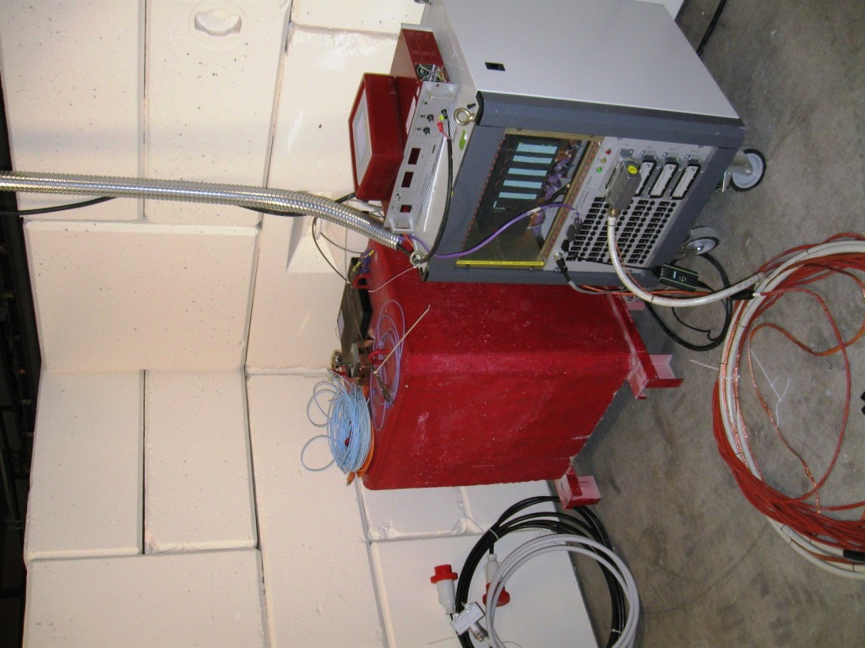
Installation (temporary) in the RP Bunkers (UJs)

Slide 2
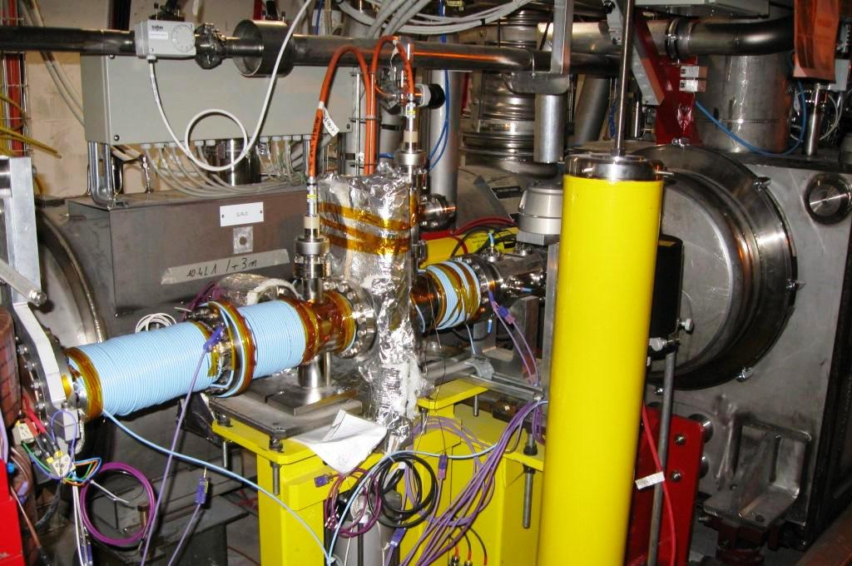
Solenoids between DFBX and D1 in IR1L
TE-VSC Group
J.M. Jimenez

Slide 3
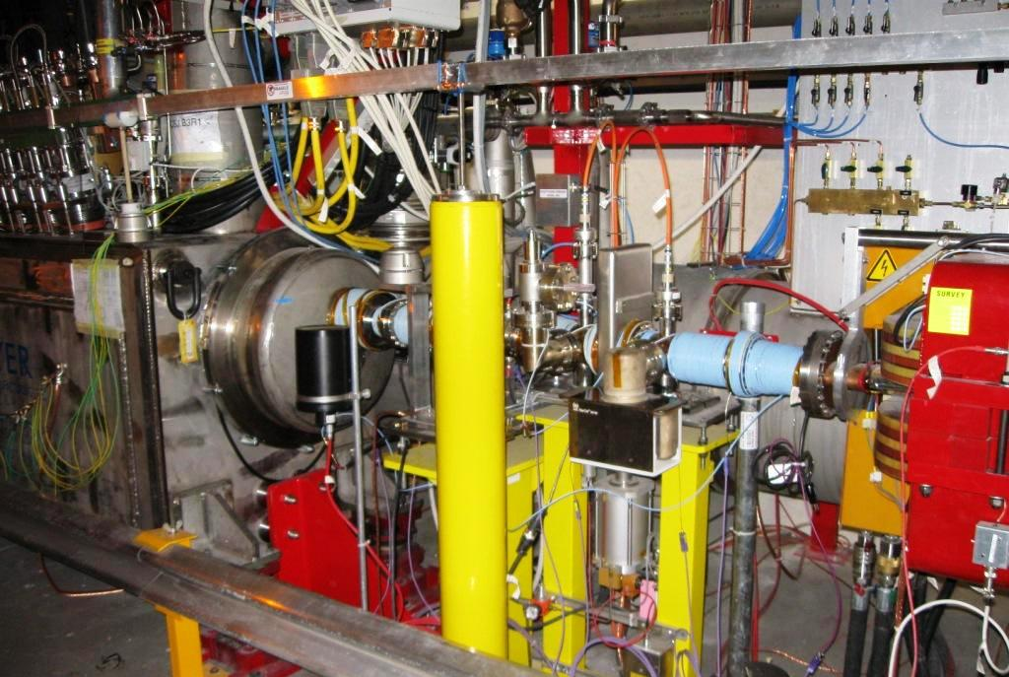
Solenoids between DFBX and D1 in IR1R
Solenoid A4L1 - ON
TE-VSC Group
J.M. Jimenez

Slide 4
Fill 1404
Injection Study with train of 24 Bunches
10/10/10 – 15:00

Slide 5
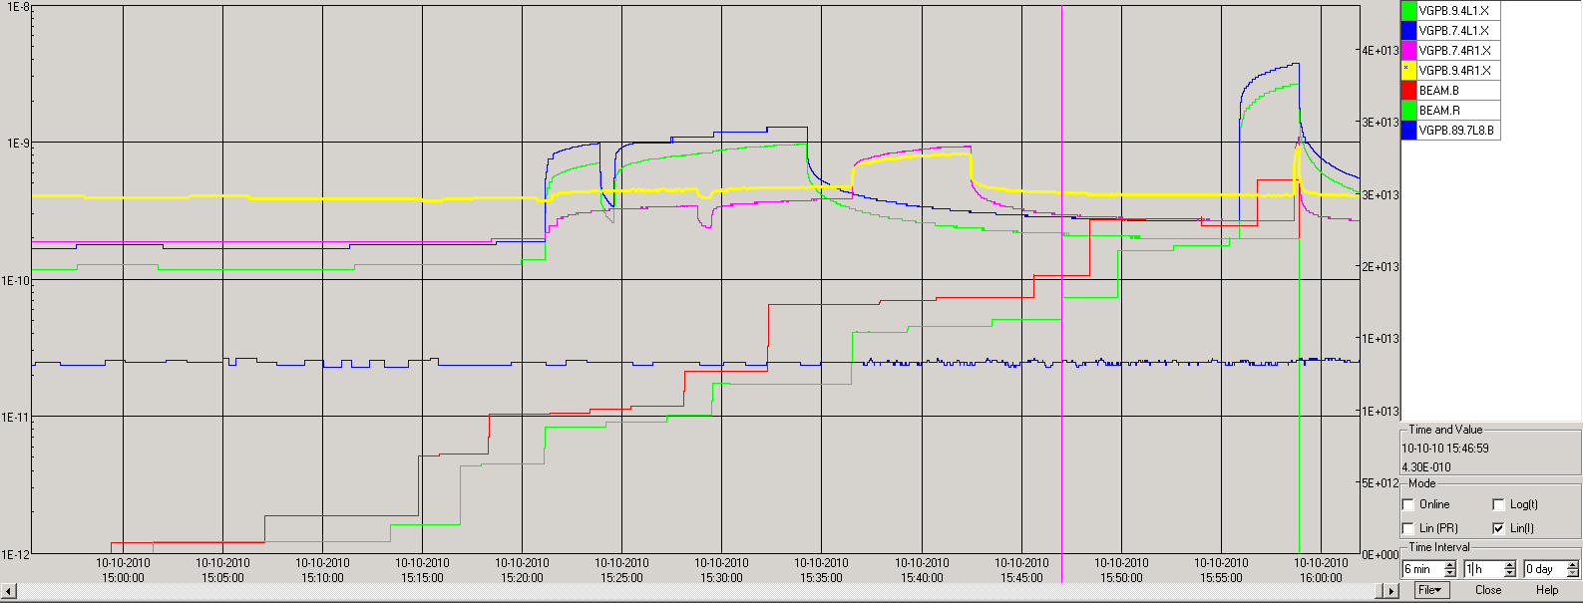
Injection Study with train of 24 Bunches
10/10/10 – 15:00
Test Solenoid A4L1
T=40C = 6A
Solenoid A4L1 - OFF
Solenoid A4L1 - ON
DUMP
Solenoid A4R1 - ON
Solenoid A4R1 - OFF
Test Solenoid A4R1
T=40C = 8A
Start increase pressure on both lines when the number of protons in the machine is about:
Beam B=1E13
Beam R=8E12

Slide 6
Injection Study with train of 24 Bunches
10/10/10 – 15:00
A4L1.X | START (No beam – Solenoid OFF) | Solenoid ON | Solenoid OFF
VGPB.7.4L1.X | 1.9E-10 | 2.7E-10 | 3.8E-9
VGPB.9.4L1.X | 1.3E-10 | 2E-10 | 2.7E-9
A4R1.X | START (No beam – Solenoid OFF) | Solenoid ON | Solenoid OFF
VGPB.7.4R1.X | 1.9E-10 | 2.7E-10 | 1.1E-9
VGPB.9.4R1.X | 3.9E-10 | 4.2E-10 | 9.2e-10
There was an expected dump of beams due to lost during injection, so the final pressure without the solenoid are lower than expected.
Temperatures on the TC:
A4L1:
CH 6= 26°C
A4R1:
CH 2= 24 ° C
CH6= 26 ° C
Stable beams should be guaranteed in order to have better indication of temperature increase

Slide 7
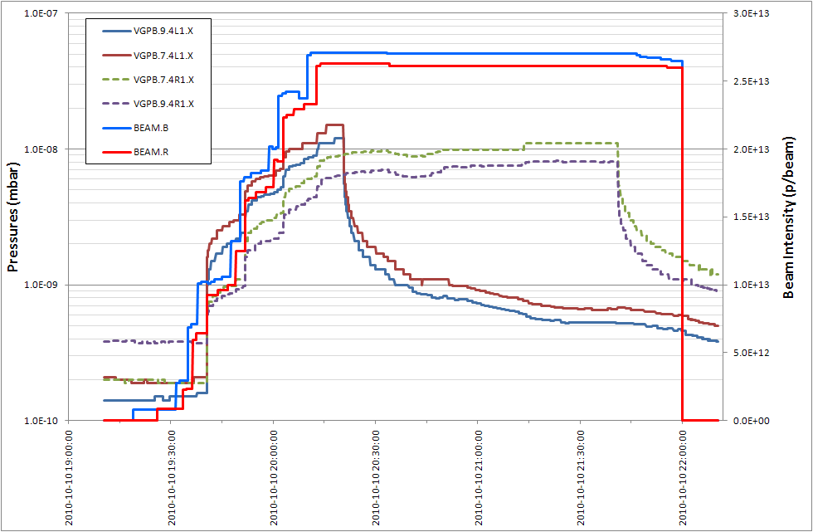
Solenoid A4L1 - ON
Solenoid A4R1 - ON
TE-VSC Group
J.M. Jimenez

Slide 8
Acknowledgements
Many thanks to V. Baglin, G. Bregliozzi, N. Zelko, S. Blanchard, A. Sinturel, A. Marraffa and B. Rio for their help this weekend.
Vacuum, Surfaces and Coatings Group
Technology Department

Slide 9
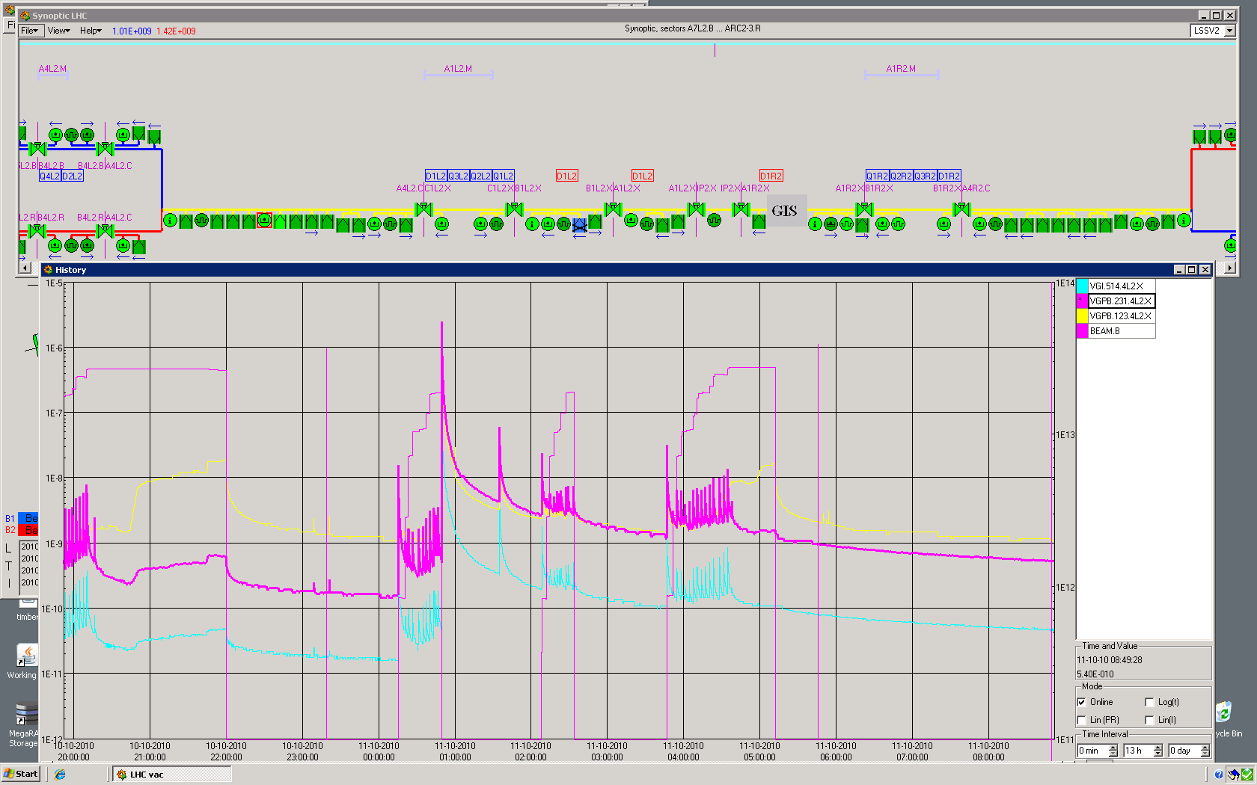
TE-VSC Group
J.M. Jimenez

