Slide 1
Wednesday 6.10
Morning: Quench test at 450 GeV
Vertical bump (upward) on MQ.14R2.B2, horizontal bump (inside) on MQ.14R2.B1. Probing loss scale of ~ 1 second.
Beam2:
Triggered busbar protection of nQPS on MQ with 1.6E11 and 2.4E11 (not with 1E11). EE opened, but heaters not fired. Beginning of the quenching of MQ observed.
Beam1:
Triggered old QPS on MB C14.R2 in front of MQ with 1.7E11. Quench heaters were fired.
Beam loss before PM trigger ~1E11.
Detailed analysis to be done.

Slide 2
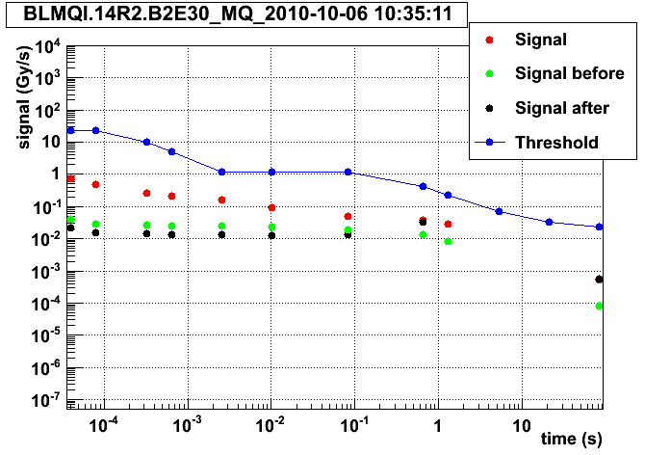
BLM signal with 2.4E11 p – note the threshold was increased by a factor 3 to correspond to 3 times estimated quench level.

Slide 3
Wednesday 6.10
Central timing lost synchronization with the GPS at about 8am. Synchronization problems seen for PM timestamps, in particular the BIS.
Timing expert reconnected the central timing around 11:00.
Another ½ hour and a couple PM tests required to ensure all BICs were correctly synchronized again.

Slide 4
Wednesday 6.10
Afternoon: PLL test in ramp
ADT gain reduced by -3 dB for PLL to work.
Ramp of 8 nominal bunches with PLL on B2 and constant excitation amplitude (amplitude loop not commissioned).
PLL locked for most of the ramp.
Some issues observations that need further attention: - PLL locked on line that was 0.01 off the real tune (possibly Q+nQs). - Systematic tune offset error of few 1e-3. - PLL Q estimates oscillated during part of the ramp while FFT Q measurements were stable. - Beam-blow up: no measurement of the initial emittances, but ended up with quite big beam in B2. - Life-times puzzle: sometimes good (> 600 hours) sometimes very bad (< 5h)
Test of a PLL/ADT failure where the ADT switches 'off' while the PLL is 'on'. Slow losses of about 3% over a minute.

Slide 5
Wednesday 6.10
19:00 Preparing for physics fill with 200b
Again problems with RBI.221 in TI2 (third intervention on the PC today).
Again problems with BLM crate in IR7 (crate fails, SIS dump) – same that dumped the previous physics fill. Beam dumped twice. Power cycled by BLM expert. Did not help.
CPU exchanged with a lab CPU – temporary fix.
Then problem of booster PS.
02:00 Filling
Both B1 and B2 QFBs off in the ramp.
Issues with coupling in the squeeze – B1.
04:40 Stable beams 1397

Slide 6
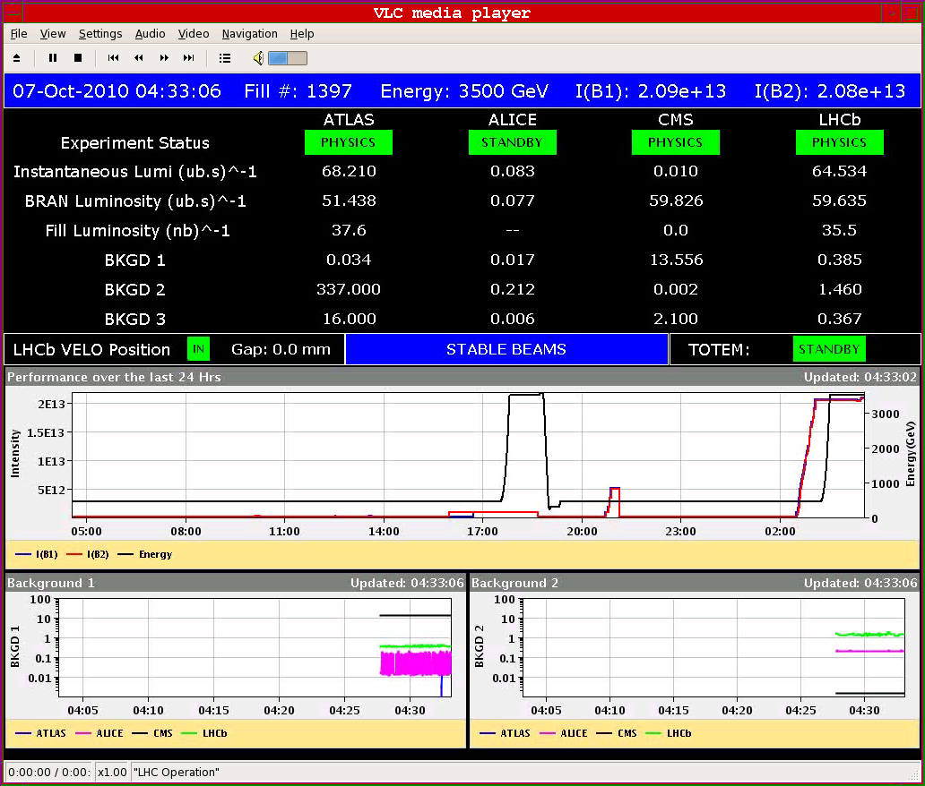

Slide 7
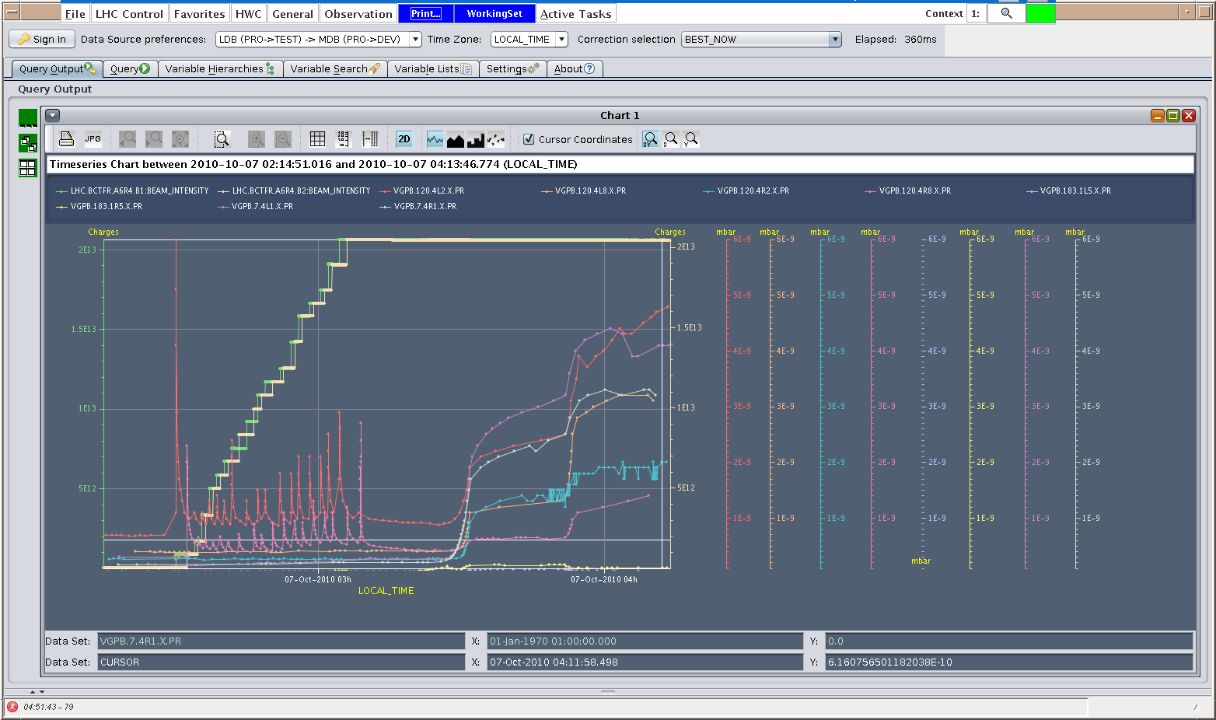
Vacuum
Few 10-9

Slide 8
Today
Access ~ 1 hour:
Pt4 BBQ
Pumping station Pt2
ALICE
ATLAS
AC dipole if it fits in.
BLM crate CPU exchange SR7
No access in Pt8 – lift maintenance.
Injection of 24 bunches
Physics with 248 bunches – if no problems found with fill 1397.

Slide 9
Scheduled lift maintenance
Some preventive maintenance has been requested on the LHC lifts, and agreed according to the following planning:
Tuesday 5 October: PM15 from 8h to 12h00; PM25 from 13h30 to 17h30
Wednesday 6 October: PX24 from 8h to 12h00; PZ33 from 13h30 to 17h30
Thursday 7 October: PM85 from 8h to 12h00; PZ85 from 13h30 to 17h30
Tuesday 12 October : PM56 from 8h to 12h00; PM65 from 13h30 to 17h30
Wednesday 13 October: PZ65 from 8h to 12h00; PM76 from 13h30 to 17h30
Thursday 14 October: PM45 from 8h to 12h00; PZ45 from 13h30 to 17h30

