Slide 1
Saturday 2nd October
BLM threshold follow-up - Bernd Dehning and Joerg Wenninger
Following MPP approval, Bernd Dehning has increased the BLM thresholds by a factor 3 for arc + DS.
The last UFO (not very strong) was on Q5.R2 and was triggered by BLMs of the family with the low thresholds.
After yesterday morning beam dump, Bernd applied the same factor 3 to the LSS quadrupoles with the exception of the triplets, the warm elements (like TCTs), and the quadrupoles that already have special thresholds near the injection regions.

Slide 2
Saturday 2nd October
Morning – Verena Kain and Lasse Normann:
9:00 : Inject 152b x 152 b : very smooth injection process
Ramp
Squeeze
10:56 : Stable beams # 1388: B1 H 2.21 V 2.07 B2H 2.59 V 2.80 um

Slide 3
Saturday 2nd October
V. Kain

Slide 4
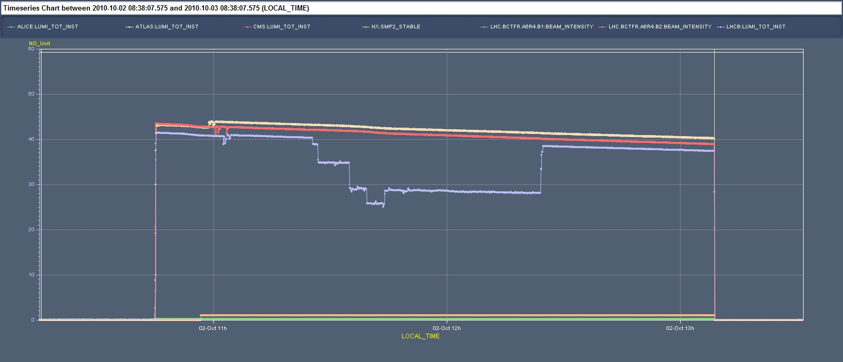
Saturday 2nd October
Some LHCb separation tests done : no effects on CMS and ATLAS seen

Slide 5
Saturday 2nd October
10:56 – 13:09 : Stable beams - ~2h15 – Beams dump by an apparent communication problem of QPS (trip of sector 56). ~360 nb-1 (ATLAS) accumulated.
13:09 – 23:56 : Investigation - access and repair on going. Mirko Pojer’s summary:
Access by QPS and CO piquet: it turned out to be a problem of a computer (the one controlling the Mains global bus bar detector) whose power supply burned, producing the opening of the circuit breaker of the whole rack, where also the WorldFIP is contained. After replacement of the PS on his office, Gert went back to the tunnel and re-installed the computer. While cleaning all circuits that had been affected by the COMM lost, we had to carry out many power-cycles, both software and hardware. Unfortunately, we realized that one QPS controller with its four circuits (RCDs and RCSs) was not behaving correctly; investigations showed that the communication board was dead. Gert went back to his office to look for a new one and reprogrammed it. And back to point 6 to re-install the board.

Slide 6
Saturday 2nd October to Sunday 3rd October
Midnight – 03:25 : Recovering the machine conditions for injection (trips, BETS) and setting up with pilots
03:25 – 08:30 : PC for the Main circuits in the SPS tripped and could not be reset. The piquet was called but for remainder of the shift there was no beam from the SPS
8:30 : LHC in injection for Physics fill
TODAY
…. Same a yesterday : get that last 152bx152b in the machine for a LONG physics fill…

