Slide 1
Friday 1st October : Van der Meer scans
7:00 – 12:00 : Filling 19 single bunches/beam, ~8e10p/bunch!
Every ~10 minutes TT60 MBB PC tripped due to over temperature. Reset it each time. Required intervention only done while ramping (PO piquet was working all day long)
Communication between the database and the injection sequencer during setting requests active. Initially wrongly thought it had been a problem with the CBCM. Several releases of the injection sequencer were necessary to make all the different modes work again. However, now the IQC RF bucket check always fails as the injected scheme is not correct in the DB. It is masked for the time being.
13:30 – 16:30: Stable beams. Done ATLAS vdm scans and only half of the CMS scans. Could not make the vdm scans in LHCb and ALICE, and also no length scale calibrations, no longitudinal scans, etc.

Slide 2
Friday 1st October : Recovering
~16:30 : Beams dumped. Electrical perturbation. SVCs at point 2, 6 and 8 were tripping, producing the trip of sector 81, the main dipoles of sector 12, 34 and 67, the ATLAS toroid and also one RF module.
The electrical service was very efficient in reconnecting all SVCs
~19:30 LHC back in service ! Start pre-cycle started and ramping up of all exp. magnets
Until 23:00: Recovering beam conditions in the machine– Chromaticity evolution at 450 GeV for beam 2. MBB TT60 PC was preventing from injecting B1
Following corrections: chroma correction +12 in H and -12 in V; chroma correction of +3 in V after 40 min; Chroma values after about 2 hrs of about 8.5 in H and 1.5 in V.

Slide 3
Friday 1st October – Recovering
.
Mirko Pojer

Slide 4
Friday 1st to Saturday 2nd 0ct – to stable beams
23:00 – 07:00 : Alick and Ron on shift : Great work done in re-establishing stable beams Injection of 152b x 152b, with 8b+8b injection filling pattern
Careful monitoring of the beam parameters from the injectors and injection oscillations
Vacuum expert in CCC G. Schneider during the whole process

Slide 5
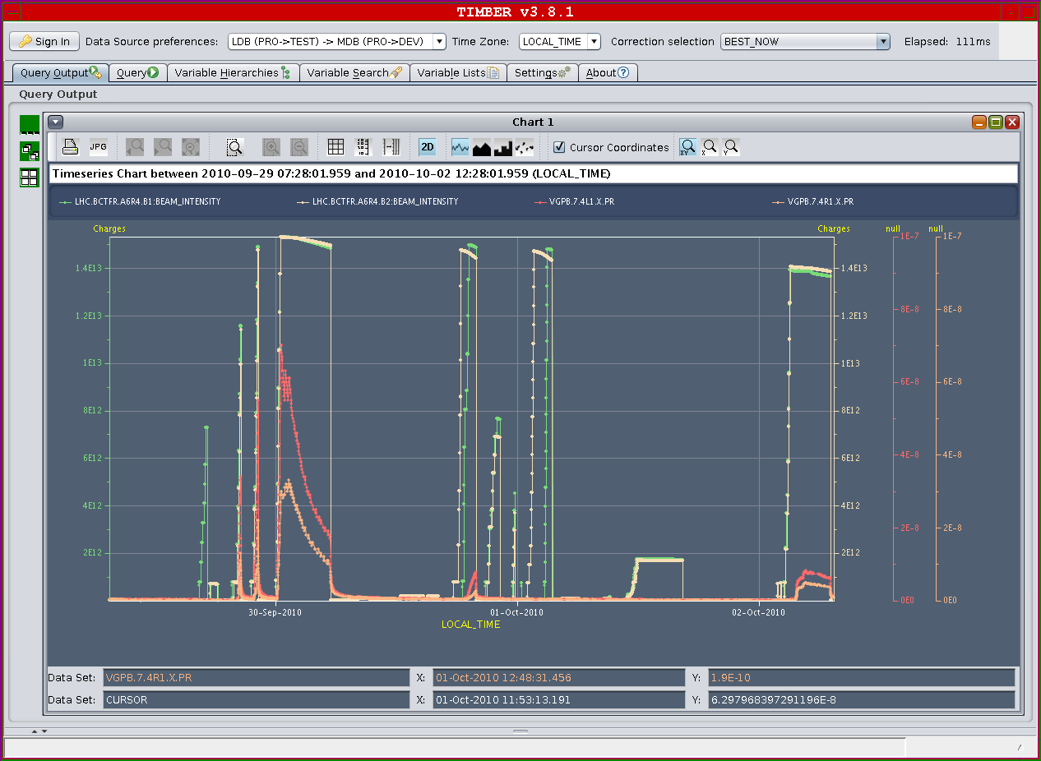
Friday 1st to Saturday 2nd October
Alick Macpherson

Slide 6
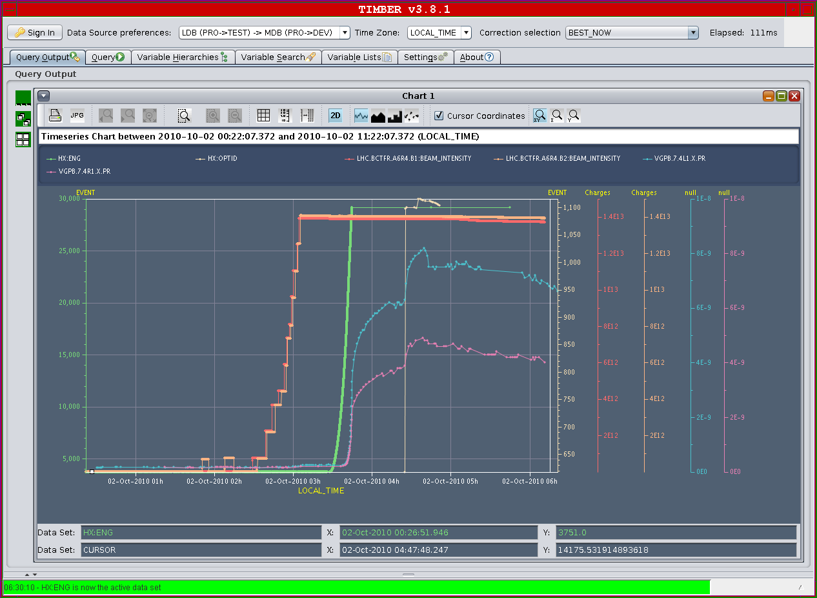
ATLAS

Slide 7
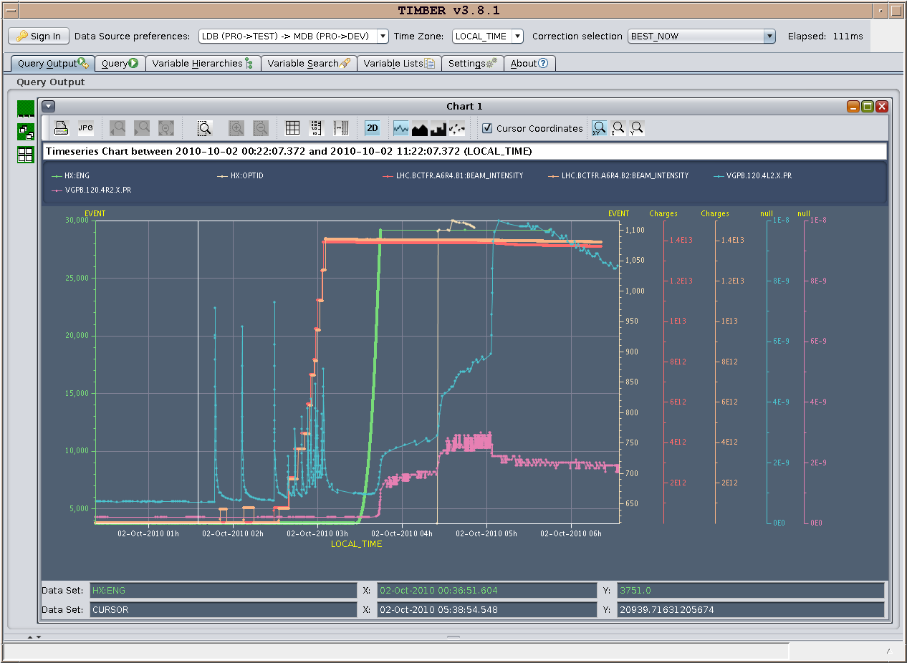
ALICE

Slide 8
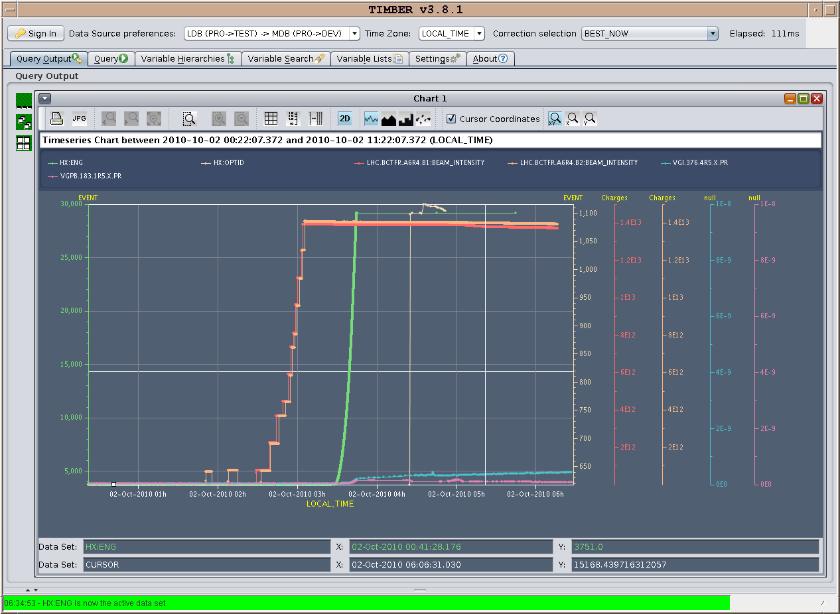
CMS

Slide 9
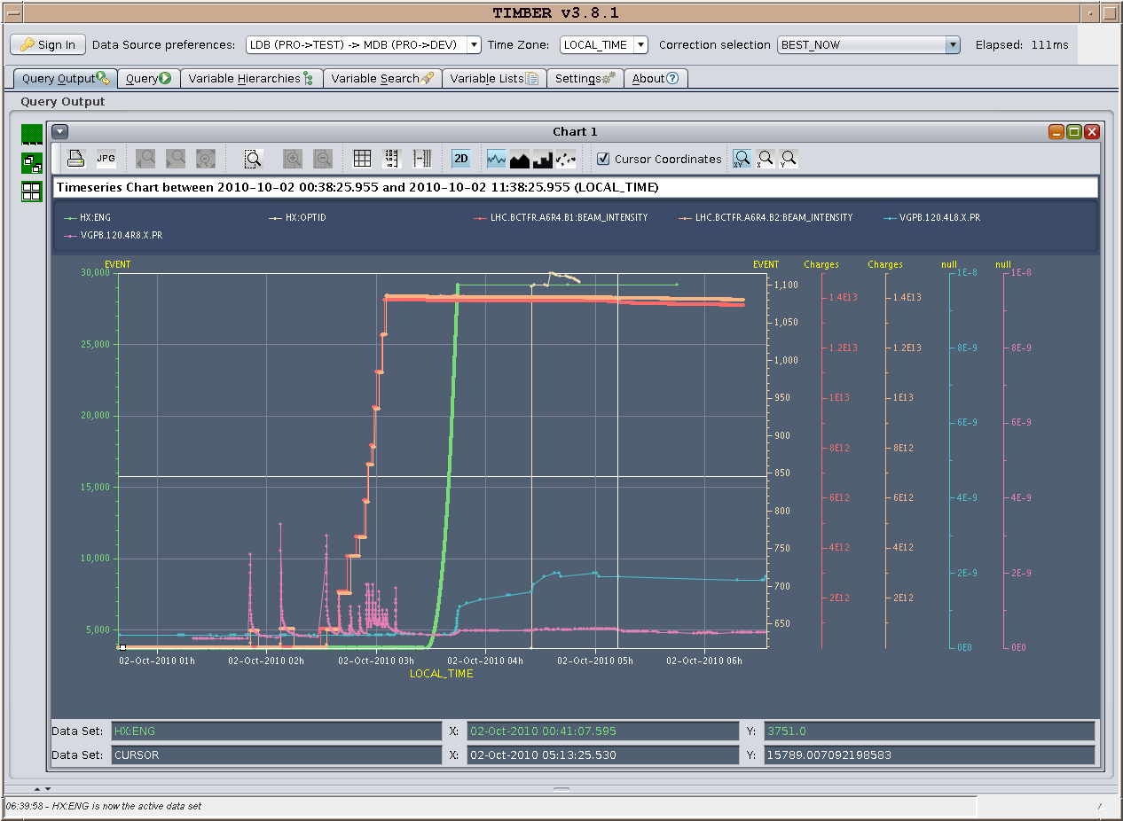
LHCb

Slide 10
Saturday 2nd October
5:08 – 7:08 : stable beams

Slide 11
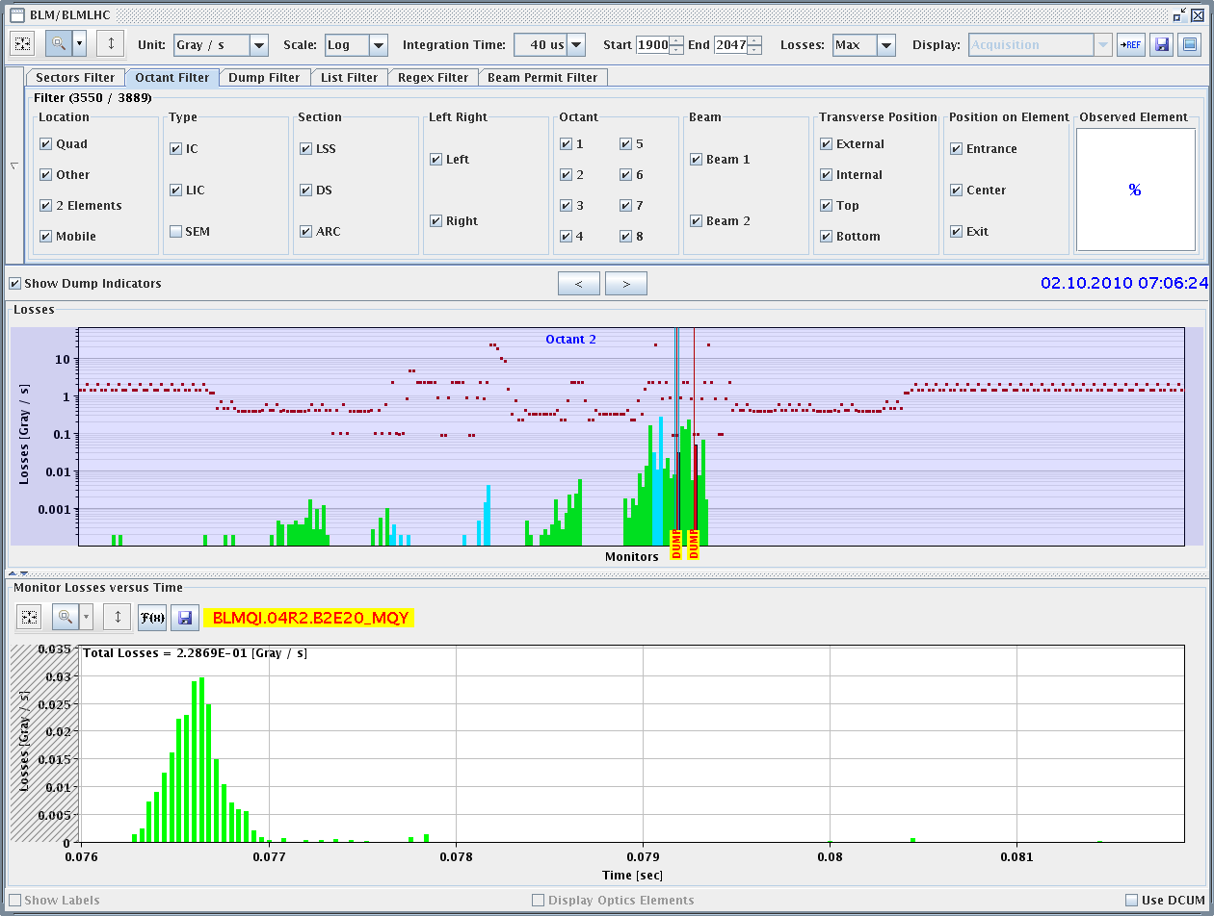
Saturday 2nd October
7:08: Dump beams. UFO point 2

Slide 13
TODAY
Refill in progress
Physics fill 152b x 152b
Tomorrow: Physics 152b

