Slide 1
Wednesday 29th September
08:15
QPS ok
Prepare for injection studies 8 & 16 bunches
09:15 Sector 56, 3 circuits trip during precycle... RSD1.A56B1, RSD2.A45B1, RSF2.A56B1
RSF2.A56B1 tripped first with VS fault. The other 2 circuits tripped as a consequence.
Access needed to replace the power module on the RSF2.A56B1
13:00 access over
- Power module replacement on RSF2.A56B1: tested OK - QPS firmware update for quench test - RADMONs installation on the QPS for quench test - MQKA diagnostics by R. Barlow. Not fixed. AC-dipole problem. - RF verifications following the recent trips

Slide 2
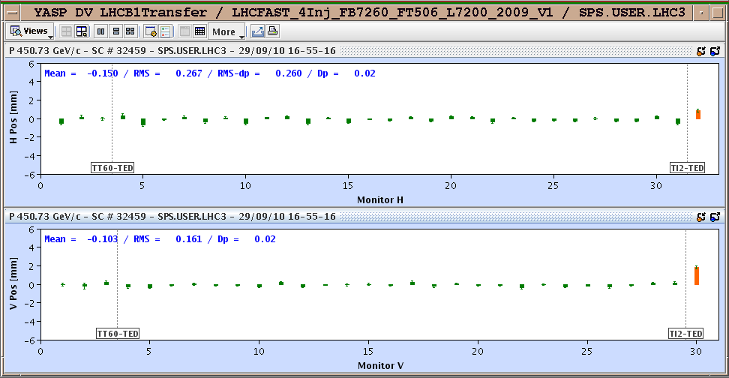
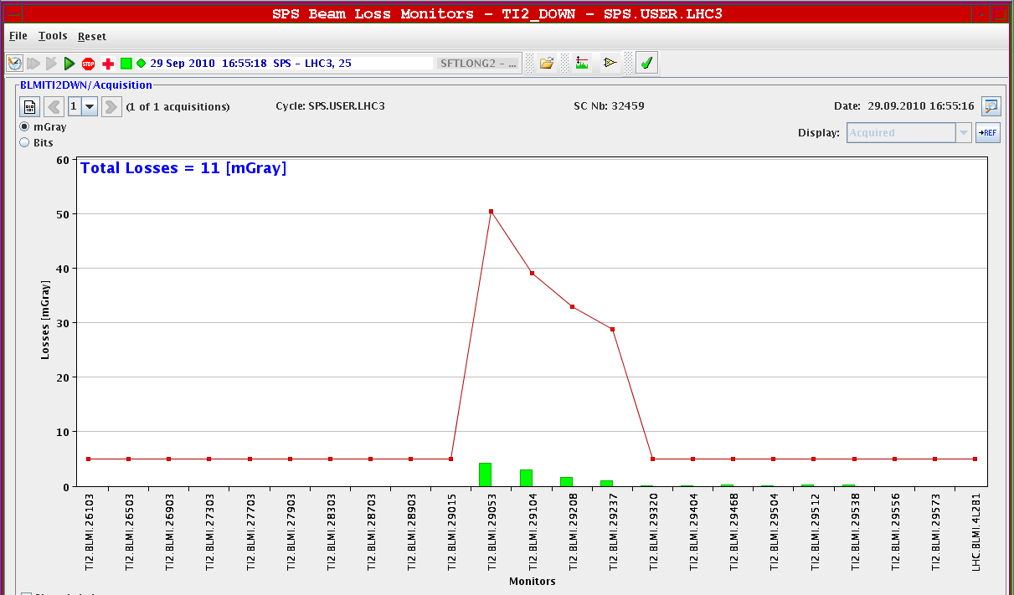
Wednesday 29th September, continued
Prepare (again) for 16 bunch injection tests
16:00 SPS beam back….
Q' measurement from on demand tune viewer not working
Setting up different beams (pilot, 8 bunches, 16 bunches) rather time consuming in the SPS
17:00 Injection set-up:
B1 injection clean after trajectory correction. OK 8 & 16 bunches

Slide 3
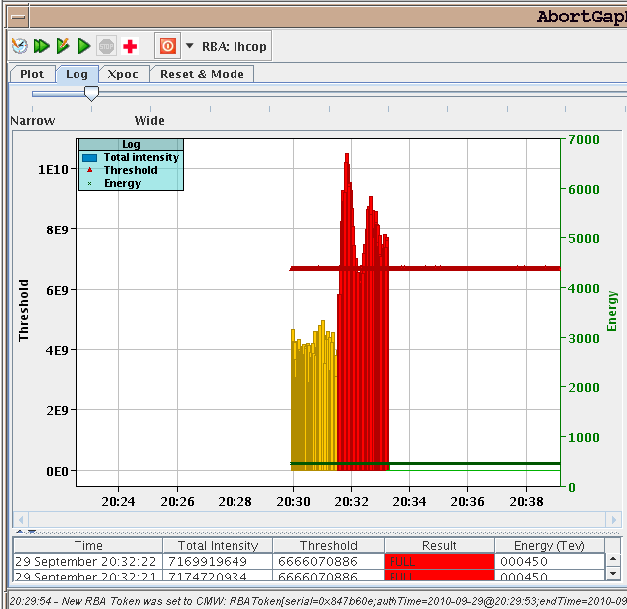
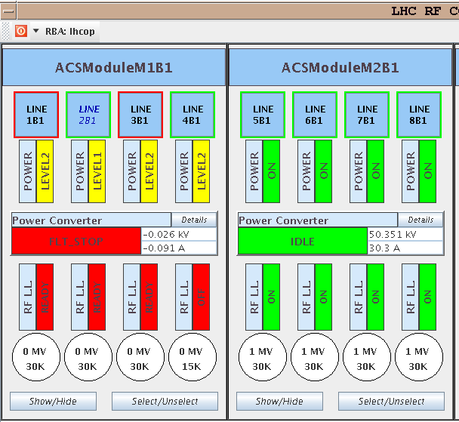
Wednesday 29th September, continued
20:30 Injection set-up B2
20:30 Lost towards the end of complete fill of 152 bunches with 16 bunch injection
10th Injection B1
RF module M1B1 tripped off -> debunched beam being kicked out on the TDI dumped the beam. Found corrupted settings.
beam dumped on losses on TCTVB

Slide 4
Conclusion Injection Studies
Steered TI2 to reference in H and V. TI8 not touched. Injection oscillations in LHC below about 0.5-0.7mm for both planes, both beams
16b injection tried for both beams - worked fine with low losses on LHC BLMs from TCDIs - IQCs green and no BLM warnings from this source
Ran through nominal filling sequence for 152b using 16b injections. At 10th injection RF problem…
Some tests with orbit acquisition for IQC - still issues to solve
16b injection looks fine = injecting above SBF limit
Brennan, Malika

Slide 5
Wednesday Night
22:15 Test interlocked BPMs point 6
22:30 Fill 1381
Fill for physics 152 bunches, injecting 16 bunches
Problems clearing the interlock from the interlocked BPMs, reboot of BPM crate "cfv-sr6-bpmint1" to reload the latest version of the firmware - it cleared the interlock.
Missing 9th bunch – check SPS
00:40 Start ramp
02:25 Stable Beams

Slide 6
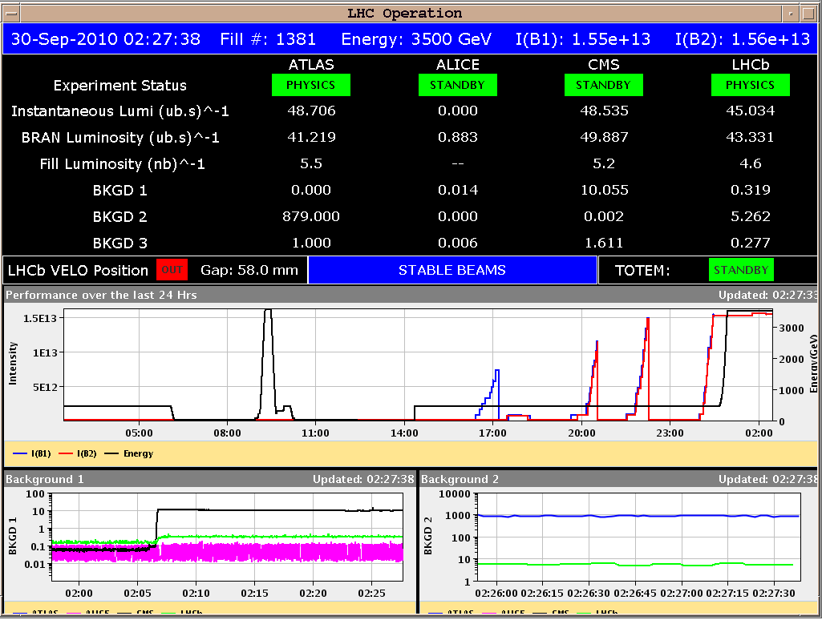
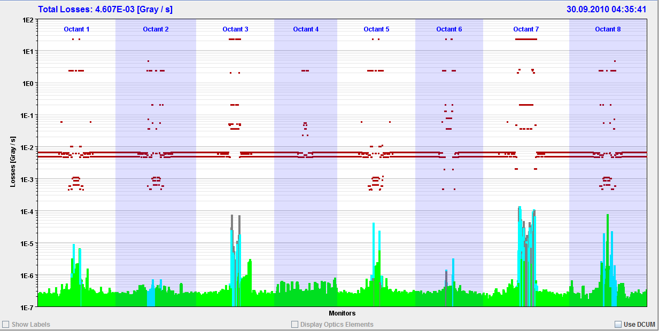
Fill 1381 152 bunches into physics
Lumi:
Cleaning:

Slide 7
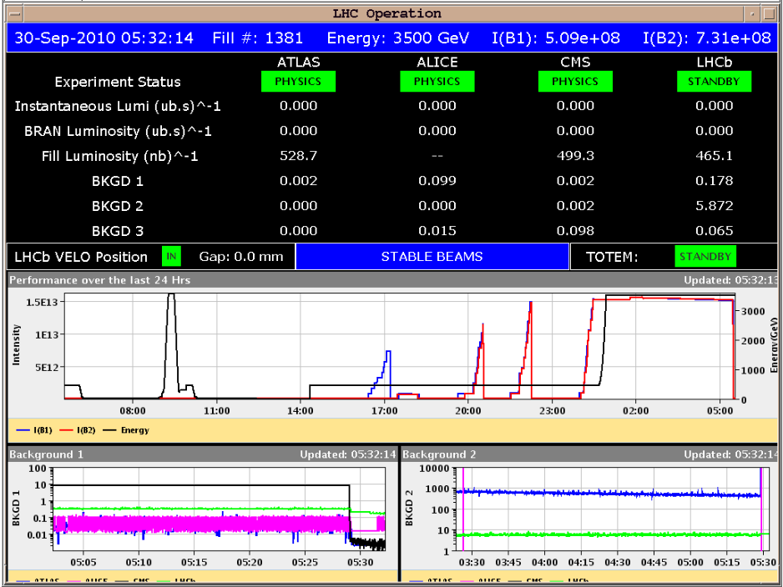
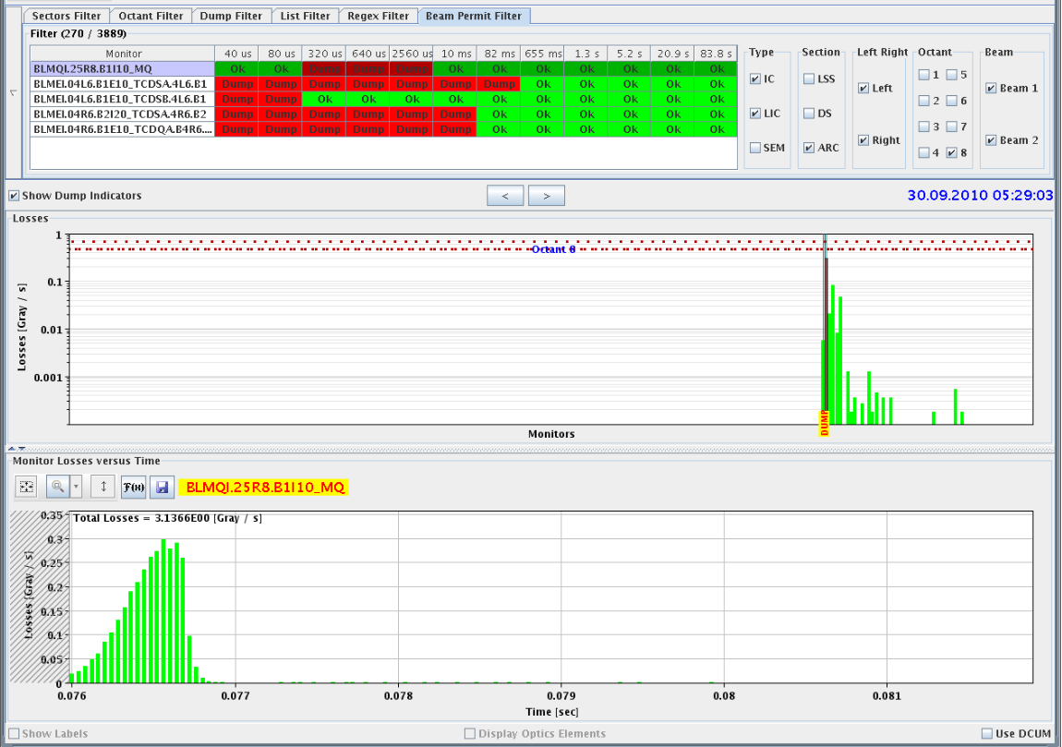
Fill 1381
ATLAS called back. Their background2 today is 3 times higher than yesterday... so they are running, but they are not completely happy.
05:29 UFO # 11, UFO #2 with 152 bunches
Total lumis after about 3 hours of fill
Loss 25R8

Slide 8
Plans
TOTEM – 1 to 2 hours before EOF
Thursday 30th | M | Abort Gap Cleaning Feedback Controller update and tests at 450 GeV
Thursday 30th | A/N | Physics 152 b
Friday 1st | M | VdM Atlas & CMS (Alice & LHCb next week?)
Friday 1st | A/N | Physics
Saturday 2nd | M | Quench Tests with beam

Slide 9
On the list
Transverse damper – 2 hours without beam – no access
MKQA & AC-dipole – will need another access
Voltage rampdown@injection
Lift maintenance
Intensity effects
Vacuum – point 5 – sharp increase during ramp, dropping back off after end
Quench test with circulating beam – access required first to install RADMONs
Test of new beam presence flag system – M. Gasior
CO security intervention to be scheduled - A.Bland

Slide 10
BI MD - c/o JJG – One Shift
PLL studies
Measure the sensitivity of Marek’s new beam presence detection system
Check the linearity of the fast BCT’s in the new configuration for nominal bunches
Tune the High BW/Low Gain fast BCT calibration for the coming ion run
Measure the High BW/Low Gain fast BCT sensitivity limit and linearity for low intensity bunches (ion run)
Re-check BPM sensitivity limit
Calibrate the abort gap over the whole ramp
Check the abort gap acquisition gate timing resolution and stability
Commission BGI in preparation to ions
Check BSRT/BGI/BWS cross-calibration including corresponding emittance logging
Test and compare bunch/bunch profile measurement via BWS and/or BSRT
For all this, we would need the 2 rings for a few hours at 450 GeV then a ramp and again a few hours at 3.5 TeV.
This would be really difficult to fit in a 4 hour slot. 8 would be perfect but we could try with 6.

