Slide 1
Tuesday 28th September
Fill 1375 ongoing
09:00 Move in Roman Pots
‘Safe ones’ first
Vertical one, which in the past caused UFO, move in 15 minutes before end of fill
No problem!
11:25 End of Fill 1375 (104 bunches)
Lumi: 952, 1.59, 932, 889 nb-1
PM: Planned for injection studies. Instead we had:
RQD.A81 trip
PS MPS problem (DCCT and controls)
No beam most of the afternoon
17:30 Inject for the first time 152 – 8 =144 bunches !
8 bunches did not go in because of Abort Gap Keeper
Successful test of Software and Hardware Interlocks

Slide 2
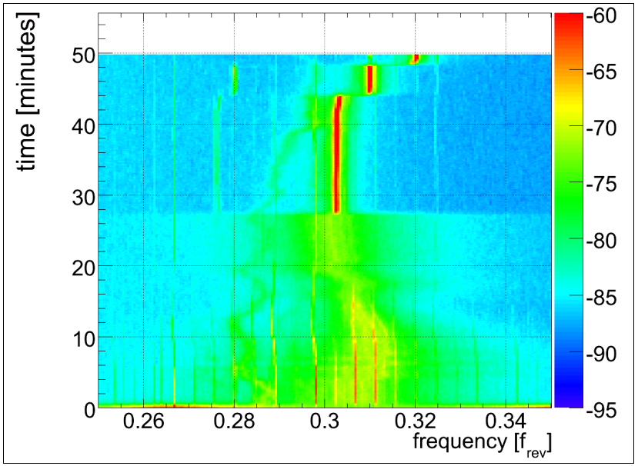
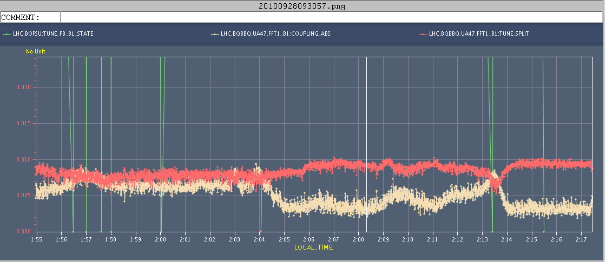
Tune FB
Preliminary look at Tune-FB outage during the last ramp:
Swapped the 'development' with 'old operational' BBQ system, now containing a 400 MHz low-pass filter prior to the BBQ detector. This fillter effectively reduces the intensity seen by the BBQ by more than a factor of two. Still, the time the B1/2 switched 'off' during the ramp seems to coincide with the longitudinal activity which may indicate that this switch-off is primarily related to the BBQ sensitivity to longitudinal effects (bunch shape/filling pattern) than the bunch intensity itself. While noisy, tunes seemed to be tracked -- in contrast to previous ramps where the tune lines were swamped by an increasing noise-level in the BBQ spectra. Attached measured tunes during ramp, flat-top, squeeze and physics. Suspect additional interference lines in the spectra. Tune-FB switched 'off' for B1 during the squeeze due to (possibly spurious) betatron coupling dominating the effective tune-split. B2 signals and measured seemed to be fine though...
Further analysis is required...
Ralph S.

Slide 3
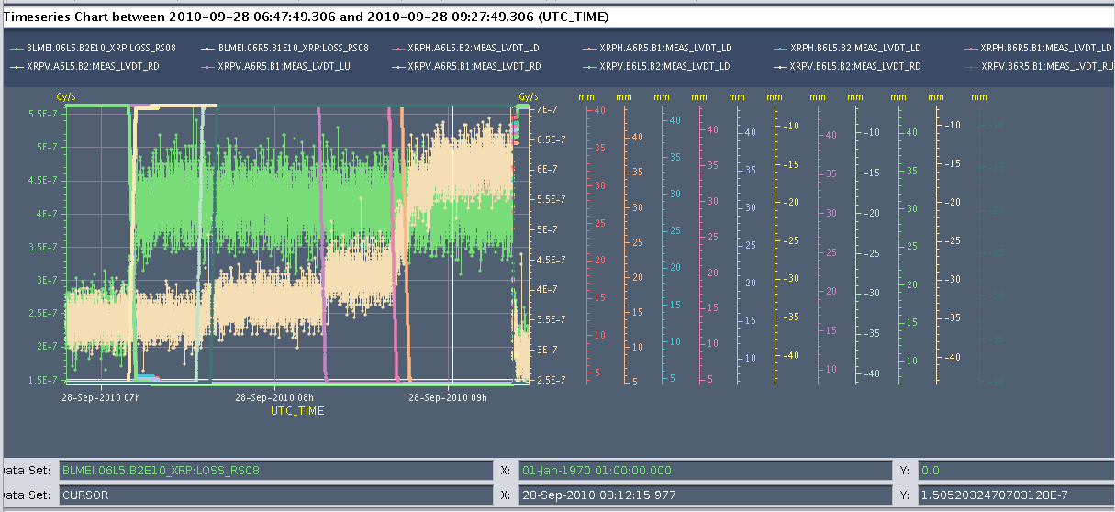
Roman Pots – all going fine…
After all pots were in TOTEM took data for ~20 min (20 nb^-1) before the beam was dumped with a programmed dump. No "UFO" type losses were seen

Slide 4
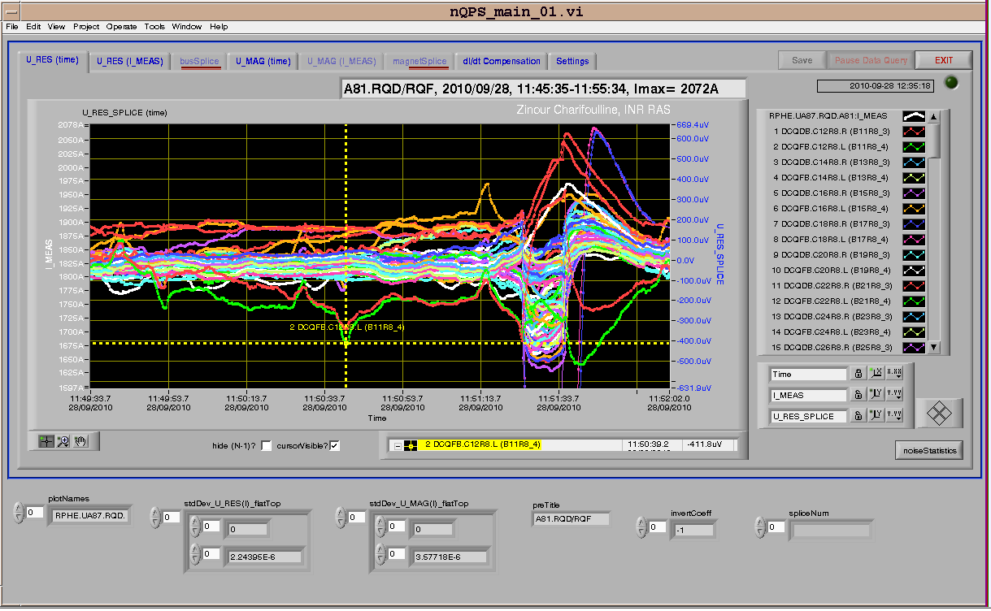
12:00 RQD.A81 trip
Trip due to QPS at the end of the cycle.
On the rampdown the RQD.A81 tripped near the end of the cycle. There was clearly some noise on the U_RES around RQD./RQF at 11R8 but the trip ( with heaters firing) appears to be triggered 0.1mv below the 0.5mV threshold.

Slide 5
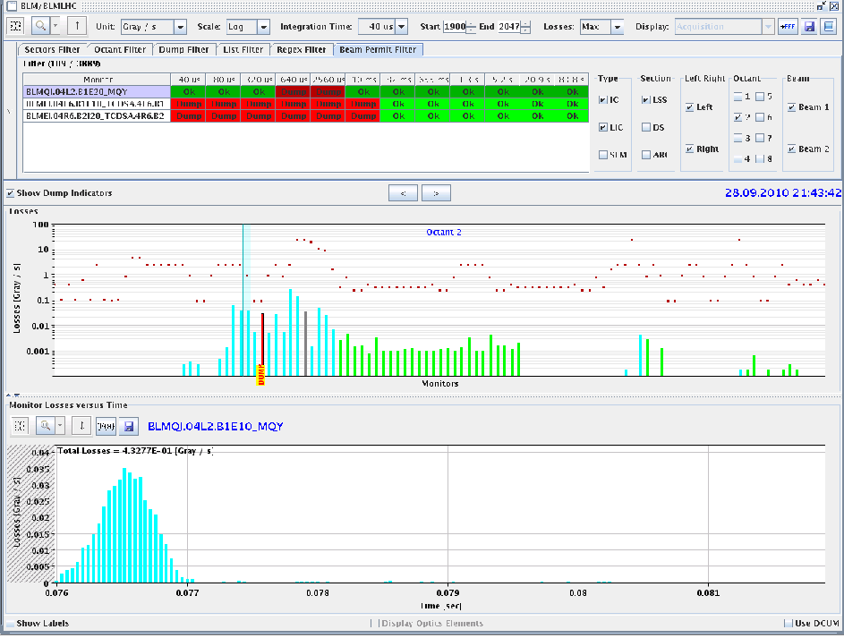
Tuesday continued
20:00 Shift last injection by 250 ns to avoid AGK stopping injection and successfully inject 152 bunches
Dump for interlocked BPM test: OK
Fill for physics (the plan)
21:45 Beams dumped at end of 1st squeeze step.
BLMs left of 2 triggered, fast localized loss. Possibly another UFO event. Orbit was fine, tunes under control, lifetime above 25 hours.

Slide 6
Tuesday Night / Wednesday Morning
00:00 Fill again with152 bunches
IQC fine again
01:02 Beams dumped in ramp around 1 TeV
Trip of undulator RU.L4, Ures above thresholds
Trip of RQ9.R1 during the ramp down, can be reset
At the end of precycle of S12, RQT13.L2B2 tripped at zero current
04:00 Pilots in again
Lost QPS-OK on RB.67 because of a heater discharging on MBA8.L7-> Access: Standard change of switch
08:15
QPS ok
Prepare for injection studies 8 & 16 bunches

Slide 7
Plans
TOTEM – 1 to 2 hours before EOF
Wednesday 29th | M/A | Injection Studies 16 bunches
Wednesday 29th | A/N | Physics 152 b
Thursday 30th | M | Abort Gap Cleaning Feedback Controller update and tests at 450 GeV
Thursday 30th | N | Physics 152 b
Friday 1st | M | VdM Atlas & CMS (LHCb next week)

Slide 8
On the list
Transverse damper – 2 hours without beam – no access
MKQA – possible access
Voltage rampdown@injection
Lift maintenance
Intensity effects
Vacuum – point 5 – sharp increase during ramp, dropping back off after end
Quench test with circulating beam – access required first to install RADMONs
Test of new beam presence flag system – M. Gasior
CO security intervention to be scheduled - A.Bland

Slide 9
BI MD - c/o JJG – One Shift
Measure the sensitivity of Marek’s new beam presence detection system
Check the linearity of the fast BCT’s in the new configuration for nominal bunches
Tune the High BW/Low Gain fast BCT calibration for the coming ion run
Measure the High BW/Low Gain fast BCT sensitivity limit and linearity for low intensity bunches (ion run)
Re-check BPM sensitivity limit
Calibrate the abort gap over the whole ramp
Check the abort gap acquisition gate timing resolution and stability
Commission BGI in preparation to ions
Check BSRT/BGI/BWS cross-calibration including corresponding emittance logging
Test and compare bunch/bunch profile measurement via BWS and/or BSRT
For all this, we would need the 2 rings for a few hours at 450 GeV then a ramp and again a few hours at 3.5 TeV.
This would be really difficult to fit in a 4 hour slot. 8 would be perfect but we could try with 6.

