Slide 1
Monday 27th September
09:55 End Fill 1373
1134, ,960,1052 pb-1
VdM scans
1 & 5
10:34 beams dumped
11:30 Access

Slide 2
Access…
FBCT CPU changed
QPS heater for MB.C12L1 recovered
Access for BBQ to re-apply filters
RF - investigation of RF cavity trips
Arc detector on waveguides (photodiodes – signals ANDed rather than Ored to reduce false alarms)
BPM crates in S34 reset (could not be checked without beam)
DCBCT: expert made an access to try to diagnose problem saturation/mismatch with FBCT
Access was made for the MKQA for B2 but the expert was not able to resolve the problem, and suspects that there is a corruption of the software.
Further investigation is needed. and for the moment the B2 tune kicker is not available
At the end of the shift, TCDQ movement tests and investigations on the RF noise on Module 4B1 were ongoing.
During the access period
SVC at pt 2 was restarted
ALICE dipole and Solenoid were ramped down, an intervention made, and then ramped up again
An intervention was made on a cryo valve at pt 8 (DLAF09_RR13_CV891)

Slide 3
Monday continued
RF noise tests M4B1
Intermittent, violent, video available,
Transparent studies without beam in coming days & then access UX45
17:00 Pilots in
17:54 Injection Kickers
2nd MKI-B1 magnet had a break-down during the injection of the 1st nominal batch. beam didn't see it
19:22 Started MKI soft start with modified parameters - expect to take about 45 minutes
RF crowbar M2B1, also lost M1B2
20:16 beam back in
20:46 lost S67 & S78
In both cases the RQ10 (RQ10.R6 and RQ10.L8) triggered. A similar event was seen some days ago this is a known issue (can QPS experts explain better?)

Slide 4
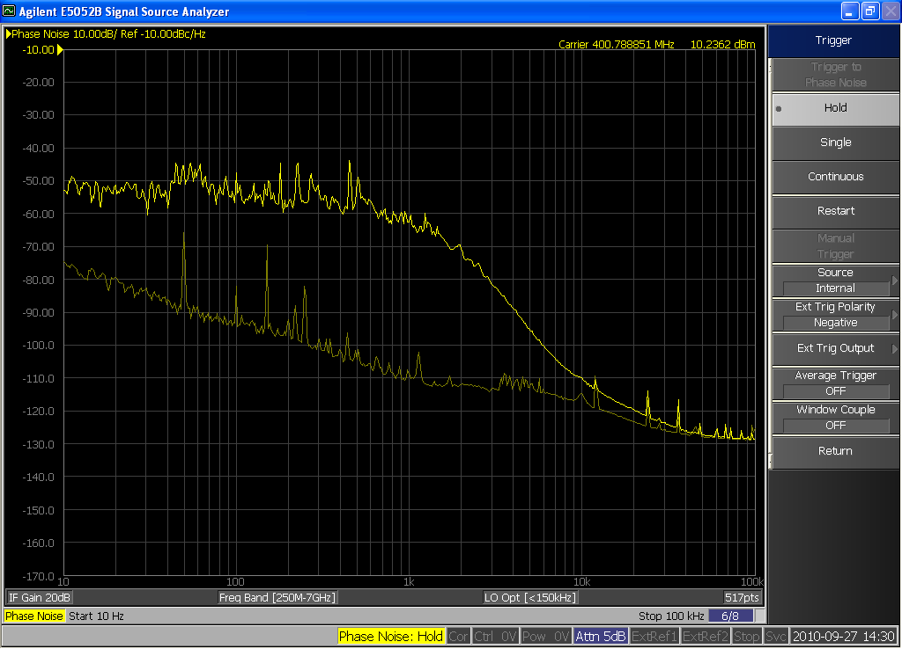
RF noise – M4B1
P. Baudrenghien

Slide 5
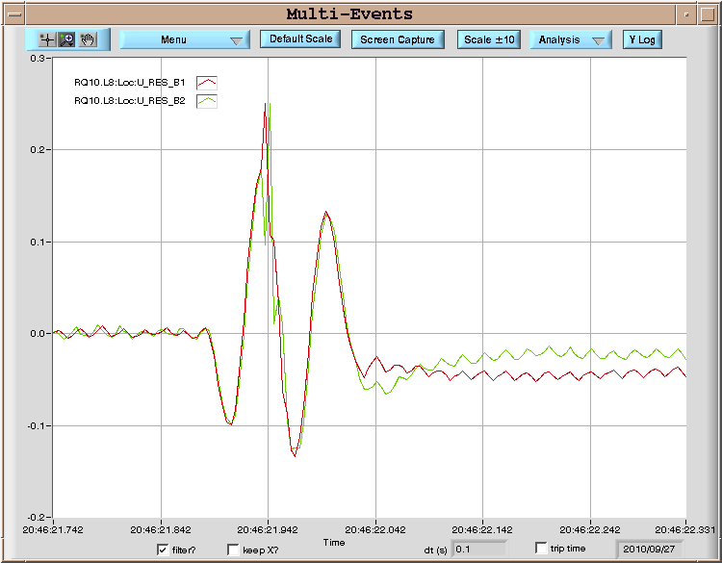
QPS…

Slide 6
Tuesday morning
23:40 beam back
IQC latched at almost each injection for beam 2, better for beam 1.
Head tail measurements in ramp
Lost tune feedback during the ramp around 750 GeV for beam 1 and a little later for beam 2 because of noise at the same level of tune signal. Signals back at the very end of the ramp.
Tune feedback stopped again on beam 1 during the squeeze
Fill 1375…

Slide 7
Plans
TOTEM – 1 to 2 hours before EOF
Tuesday 28th | A | Injection studies – optimization/16 bunches
Tuesday 28th | N | Physics
Wednesday 29th | M | Transverse damper studies (4 hours) Orbit feedback controller update – test ramp Parallel luminosity optimization
Wednesday 29th | A/N | Physics
Thursday 30th | M | Abort gap cleaning
Sunday |  | VdM Atlas & CMS (LHCb next week)

Slide 8
On the list
Transverse damper – 2 hours without beam – no access
MQKA – possible access
Voltage rampdown@injection
Lift maintenance
Intensity effects
Vacuum – point 5 – sharp increase during ramp, dropping back off after end
Quench test with circulating beam – access required first to install RADMONs
Test of new beam presence flag system – M. Gasior
CO security intervention to be scheduled - A.Bland

Slide 9
BI MD - c/o JJG
Measure the sensitivity of Marek’s new beam presence detection system
Check the linearity of the fast BCT’s in the new configuration for nominal bunches
Tune the High BW/Low Gain fast BCT calibration for the coming ion run
Measure the High BW/Low Gain fast BCT sensitivity limit and linearity for low intensity bunches (ion run)
Re-check BPM sensitivity limit
Calibrate the abort gap over the whole ramp
Check the abort gap acquisition gate timing resolution and stability
Commission BGI in preparation to ions
Check BSRT/BGI/BWS cross-calibration including corresponding emittance logging
Test and compare bunch/bunch profile measurement via BWS and/or BSRT
For all this, we would need the 2 rings for a few hours at 450 GeV then a ramp and again a few hours at 3.5 TeV.
This would be really difficult to fit in a 4 hour slot. 8 would be perfect but we could try with 6.

