Slide 1
LHC commissioning Week 38
Coordination G.Arduini, R.Bailey
Aims for the week
Finish qualification of the machine for operation with bunch trains
Physics with bunch trains
24 bunches
48 bunches
96 bunches

Slide 2
Monday
QPS trigger in Sector 12 due to noise on RQ10.L2
2 hours no beam for TCDQ controls
Cycle machine
Beam back at midday
Ramp (with Q’ measurement) squeeze collide
B2 lifetime poor at end of squeeze
Q’ H pushed up (also in functions)
Momentum collimation setup
B1 dumped to make off momentum loss map with B2 (-1000Hz)
TCDQ controls test
Injection verification (TDIs, 4 bunch, 8 bunch)

Slide 3
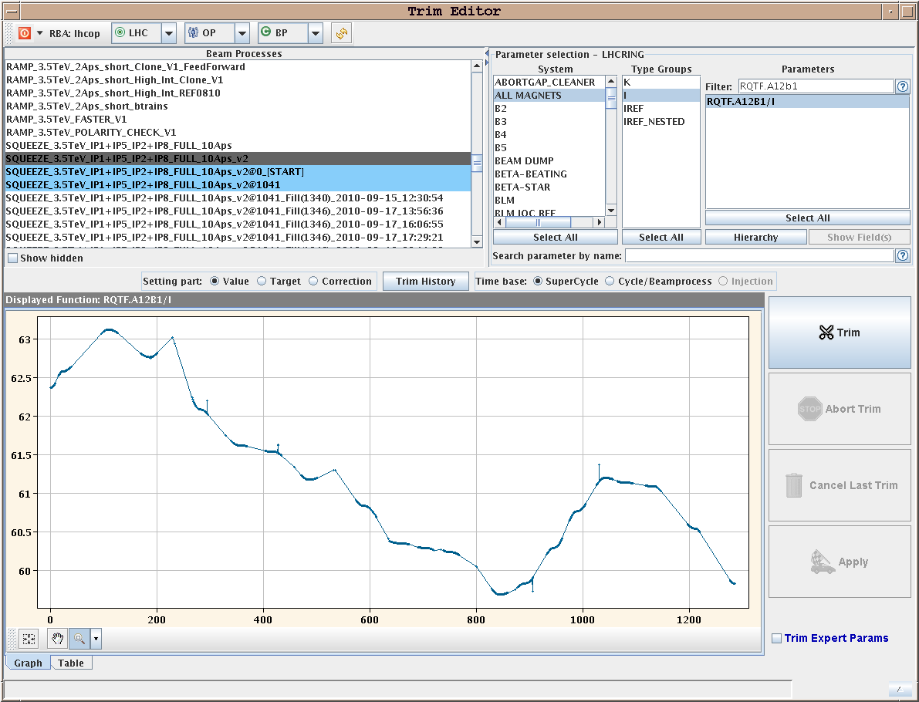
Monday
Overnight
Asynch. dump test at end ramp, Xing reduced
Probs again with TCDQ control (to be followed up)
Test performed OK
Asynch dump test at end squeeze separated
Trip of RQTF.A12B1 in squeeze
We found back the spikes on the correction (they were cleaned out!)

Slide 4
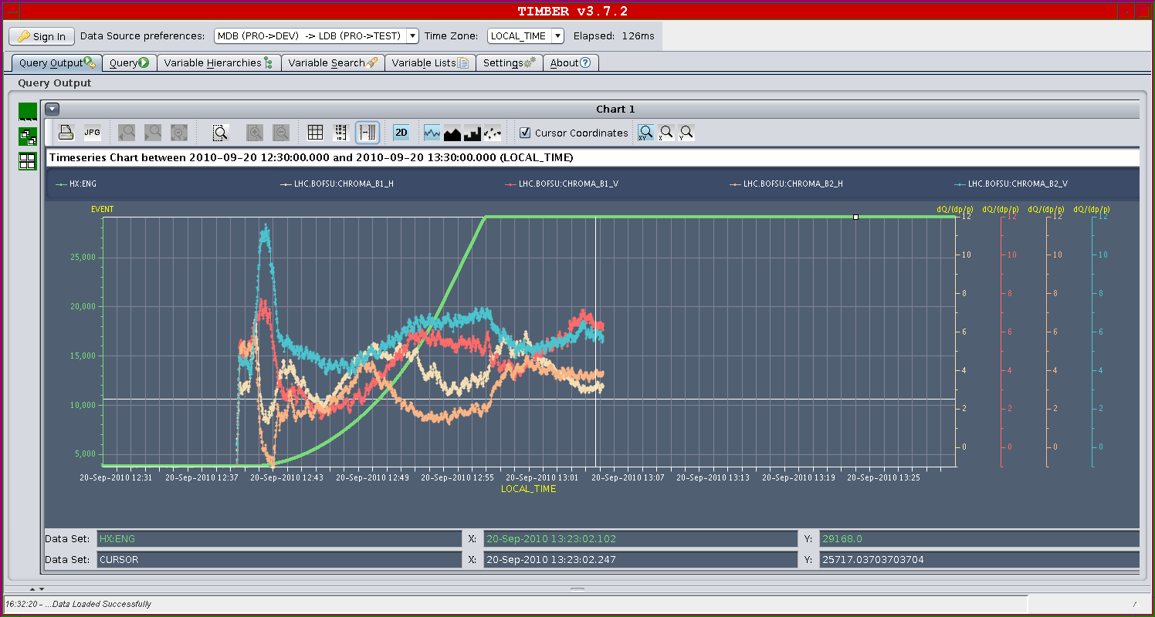
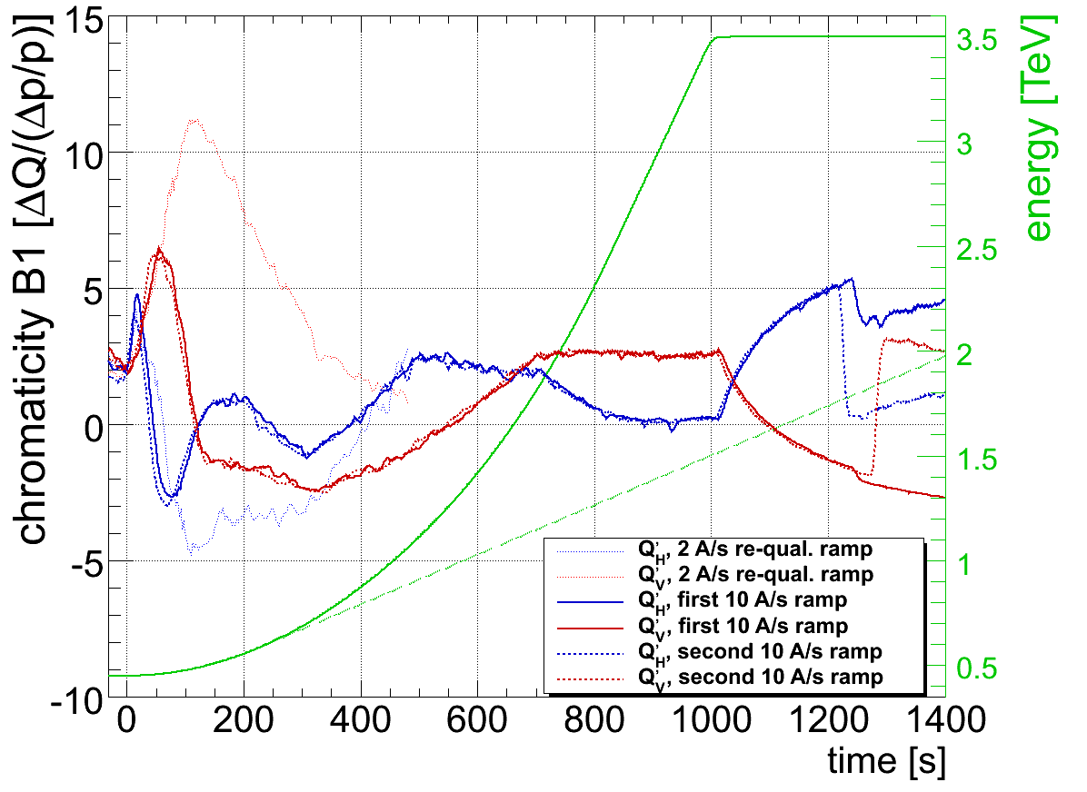
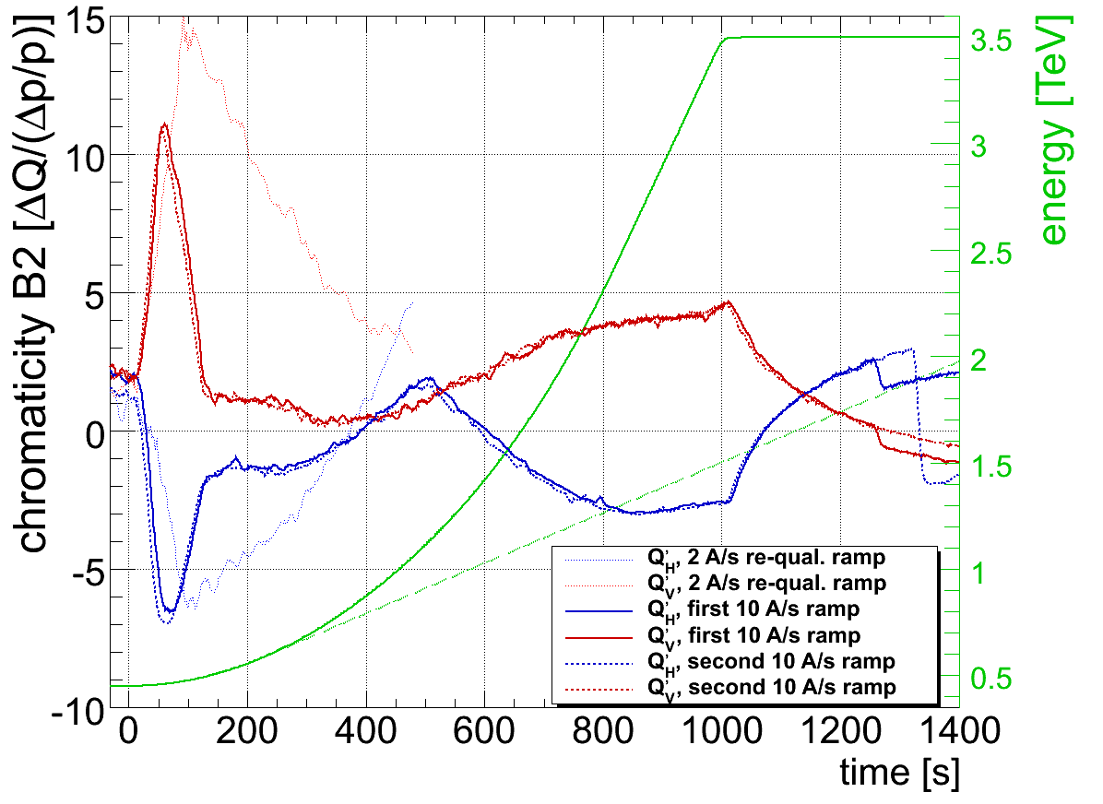
Q’

Slide 5
Summary of injection checks
TDI centering checked for both beams - of the order of 0.2 mm erro for both - inside the tolerance we've allocated so left TDIs at present positions
Transfer line and injection losses checked with 4b 150ns trains - small adjustments made to both lines in H planes to bring RMS below 0.2 mm. Losses on B1 were higher than we've seen in the past - may need to revisit later
Injection oscillations 0.5 - 0.7 mm everywhere
Injected the 24b filling scheme with 3 trains of 8b - worked fine - with still no warnings from LHC BLMs, so OK at this intensity
However IQC is latching with losses for B1, so will either have to readjust TCDIs (1 or 2) or increase the limits.

Slide 6
Summary of loss maps of Monday afternoon
We have verified the beam-based centre of the secondary collimators in IP3. We found values that are consistent with the ones previously found (deltas < 150 um, which is what we expect as orbit reproducibility).
We defined new settings with TCP in IP3 for beam 2 closer to the beam: 10 sigmas instead than 12 sigmas.
We performed cleaner off-momentum loss maps with beam 2 only.
Loss maps look ok now: the hierarchy is respected and the higher losses at the TCTs are 3.5e-3 lower than the peak at the TCP.
This validates the collimator settings in physics conditions.

Slide 7
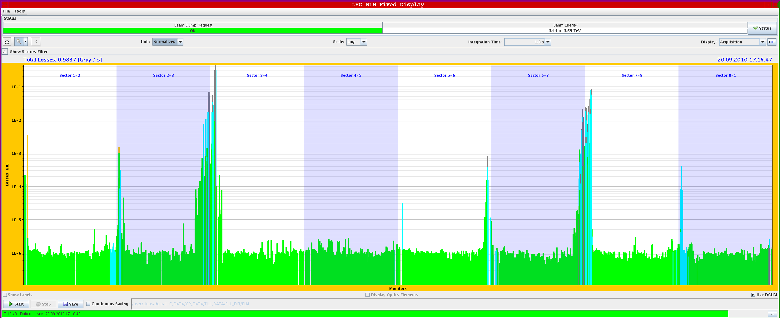
B2 off momentum (+) loss map after set-up

Slide 8
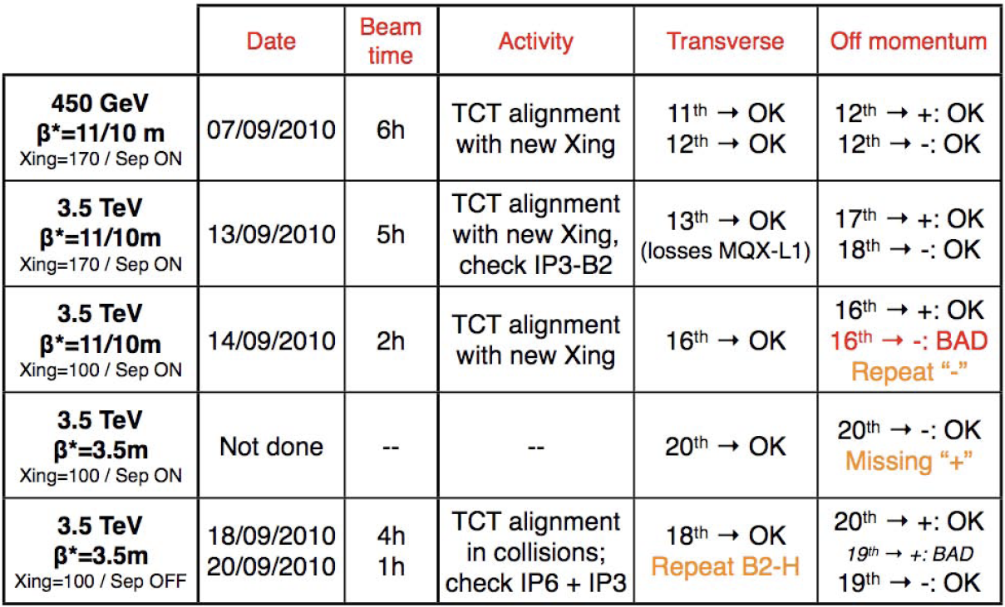
Loss map summary (Monday evening)

Slide 9
Still to do (starting 20h)
Asynch dump end of ramp reduced Xing (5h) OK
Asynch dump end squeeze separated (5h)
TOTEM and transverse loss map (10h)
Review Tuesday during the day
Pilot run through ramp and squeeze
Loss map off momentum end of ramp reduced Xing (5h)
Loss map off momentum end squeeze separated (5h)

Slide 10
Filling patterns envisaged
24 with 3 trains of 8
48 with 6 trains of 8
96 with 12 trains of 8
96 with 8 trains of 12
144 with 12 trains of 12
From the moment we reach 48 bunches
Intensity steps ~ 48 bunches
At a given intensity step at least 3 fills and around 20 hours (or more) of Stable beams are required
Intensity increase possible if no problems are encountered on the MP side (checklist)
This week
Next week

