Slide 1
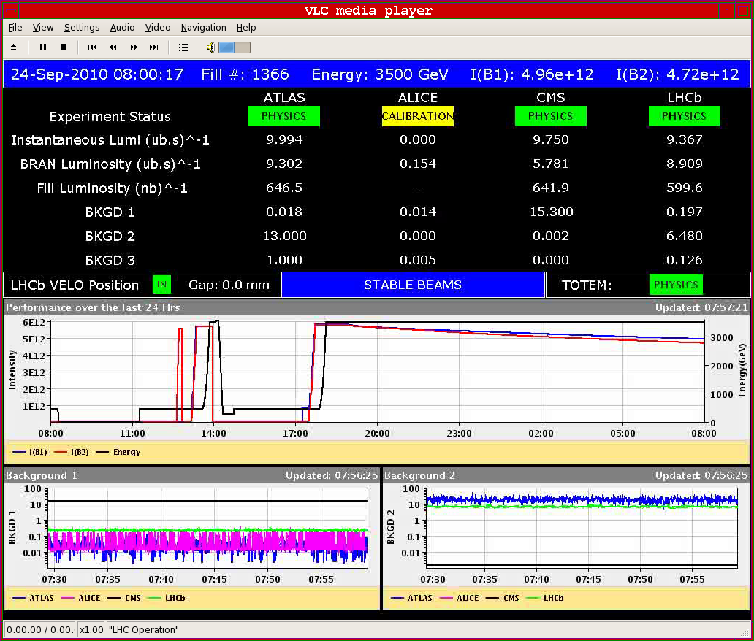
Fill 1366 after 13h

Slide 2
Friday
End of fill studies
extended lumi scans for emittance measurements
IP1
epsX = 3.33um epsY = 3.58um Derived Luminosity 9.35e30
IP5
epsX = 3.67um epsY = 3.41um Derived Luminosity 9.15e30
Wirescan B2 V 3.5um
All looks consistent
Emittance growth through
the fill from 2.2 to 3.5

Slide 3
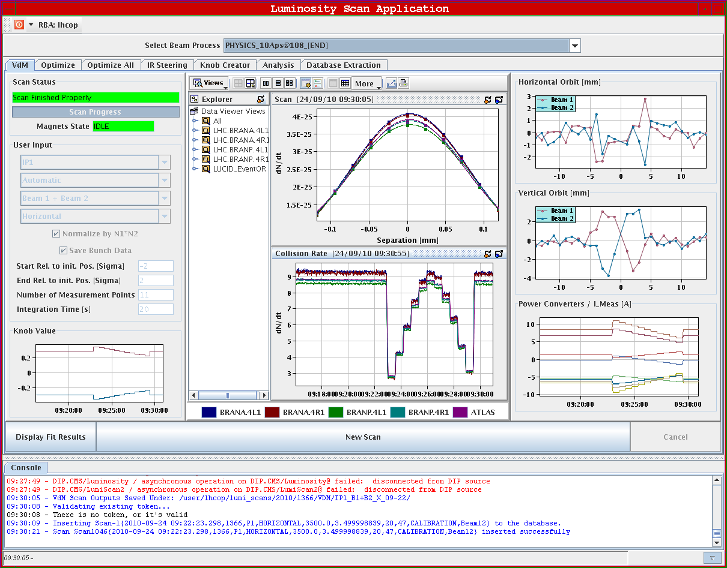
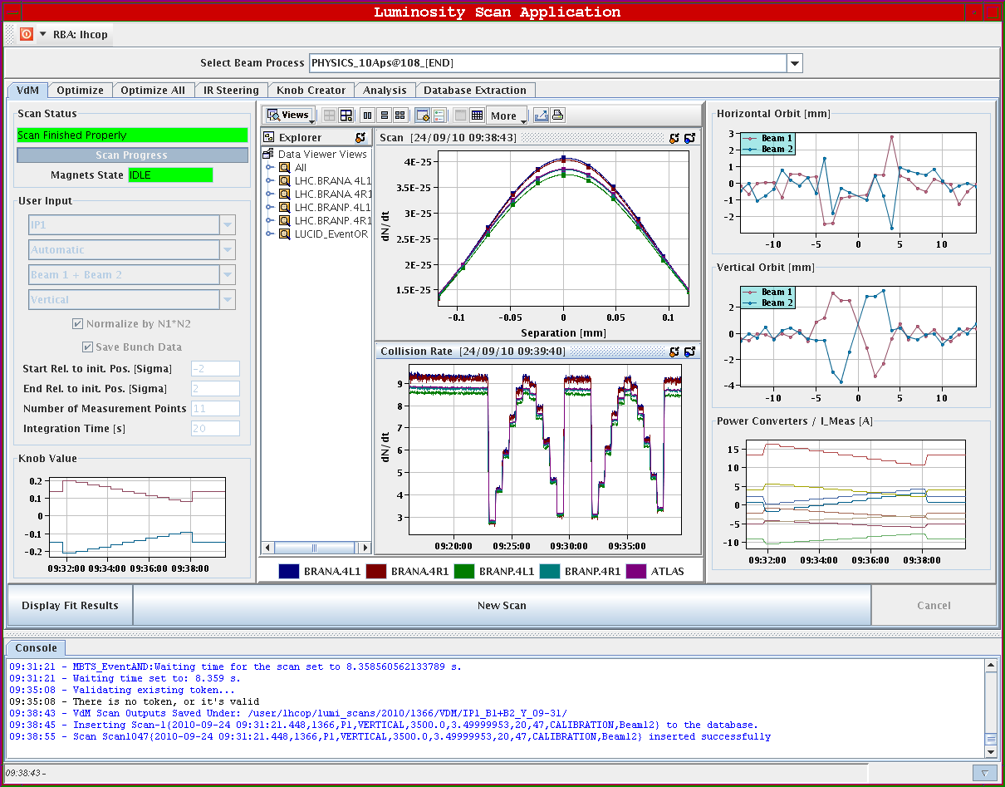
Friday
G. Papotti & S. White

Slide 4
Friday
Beams dumped by wirescan B1 V at 10.00
ALICE polarity switch (polarity of the solenoid not consistent with crossing angle leading to a reduction of the effective crossing angle at the IP)
Test ramp and squeeze
Orbit through the cycle
Optimisation of collisions in IR2
Tests with TCTs at 13 sigma for future VDM scans
Fill for physics from 19.00
Scheme 150ns_56b_47_16_47_8bpi
21:50 RCBXH3.L8 power converter trip at the end of the squeeze.
Access required for replacement of quench heater power supply of B33L5 which started to discharge during the previous ramp
00:30 lost communication with QPS RB/RQ in Sector 56 ➔ Access in point 6….
04:00 Access finished
Fill for physics
Scheme 150ns_56b_47_16_47_8bpi

Slide 5
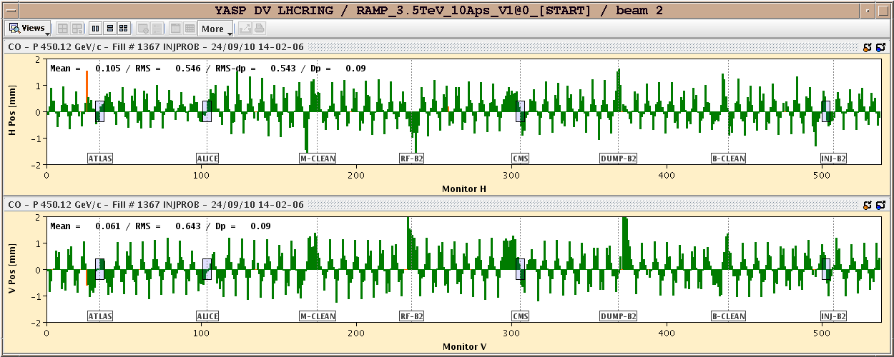
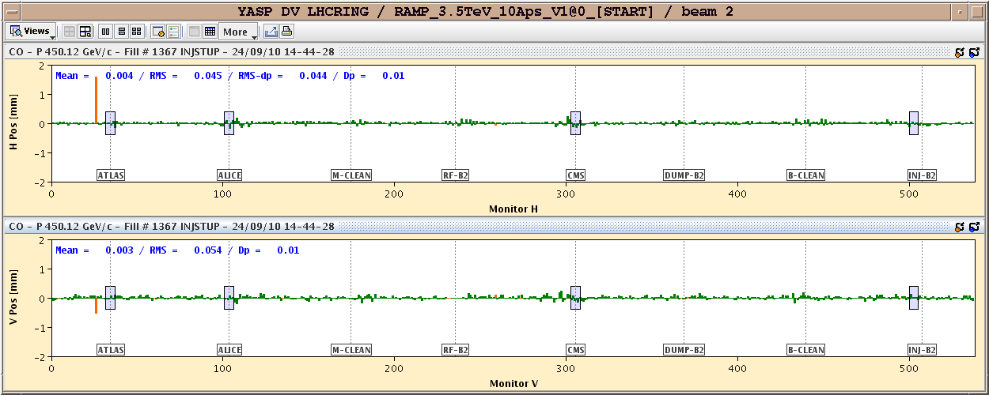
Friday
After ALICE polarity reversal
After polarity reversal & orbit correction

Slide 6
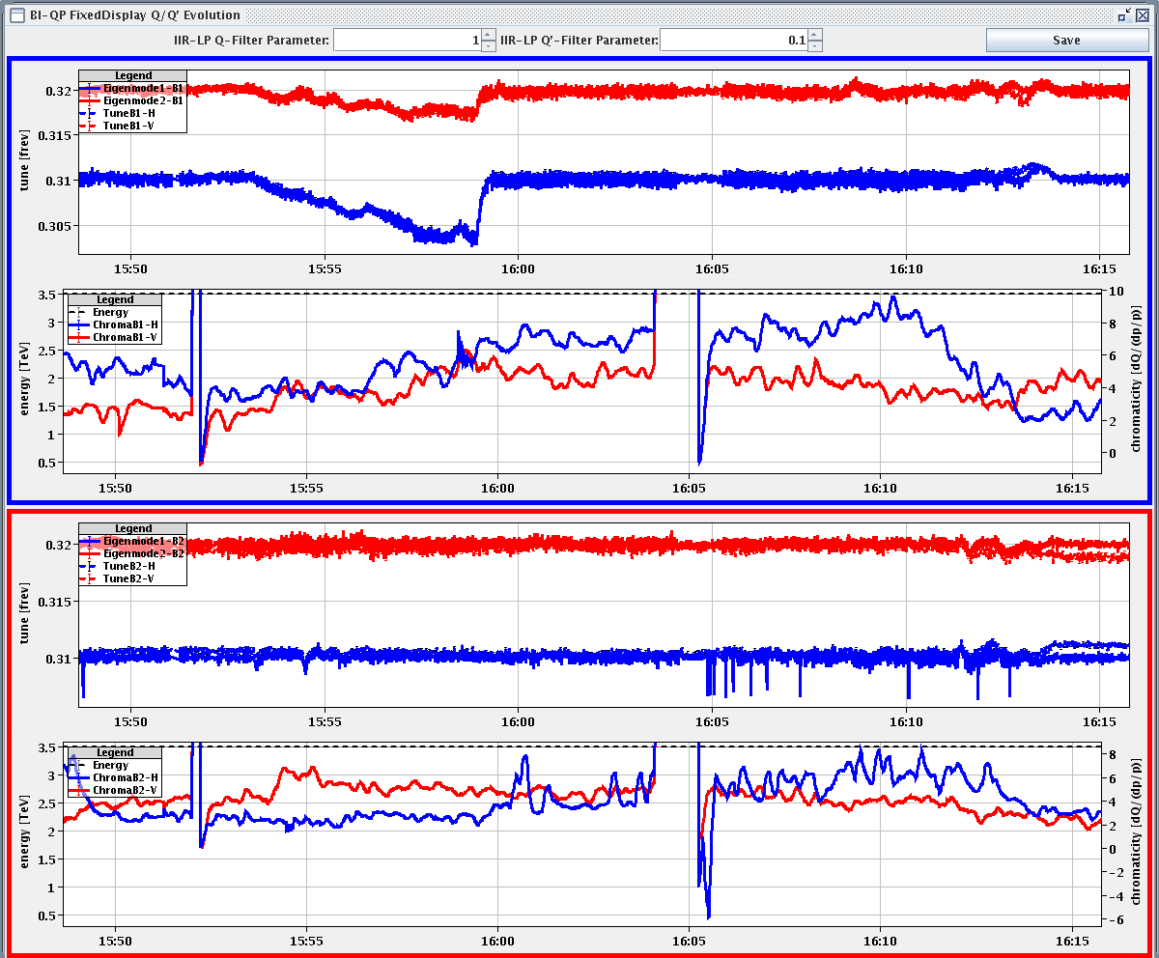
Friday
Chromaticity measurement during the squeeze
R. Steinhagen

Slide 7
To fit in later
Transverse damper firmware update (to prevent glitches positions very close to 0) – W. Höfle
Test of luminosity optimization software - S. White
Gas Ionization Profile Monitor tests - M. Sapinski
Abort gap cleaning – M. Meddahi
Test of new beam presence flag system – M. Gasior
DC BCT – P. Odier
Q kicker – R. Barlow
CO security intervention to be scheduled - A.Bland

