Slide 1
Wednesday /Thursday
09-11:00 Verification of the LSS6 interlocked BPMs: took longer to fill due to some problems with RF cavities in the PS. In the mean time analysis of the loss maps and asynch dump by experts ➔ OK
11:00-12:30 Injection of 24 bunches and start of the ramp – beam dump during injection due to a left-over of the previous test
12:49 – beam dump at ~3 TeV ➔ fast beam loss
13:00 – 17:00 Pre-cycle and prepare for stable beams
17:04 STABLE BEAMS (24 on 24)
06:00 go to ADJUST (problem with ALICE handshake)
06:30 wire scanners
06:45 Dump
Ongoing access for replacement/repai of a quench heater power supply in Sector 45

Slide 2
Interlocked BPMs
Finished testing of interlocked BPMs with bunch trains.
separated by 150 ns tested all point 6 interlocked BPMs of both beam by moving the interlock level. Difference with interlock level and measured beam position generally smaller than 0.5 mm.
- put 3 x 8 bunch trains with nominal bunches in the machine. Tested interlock threshold of BPMSA.A4L6.B1 horizontally. Position reading was 0.56 mm and dumped beam at 0.6 mm interlock setting. Both beams were dumped, but because pm was disabled it was not clear why beam 2 was dumped as well.
- all bpms interlock settings put back to their original values.

Slide 3
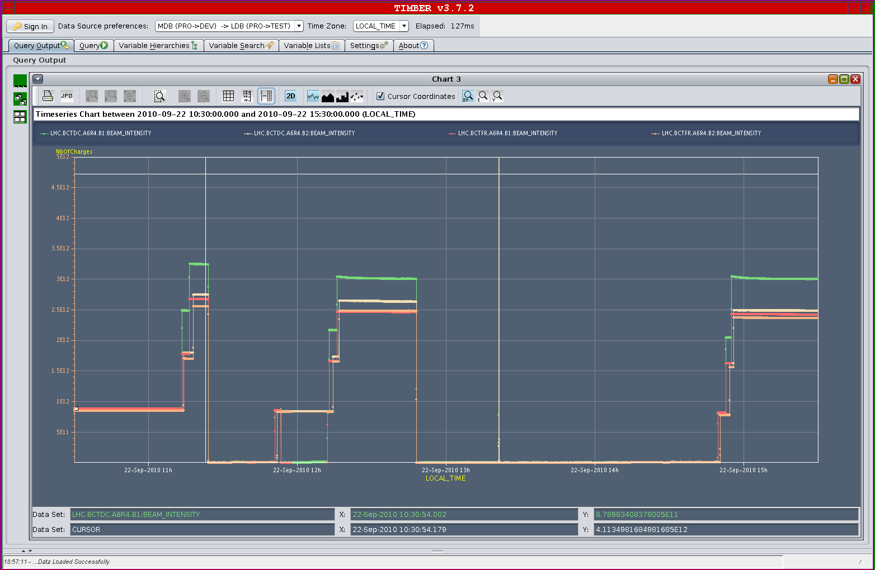
Injection and Ramp
Problem with DC-BCT B1 appearing as a result of the filling pattern generating noise ➔ expert investigating

Slide 4
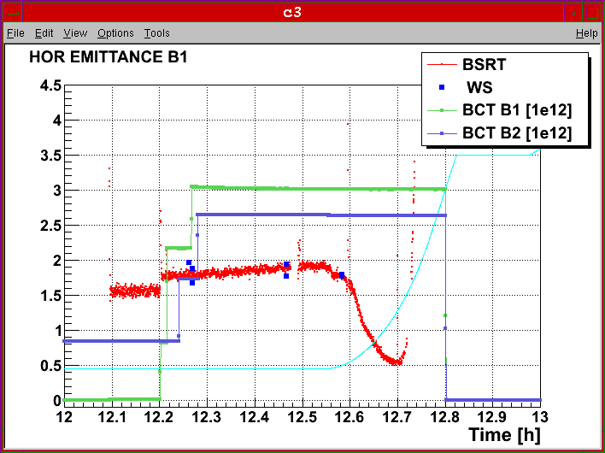
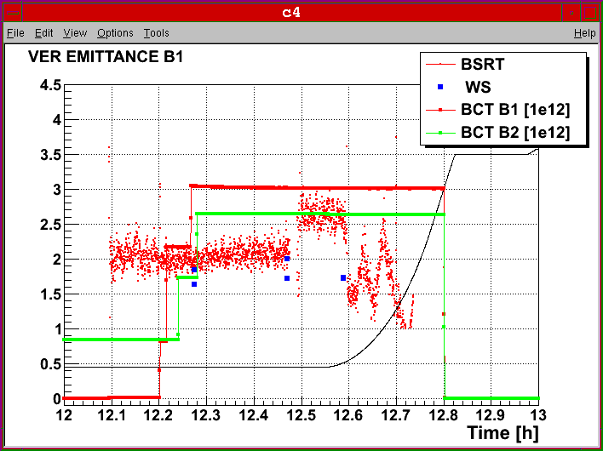
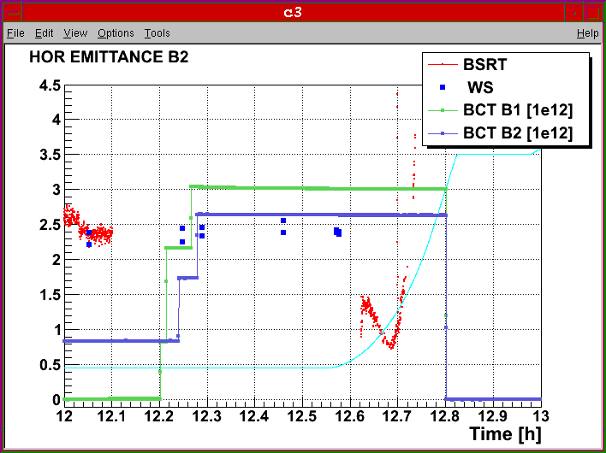
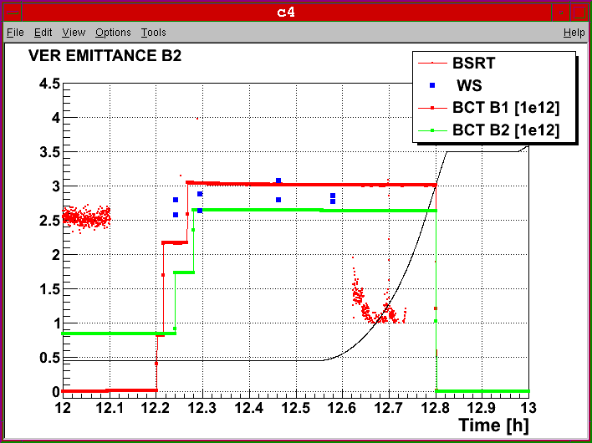
Injection and ramp (1)
High gain of the damper at injection. Very small emittances from SPS
F. Roncarolo

Slide 5
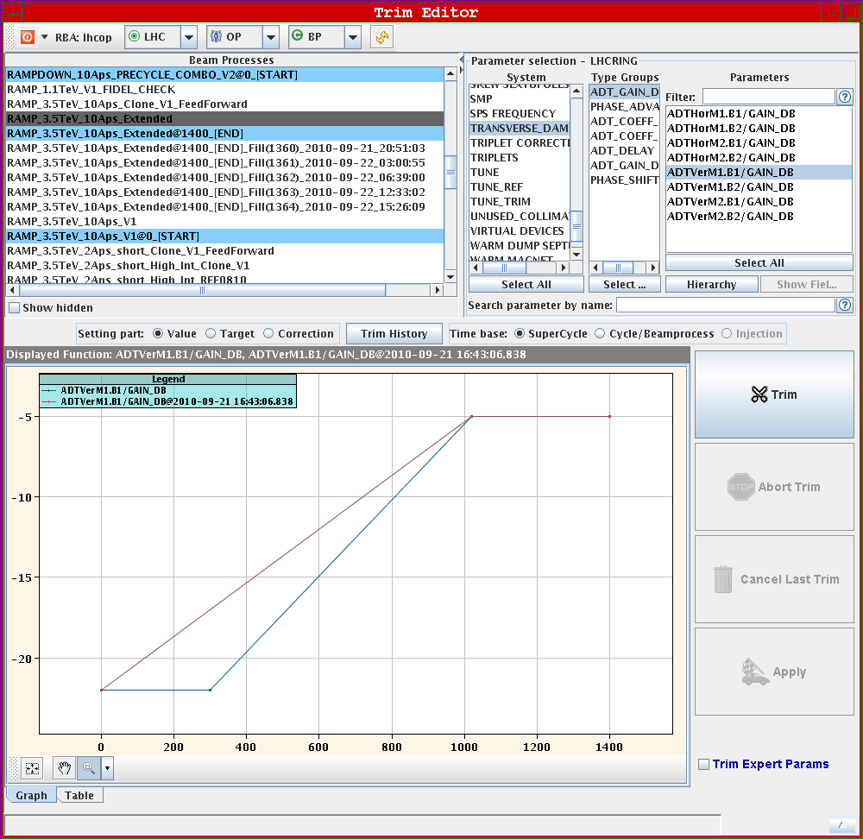
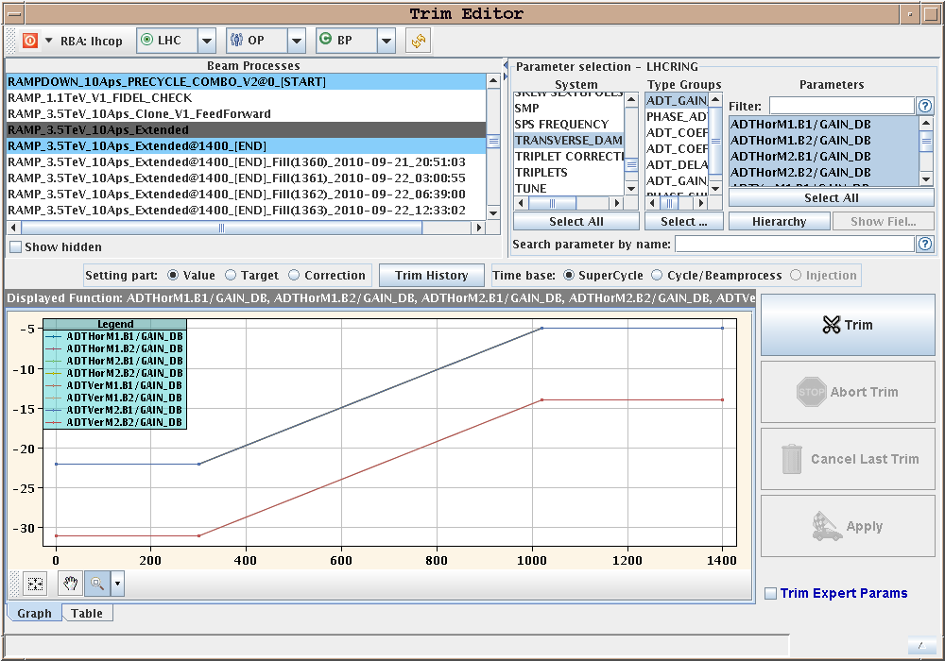
Injection and Ramp
A bit rocky at the beginning of the ramp ➔ B2V damper gain too high for the tune feedback to track (several stops)➔ reduced gain by -3 dB + changed the functions ➔ will be further improved by having a momentum dependent trim

Slide 6
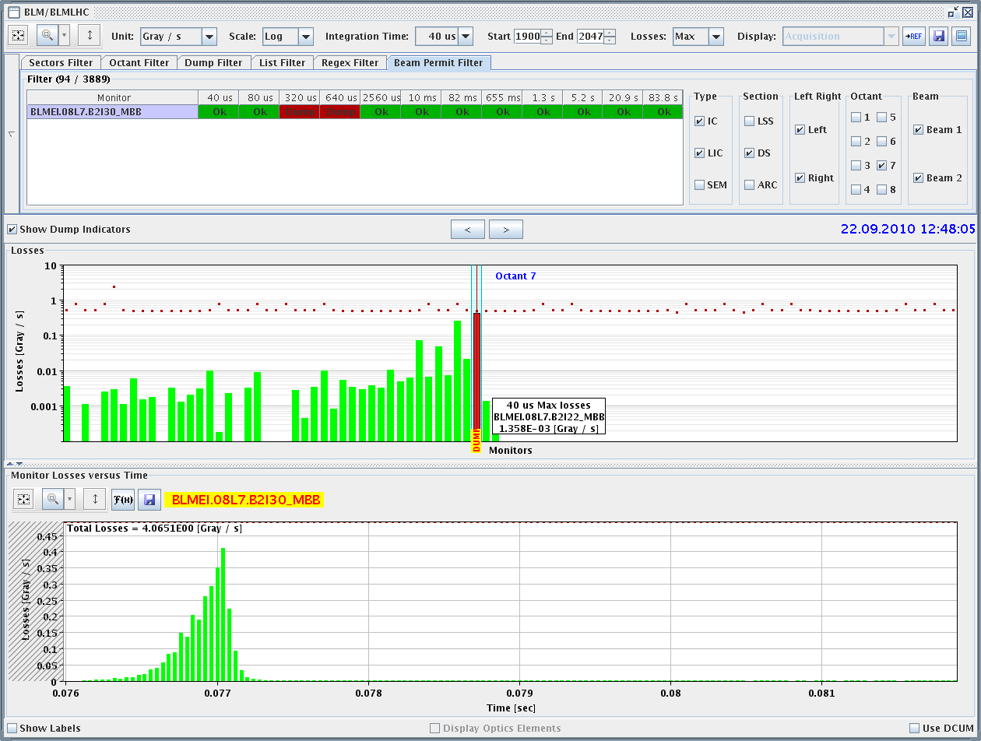
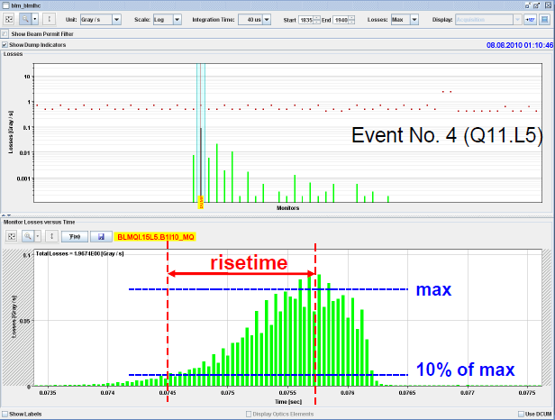
Fast loss
Fast loss event type (8L7). Faster rise time as compared to previous events. Same position as first fast loss event (07-07-2010 20:22:19 during the squeeze).
Yesterday
25 bunches – 8/8/2010

Slide 7
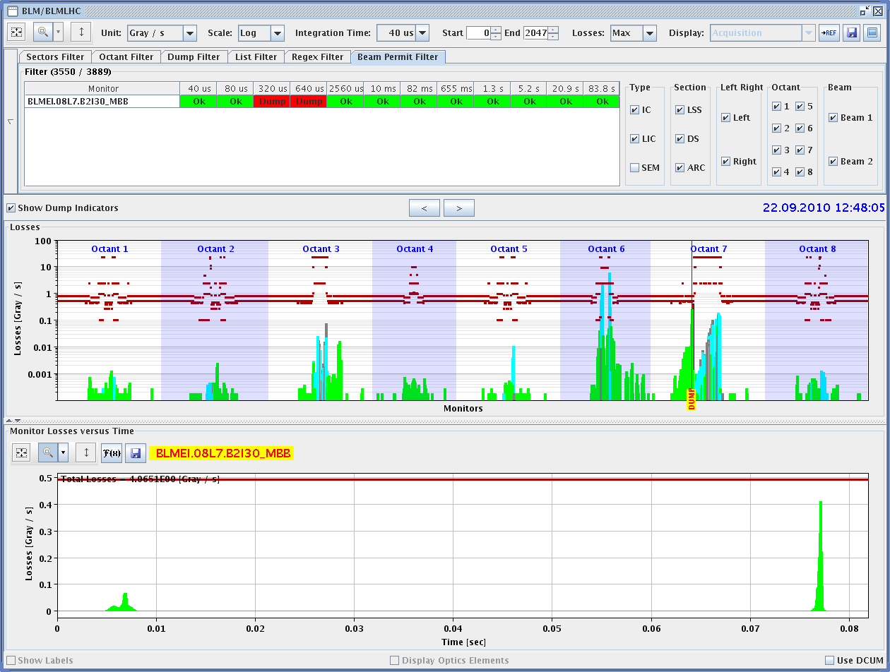
Fast loss
One pre-cursor (in July 5 pre-cursors spaced by 80 ms)

Slide 8
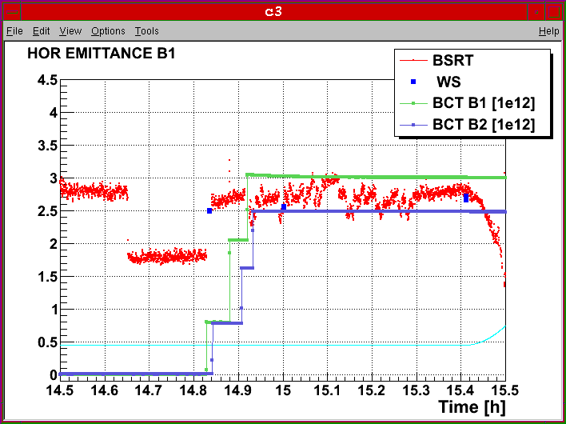
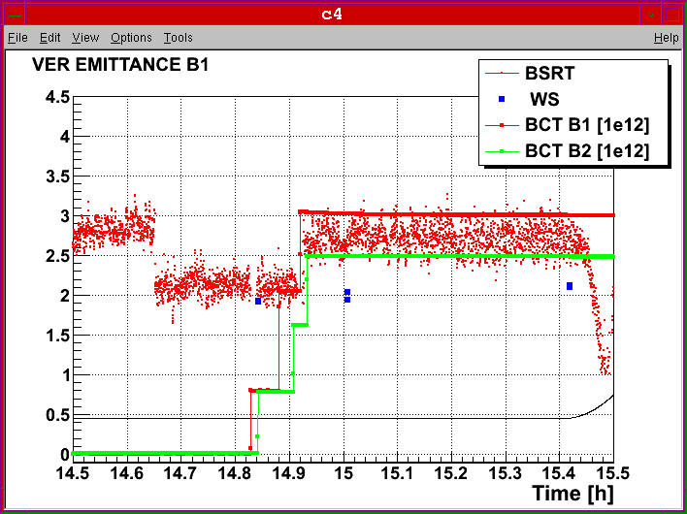
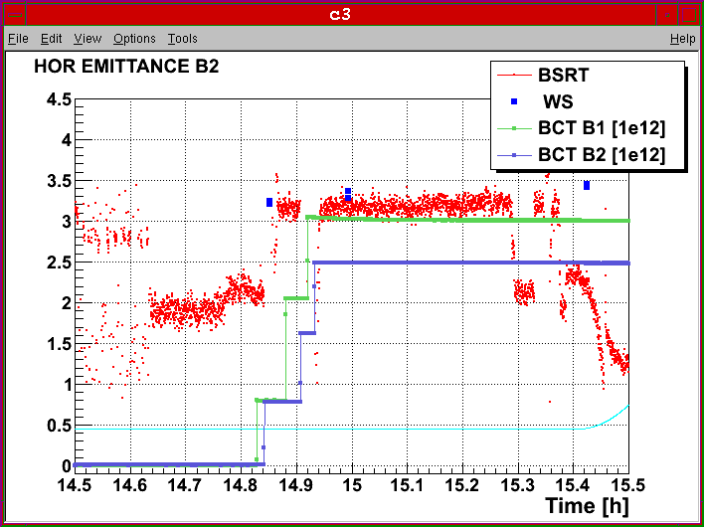
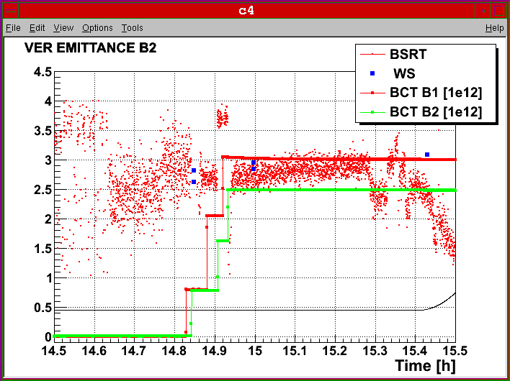
Injection and ramp (2)
Emittances at low energy. Blow-up increased in the SPS - Had to stay a bit longer at injection due to problem to load collimator function
F. Roncarolo

Slide 9
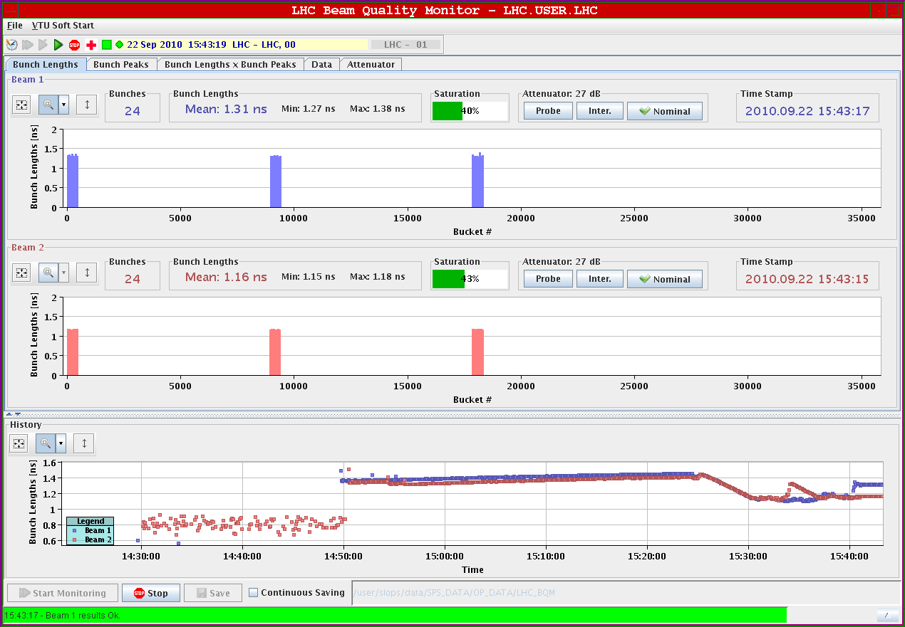
Injection and ramp (2)
Longitudinal blow-up leading to differnt bunch lengths for Beam 1 and Beam 2 ➔ function to be optimized ➔ P. Baudrenghien

Slide 10
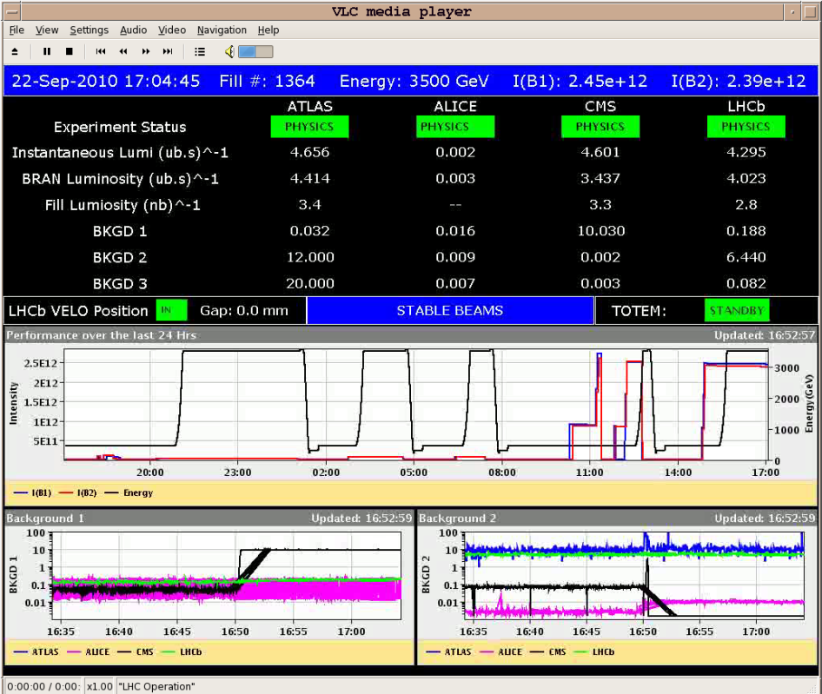
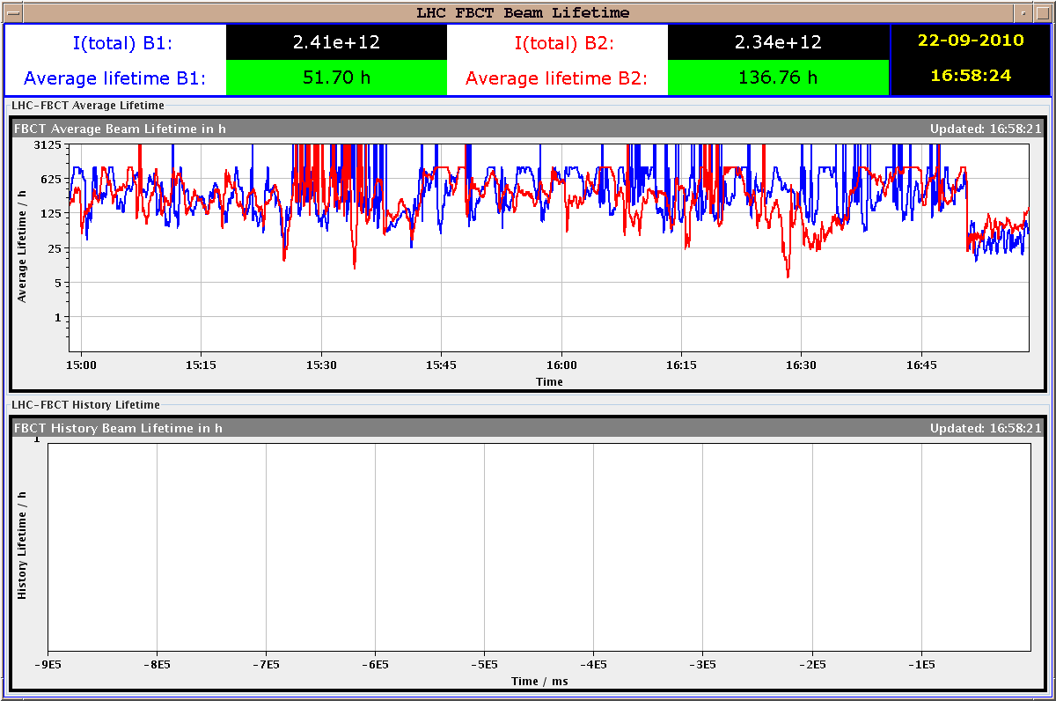
Stable beams
Initial luminosities (up to 4.6 x 10³⁰ cm⁻² s⁻¹) compatible with ε*~3.2 μm.
Very good lifetime when going in collision

Slide 11
Stable beams 1364
Low initial losses, lower than equivalent 25 bunch run although the number of max. head on collision is the same and on top we have long range
  IPs: 1 5 8 - 1 5 2 - 2 8
G. Papotti

Slide 12
Stable beams 1266
One of the coasts with lowest losses
  IPs: 1 5 2 - 1 5 8 - 2 8
G. Papotti

Slide 13
Stable beams
Possible reasons for the improvement:
  Beta beating correction
  Transverse damper pick-up with reduced noise (factor 2).
  More equal bunch intensities

Slide 14
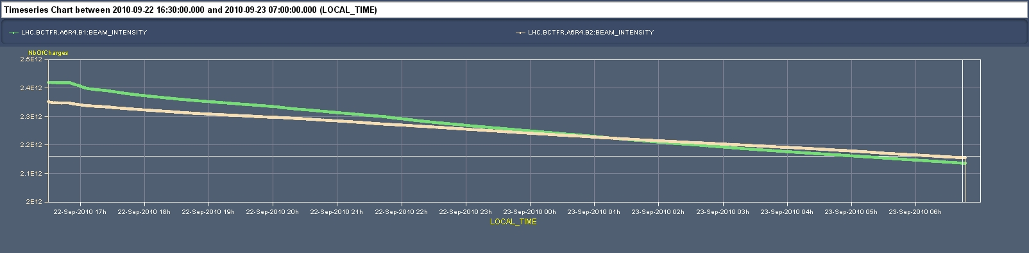
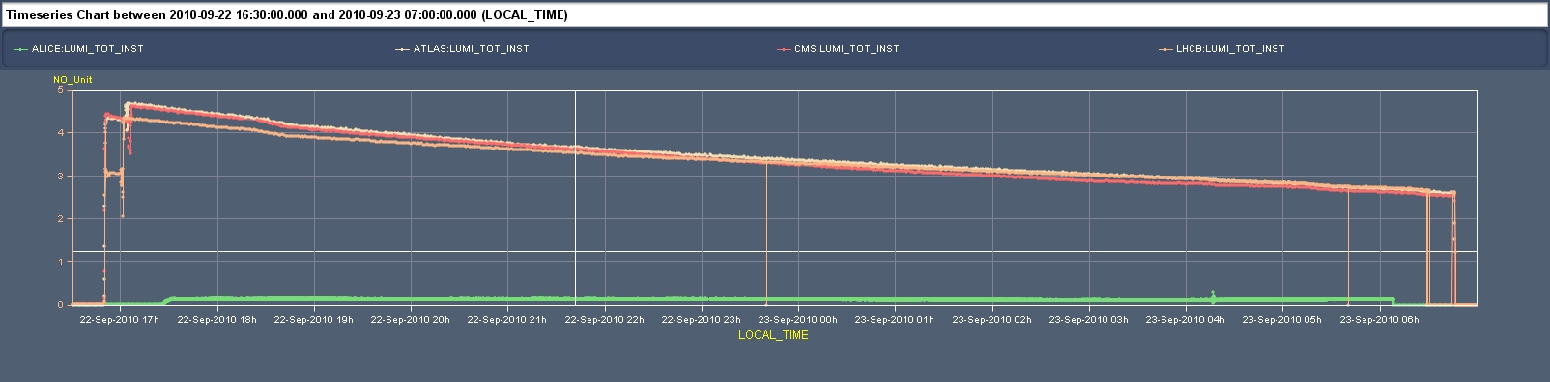
Stable beams
Luminosity reduction faster than I_{bunch}² reduction ➔ Blow-up (roughly ~40 %). Measured emittances at the end of the coast B1H 4.0 B1V 3.8 B2H 4.5 B2V 4.9 ➔ consistent with expectations

Slide 15
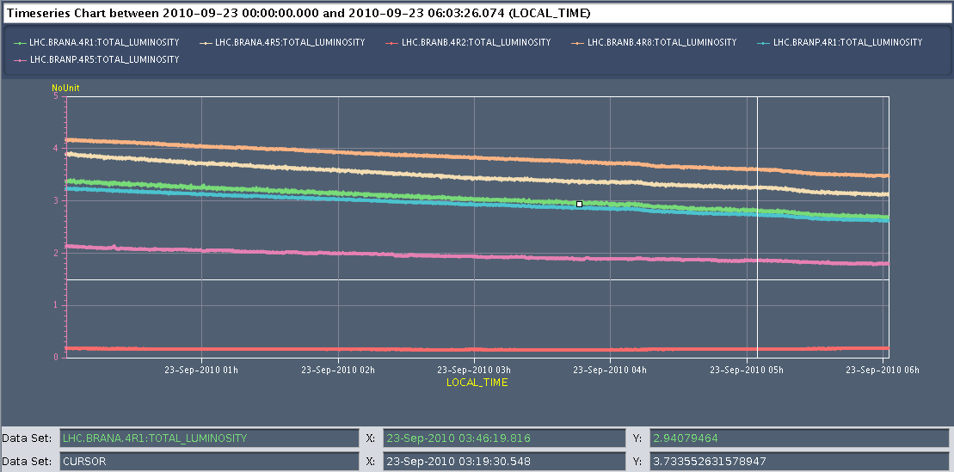
Stable beams
Test to increase damper gain in 2 steps (3 dB each) at 04:00 and 05:00 ➔ observed slight reduction of the luminosity in both occasions ➔ need to optimize (reduce the gain in collision)

Slide 16
Today
Access for Quench Heater Power Supply in Sector 45
Physics fill with 56 bunches (7 x 8):
  150 ns_56_47_16_47
  B1 B2
  1 1
  3801 3801
  8941 8881
  12741 12711
  17821 17821
  21651 21651
  26701 26701
Another fill with 56 bunches over night
If OK try to go to 96 bunches tomorrow during day time

Slide 17
To fit in later
Transverse damper firmware update (to prevent glitches positions very close to 0) – W. Höfle
Test of luminosity optimization software - S. White
Gas Ionization Profile Monitor tests - M. Sapinski
Abort gap cleaning – M. Meddahi
Test of new beam presence flag system – M. Gasior

