Slide 1
Tuesday
09-16 TOTEM and transverse loss map (1) OK
16-20 Setting up operational cycle for physics run
ADT gains
Collimator sequences
Automatic change of BPM sensitivity
20-01 Pilot run through ‘new’ operational cycle
Fat pilots
Chromaticity measurement after first iteration of chromaticity feed-forward
Beta measurements at 3.5m (to check IR8)
Loss map off momentum end of squeeze separated (low priority – done with low intensity)
Overnight Completion of qualification runs
Asynch dump end of squeeze separated
Loss map off momentum end of ramp reduced Xing (3)

Slide 2
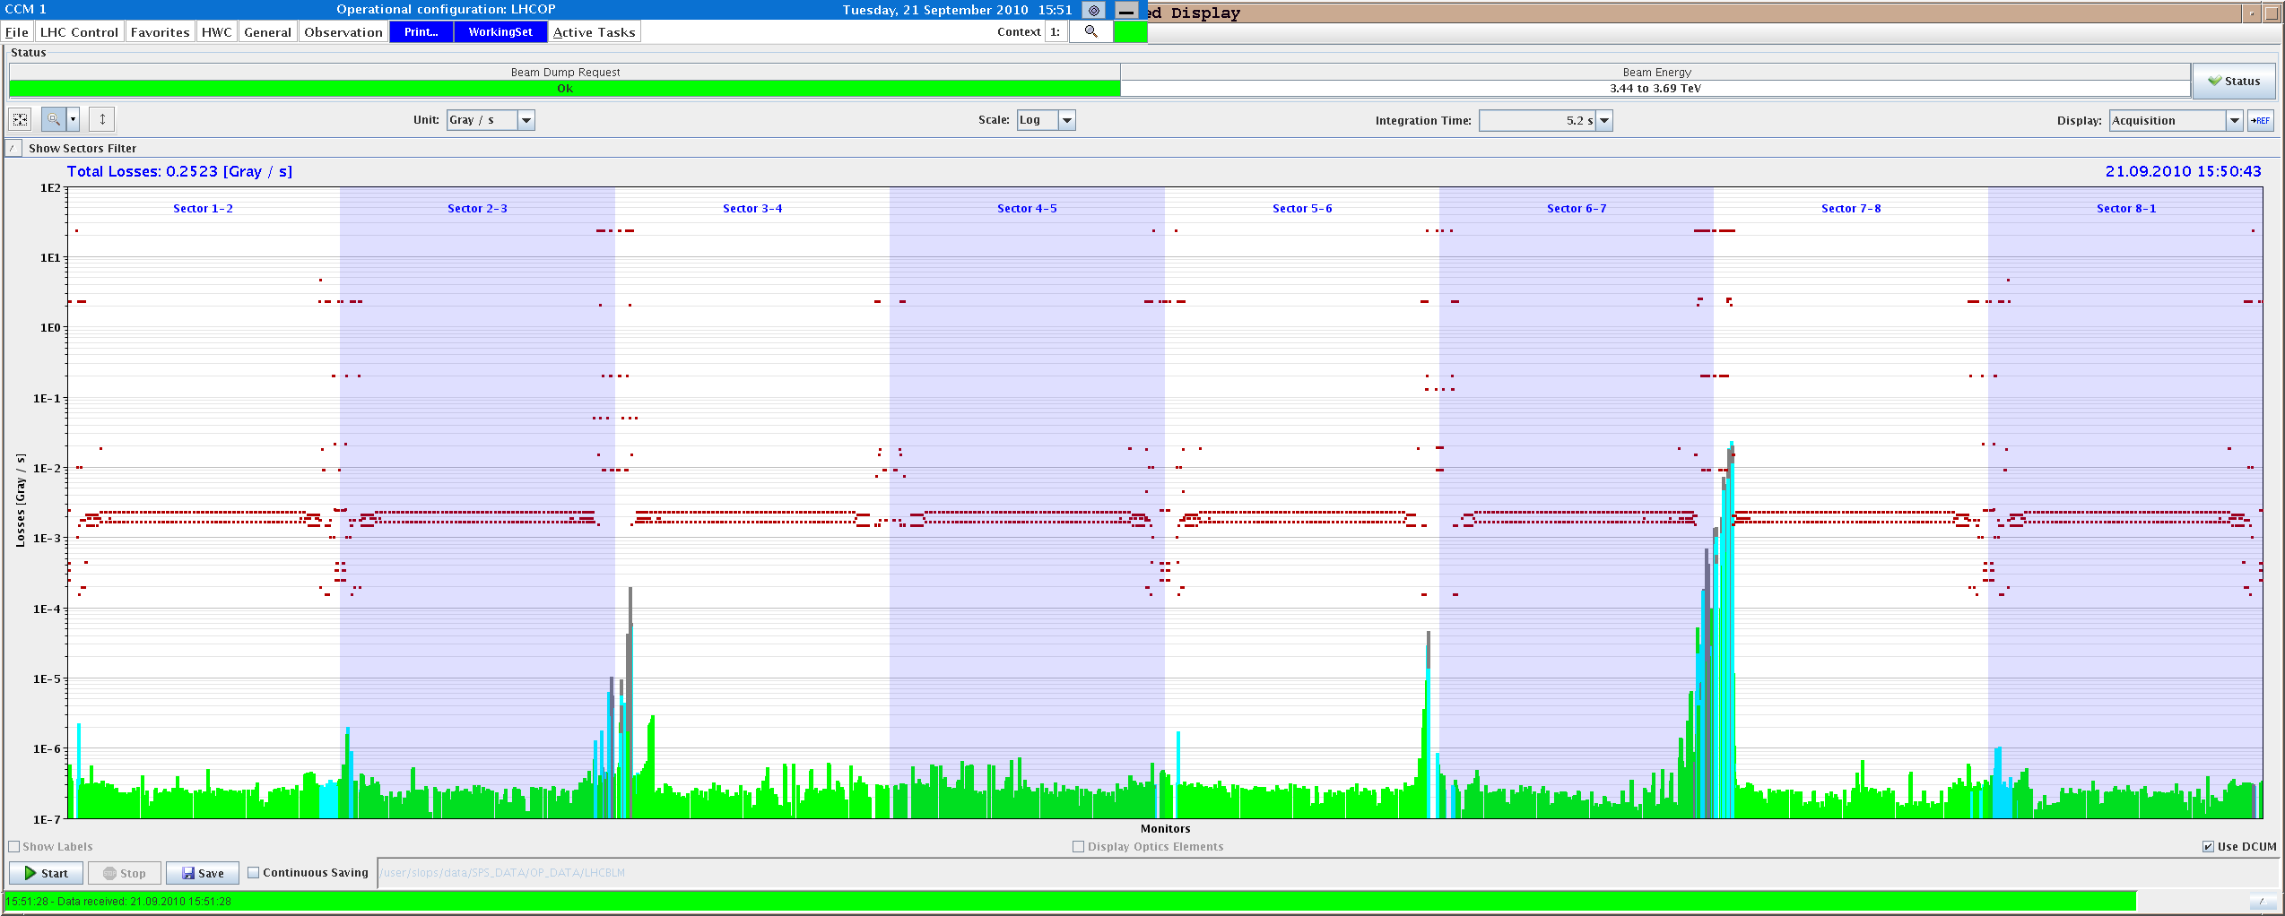
TOTEM and transverse loss maps
B2H
B2V

Slide 3
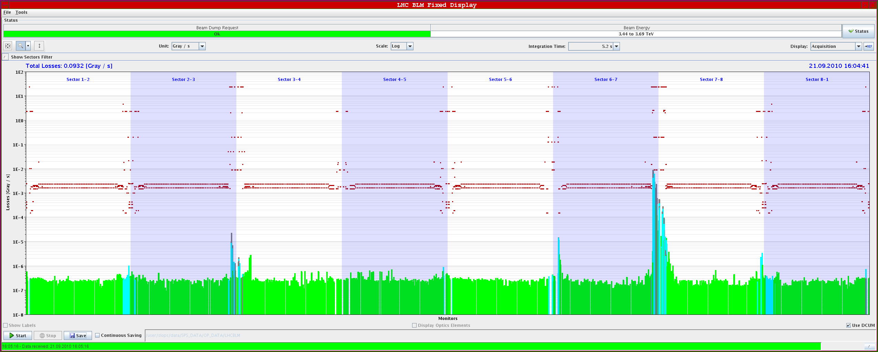
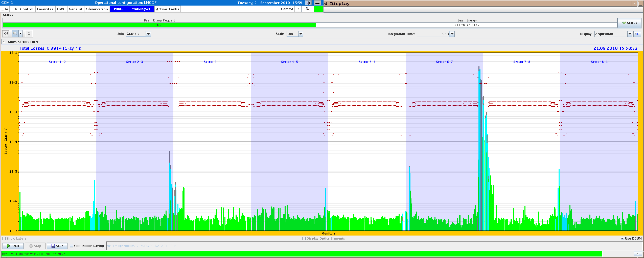
TOTEM and transverse loss maps
B1H
B1V

Slide 4
TOTEM and transverse loss maps
Summary of TOTEM setup (S. Redaelli,D. Wollmann+M. Deile):
We performed the beam based setup of all the Roman pots of TOTEM in physics conditions (3.5 TeV, squeezed beams, separation OFF, nominal Xing angle). This worked well.
We established operational settings with V pots at 18 sigmas and H pots at 20 sigmas. They are imported in the functions of the PHYSICS beam process.
We performed loss maps for both beams in collision conditions. Loss maps look good (to be confirmed by detailed analysis): all triplets protected by the TCTs, no losses seen at the XRPs in the physics conditions, collimation hierarchy around the ring respected for "slow" losses.
These loss maps validate fully the collision conditions because they also covered the B2-H loss maps case (last missing case from collimation requirements in collision conditions).

Slide 5
Setting up operational cycle
Injection and ramp settings for the ADT gains to test new settings
Tested collimation sequences for squeeze and collision
One sequence for discrete change of TCT collimator positions to shift them around the new centres after the Xing angle change from 170 to 100/110
One sequence for discrete change of TCT collimator positions to close their gaps to the beta* = 3.5 m settings at the stopping point
New tasks into the PREPARE COLLISION sequence to drive TCT collimators by functions to shift their centres while the separation is being changed
Check the automatic change of BPM gain and est of synchronous BPM mode
Tests not fully conclusive ➔ to be continued by experts

Slide 6
Pilot ramp
Damper functions at injection-ramp
damper gain
450 GeV (-6 dB B1HV / -12 dB B2V)
3.5 TeV on (-5 dB B1HV / -11 dB B2V)
maintain damping time
in ramp (exact function
to be calculated)
Max. gain for hump dumping
Q-FB on (-22 dB B1HV / -28 dB B2V)
cycle time

Slide 7
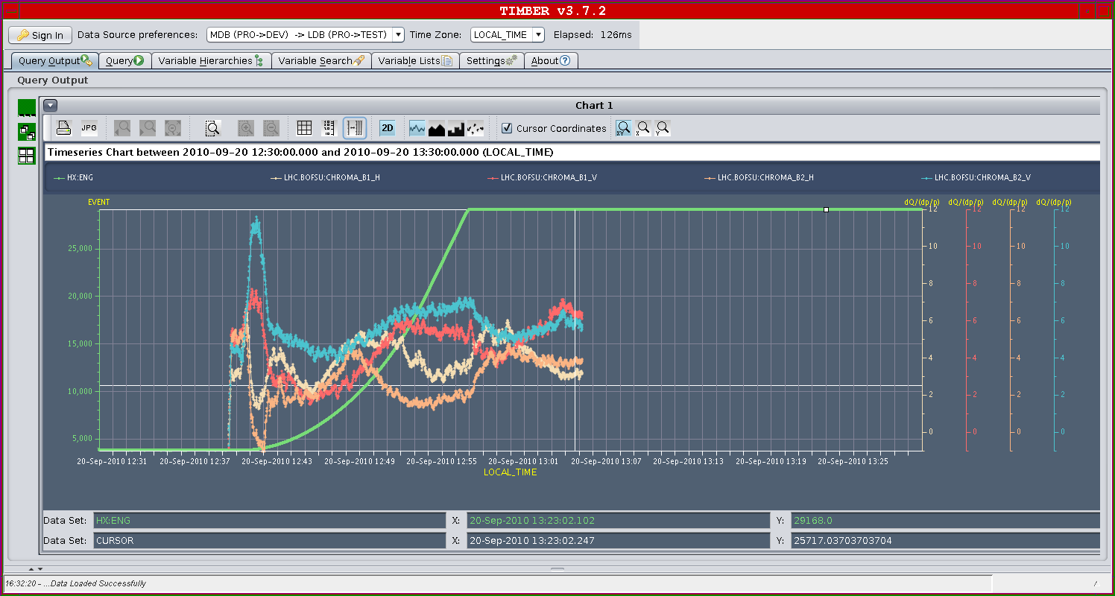
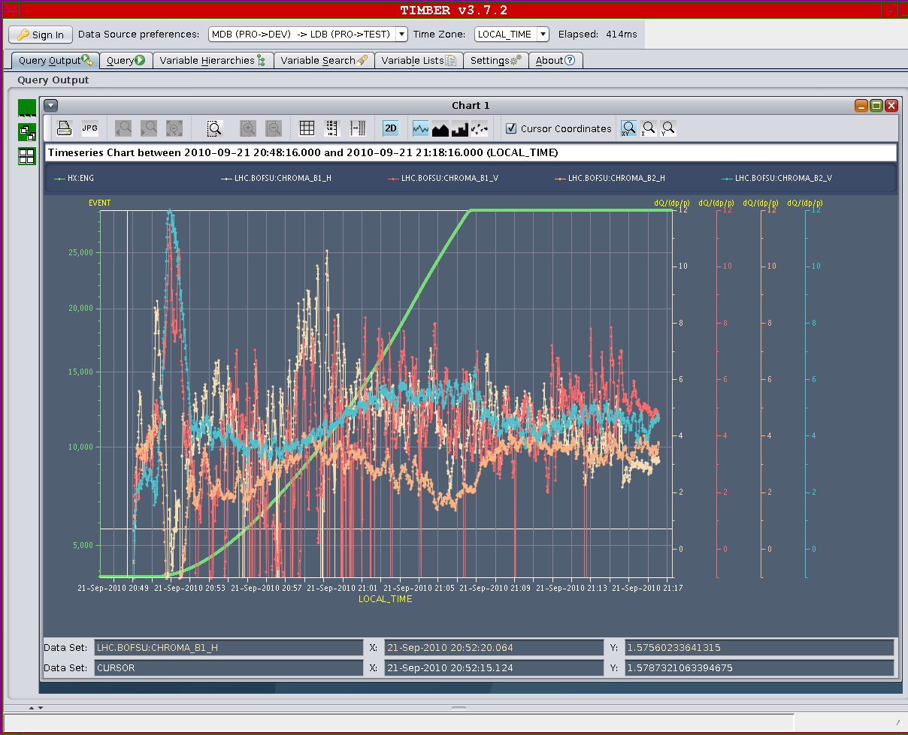
Pilot ramp
Collimator functions OK
Chromaticity feedforward (20 % of correction applied)

Slide 8
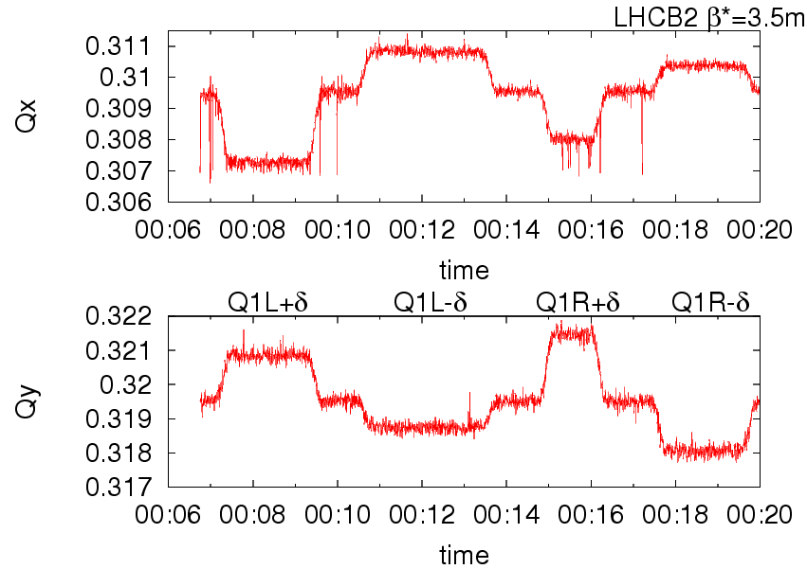
K-modulation
K-modulation. It is striking that the tune shift for +delta is considerably different than the tune shift for -delta. The Q1 magnet cannot be responsible for the asymmetry +/- because the measurement is in good shape for beam1. The last possible explanation is coupling. To avoid a systematic error from coupling only the deltaK that moves the tunes a part should be used in the computation of beta*. This gives: IP8 betax*= 3.5 +/- 0.2 IP8 betay*= 4.0 +/- 0.2 In much better agreement with the AC dipole measurements (bx*=3.3+/-0.1 and by*=3.5+/-0.1). Had we realized this with beam we would have performed more accurate measurements.
R. Tomas et al.

Slide 9
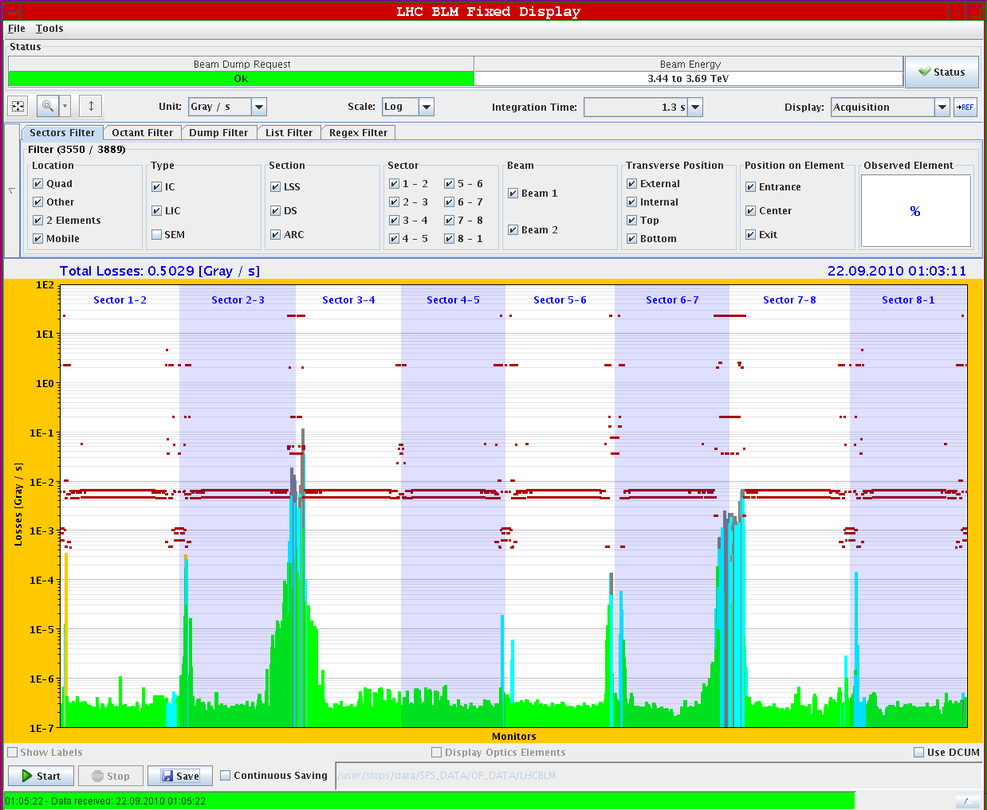
Loss map off-momentum
Low intensity

Slide 10
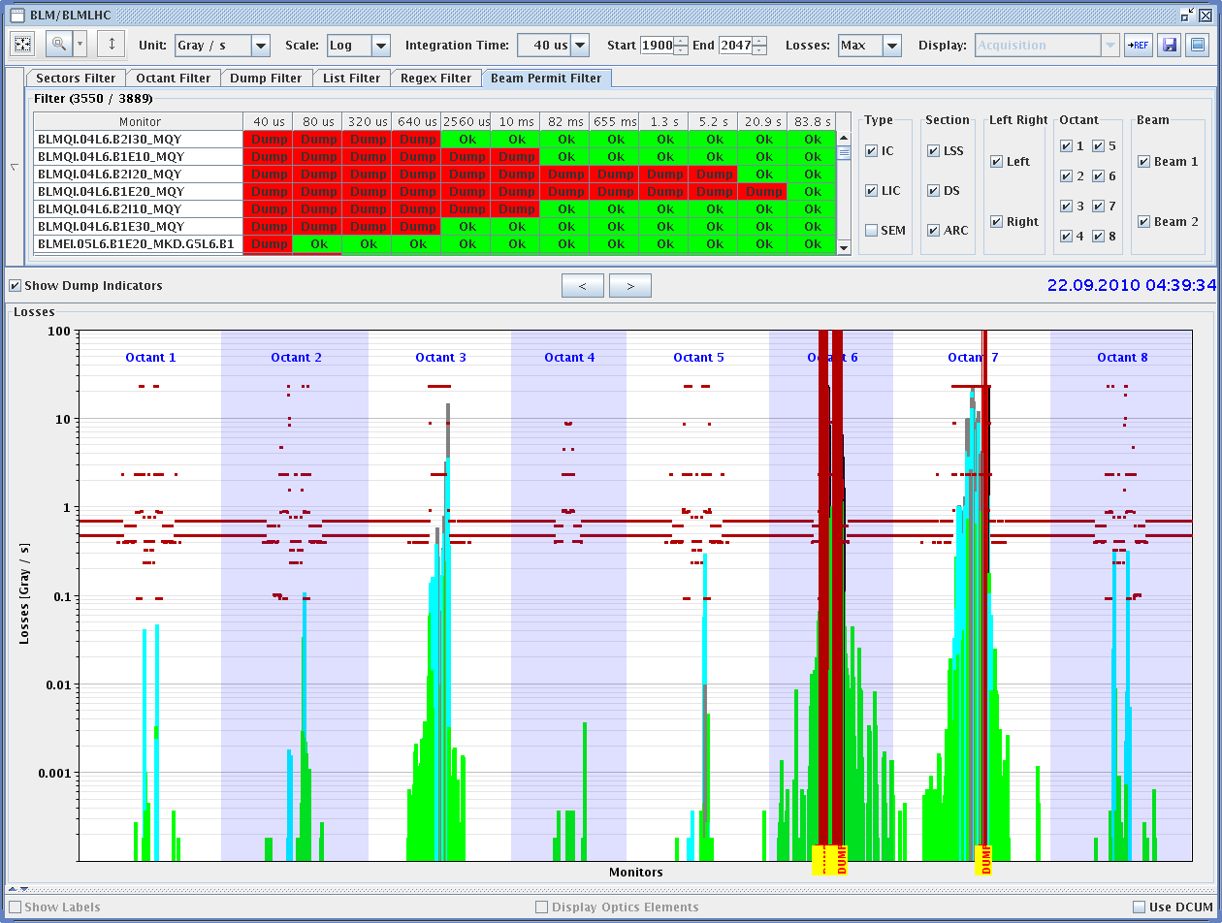
Last asynchronous dump
3.5 TeV, End of Squeeze: 3.5 m β*, 110/100 urad Xing, separated

Slide 11
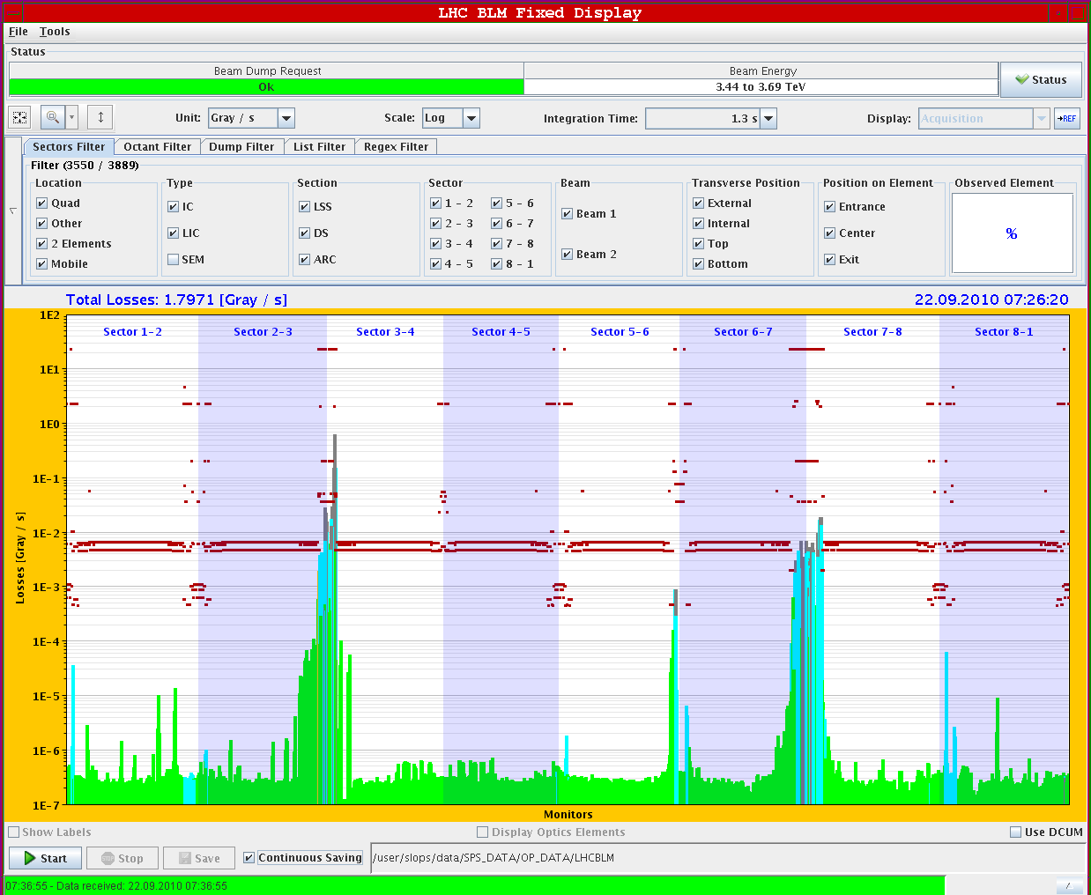
Last loss map
3.5 TeV, Unsqueezed110/100 urad Xing, separated, off momentum

Slide 12
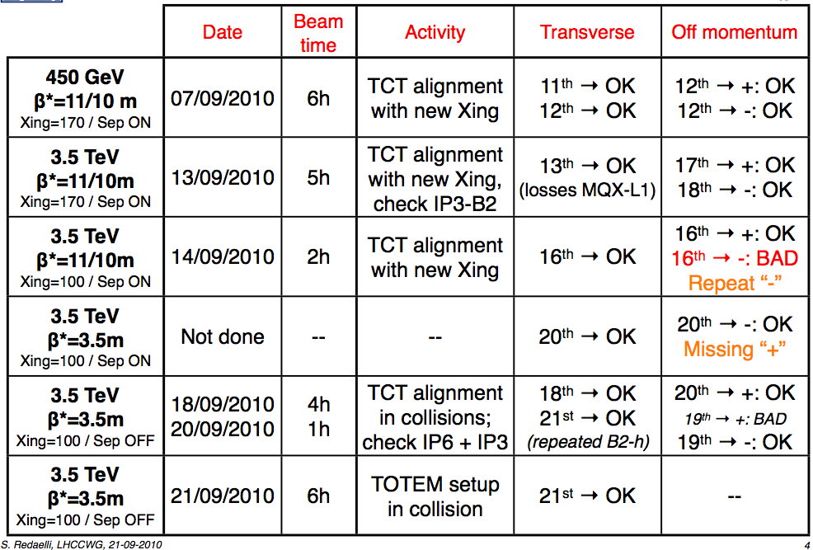
MP qualification status
All asynch dump tests completed. Last loss map ongoing
Done
Done – low int.
S. Redaelli

Slide 13
Today
Interlocked BPM test at 450 GeV (1/2 hour)
Should be ready to go for stable beams 24 on 24 (3 x 8)
B1 B2
1 1
8941 8911
17851 17851

Slide 14
To fit in later
Test of luminosity optimization software S. White
Gas Ionization Profile Monitor tests M. Sapinski

