Slide 1
Thursday 16.9
09:30 Off-momentum loss map fRF +1000 Hz
Test OK for B1, not OK for B2.
Traced to a difference between the injection and flat top orbit reference for B2 in IR3 (OK for all other planes/beams in IR3 and IR7).
Will modify the orbit at injection to have (as close as possible) identical references all along the cycle. If a setup would be nedeed, it is anyhow faster to redo injection.
10:30 Access
RCBCV9.R1B2 and RCBH28.L3B1 fixed.
QPS firmware not changed (near end of TI2/TI8).
Interlock BLM WBTN cards exchanged and all BPMs calibrated.
ATLAS patrol box lost.
Patrol box lost for PM25. Intervention by access team.

Slide 2
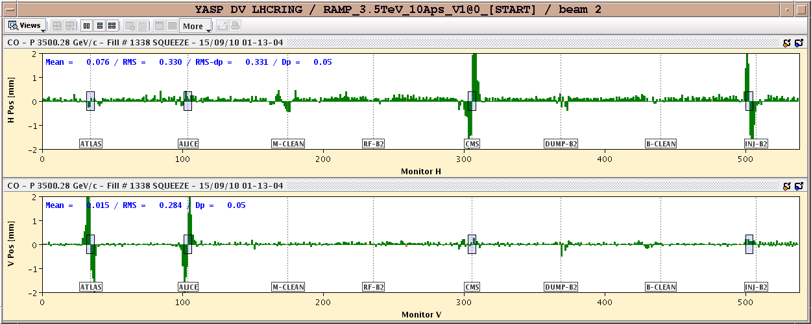
Orbit B2 : difference injection-flat top

Slide 3
Thursday 16.9
14:00 Powering interlock problem on RB.81
Problem somewhere between QPS, PIC and PC. All (super-)experts out of town…
20:00 problem solved by exchange of a ANY(PROFI)BUS interface.
PIC tests of RB.81 done.
20:45 Pre-cycle
22:30 Injection
PC problem (CV) on RCBXV2.L8 – access needed
23:30 Access Pt 8
Water flow increased.
04:50 Injection
Humpy ramp.
Off-momentum loss map 3.5 TeV 170 urad.
06:40 Ramp down

Slide 4
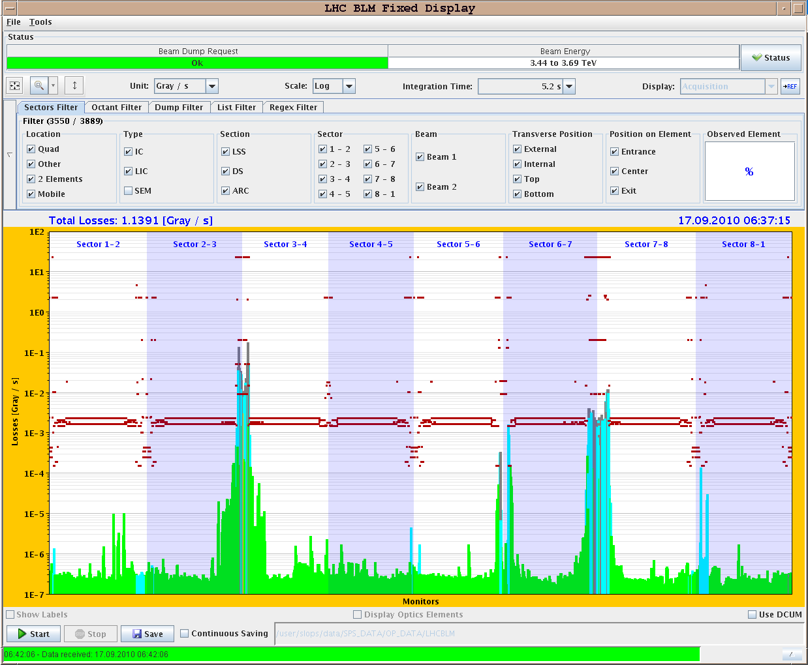
Off-momentum loss map

Slide 5
Today
Collimator setup for collisions and collision setup
Check squeeze (orbit, coupling) on the way.
Tuning of longitudinal blowup.
Setup of SIS interlock for TCDQ, orbit and CODs for stable beams.
Loss maps and asynchronous dump tests
We should finally feed-forward the Q and Q’ measurements taken along the ramp.

Slide 6
Outlook
Tue | M | 8 | Access system problem - recovery
Tue | A | 8 | Injection protection
Tue | N | 8 | Collimation set up at 3.5TeV
Wed | M | 8 | Squeeze and collision – sequence test
Wed | A | 8 | Injection qualification
Wed | N | 8 | Loss maps at 3.5TeV 100/110 urad no collisions
Thu | M | 8 | Access Collide with higher intensity, squeeze check
Thu | A | 8 | Collimator set-up at 3.5 TeV – separation off
Thu | N | 8 | Loss-maps
Fri | M | 8 | Collimator setup for collisions
Fri | A | 8 | Loss maps, asynch dump tests
Fri | N | 8 | Loss maps, asynch dump tests
 |  |  | Collimation integration into sequencer and tests
 |  |  | Ramp and squeeze bunch trains - collisions with 3 trains of 8
 |  |  | Quench test at 450 GeV

