Slide 1
Saturday 11.9
From Friday
Minimum required crossing angle is 100 μrad in 2010
Plenty of aperture at triplets: > 13 σ (n1 > 10)
Can stay with 170 μrad crossing angle at injection.
Only possible reason to change
simplify operational procedure:
same settings at injection and top energy
Subsequent decision
Stay with 170urad crossing angle at injection
This will then be valid for all bunch spacing in the future
Open tertiary collimators to 13 σ at injection (from 8.5 σ)
Set up procedures to handle Xing angle change through the cycle

Slide 2
Saturday 11.9
07.00 – 15.00 RF setting up (PB, AB, JW)
Pilot and LHC3 energy difference observed
Fixed by correcting LHC3 energy on SPS flat top (~0.1GeV)
Transfer line and injection look OK (experts to check)
With pilot bunches, the optimum frequencies were found for beam 1 and beam 2. They were found to be 22 Hz apart (~1.5e-4 in dp/p)
The frequency found for beam 2 (400.788865) was close to the previously used nominal value, and we used this as the reference for both beams
The energy of ring 1 was trimmed by -1.2e-4 using the orbit correctors to bring it in line with ring 2
The stable phase offset in the phase loop was also checked and adjusted for both beams

Slide 3
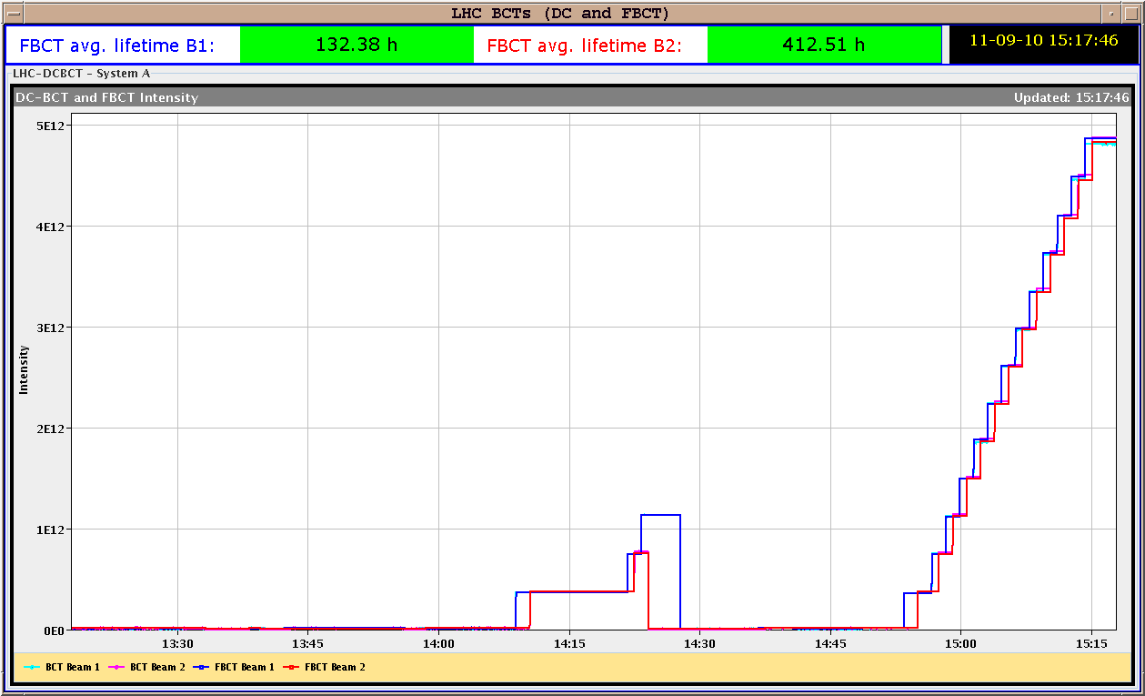
Saturday 11.9
RF setting up
Finally the complete injection sequence of 13x4 bunches per beam was executed and went smoothly with very little uncaptured beam

Slide 4
Saturday 11.9
New orbit references established on the way
New orbit references for injection and ramping were made ( and set as Golden) and are called: High Int: Ref. HIGH int. with IR3/6/7 steered to MAY ref (E-matched) Low Int: Ref. LOW int. with IR3/6/7 steered to MAY ref (E-matched)
When arriving on the FT with 170 urad Xing angles, one should correct back to those references.

Slide 5
Saturday 11.9
Access to fix 2 RCD circuits of S23.
15h00 – 23h00: Collimator ramp setting up (SR, RB)
dry ramp without beam for collimators
B2 interlock collimator TCSG.7L3.B2. Positions are all within limits
B1 interlock collimator TCLA.7R3.B1. Positions are all within limits
Recommendation from low level experts: fewer points for the ramp functions. Fixed issue → several collimator ramps without beam OK.
Also included a collimator TCLA.B5L3.B2 that had been disabled for operation and fixed in a technical stop.
15h00 – 23h00: Opening tertiary collimators to 13 σ:
Gaps increased for same beam center (no beam based calibration) from 8.5 to 13 σ.
Ramp functions and MP limits adapted accordingly.
23h00 – 07h00: Qualification:
Loss maps with nominal bunch at injection, with & without injection protection.
Test ramp with collimators and beam
7h00: TCLA.B5L3.B2 (back in use since last evening) does not move one jaw (it is at parking). Most likely same problem as before: driver! Was not really fixed.

Slide 6
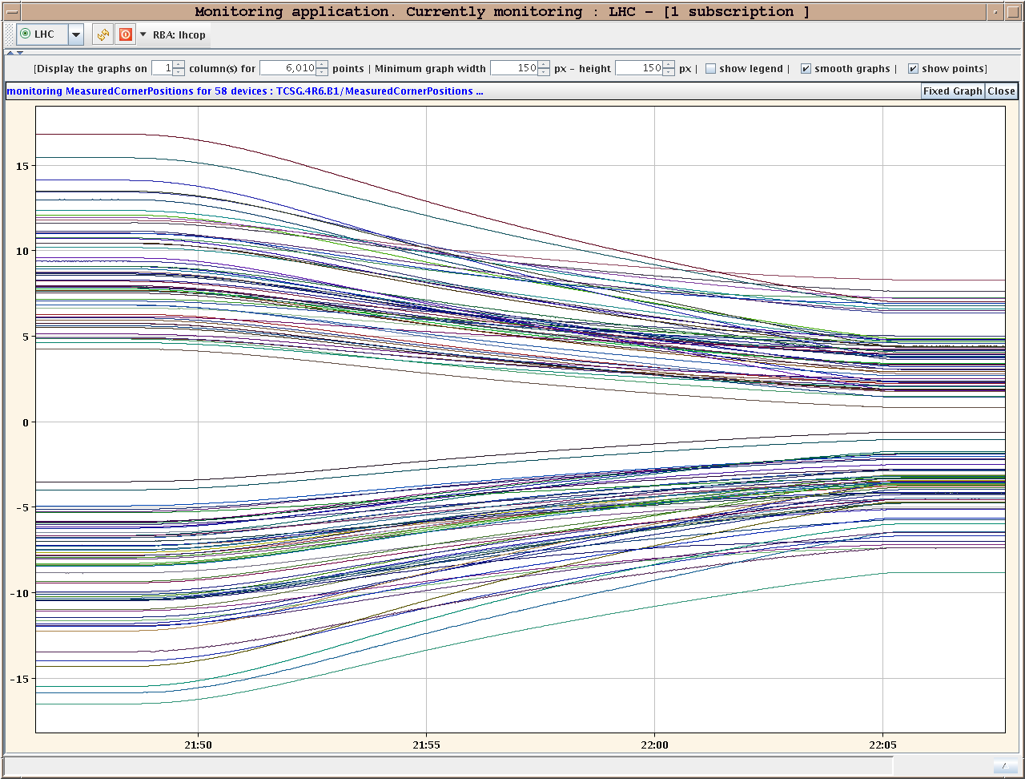
Collimators Ramp w/o Beam

Slide 7
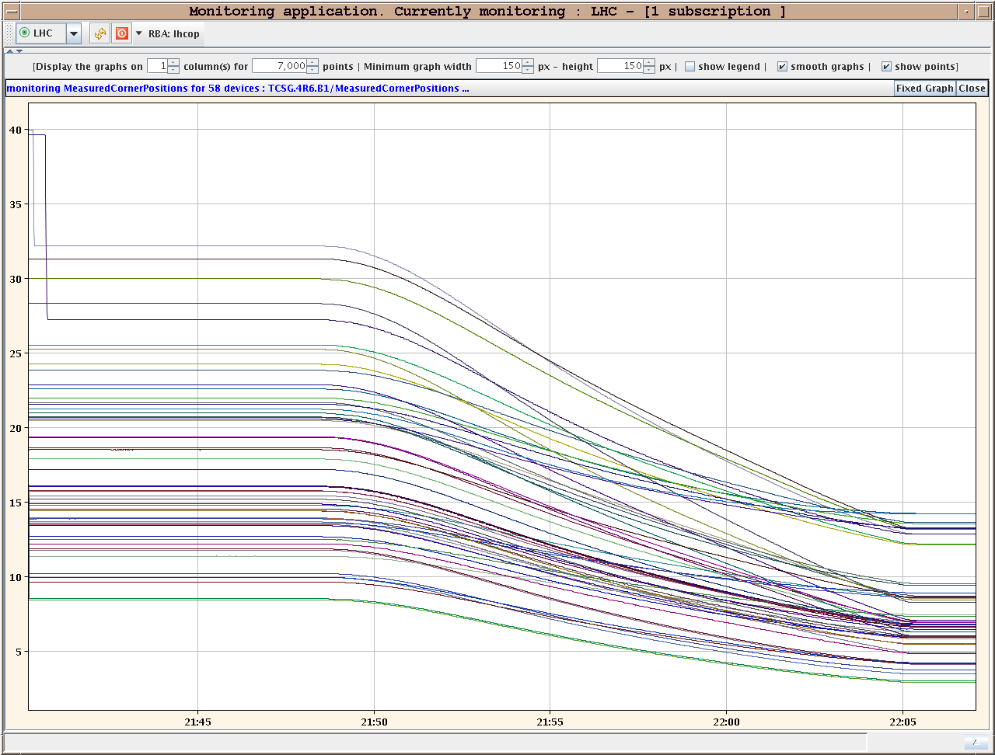
Collimators Ramp w/o Beam

Slide 8
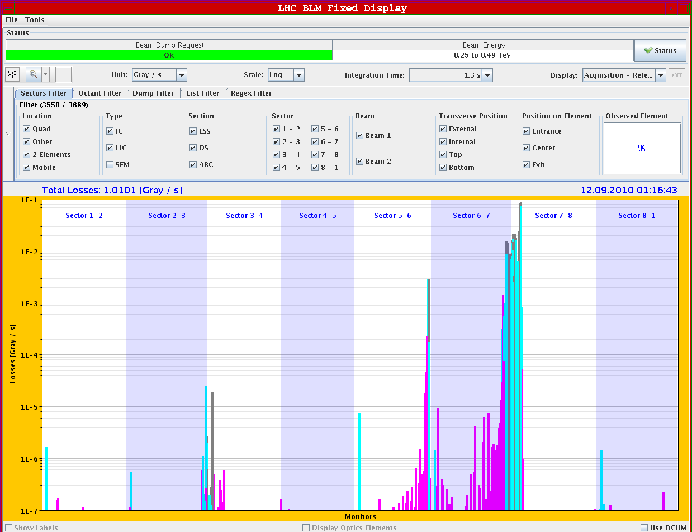
Loss Map B2 H

Slide 9
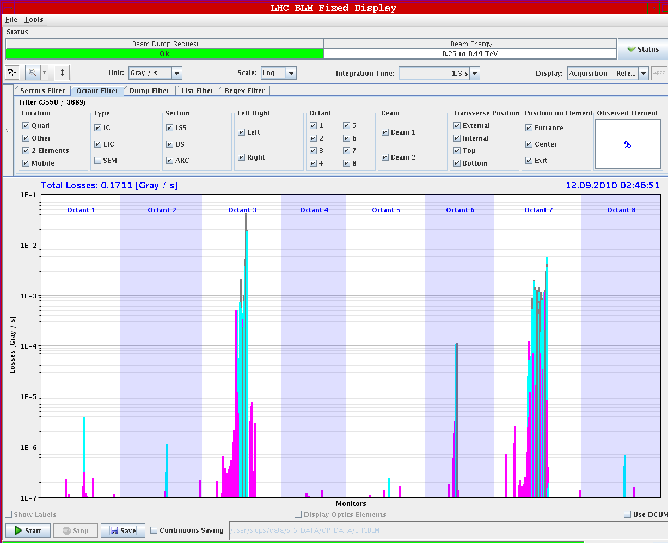
Loss Map Pos. Energy B2

Slide 10
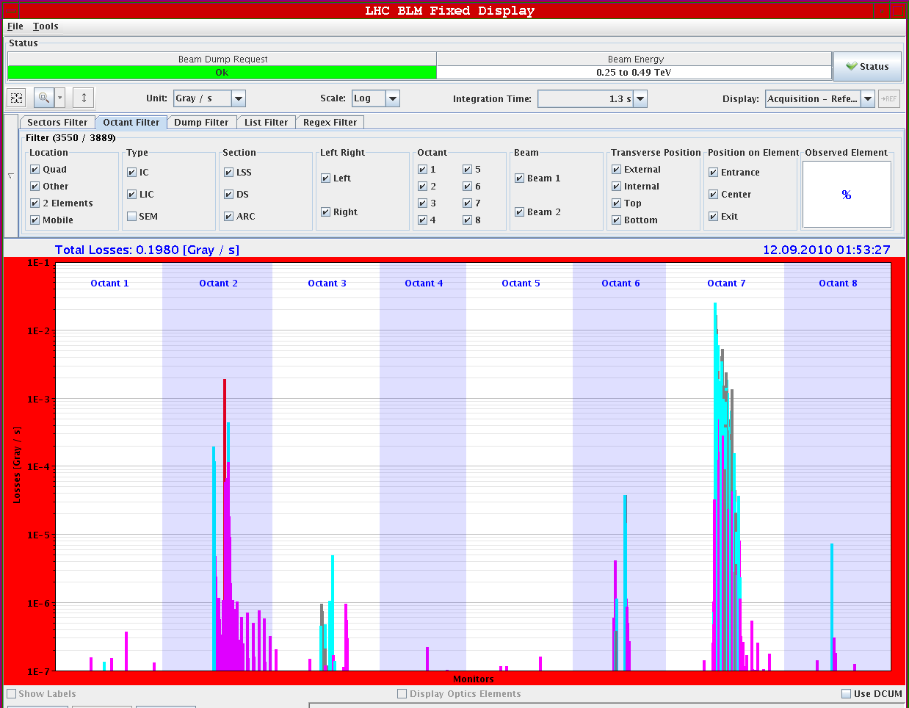
Loss Map B1 V with Inj. Prot.

Slide 11
Loss Map Conclusion
Looks all fine…
No losses seen in triplets, very low losses in tertiary collimators.
No significant losses in SC magnets.
Confirms measured large aperture!
To be done: Asynchronous dump test (B. Goddard et al)

Slide 12
Test Ramp Pilot with Collimators (LP)
Collimator functions worked fine.
No beam losses with collimators moving in during ramp.
Some issues with beam processes:
First, the collimators function did not load, again because of the MCS signatures not being copied. We managed to load them by rolling back the ramp to the old one and we played the new ramp for RF and PCs.
We then had to stop after trying to load the squeeze because the LHC.USER.FLAT-TOP was still attached to the actual END BP of the old ramp.
So we regenerated the end BP of a ramp that we did not play and trimmed the IP crossing, chromaticity and coupling on this wrong beam process. So we decided not to go-on and dumped the beams.

Slide 13
Not to forget
To fit in before we ramp nominal bunch (Sunday ?)
RF longitudinal blowup. V reduction at injection.
Transverse feedback setting up to be finished ?
The present tune-fitter settings are optimised for single bunch intensities below 5e10. Need Ralph before ramping with nominal beam
I need to change the settings and validate them for the new damper settings beforehand.
Please put pretty Q'(t) pictures in the logbook…
We removed RCBH28.L3B1 from the hardware groups SECTOR23
No beam from injectors Monday 07.30 to 09.30
Problems with polarity switching of ALICE solenoid (until next TS)
No remote switching
Plan polarity switches during working hours
Pass by the piquet EPC (16-1919)

Slide 14
Ahead
7h00 – 9h30: Sort out collimator problem. Remove TCLA.B5L3.B2 from operation, most likely.
9h30: Test ramps with beam.
15h00: Collimator set up at 3.5 TeV.
23h00: Loss maps (if collimation setup ready for one point) otherwise ramp & optics at 3.5 TeV.
07h00: Transfer line qualification.

