Slide 1
Technical Stop #6 30th – 31st August, 1st – 2nd September 2010 DAY3: WEDNESDAY 1st
Julie Coupard
Schedule and Coordination

Slide 2
Day 2
Change of the ion pumps
Complete, leak detection ok
The mobile shielding is closed
RP survey
- LSS7: Veto removed
EN/CV
Good advancement according to S Deleval

Slide 3
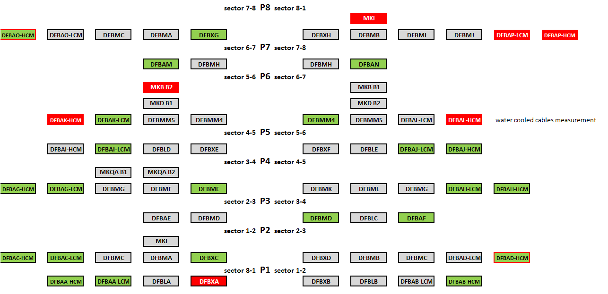
Day 2
Electrical locking-out/Unlocking

Slide 4
Day 3
Start tests from this evening
Access constraint
Lift maintenance
PX24, PM25 6:00-8:00
PM18, PZ33 8:00-10:00
PAD maintenance
UJ14: access through the MAD is possible if the people need to go in the sector 1L
Patrols
Point 7 12:45
Lose of the patrol due to problem with the safety handle of the door
Point 6 12h45 – tunnel areas (arc56+LSS6+arc67)
17:00 (or earlier if possible) – service areas
Point 1 17:00 (or earlier if possible) – arc81
Thanks to volunteers (~21; TE/VSC, BE/BI, TE/MSC, EN/MEF)

