Slide 1
Summary Tuesday 24.8.
06h23: Machine closed. Precycle started.
07h47: Problem with QPS OK on RB.A67 (worldFIP problem on the RB/RQD/RQF). Access for repair. Water problem with transverse damper. Access to P4. New transverse damper firmware for nominal bunch intensity (saturation problem).
11h05: Recovery from access. Trips of RSF2.A56B1 and RQTL8.L3B1. RF power: crowbar alarm on module 6B2 and 7B2.
13h02: Maintenance injetion lines (steering). Losses reduced by factor 2-3.
13h30: Injection into LHC. Injection phase +12 Hz on both beams. New injection scheme used: “1000ns_50b_35_14_35”.
15h39: Ramp started. Fill 1301.
17h35: Stable beams.

Slide 2
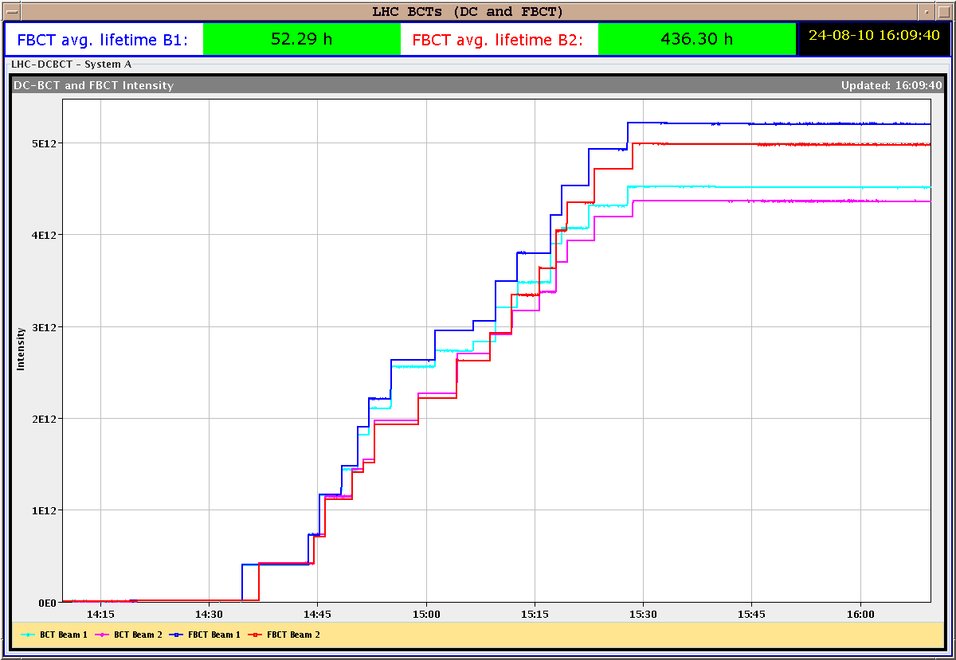
New filling scheme
BI: Discrepancy between FBCT and BCT is not real: saturation problem.
To be fixed.

Slide 3
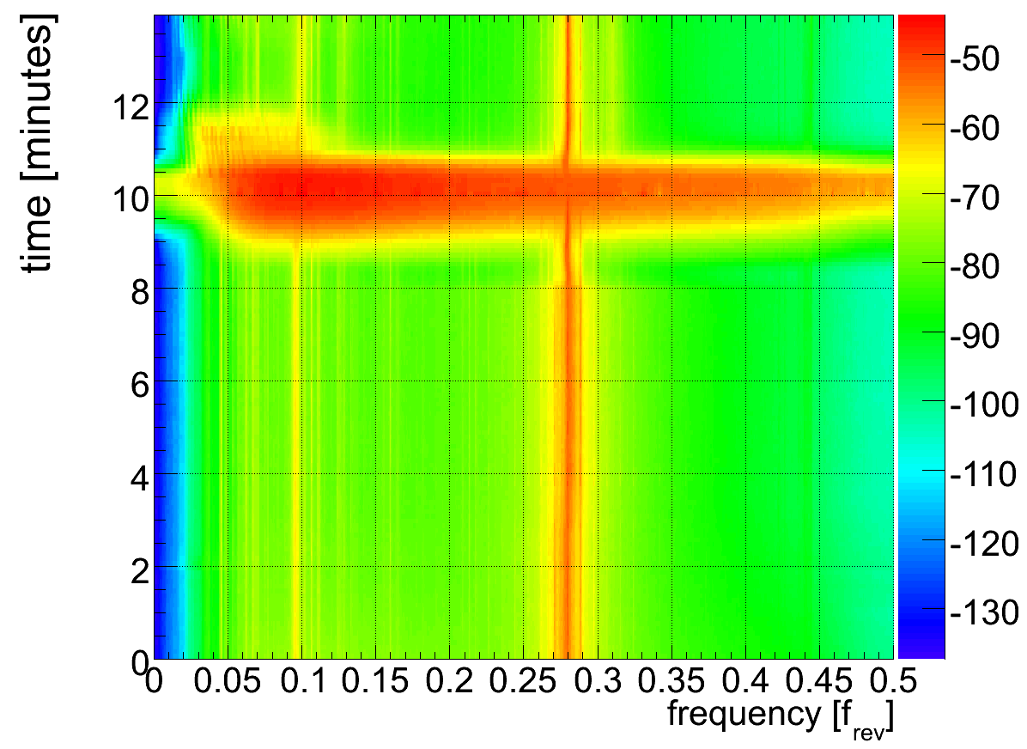
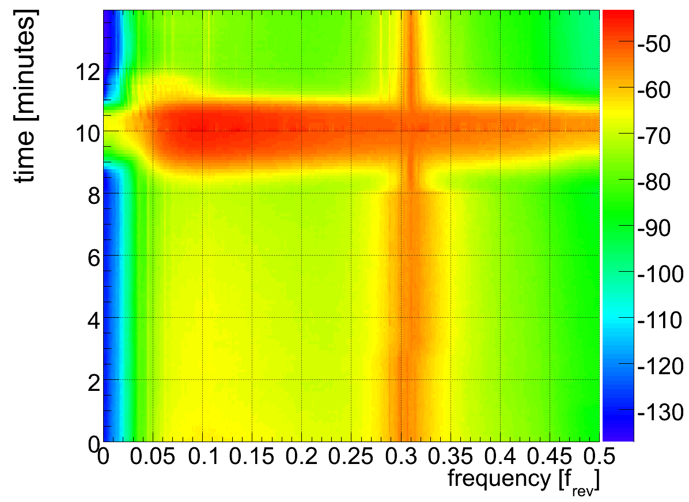
Noise issue for tune feedback
V
H
R. Steinhagen
→ follow-up from RF group would be helpful to understand this and minimize it

Slide 4
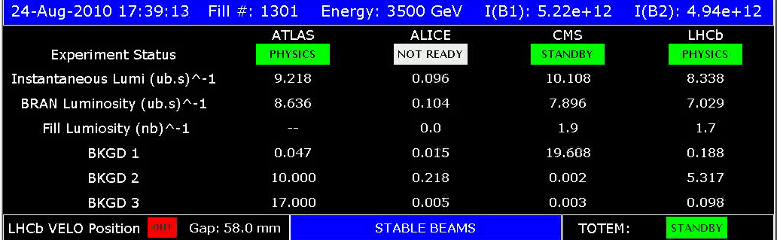
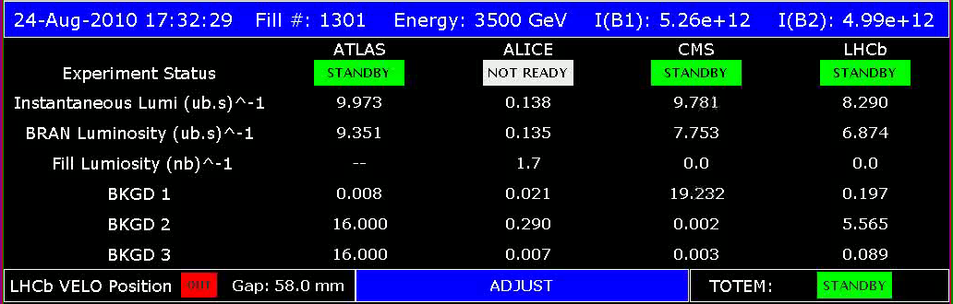
First time lumi above 10e31 (in CMS)

Slide 5
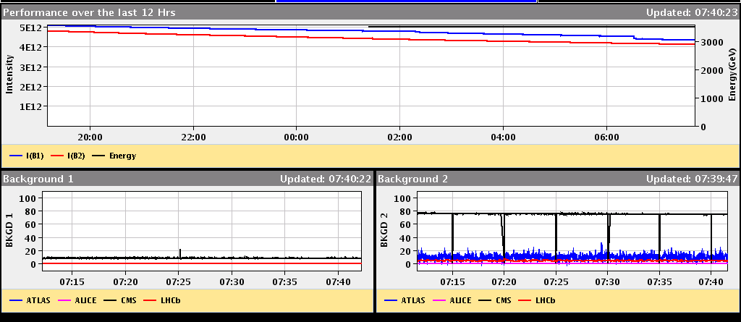
12 hour history
Background in CMS appearing in middle of fill!?
Max delivered: 350 nb-1 per experiment.

Slide 6
Fill 1301
6 hours of stable beams
  (so far)
  new filling scheme: 50b
    no long range encounters
  IPs: 1 5 2 8 - 1 5 8 - 1 5 2
  - 1 5 - 2 8 - 8

Slide 7
Fill 1301
no Long Range interactions
with Long Range
  IPs: 1 5 2 8 - 1 5 8 - 1 5 2 - 1 5 - 2 8 - 8

Slide 8
Fill 1298
1 LR in 2 (33m)
1 LR in 2 (33m)
1 LR in 8 (33m)
1 LR in 8 (33m)
1 LR in 2 (22m)
1 LR in 2 (22m)
no Long Range interactions
with Long Range
  IPs: 1 5 2 8 - 1 5 8 - 1 5 2 - 1 5 - 2 8 - 8

Slide 9
Fill 1295
1 LR in 2 (33m)
1 LR in 2 (33m)
1 LR in 8 (33m)
1 LR in 8 (33m)
1 LR in 2 (22m)
1 LR in 2 (22m)
no Long Range interactions
with Long Range
  IPs: 1 5 2 8 - 1 5 8 - 1 5 2 - 1 5 - 2 8 - 8

Slide 10
Fill 1301
no Long Range interactions
with Long Range
  IPs: 1 5 2 8 - 1 5 8 - 1 5 2 - 1 5 - 2 8 - 8

Slide 11
List of Ongoing/Pending Work I
Commissioning work for higher intensities:
  Multi-bunch injection: N bunches per injection, completed for beam1, to be completed for beam2.
  Transverse damper: Train test with 4 bunches at 150 ns. 1 shift. Adjustments for train. 1 shift. Total: 2 shifts.
  Multi-bunch studies for RF and BPM's, instrumentation, dump, ...
  Crossing-angle setup at 450 GeV. Address losses with 100 micro-rad in IP2, goal is 150 micro-rad (full, see w33 Tuesday summary).
  Check of orbit feedback improvement (minimize energy changing COD trims). Can be parastitic. 2 ramps.
  PLL commissioning work (better tune feedback with high intensities and damper on): at 450 GeV and later during ramp. 6 times 0.5 shifts.
  Injection preparation for 12b bunch train injection (injection protection setup). 2 shifts.
  Injection test for 12b bunch train. 0.5 shifts.
Increase of intensity:
  Increase bunch intensity to 1.1e11.
  More bunches after 1 week with 48b? → NO.
Define plan
Agree target crossing angles

Slide 12
List of Ongoing/Pending Work II
Maintenance of LHC performance & protection:
  Monitor collimation validity and efficiency (loss maps). 1b of 1e11 per beam. 1.5 shifts.
  Correct the momentum cleaning for beam 2 (collimator setup IR3). 1b of 1e11 per beam. 1 shift.
  Test less heavy method for loss maps (blow up selected bunches with transverse damper at end of shift). 1b of 1e11p. 1 hour.
  BCT response check for different bunch intensities. Parasitic to collimation loss maps.
  BCT response check for different bunch lengths. 450 GeV. 2 hours.
Study and measurements of important LHC parameters:
  Independent measurement of beta* and beam offsets in triplets: k-modulation. 1b of 1e11 per beam. Not colliding. Change RQTX1/2/3 by +- 0.5 A. Measure after squeeze to 3.5m. 1 shift.
  Measurement of transverse beam distribution at 3.5 TeV.

Slide 13
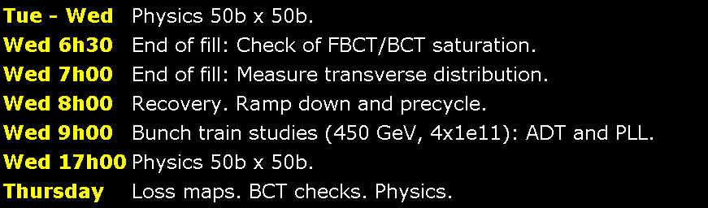
Program today
Thursday evening Physics 50b x 50b
Friday day Bunch train studies part II: ADT, PLL, …
Friday evening Physics 50b x 50b
Saturday k-modulation in triplets (beta*, offsets), ADT test for loss maps, physics
Sunday tbd

Slide 14
Week 34
Open Issues for next Technical Stop:
  CMS cooling for central tracker.
  Ion pumps in dump line MKB (B2 only 4 out of 8 pumps working; few days intervention).
  BLM racks (in buildings SR1 and SR5 and both at position BY02): would like to correct the way the power cable for the multi-plug arrives inside the rack.
  QPS boards: several boards had to switch from channel A to B.
  Access team to replace oxydized connectors for PAD-PX24 (3 hours).
  CV needs to replace a motorization of the water valve of the sector 56 (3h).
  RCBH18.R7B2 – Miguel Cerqueira Bastos.
  RCSSX3.L1 super blocked for cryo.

