Slide 1
Power cut
18kV cable for EMD404/E9 is heating
23:20:54 Fire alarms in building 958 (BE) where the breaker is situated
Breaker trips, but brings down also 66kV transformer EHT7
EHT7 feeds North zone loop, SPS, LHC point 1 and further the LHC loop
Power was reestablished in 28 s following a successful auto-transfer

Slide 2
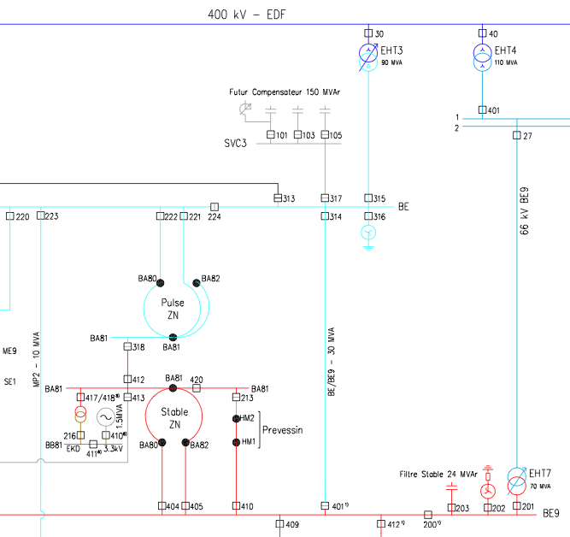
Configuration

Slide 3
The fault was not on the 400 kV but rather on a cable terminal inside the 404 cabinet; it connects the BE9 bus bars to the North Area loop.
An arc developed inside the cabinet and then a short between phases. The circuit breaker did not open on the short because of the arc; instead it opened on thermal protection after 250 ms; then, the 66 kV supply through cabinet 27 (which was sensing the fault since the incident started in cabinet 404) triggered, shutting down the PS, the SPS and the general services LHC loop. All the machine, experiments and infrastructure systems were affected.

Slide 4
Saturday 18:00
We are now back to the nominal configuration having excluded cabinet 404 and the cable between it and the BA80 (see diagram below). i.e the NA loop is not a loop anymore.
EPC is presently switching in the SVCs.
It is yet another occurrence of a cable terminal fault. We are carefully analyzing these terminals and their screen connections; we will bring systematic consolidation when the findings are conclusive.

Slide 5
Recovery
Major effort Saturday
EL, SVC, Cooling, ventilation, vacuum, controls, BI, power converters, cryogenics, RF
Access plus RP as required
Booster back up early Saturday morning,
PS Saturday afternoon
AD still does not have beam – cooling pump problem target area
SPS late Saturday evening
North area & CNGS

Slide 6
LHC recovery
Power cut caused 3 trips that required further investigation
RB.A45 (MB.B21R4) : heater discharge
RB.A81(MB.C32L1) : heater discharge
MQ.25L1 : Only 1 of 2 heaters fired?!
All Switches now closed and QPS reset for all circuits
EPC had ~20 circuits that needed attention
all fixed Saturday morning (Valerie Montabonnet)
Collimators OK
MKI8 power supply access may be required
Access system: LHC Access system is operational
has one 48V power supply warning

Slide 7
LHC recovery
Transverse dampers (E. Montesinos, Daniel Valuch)
All ADT low level crates in the SR4 are up and running, FESA classes up and running, clocks present
Opened all analogue switches to disable the transverse feedback. Needs to be switched back on by expert when the ADT is required. Need to be verified when the beam is back.
Set some triggers used by the ADT fixed display, they are persistent so they should initialize correctly next time.
Injection kickers – good to go
Beam instrumentation
numerous front-ends down – local resets requierd
OP - mini dry run

Slide 8
LHC recovery - vacuum
All insulation vacuum equipment restarted and functioning.
All beam vacuum equipment restarted/repaired.
All beam vacuum sector valves reopened except where the cryo temperature is not yet < 5K at cavity in 4R and triplet + q4/d2 in 2L.
SPS: All beam vacuum equipment functioning and sector valves open.
Paul Cruikshank & team

Slide 9
Cryogenics – summary 1/2
P18
QSCB compressor station for 4.5 K and QSCCB upper compressor station for cold compressors
Full stop on whole installation
Effected sector 12
P2
QSCCA compressor station for 4.5K fridge and full stop on whole installation
Full stop on cold compressor station
Effected sector 2-3
P4
QSCCA compressor station for upper compressor station for cold compressors
Full stop on cold compressor station
Effected sector 3-4

Slide 10
Cryogenics
P4
QSCB compressor station for 4.5K fridge and QSCCB upper compressor station for cold compressor station
Effect sector 4-5
P6
CS and CM for both sectors
P8
QSCCB upper compressor station for cold compressor station
Full stop for cold compressor station
Effected sectors 7-8 and 8-1
Latest estimate – end Sunday morning

Slide 11
Outstanding
RF
One cavity B1 – fill status not clear, despite access and checks yesterday
Front-ends
Continuous FFT for beam 2 and brans not working yet.
Experiments magnets
Alice solenoid on, Atlas Toroid coming up, otherwise all still off
SVCs
Cryogenics

Slide 12
Today
Re-establish circulating beam
Careful checks of hump (nice clean conditions)
Full check of all beam instrumentation system
TDI settings check
Ramp
Transverse damper

