Slide 1
Power cut
18kV cable for EMD404/E9 is heating
23:20:54 Fire alarms in building 958 (BE) where the breaker is situated
Breaker trips, but brings down also 66kV transformer EHT7
EHT7 feeds North zone loop, SPS, LHC point 1 and further the LHC loop
Internal auto transfer on CERN network repowering the busbar after some 10-20 seconds

Slide 2
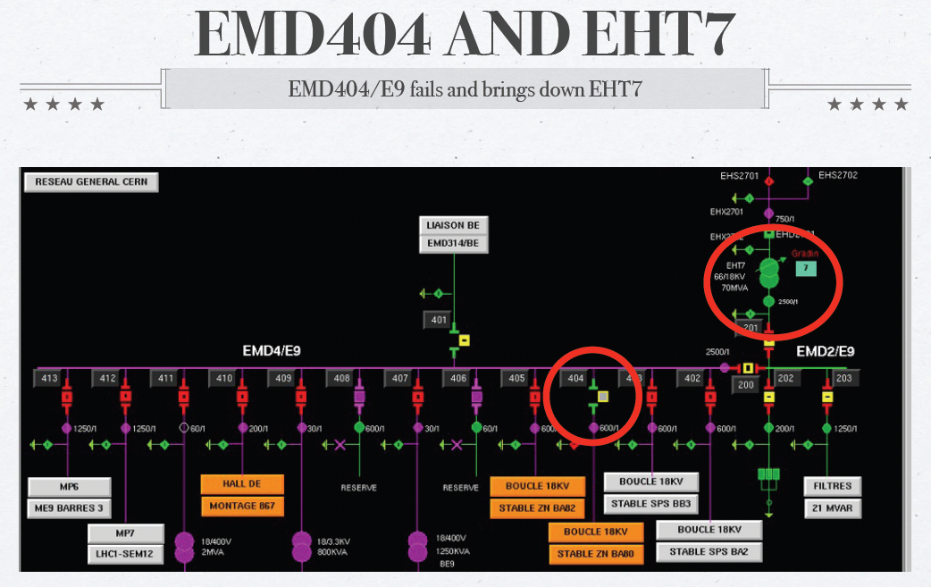

Slide 3
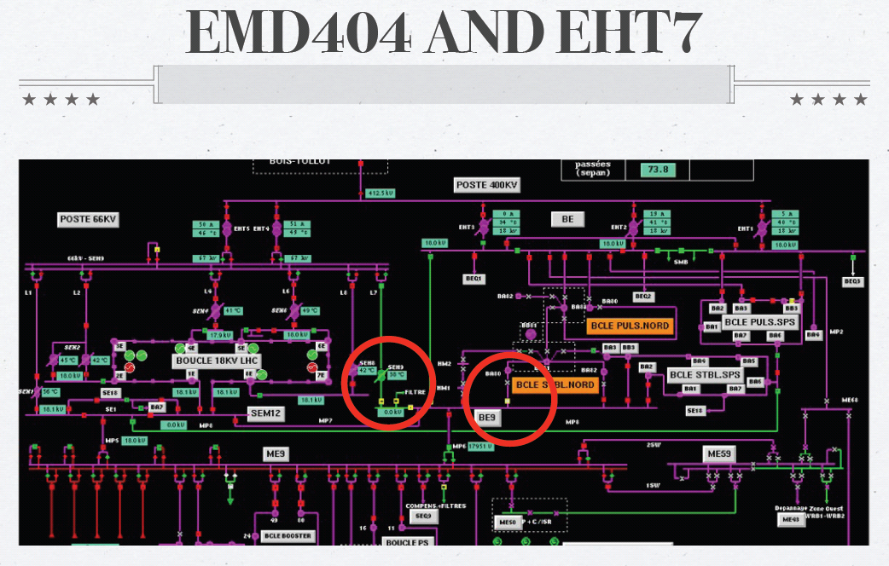

Slide 4
Effects of the power cut
Prevessin, SPS, Meyrin, LHC1 and LHC loop saw power outage
Cryo stop in all points but LHC6
Auto transfer kicks in after a few seconds and repower
Only North Zone remains without power

Slide 5
Knock on effects
Fire alarms (various, false) & ODH
RF safety valves – He release
03:08 Access in UX45 was given to cryo team accompanied by firemen to reset cryo crates and ODH alarms
All experiments’ magnets tripped
SPS, NA, PS, Booster all down hard
controls,
cooling (some leaks on turning back on),
ventilation,
MPS
vacuum
SVC
(Booster back up and delivering beam to ISOLDE)

Slide 6
Status 5 a.m.
All cooling stations are back up and running
Some fire detection units need attention in the LHC
Cryo is recovering
Network configuration is still in the back-up state, the faulty cable/breaker is still off (investigations will take place)
It seems we can run the machines in this configuration (MP7 line can take 30MW and we were using ~26MW before the cut)

Slide 7
LHC
Power cut induced trip of all sectors occurred at 23:20:43.
There was no beam in the machine.
Ramp down from 3.5 TeV had just started
The RB circuits were at 5786A when they tripped
Power cut appear to last for ~ 10sec
Valves in, pumps, gauges off
restarted by piquet, valves still in

Slide 8
LHC recovery
Power cut caused 3 trips that require further investigation
RB.A45 (MB.B21R4) : heater discharge
RB.A81(MB.C32L1) : heater discharge
MQ.25L1 : Only 1 of 2 heaters fired?!
All Switches now closed and QPS reset for all circuits
Awaiting cryo conditions and power permit from EPC
EPC have ~20 circuits that need attention
Access required for vacuum gauge on MKI8
MKI8 power supply access may be required
Access system: LHC Access system is operational
has one 48V power supply warning

Slide 9
Cryogenics – summary 1/2
P18
QSCB compressor station for 4.5 K and QSCCB upper compressor station for cold compressors
Full stop on whole installation
Effected sector 12
P2
QSCCA compressor station for 4.5K fridge and full stop on whole installation
Full stop on cold compressor station
Effected sector 2-3
P4
QSCCA compressor station for upper compressor station for cold compressors
Full stop on cold compressor station
Effected sector 3-4

Slide 10
Cryogenics
P4
QSCB compressor station for 4.5K fridge and QSCCB upper compressor station for cold compressor station
Effect sector 4-5
P6
CS and CM for both sectors
P8
QSCCB upper compressor station for cold compressor station
Full stop for cold compressor station
Effected sectors 7-8 and 8-1
At least 24 hours recovery. Should be back ~ midnight on Saturday. All other sectors in shadow of this sector.

