Slide 1
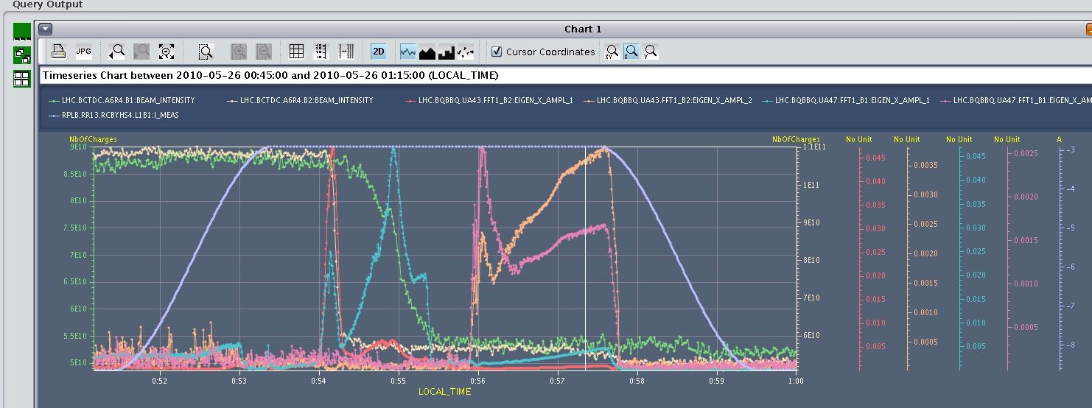
From yesterday

Slide 2
Wednesday 26th
Welcome Verena back on shift
07:08 Access in PM85 for piquet EPC (O.Fournier).
Fuse on RD2.R8 circuit.
10: 20 RD2.R8 now ok. prepare to recycle.
14:00 Injecting 1 e11
coherent instability induced by hump
15:00 ramping 2 * 1e11 for OFB test
emittances already reasonably big starting the ramp
B1H 4.6 B1V 6.5 B2H 7.5 B2V 6.9
OFB looks good
15:39 Beam 2 lost to vacuum interlock

Slide 3
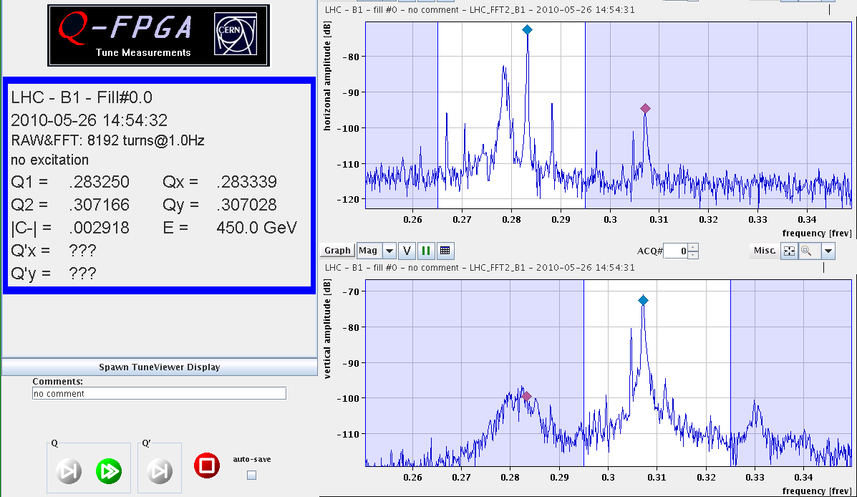
Hump again

Slide 4
BGI
BGI (Beam Gas Ionization) monitor was being tested, and after injection of 3 different level of gas, the BGI started to create discharges and the resulting out gassing gave vacuum gauge readings that were at the 10⁻⁷mb.
As the vac gauge readings were increasing, the two gauges closest to the BGI were masked by the vac expert.
The masking then caused an interlock on the vacuum system and the beam was dumped. Only after the beam dumped did a valve close.

Slide 5
Orbit Feedback
Summary of the ramp with orbit FB: - No more dancing beams,this improvement seems to come from the RST period that was changed to 80 ms (from 100) to be in phase with the FB. - The FB survived an event without energy (due to the fact that the tune systems stopped for some time). It took some time to catch up the energy, but it eventually managed.
Declare operational with some potential tuning to be performed

Slide 6
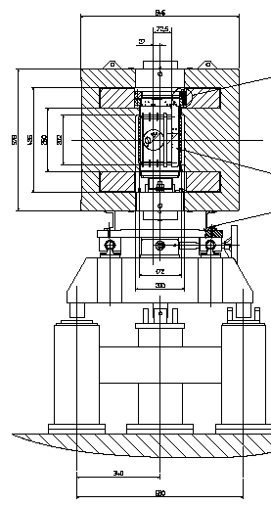
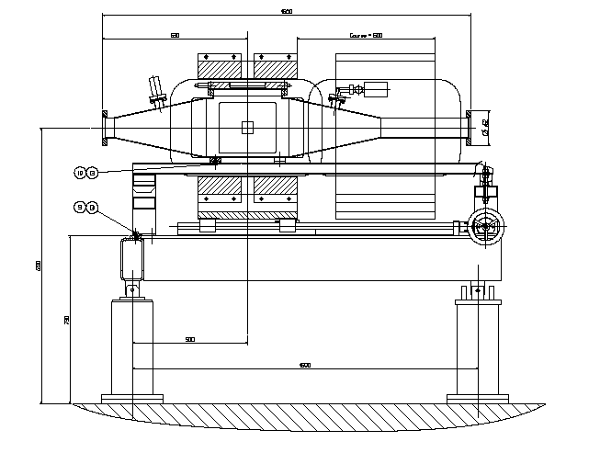
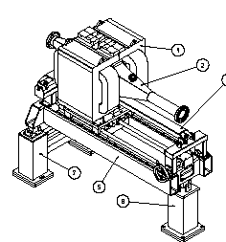
New Rest Gas Monitor: mechanical design The tank within its magnet
Light signal
side view
e⁻ signal
Light signal
Φ=84 mm
200 mm
3-D view
cross section view
680 mm

Slide 7
Big nominal bunches up the ramp
chromaticity difficult to measure
Colliding high intensity bunches in ATLAS and CMS. Looks stable. See about expected luminosity.
Bunch currents: 9.8e10 and 8e10.
Emittances 7-12 micron normalized.
Went to collision tunes.
Put an extra +3e-3 on beam 2 H and V (for tune split).
Stable after going into collision, rocky before collision with some manual chroma and tune trims to keep the beam.
First collided in CMS, optimized CMS, then collided ATLAS and optimized.
One round of optimization in beam-beam offset for each ATLAS and CMS.

Slide 8
Nominal bunch intensity - synthesis
Over-injection well established
Emittance blow-up of beam 2 V at 450 GeV well documented
Emittance blow-up during ramp
Transverse instability at 1.8 TeV+
cured by octupoles
Longitudinal
longitudinal emittance at the SPS should be set at 1.7-1.8eVs
plus matched voltage
Collisions at 10 m. looks OK with tune split and collision tunes

Slide 9
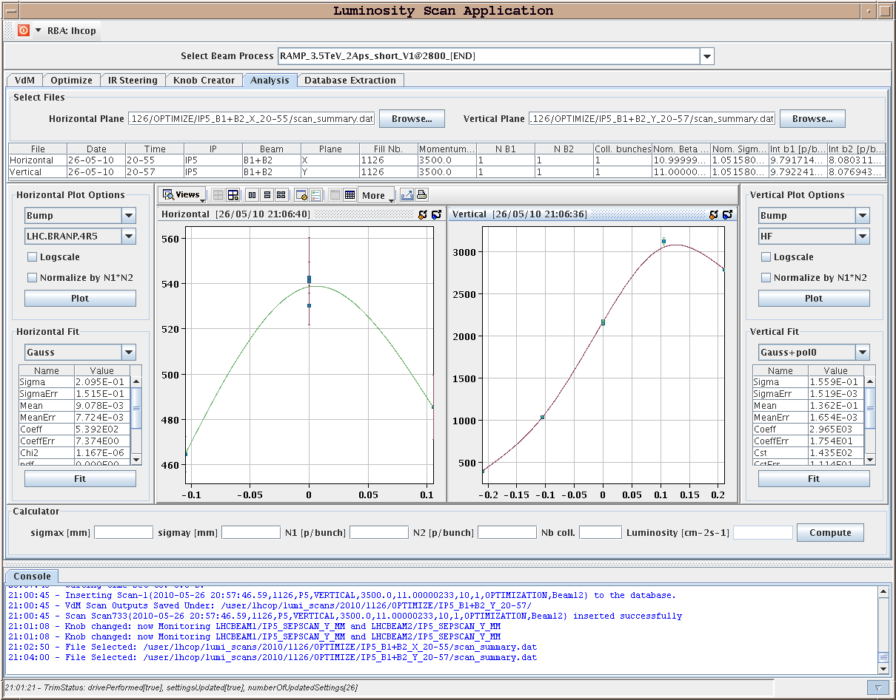
First “nominal” collisions at 7 TeV

Slide 10
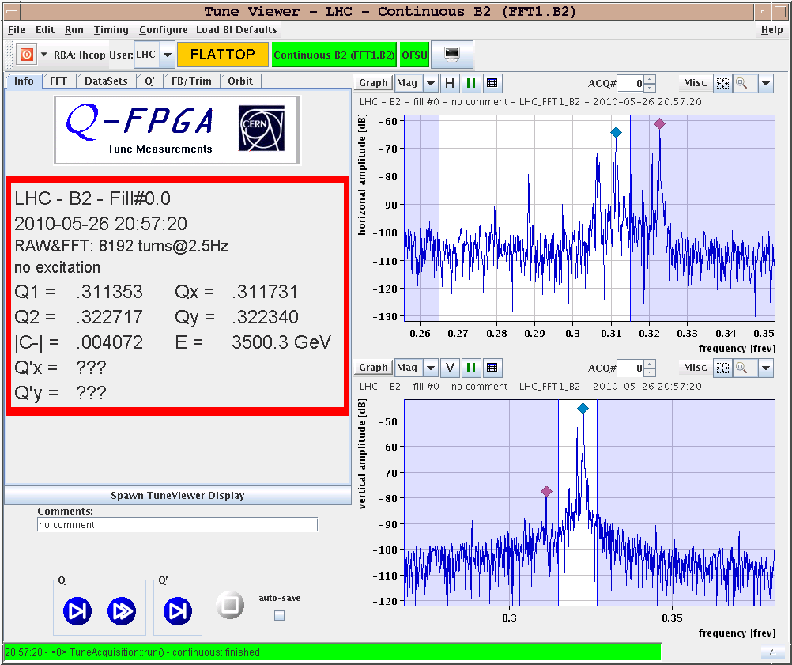
Tune spectra 3.5 TeV

Slide 11
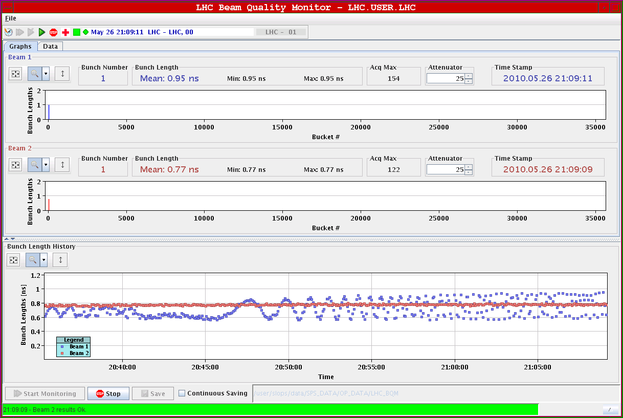
Longitudinal “instability”…

Slide 12
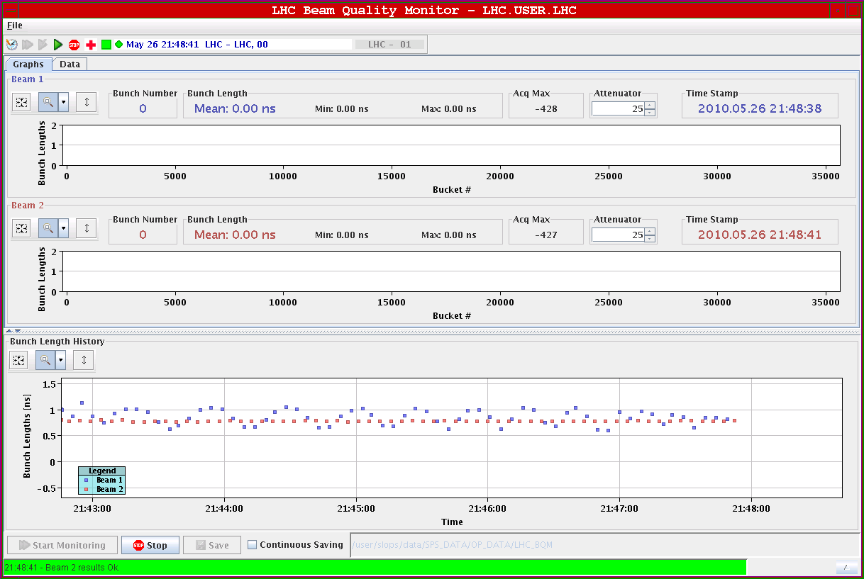
with 12 MV at 3.5 TeV

Slide 13
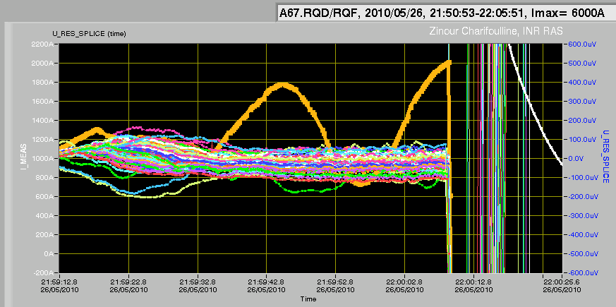
Wednesday - Thursday
21:51 beams lost – mains glitch
20:03 RB in S67 tripped when doing the ramp-down
trip of the RQF/QD caused by the nQPS where threshold is exceeded on B15L7. B15L7 signal crosses the 500 uV threshold due to a sinewave with a period of about 25 sec.
midnight - re-inject
00:34 lose S67 again – access required
Switched board on RQTD.A67B1.
07:12 Pre-cycle finished
BLM crate HC.BLM.SR3.L problem between hardware card and CPU. No communication. No beam permit from this crate until fixed. Christos will go to point 3. Front-ends on the surface.

Slide 14
Plans for today – to be discussed

