Slide 1
Nominal intensity bunches
First ramp with nominal intensity bunches suffered from an instability appearing around 1.8 TeV.
Nominal intensity bunches suffer (most likely) from head-tail instability.
Cures / improvements:
Operate at lower Q’ (< 5).
Octupoles
Larger (closer to nominal) longitudinal emittance

Slide 2
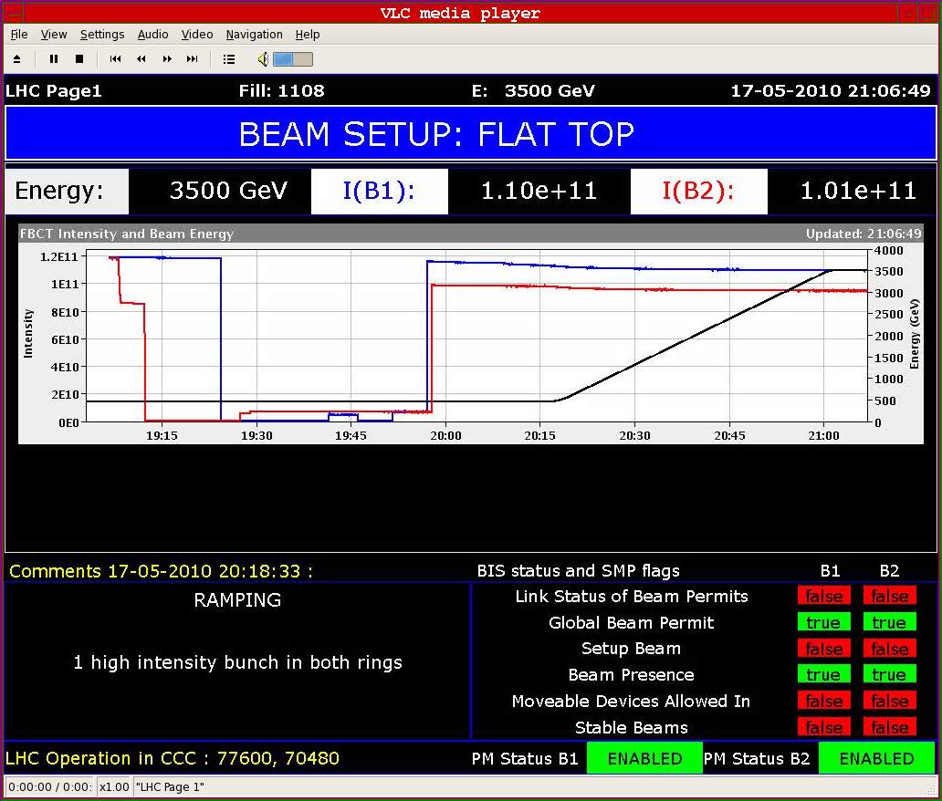
Ramp 1e11
Ramp with larger longitudinal emittance (and octupoles), obtained by opening phase loop in the LHC for some time: 0.7 eVs instead of 0.3 eVs.

Slide 3
Bunch length in ramp
With the longer bunches, the strength of the octupoles could be reduced to ~ 5-10% of the previous settings (20 A instead of 200 A) – the previous setting was ‘guessed’.
Over the previous week-end :
0.6 ns at 3.5 TeV

Slide 4
Beam becoming unstable…

Slide 5
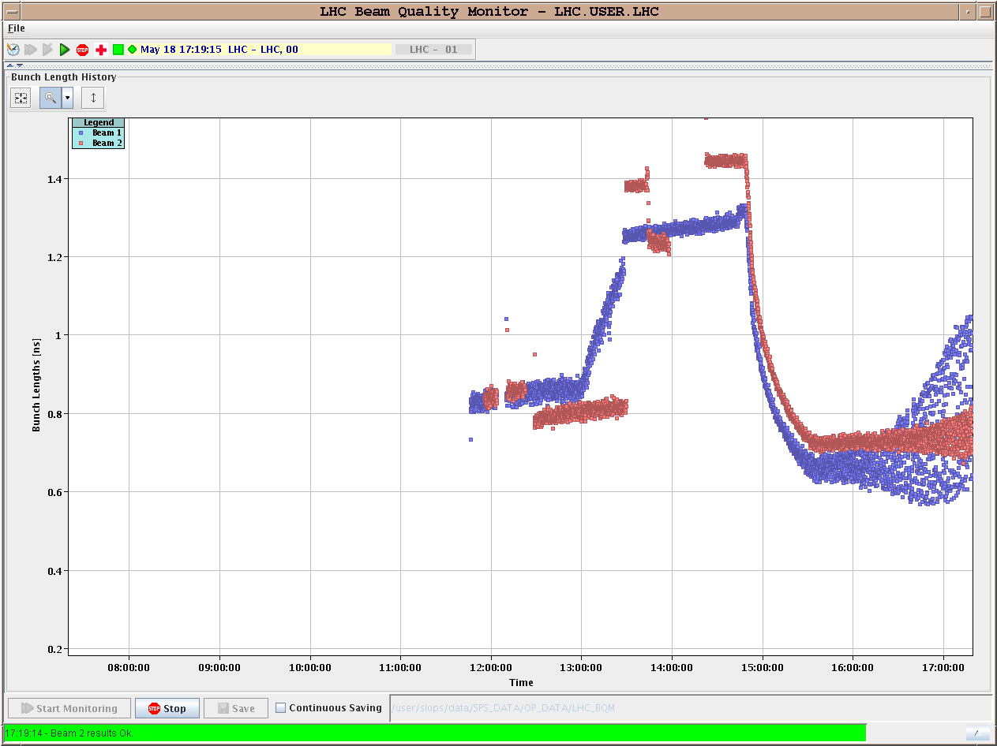
‘Dancing’ bunches at 3.5 TeV
Another ramp: beam unstable at 3.5 TeV, with length < 0.8 ns

Slide 6
Nominal intensity bunches issues
Beam can be stabilized with octupoles.
Larger longitudinal emittance is very beneficial.
Increased in a controlled way in the SPS (up to ~ 0.8 eVs).
In the LHC increase by opening phase loop.
Issues of uncaptured beam / beam in abort gap with larger longitudinal emittance / phase loop opening.
To be followed up…
So far, even when the beam was stable at 3.5 TeV, the emittances were huge: 8 to 10 um !
Very strong blow-up in the ramp.

Slide 7
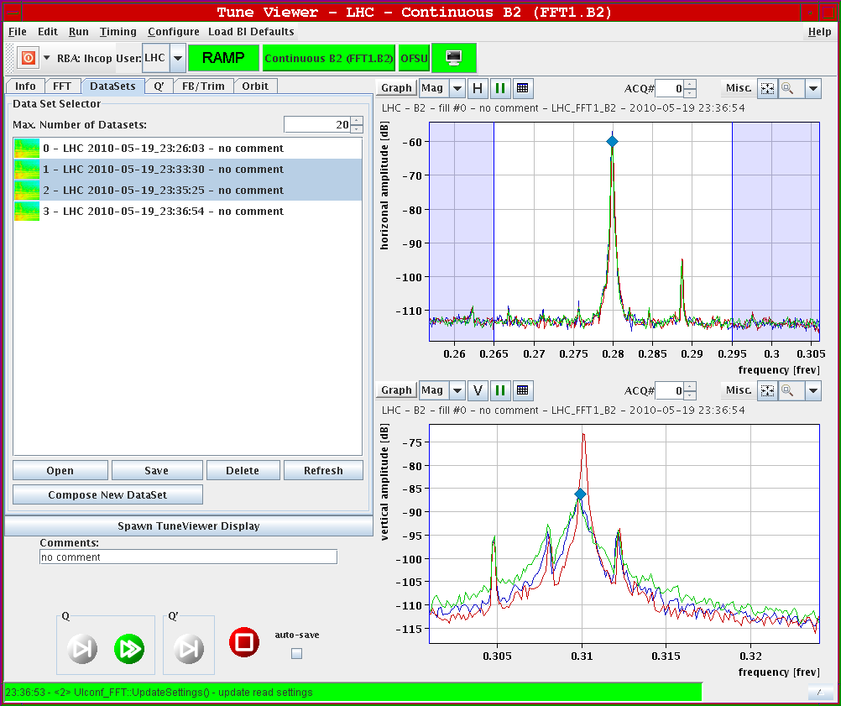
Transverse Damper
Used successfully on B2 V plane.
Also in ramp.
To be continued and extended to other beam/planes.
Damper OFF (red) and ON (green) at 3.5 TeV

Slide 8
The orbit feedback saga
The orbit FB had been introduced successfully for the ramp in the previous week.
Monday-Tuesday COD trip ‘storms’ were observed: suddenly 10-30 CODs trip together. Sometimes the beam survives, sometimes it doesn’t (into the collimators and then BLM dump).
The trips could be tracked to sudden jumps in the real-time correction reference. Combination of:
Jumps in the corrections from the OFB.
Regulation issue of the CODs when running at ‘low’ current since all CODs were affected by the jumps, but only a few tripped.
The reference jumps could be traced to incorrect energy information arriving at the OFB (via BI FE computers).
Information of energy arrives with the tune data.

Slide 9
The orbit feedback fixes…
A fix was introduced on Wednesday and ‘tested’ on Wednesday.
Another ramp was lost Friday night on the same symptoms:
It turned out that the fix had not been deployed.
Another iteration was made Saturday evening with a new fix:
We survived an event with incorrect energy.
But the FB entered into a strange state from which it could not recover and that affected also Q and Q’.
>> decided to continue operation without OFB until a better fix is received (from Kyoto…).
Orbit in the ramp (and squeeze) cleaned and stable over the weekend.
Peak rms excursions 0.3 mm OK !

Slide 10
Dancing orbit
With OFB the orbit is dancing around in the ramp – amplitudes of few 10’s of microns (not a severe issue!).
Clearly visible on BSRT.
The period is 200 ms, which does not really match the FB periods (25 Hz).
Could be an interference due to COD PCs operated with RST period of 200 ms? To be verified…
Some CODs (MCBY…) send back status info indicating that they are rate-limited during the ramp when the OFB is active.

Slide 11
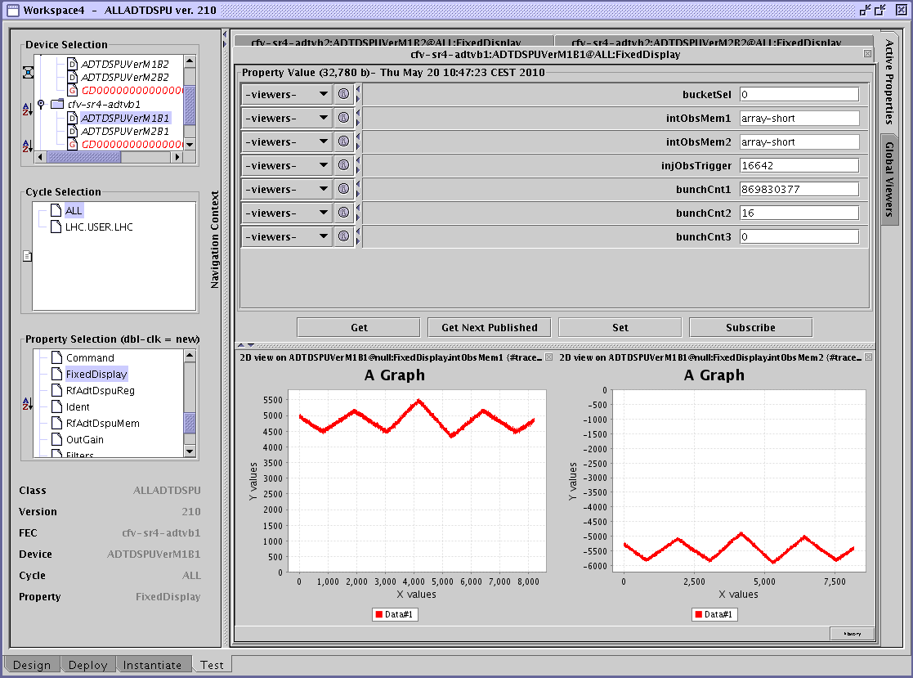
As seen by ADT

Slide 12
Cryo stop
Cryo de-icing in S45 done.
Various issues fixed in the 1 day stop.
S67 was successfully commissioned with ramp rates up to 10 A/s and 6 kA.

Slide 13
Injection oscillations
Un-explained difference in V injection oscillations between bucket 1 and the other buckets (> 2000).
Leads to emittance blow-up.
We are now adjusting inj. oscillations on bucket 2001.
Injection oscillations of the 5 last bunches with respect to the first bunch in bucket 1.

Slide 14
13 bunches
Finally pushed the number of bunches to 13 on Monday.
Smooth, but injection is really lengthy…
Tightened orbit and corrector interlocks.
Reaches luminosities of 1.5E29 in the first fill, 2E29 overnight.
Orbit in stable beams cleaned up for first fill.
First fill lost due to problem in BLM system (followed by another problem in another IR a bit later).
Losses and low lifetimes were observed in the second fill. We are learning…
Second fill had very good emittances.
From fill to fill the emittance variations in V plane can be large and are not really explained.

Slide 15
2E29 !!

