Slide 1
Friday 21.05
Prepare to inject beam
Rephasing problem in the SPS
Trip of sector 67 – nQPS (noise)
12:00 : RF work at injection with nominal bunch
15:30 : LBDS checks
Interlock BPMs
TCDQ alignment check: optimum was found ~ 1 sigma tighter than present setting (from collimator setup).
Debunched beam test with default settings is however good enough. No change of settings required for the weekend.
19:00 : power cycle 78 for QPS_OK, pre-cycle
21:00 : injection.
We observe that for beam2 the bunch in bucket has SYSTEMATICALLY different injection oscillations than all other buckets.

Slide 2
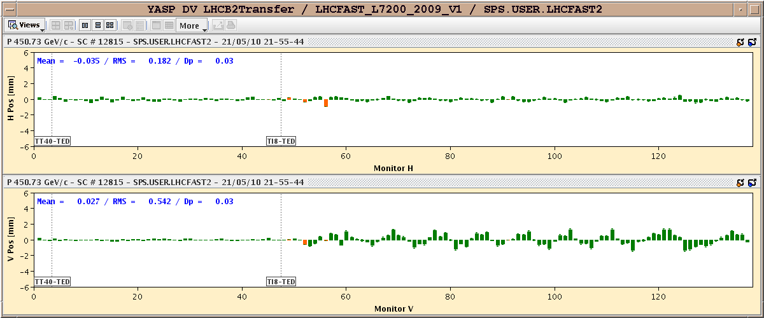
Injection oscillations
Injection oscillations of the 5 last bunches with respect to the first bunch in bucket 1.
Consider changing injection schema to use only buckets > 100 or so for beam2 (for the moment).

Slide 3
Friday 21.05
22:20 : Start ramp with orbit and Q FB
Lost 25 H cods due to glitch in RT correction from orbit FB. The symptom is identical to the problems earlier this week. The fix did not fix it !
Beam lost from orbit excursion interlocks.
Phone with R. Steinhagen: reboot the tune FECs that also provide the energy info to the FB … Maybe this cures the problems for some time…
01:30: Re-inject 6 bunches 2E10
We decide to ramp without FB, and switch it on with the injection ref. orbit only if the situations becomes too bad.
Correct injection oscillations based on bunch in bucket 2001 for beam2.
02:30 : At 3.5 TeV!
Orbit not great, but still reasonable RMS, and some margin with respect to interlocks. No need to switch on FB.
Corrections incorporated into the ramp.

Slide 4
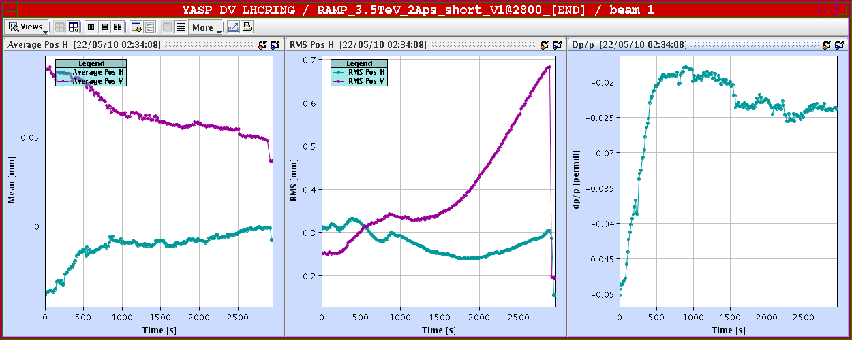
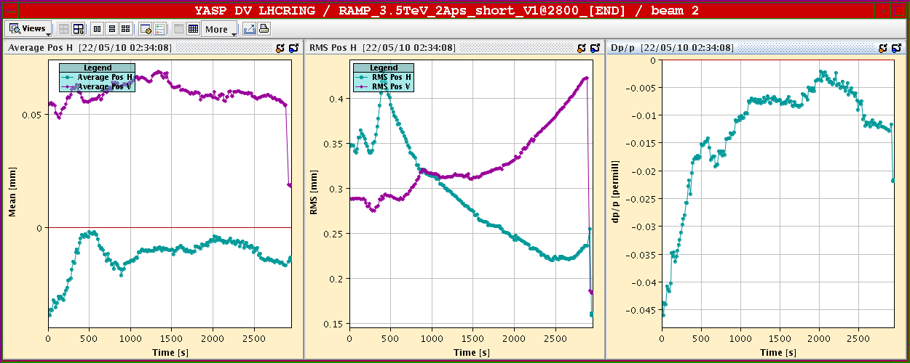
Orbit in the ramp – no FB

Slide 5
Saturday 22.05
03:15 Squeezed to 5 m, 2 m
Orbit corrected & incorporated.
03:30 Stable beams

Slide 6
Plans
If we operate without orbit FB, we need another ramp with 6b to verify that the excursions are reduced after the corrections of the night ramp.
Then we can decide if the orbit is good enough to move to 13b…
Unless we take the risk of operating with orbit FB.

