Slide 1
Wednesday 19.05
07:35 : Beam lost because of trip of RCBXH3.L1
access needed to fix problem
10:00 : End of access
13:20 : Beam injection
RF studies for bunch lengthening in the SPS and capture in the LHC
analysis of injection oscillations
15:41: Beam circulating with 10¹¹ particles per bunch
additional longitudinal blow up in the LHC by turning off phase loop
15:45: Preparing for ramp
B1 emittances: h = 9.2 μm; v = 2.7 μm; B2 emittances: h = 3.8 μm; v = 7.0 μm
large losses for Beam2 without adjusting machine
➔ new injection & large un-captured beam during dump

Slide 2
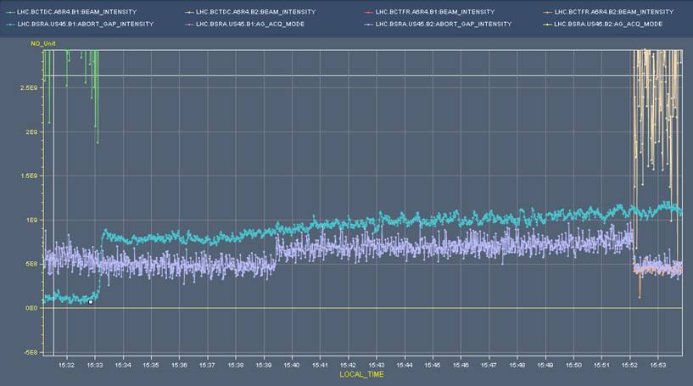
Un-bunched beam during last fill

Slide 3
Wednesday 19.05
17:00 : Start ramp
Both beams dumped at 1.1 TeV by orbit excursion. No FB in the ramp to avoid spurious trips.
19:00: Ramp down finished & ready for new injections:
Studies with orbit feedback system
Damper commissioning
Measurement of Q’ drift due to decay

Slide 4
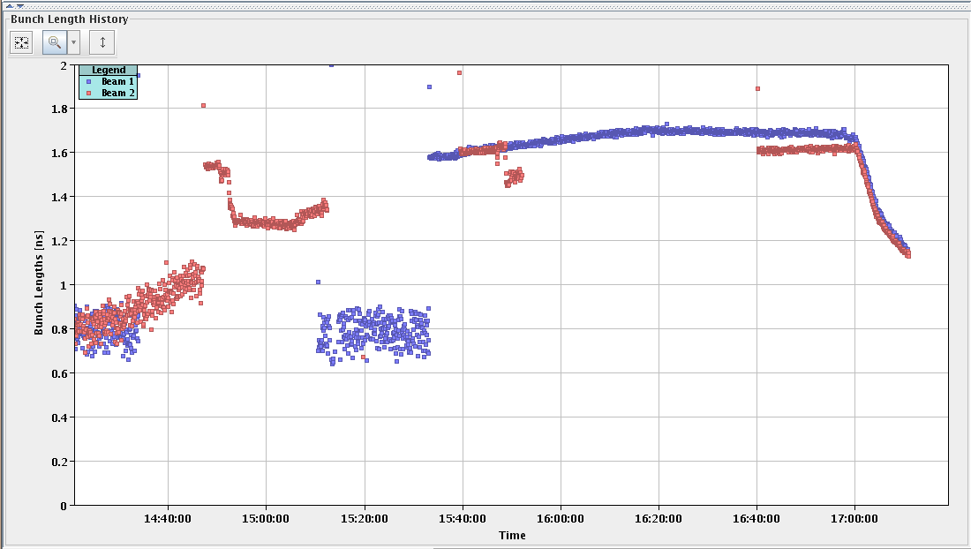
Beam length during ramp

Slide 5
Wednesday 19.05
22:30 : Test ramp with orbit FB and transverse damper on B2 V plane
No problems on orbit. Increased no eigenvalues to 370 for better performance.
Did not quite get the orbit that was expected at 3.5 TeV. Previous incorporation did not quite do what I expected…
Re-corrected orbit at 3.5 TeV. RT trims transferred to ~80% into LSA. Incorporated once more…
Wire scanner at the end of the ramp: B2H 1.79 B2V 1.48 ** damper on (at low gain) in the ramp B1H 1.75 B1V 1.60
Tune FB test with large modulation from fRF: no RQT trips.
MPS test at the end: start ramp-down with beam. To be analyzed – somewhat strange event…

Slide 6
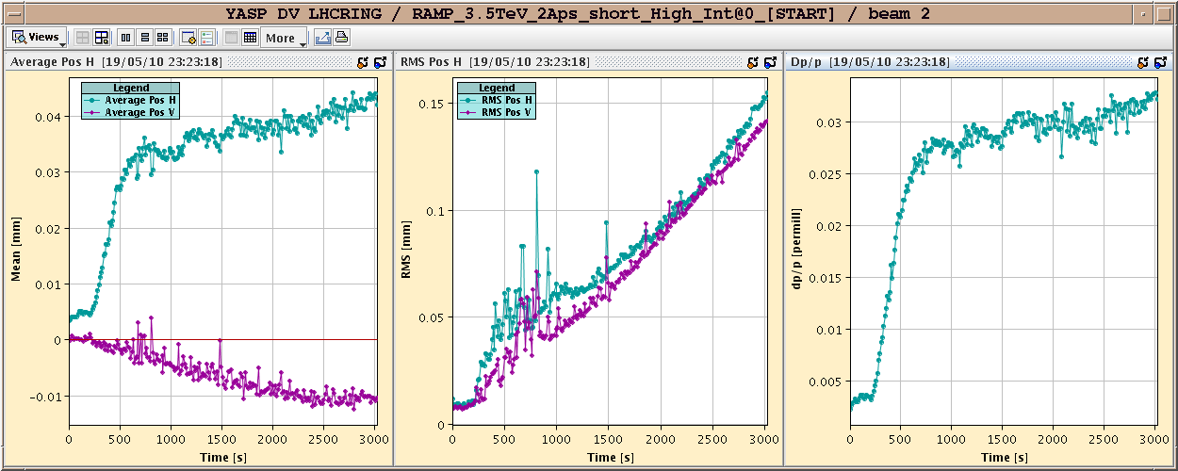
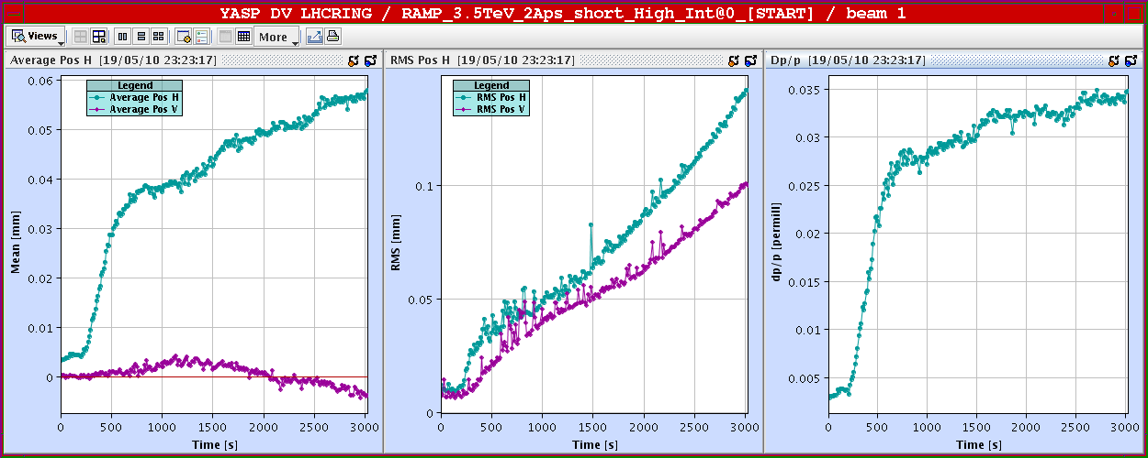
Orbit in the ramp
RMS < 0.15 mm

Slide 7
RT orbit trims
RT trims transferred to LSA settings

Slide 8
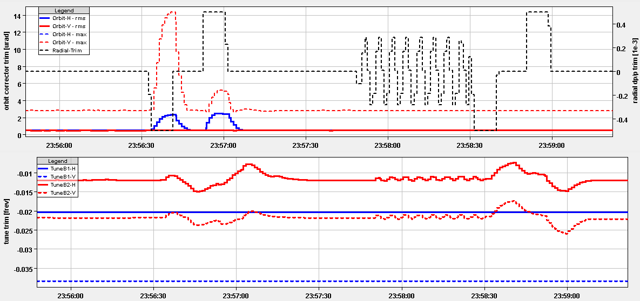
Tune FB without RQT trips

Slide 9
Damper summary
Summary of damper setting-up (D. Valuch, W. Hofle) Measured phase advances between pick-ups for all dampers to prepare for use with two pickups: H.B1: left of 4 Q9 -> Q7 : 115 degrees delta with respect to 90 degrees: 25 H.B2: right of 4 Q9 -> Q7 : 107 degrees 17 V.B1: right of 4 Q7 -> Q9 : 56 degrees 34 V.B2: left of 4 Q7 -> Q9 :137 degrees 47 ! The values seem to be correct when compared to the latest optics version. For the vertical plane the situation is now marginal and needs to be checked in detail for the use with two pick-ups. Compared to version 6.500 there is a change for the vertical plane which is significant. We continued therefore with one pick-up on V.B2; Q7 pick-up V.B2 some noise observed which must be followed up by RF. We used Q9 exclusively. Switched on feedback with previous settings from last session. Works correctly. We used ~ 2 1/2 hours beam time. We decide jointly to leave FB on in the vertical plane with one module at - 6dB gain setting for ramp. During the ramp tune activity outside tune line, lifetime is changing often, but approaching high levels of > 100 hours at high energies. Emittance measurements show better preservation for the plane for the damper was used (V.B2): 22:31 before ramp 23:54 before dump at 3.5 TeV emittance increase HB1 1.0 -> 1.053 1.747 66 % VB1 1.0 -> 1.009 1.603 59 % HB2 1.3 -> 1.334 1.787 34 % VB2 1.3 -> 1.305 1.487 14 % -> here one damper module was on most of the time

Slide 10
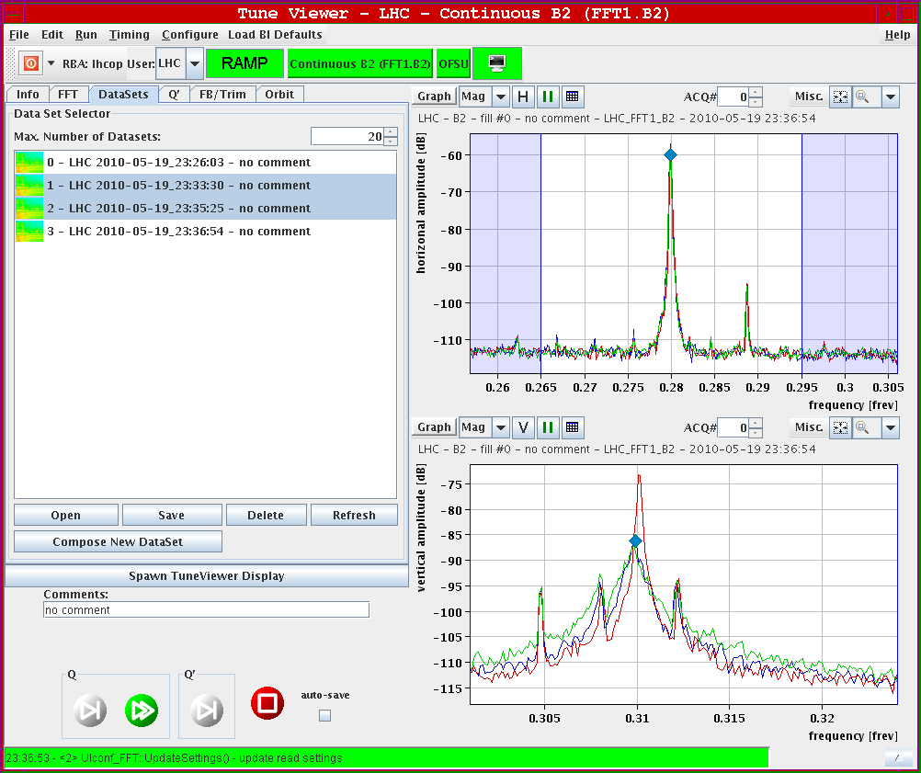
Damper
Damper OFF (red) and ON (green) at 3.5 TeV

Slide 11
Wednesday 19.05
02:00-06:00 : Studies at injection
Re-check aperture in IR6 - MQY.4R6.B1
Off-momentum n1. Seems the aperture is 2/3 of the on momentum aperture – to be analyzed
Off-momentum beta-beat.

Slide 12
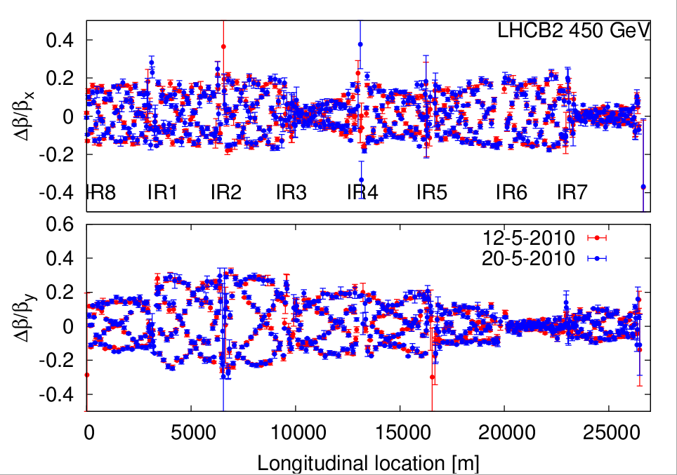
Beta-beat stability

Slide 13
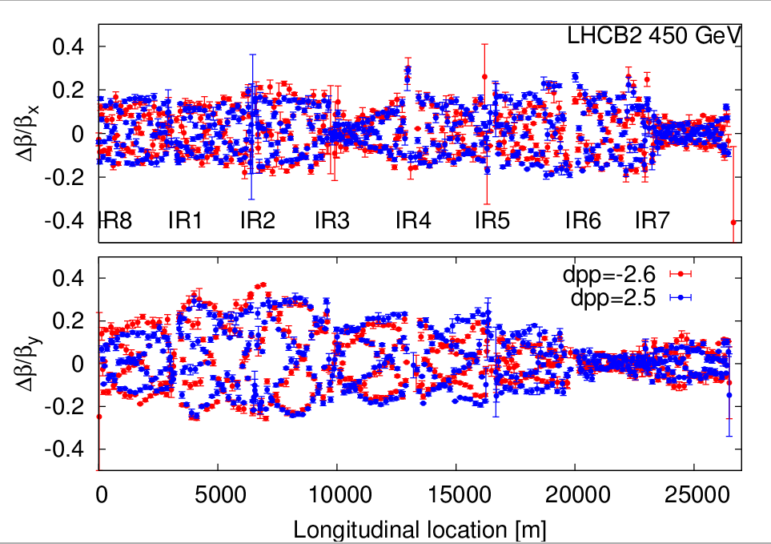
Off-momentum b-beat

Slide 14
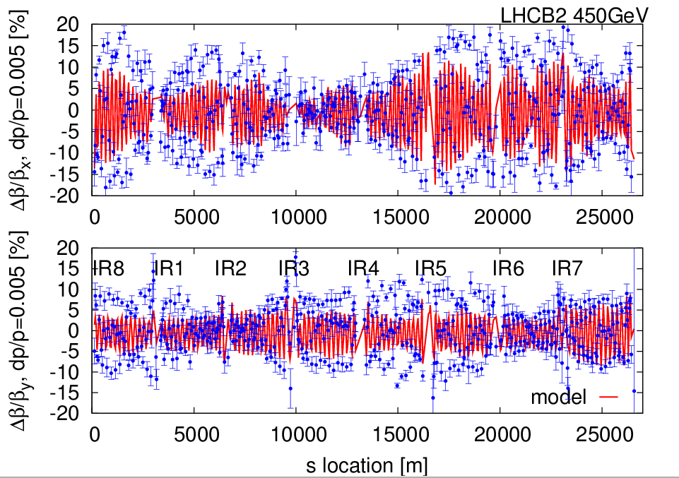
Off-momentum beta-beat

Slide 15
Thursday 20.05
07:00 : Start 24 hours cryo intervention for filter cleaning
access for:
QPS: new card in S56 & hardware commissioning during evening
BI: BPM
LBDS: ADC cards and humidity filter
Controls: reboot Windows consoles and LINUX servers & release of new software versions
Program for weekend:
Physics fills
Potentially some damper studies in between physics fills

