Slide 1
Tuesday 18.05
09:00 : Access in Pt4 for RB S34.
Water flow low – increased.
11:40 : Recovered from PC fault and access. Beams back.
12:15 : RF sets up procedure for longitudinal emittance blow-up in
the SPS for high intensity operation.
13:30 : High intensity bunches injected
Longitudinal emittance 0.6 eVs.
Octupoles on.
Ramp start 14:50:
Emittance B1: ~ 6 μm in H and 4.3 μm in V. Emittance B2: ~ 8.2 μm in H and 5.3 μm in V.
Flat top 15:45: B2 unstable ➔ trim vert Q’ down by 6 units
Emittance B1: ~ 10.7 um in H and 10.2 um in V. Emittance B2: ~ 11.2 um in H and 14.3 um in V.

Slide 2
Tuesday 18.05
17:00 : Start collimator setup
Observe loss of Landau damping in longitudinal plane (but beam still stable)
17:30: Loss of Beam2 due to collimator motor position interlock in point 3. Controls issue.
17:43: Loss of Beam1 due to interlock generated by ‘out of limit’ offset in centering between TCDQ and TCSG.
Dump of Beam 1 was not clean with losses on the TCDS.
18:00 : Start ramp down
19:30 : Start preparation of physics fill over night
21:40: Start injection of 6 x 2 10^2 bunches per beam & start of ramp
22:11: several orbit correctors tripped due to feedback trim
22:36: separation bumps collapsed
23:34: lost more orbit correctors ➔ Beam1 lost from orbit interlock @ TCDQ
00:00: start rampdown

Slide 3
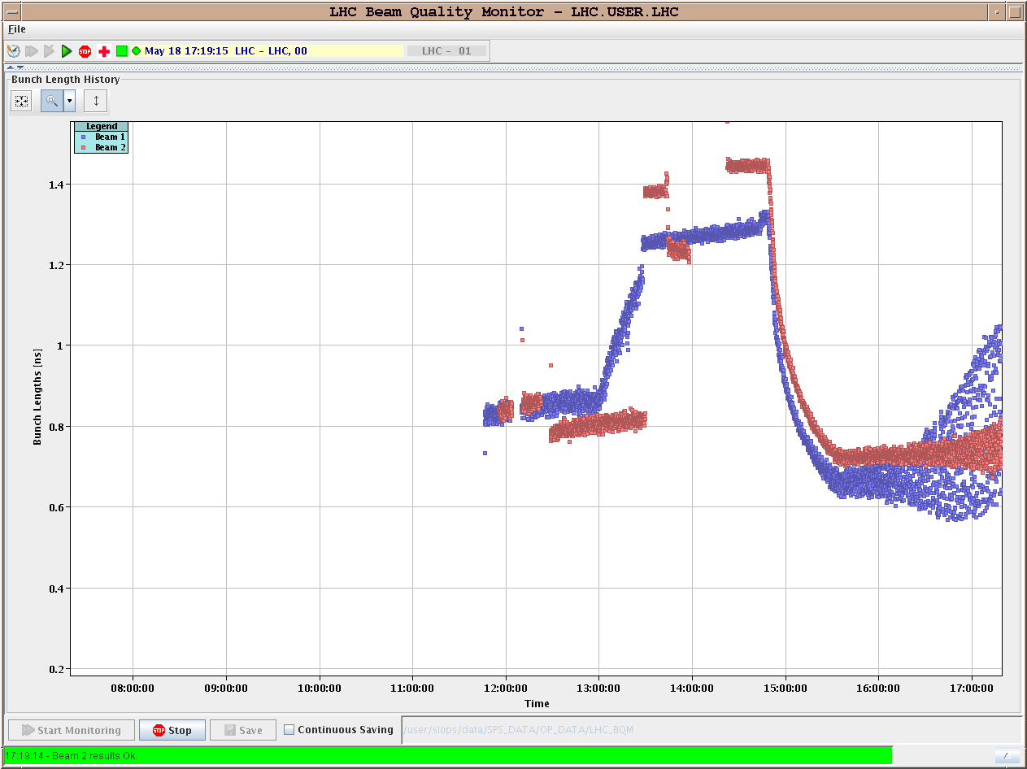
‘Dancing’ bunches at 3.5 TeV

Slide 4
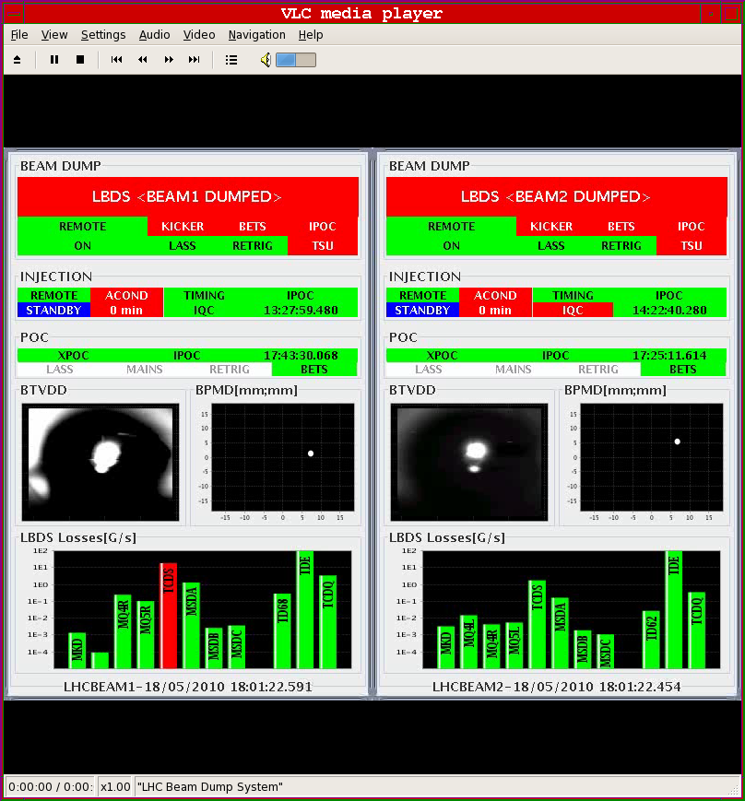
Beam 1 dump

Slide 5
Wednesday 19.05
03:00 : new fill, ramp without FB.
07:30 : beam lost due to RCBX3.L1 trip
Presently ramping down
09:00 : Continue (Start) Collimation setup for High intensities.
(Possible) program for rest of week:
Access UX45 for RF (UPS circuit breaker for RF crate)
24h stop for Cryo de-icing from Thursday noon to Friday noon ?
Try to finish collimation setup, collimator hierarchy
RF measurements with 1e11 in the ramp
Debunched beam issues with 1e11
Transverse damper
Physics fills….

