Slide 1
Monday 17.05
06:00 – 15:00 : Stable beams
15:30 : Recover…
18:00 : Injection for high intensity ramp
Longitudinal blowup : switch on phase loop after some seconds only…
Observed ‘large’ amounts of un-captured beam around the ring (dump BTV).
20:15 : Start ramp
Longitudinal emittance 0.7 eVs (B1), 0.58 (B2) as compared to 0.3 eVs over the weekend.
Octupoles on.
Ramp start:
Emittance B1: ~ 4.7 um in H (chirp !!) and 3.2 um in V. Emittance B2: ~ 3.2 um in H and 3.3 um in V.
Flat top:
Emittance B1: ~ 7.9 um in H and 5.5 um in V. Emittance B2: ~ 7.3 um in H and 4.7 um in V.

Slide 2
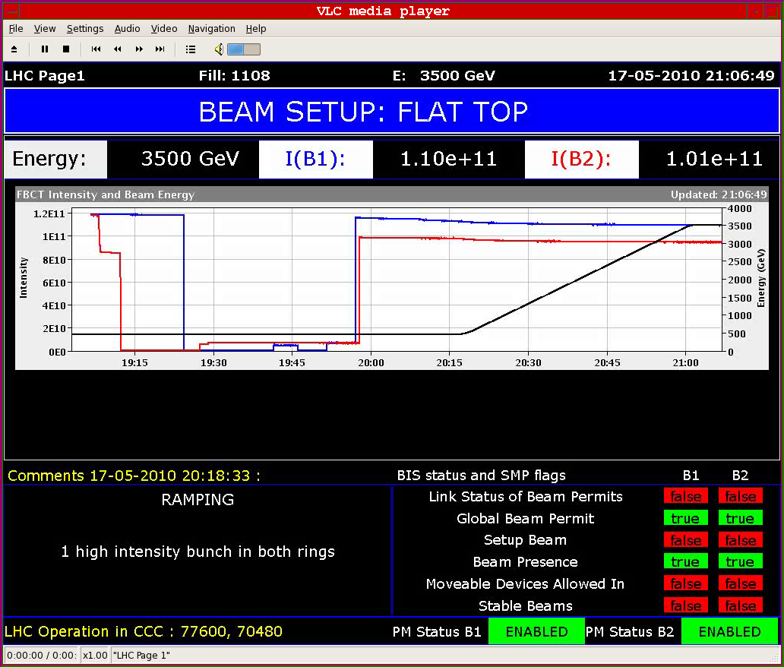
Ramp 1e11

Slide 3
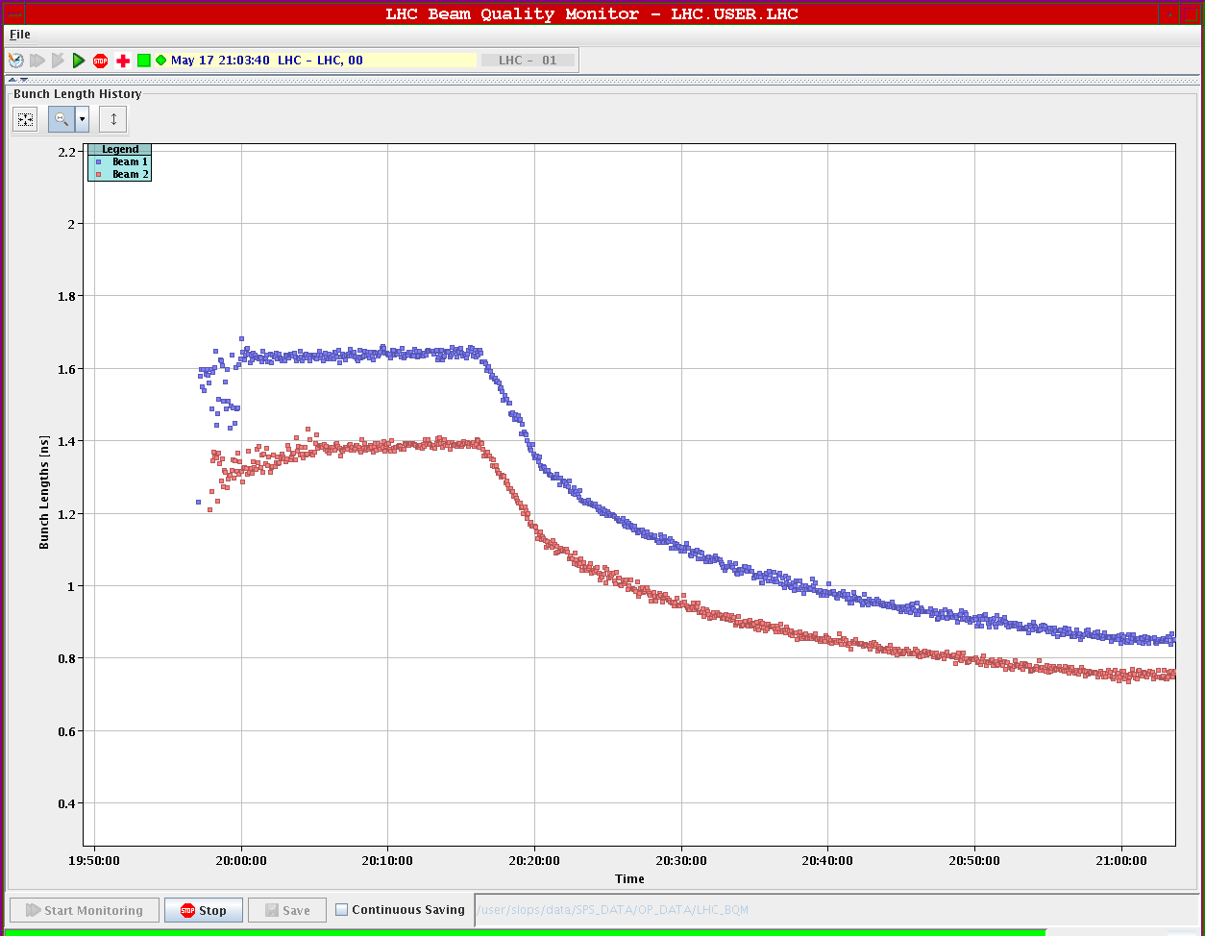
Bunch length in ramp
Over the week-end : 0.6 ns at 3.5 TeV

Slide 4
Monday 17.05
21:00 : Flat top
Base orbit for collimator setup today (rms wrt injection orbit ≤ 80 um)
Chromaticity in both beams approx. +12 (H) / +8(V).
Lowered Q’ to around +5 both planes and beams.
22:30 : Sudden trip of 24 60 A CODs all over the machine !
Manage to save the beam by correcting in parallel with other CODs, orbit maintained within 0.25 mm. Lifetime to ~ 5 hours, almost no measurable loss.
All CODs that tripped had kicks of < 10 urad, typical ~ 5 urad.
Apparently the CODs received a large change request – OFB was OFF. Ghost command ?!! we had that before…

Slide 5
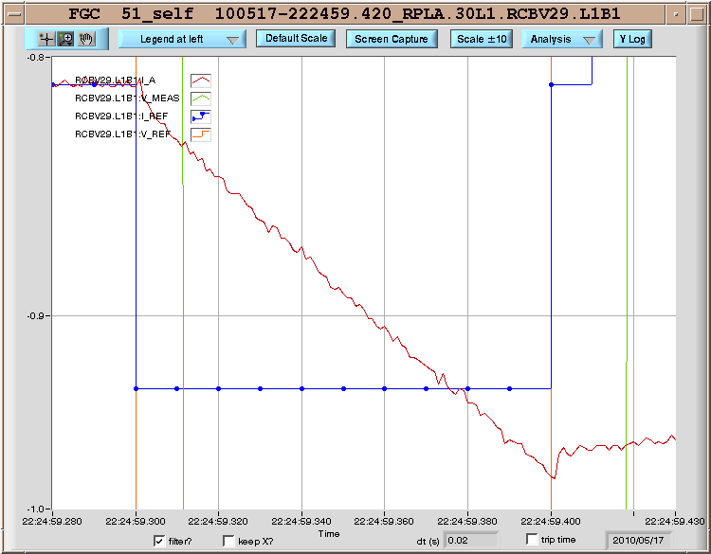
COD trips
Apparently, all 60 A which were lost at 22.24:59 fell for the same reason: REF_RATE_LIM --> TRG|VOUT_OVER_VOLTAGE. The PCs received a request of more than 100 mA in 100 ms --> more than 6 V were asked.

Slide 6
Monday 17.05
22:35 : Lowered octupoles.
Ok down to 10%, then losses on B2 at 5%. We manage to revert the trim in time. B2 bunch length increases.
Trim to 0. First nothing happens, then after some tens of seconds the losses increase drastically, lifetimes < 1 h. Beams saved by going back to 5%.
We need some octupoles, but clearly much less than what is programmed into the ramp now.

Slide 7
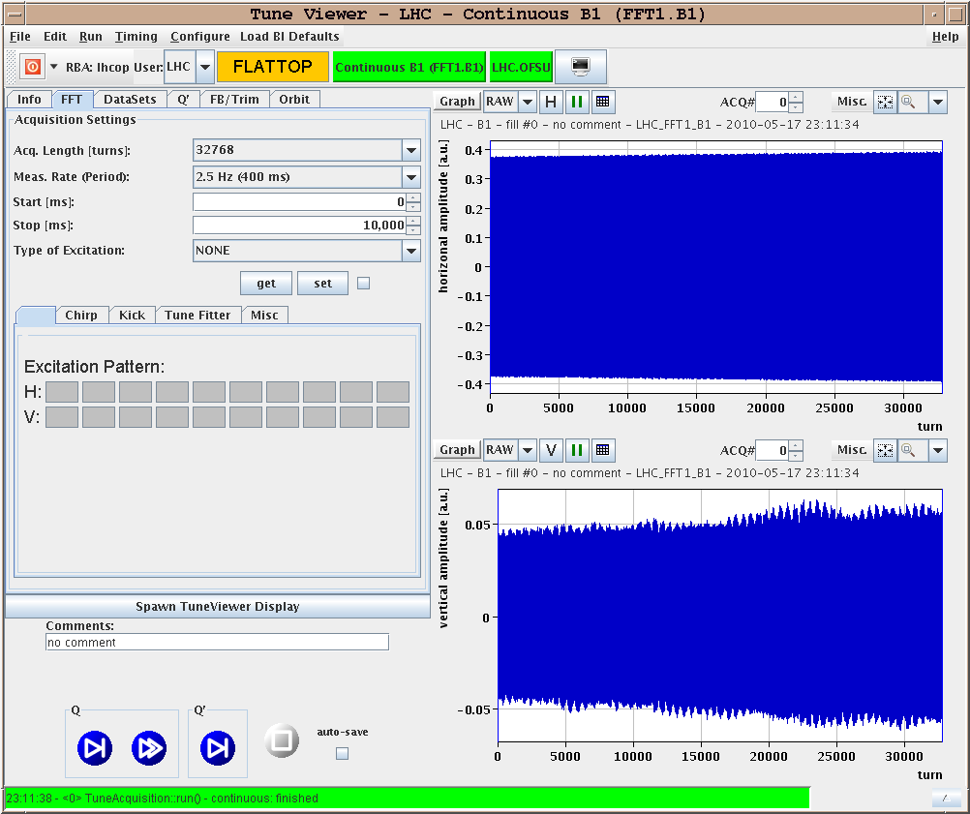
Beam becoming unstable…

Slide 8
Tuesday 18.05
01:00 : Prepare physics fill
05:00 : Stable beams
05:40 : Beam lost due to electrical perturbation
Lost beams due to perturbations on power grid. RPTF.SR3.RQ5.LR3 RPTG.SR1.RD1.LR1 RPTG.SR3.RD34.LR3 RPTG.SR5.RD1.LR5 RPTG.SR7.RD34.LR7 and ALICE and LHCb dipoles
FMCM triggers.

Slide 9
Tuesday 18.05
06:20 : Lost sector 34 during ramp down.
Initiated by a PC fault. MPR3 investigating.
Program of today:
Recover S34 and precycle.
Inject & ramp 1e11/beam for collimator setup at 3.5 TeV.
Clean up orbit at 3.5 TeV.
Then physics fill overnight.

