Slide 1
Results from Damper commissioning
5-6 May 2010
continued damper commissioning V.B2
had to re-load some settings that were lost, some software issues
tune peak reduction with damper (thanks Ralph for measurements)
advanced with H.B1, V.B1, HB1, ready to close loop
ready to leave V.B2 on for a trial ramp
next steps:
abort gap cleaning V.B2
upgrade of firm ware to enlarge tune range in order to be
ready for perturbations farther away from tune
above 2x10¹⁰, re-adjustment of pick-up (gain/ (I,Q) phase rotation)

Slide 2
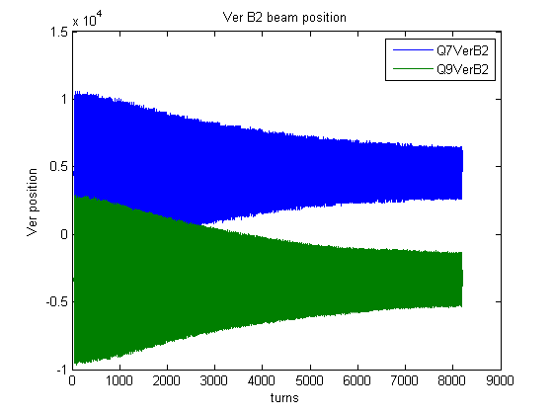
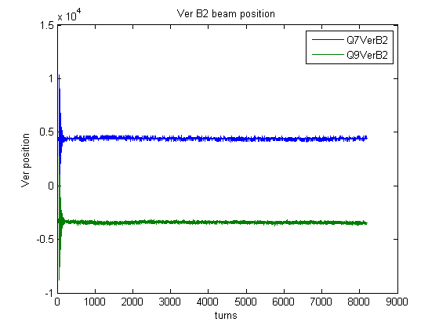
Damping with vertical beam 2, 1x10¹⁰
FB off
FB on
kicked by Q kicker at 50% strength

Slide 3
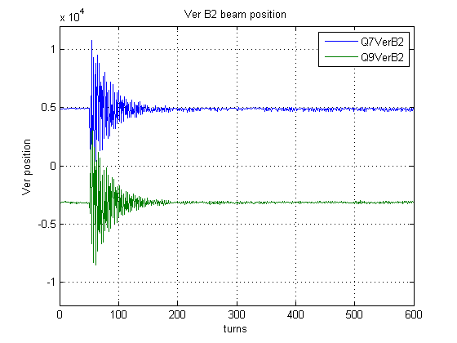
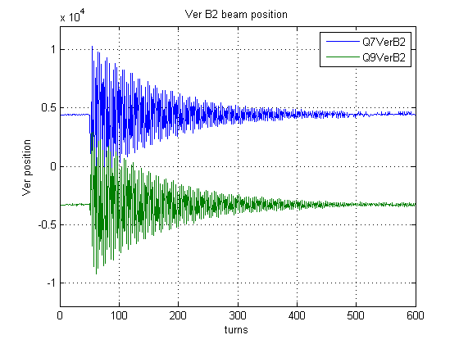
High gain
Lower gain
40 turns damping achieved with maximum gain (2 kickers used), but

Slide 4
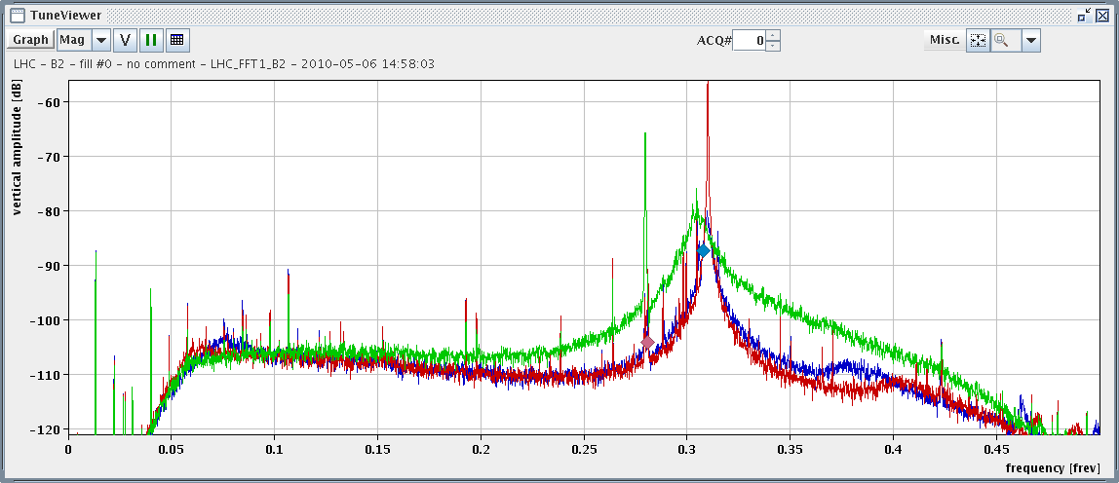
Tune peak broadens
seen first by R. Steinhagen
without damper
with damper, lower gain, 2 kickers
with damper, max gain, 2 kickers
less broadening with lower gain
reduction of tune peak, i.e.
residual oscillations by more than 20 dB
not yet good for hump,
enlarge tune range (change signal processing FPGA firmware)
range were FB works well
(limits: 45 degrees phase error)

Slide 5
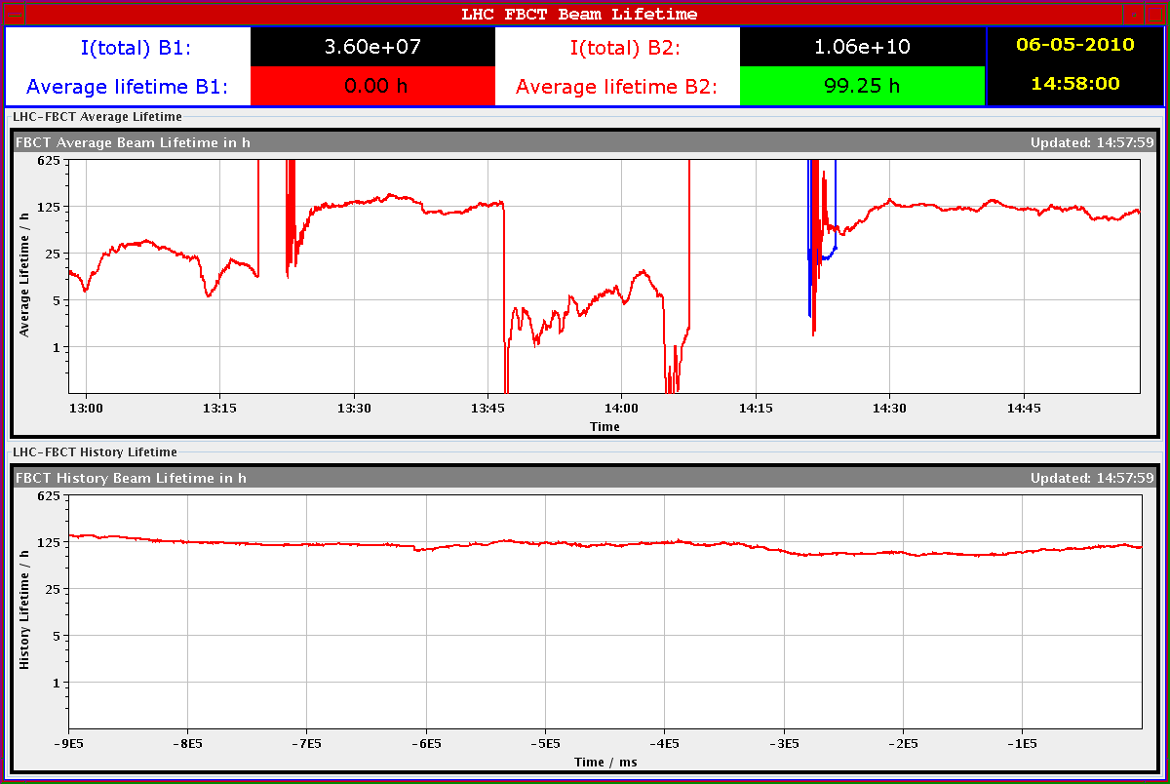
Life time with FB on (absence of hump)
FB on
lifetime drops if perturbations outside range of FB come in
→ to be fixed by 2 pick-ups scheme with short delay processing

Slide 6
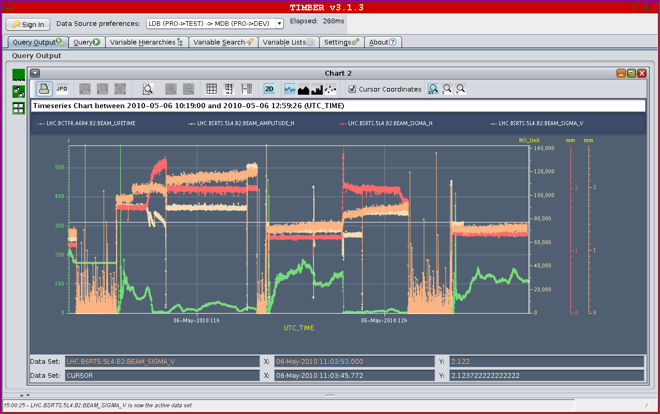
Beam Size evolution
FB on

