Slide 1
Friday 07.05
07:00 : Collimator setup at injection
All collimators are setup with ~1E11 / beam.
Validation loss maps to do (Qx, Qy, fRF).
13:00 : Loss of cryo conditions on Q6.L3
15:30 : Beam back – MPS for LBDS
RF frequency interlock test
LBDS OFF test (high level controls)
Revolution freq. off
Apertures for B1 and B2 in IR6 and at the injection septum (MSI)
Apertures for extracted beams.
TI8 extracted beam amplitude scan.
Some abort gap cleaning test in parallel, but no cleaning done. Issues with OASIS and BPM acquisition.
22:30 : Lost cryo conditions in 4 (RU), UPS not OK
Lost RU.R4: DCCT - intervention required; but continue for now with MPS

Slide 2
Saturday 8.5.
03:00:Start preparation of new physics fill:
03:00: Start Pre-cylce after LBDS setup studies
QPS-OK issues: RQTL11.L5B1 and then RQD/RQF.A23.
04:50: End of Pre-cylces
08:00: Start of ramp
08:30: Ramp finished & start squeeze
09:20: Separation bumps collapsed
09:30: Collimators in ‘Stable Beam’ conditions
09:40: Cryo conditions lost in S23.
Cryo maintain was lost in S23 for 6 seconds. RB went into slow power abort , RQD/RQF tripped, and some other citcuits also tripped. Beams lost.
12:40: Beams back at injection settings and Starting Collimation verifications:
Initial problems with over injection (10¹¹ / bunch by 14:00)

Slide 3
Saturday 8.5.
Summary of Collimation studies (10¹¹ / bunch):
Loaded collimation settings at 450 GeV for nominal bunch intensity from yesterday (improved beam-based calibration method ➔ higher accuracy with increased intensity and correction for halo cuts during setup). - We provoked stored beam losses in H, V and off-momentum (positive and negative) for beam 1 and beam 2. Separate loss maps recorded. - Results looked fully OK in preliminary visual inspection, but further detailed analysis required. Much lower (invisible) losses in tertiary collimators. Like expected in simulations. - All collimators set back to previous settings in the end (low bunch intensity). - Did not perform beam scraping for additional cross-checks of beam size and beta at the collimators. To be done later.

Slide 4
Saturday 8.5.
17:20: Setup & preparation of physics fill:
18:50: emittance measurement: Injections: B1H 1.83; B1V 1.87; B2H 2.76; B2V 3.3
B1 = 3.5 10¹⁰; B2 = 4.1 10¹⁰ per beam in two bunches
19:30: Start of ramp
20:20: End of Ramp:
3.5 TeV: B1H 2.6; B1V 2.7; B2H 3.6; B2V 4.0 ➔ ca. 50% - 25% increase
20:40: Separation bumps collapsed
21:20: Starting squeeze
22:24: Collimators in ‘Stable Beam’ conditions
Coll: B1H 3.0; B1V 3.0; B2H 3.8; B2V 3.7 ➔ ca. 5% - 10% increase
22:24: Physics fill with stable beam conditions:
18:00 Sunday: RF studies without stable beams
19:30 End of fill (ca. 20 hour fill)

Slide 5
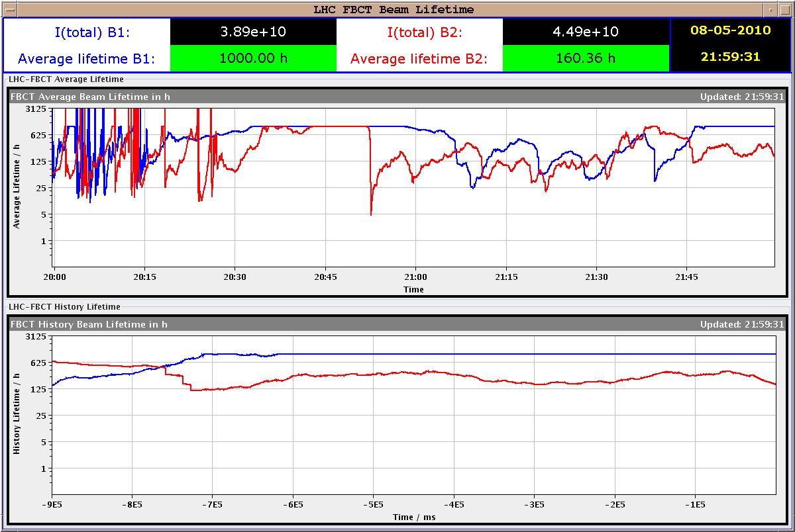
Saturday 8.5.
Lifetimes:

Slide 6
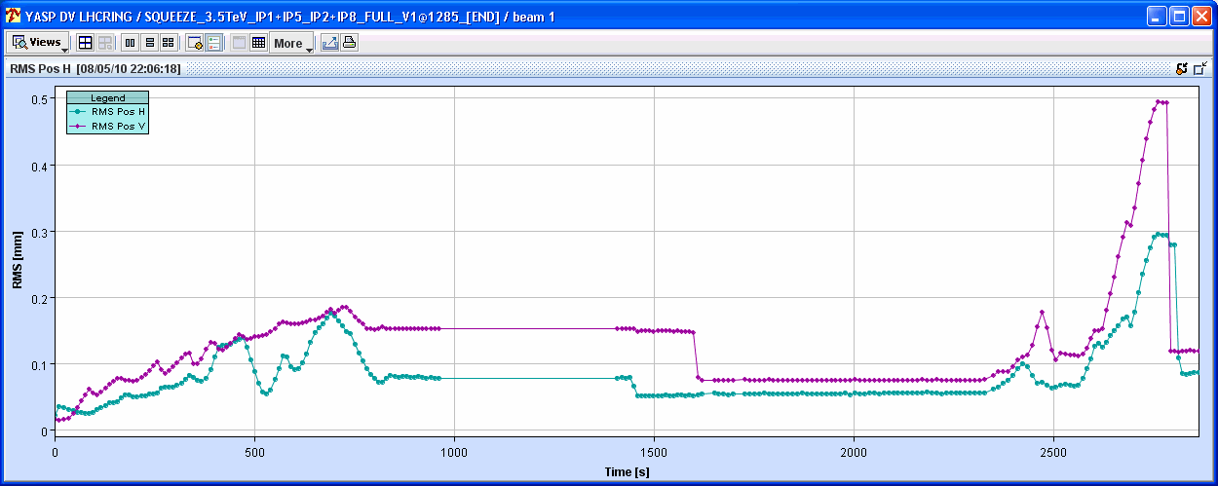
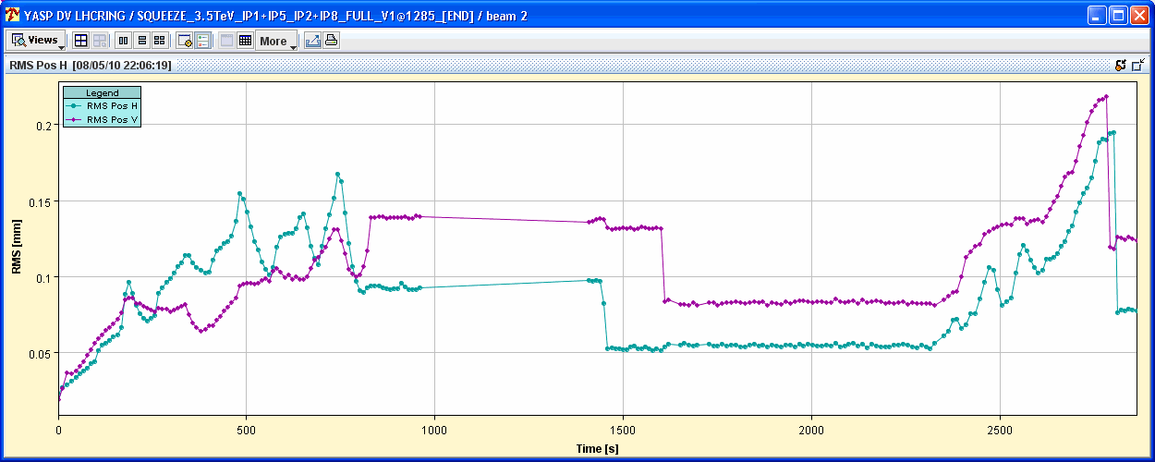
Saturday 8.5.
Lifetimes:

Slide 7
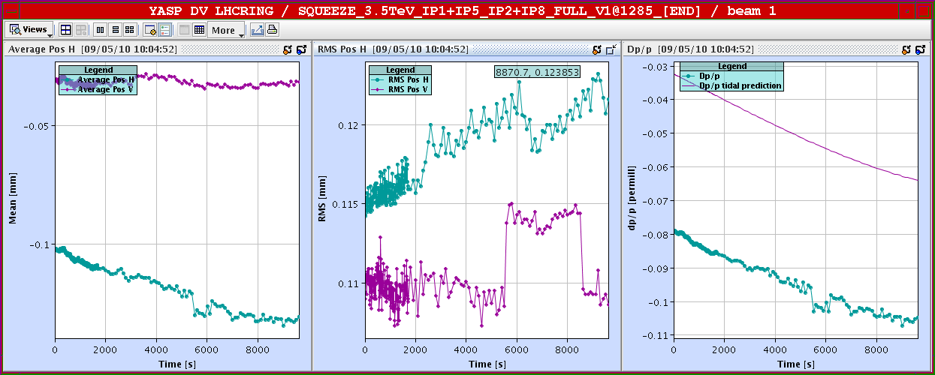
Sunday 9.5.
Orbit with TI2 and TI8 being turned off-on: Beam1
TI8 off
TI8 on
TI2 off
TI2 on

Slide 8
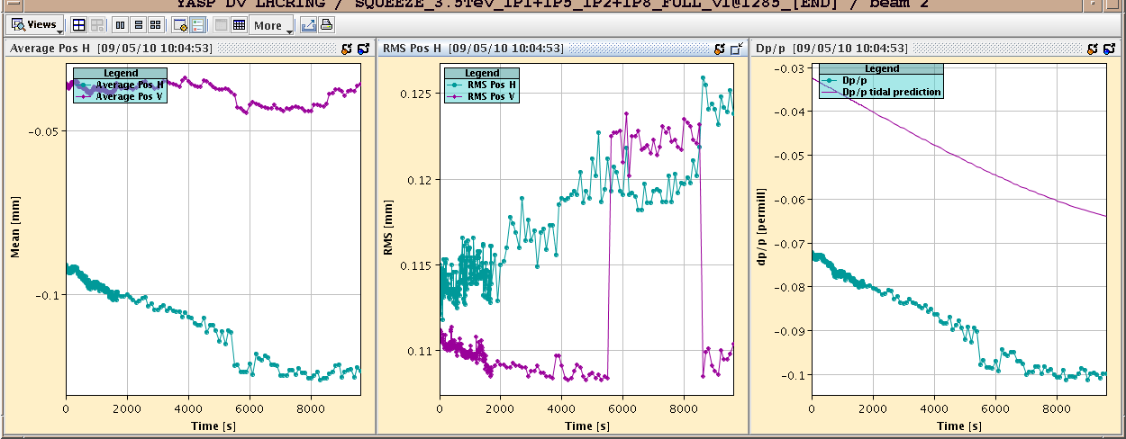
Sunday 9.5.
Orbit with TI2 and TI8 being turned off-on: Beam2
TI8 off
TI8 on
TI2 off
TI2 on

Slide 9
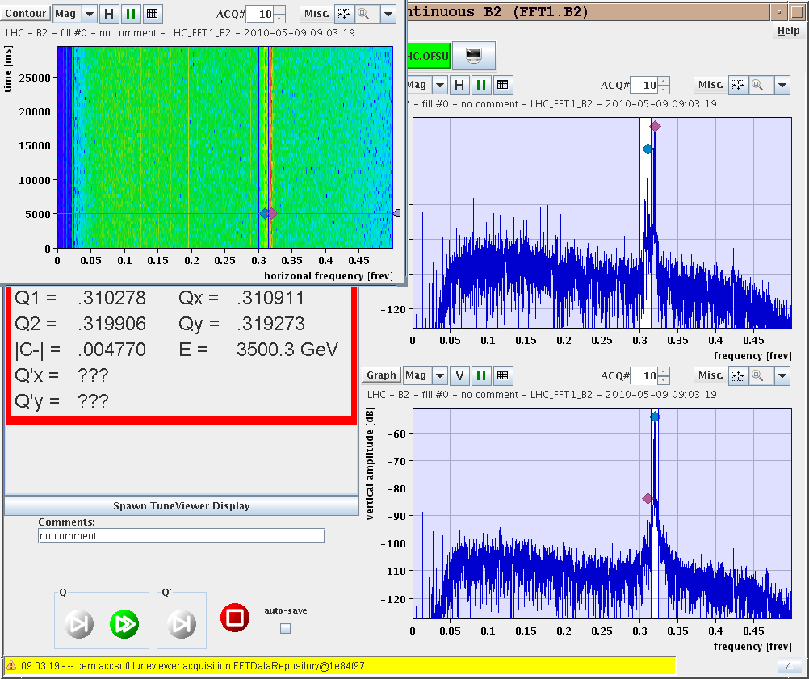
Sunday 9.5.
Tune spectrum for Beam2 with TI8 switched off:

Slide 10
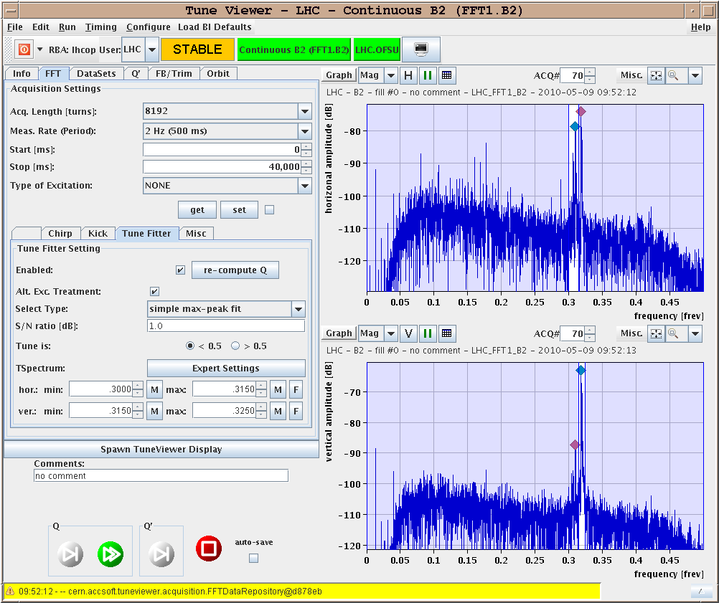
Sunday 9.5.
Tune spectrum for Beam2 with TI8 switched on:

Slide 11
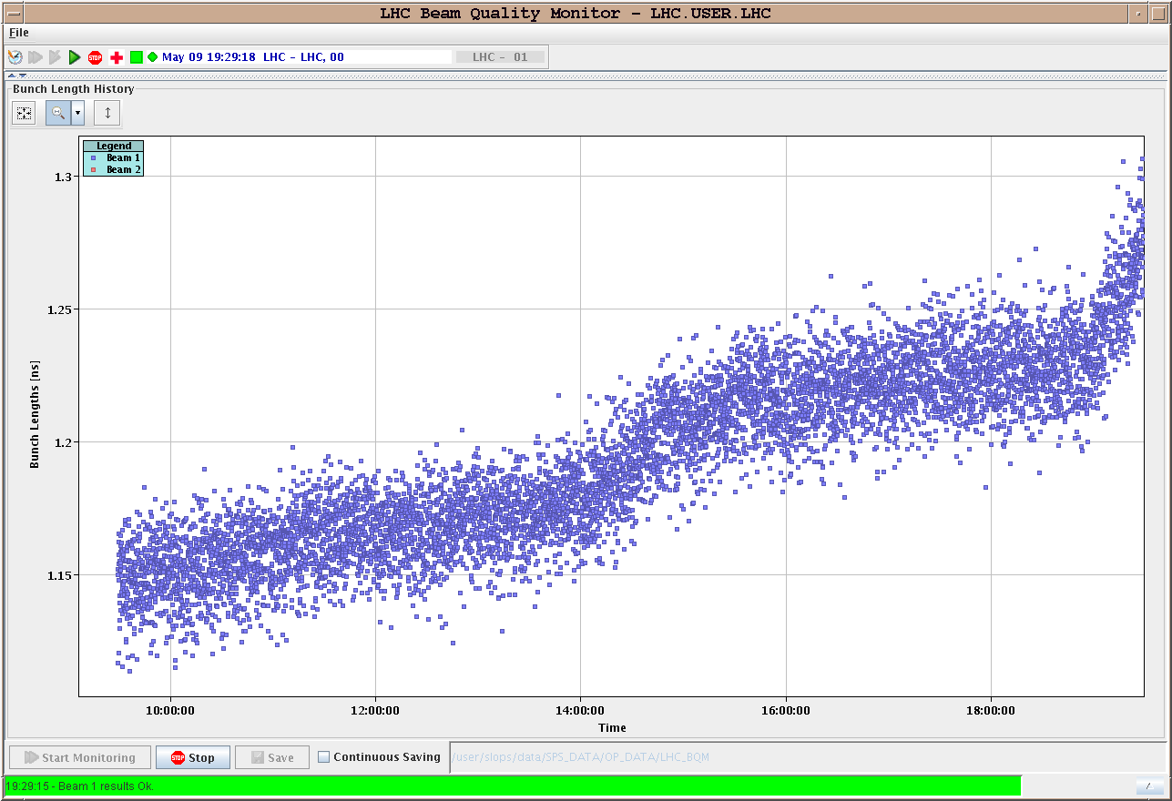
Saturday 9.5.
Bunch length evolution for Beam1:

Slide 12
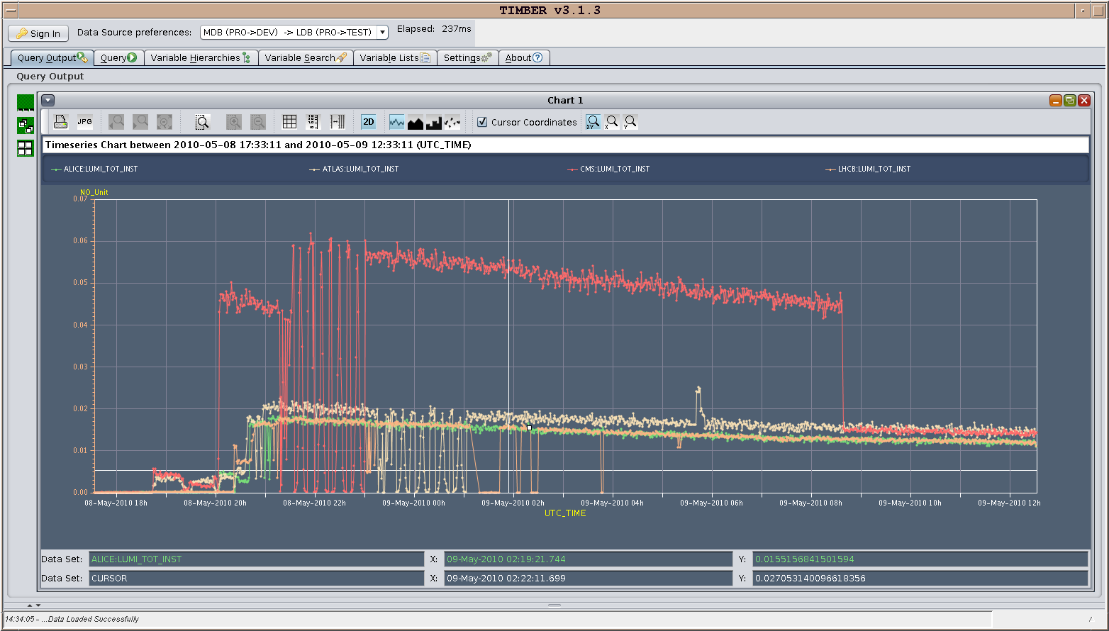
Sunday 9.5.
Luminosity lifetime towards end of the fill:

Slide 13
Sunday 9.5.
21:20: Preparing for new physics fill:
MP3 expert needs to reset QPS for main circuits in S56 and a 600A circuit in S67 (RQS.L7B2)
RQTL11.R2B2 tripped
00:18: Starting Injection
Emittances: B1H 1.2; B1V 2.1; B2H 2.4; B2V 3.2
B1 = 3.5 10¹⁰; B2 = 4.0 10¹⁰ per beam in two bunches
01:20: Starting ramp
03:00: Collapsing pumps & Start squeeze
04:30: Stable beams
Emittances: B1H 3.8; B1V 3.3; B2H 3.1; B2V 3.8
Plan for next week:
Physics fills!
cleanup of outstanding issues (LBDS, abort gap cleaning etc.)

Slide 14
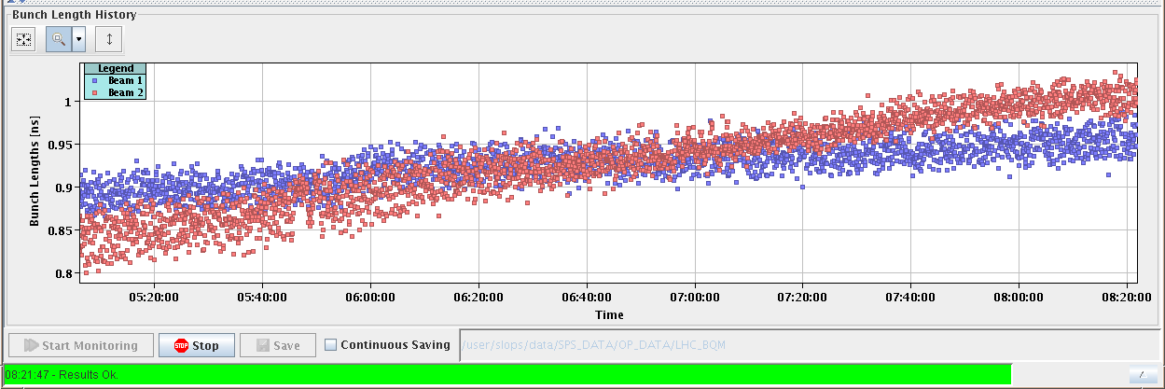
Monday 10.5.
Bunch length during fill:

Slide 15
Monday 10.5.
Plan for next week:
Physics fills!
cleanup of outstanding issues (LBDS, abort gap cleaning etc.)

