Slide 1
Thursday 6.5.
07:30: PS repair (broken emergency stop) and pre-cycle in the LHC
Problem in closing switch B of circuit RSD2.A45B2: closed only at 9th attempt.
Problems with moving collimators in park position ➔ piquet diagnosed a problem with the LSA settings but could not do anything because he has no right to change settings by hand. ➔ needed to call expert (Stefano)
Debunching of beams understood after investigation by RF experts:
from May 5th, ~ 04:00 onwards the phase loop of Beam 2 stopped working (probably stopped earlier but no beam)
from May 5th, ~12:42 onwards phase loop of Beam1 stopped working
Probably caused by re-programming of the RF gain during test of "automatic adjustment to beam intensity”
Without phase loop, the beams undergo visible dipole oscillations ➔ emittance blow-up until the bucket is full and then losses

Slide 2
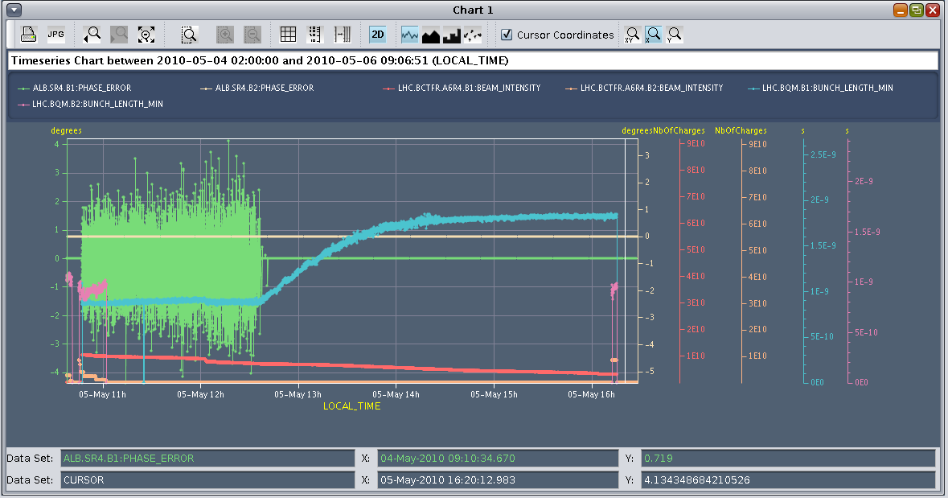
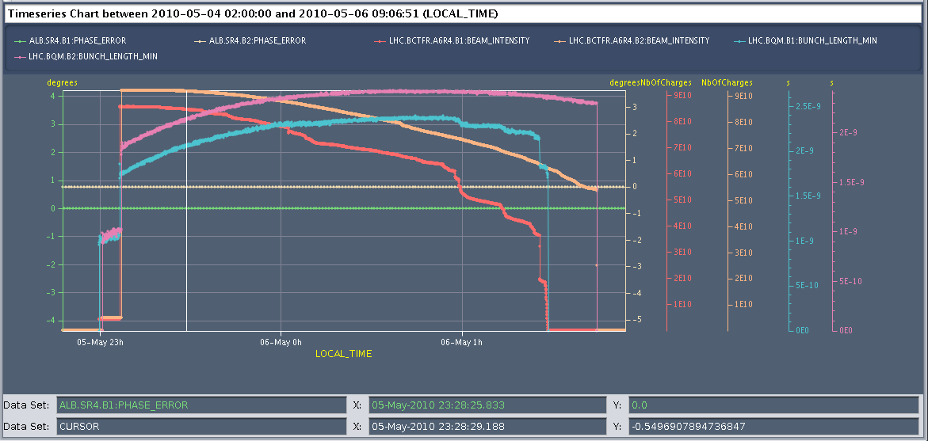
Thursday 6.5.
RF diagnostics on bunch lengthening Beam1:

Slide 3
Thursday 6.5.
10:30: Beams back in the LHC
11:30: Start Damper studies:
lifetime stayed high with damper on: above 100 hours with moderate gain and without ‘hump’.
various gain settings tried: 0dB -6dB -12dB and -20dB.
0 dB gives a damping rate of ca. 40 turns, but the tune peak broadens and the 8 kHz line amplitude increases
A better setting is -6 or -12 dB. With -12 dB the vertical beam size seems to stay constant.
The feedback currently only uses one pick-up and a FIR filter to adjust the phase. OK for a certain range of tunes. With the hump moving in from the right side lifetime goes down with high gain setting.
Reduced gain reduces the broadening of the tune peak, but there is no chance to catch the hump in this situation ➔ need the second pick-up and the FIR filter bypassed to reduce the delay and broaden the tune (requires FPGA firmware modification [not before early next week]).

Slide 4
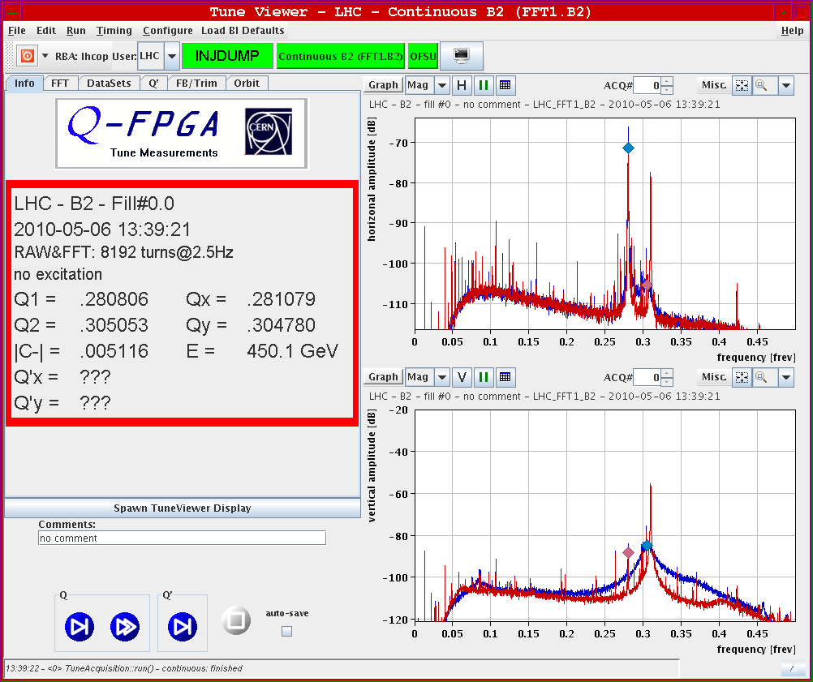
Thursday 6.5.
BBQ spectrum
without (red)
and with (blue)
damper:

Slide 5
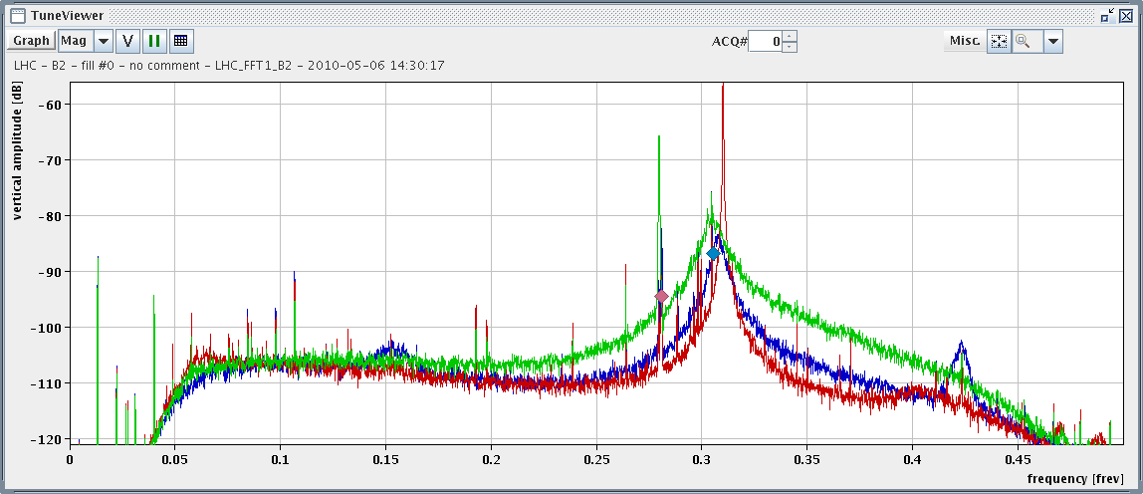
Thursday 6.5.
BBQ spectrum with damper on:
damper off (red), damper 'on' 0db (green), damper ‘on’ with -12dB (blue)

Slide 6
Thursday 6.5.
Beam 1 Injection studies (parallel to ATD):
Loss maps taken in LHC to check in detail the TCDI protection.
Trajectories also recorded for evaluation of coupling into LHC for injection matching.
15:00: Loss of Cryo in Pt2
Will take LHC off for at least 8 hours
01:00: Cryo back in Pt2 ➔
starting pre-cycle in S23
02:30: Starting ramp with optics measurements along the ramp
03:30: Beam at 3.5 TeV
04:00: Squeeze
04:50: Stable beams
05:20: Lost Beam during coupling adjustments (ΔQ = 0.01)

Slide 7
Friday 7.5.
β-Beat measurements during the ramp:
Up to 1.1TeV AC dipole did not cause any emittance growth.
Between 1.1TeV and 1.8TeV some chromaticities increased a lot (visible Qs sidebands in the tune spectra!) and rendered the AC dipole non-adiabatic causing emittance growth and beam loss.
Still half of the intensity survived and measurements could be done all the way to the top.
The beta-beating clearly increases up to ~1.2 TeV and decreases until 3.5 TeV (jumps at IR3 and IR7). This is clearly correlated to the fact that the injection corrections are linearly removed between 450GeV and 1.2TeV and remain zero up to 3.5TeV.

Slide 8
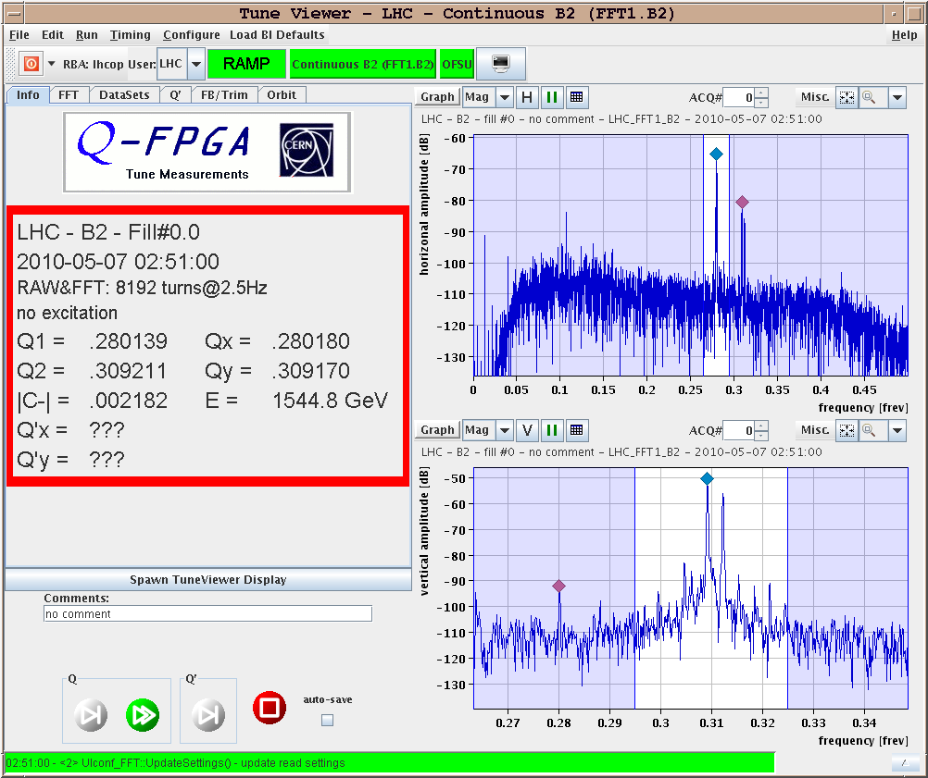
Friday 7.5.
BBQ during the ramp with sidebands in vertical plane:

Slide 9
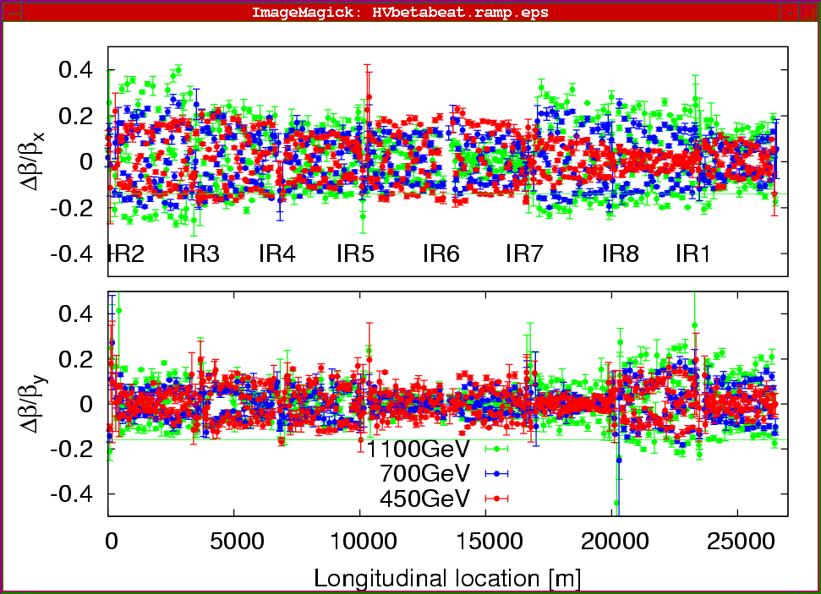
Friday 7.5.
β-Beat measurements during the ramp:

Slide 10
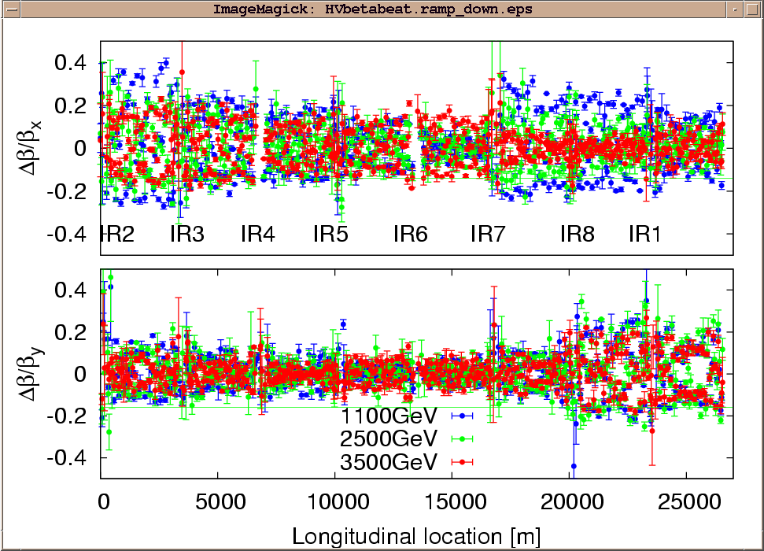
Friday 7.5.
β-Beat measurements during the ramp:

Slide 11
Friday 6.5.
Plan for the day:
Morning: continue collimation setup at 450 GeV in preparation for ramp with high intensities.
Afternoon: LBDS studies.
Physics fill for the night.

