Slide 1
Friday 07.05
07:00 : Collimator setup at injection
All collimators are setup with ~1E11 / beam.
Validation loss maps to do (Qx, Qy, fRF).
13:00 : Loss of cryo conditions on Q6.L3
15:30 : Beam back – MPS for LBDS
RF frequency interlock test
LBDS OFF test (high level controls)
Revolution freq. off
Apertures for B1 and B2 in IR6 and at the injection septum (MSI)
Apertures for extracted beams.
TI8 extracted beam amplitude scan.
Some abort gap cleaning test in parallel, but no cleaning done. Issues with OASIS and BPM acquisition.

Slide 2
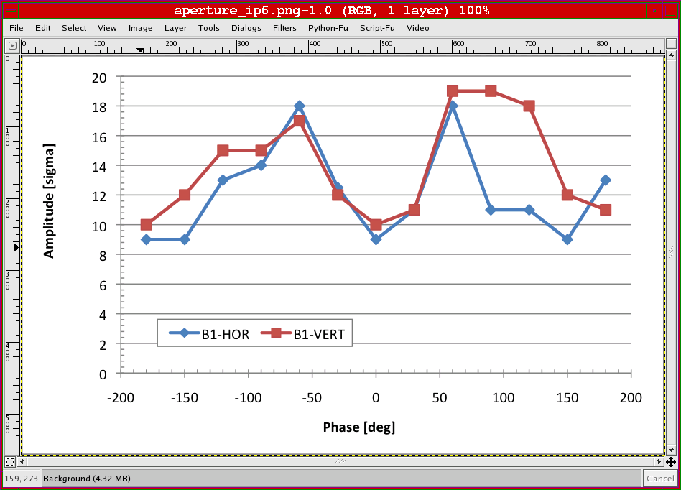
Extracted Beam1 Apertures

Slide 3
Saturday 08.05
22:30 : Lost cryo conditions in 4 (RU), UPS not OK
Lost RU.R4: DCCT - intervention required
03:00 : Prepare for physics
Precycle of sector 34, 45 and 67.
QPS-OK issues: RQTL11.L5B1 and then RQD/RQF.A23.
ALICE spectr. and solenoid OFF.
06:00 : injection
LBDS BETS had to be reset by expert.
07:50 : ramp
08:30 : squeeze starting

Slide 4
Saturday 08.05
To do for intensity increase:
Collimator loss maps for new injection setup
Collimators in the ramp (not before Monday)
Approx. 1 LBDS shift (some time not before Monday )
A lot of stable beams…

