Slide 1
Monday 4.5.
09:00: Updated and fixed issues related to feedback systems
09:30: Beam ready for machine studies (orbit, Q, Q’ and coupling)
10:00: Strange BLM readings in Pt6:
β-beat correction using ‘knobs’ for Q5 and Q6 adjustments.
10:30: Water loss for cryo in Pt2 due to fault in control rack:
Cryo for Sector 23 down for at least 6 hours (11 hours in the end).
Prepare for some accesses: LBDS [Pt6 Beam1 MKD – Beam1]; CMS; MAD [UJ27 Pt2]; IPQ splice measurements in S78; machine protection test in S56 and S67 [PIC matrix]; TI2 setup measurements with TED in.
23:50: Start precycle on sectors 12, 34, 45, 56 and 67
00:40: Start precycle in sector 78

Slide 2
Tuesday 5.5.
01:30: Cry back for sector 23
RSF1.A23B2 and RQTL11.R2B2 tripped when a U_res reset was performed.
resetting the circuits and bring them to idle before resuming the sequence solved the problem
02:00: Ramping up ALICE dipole
03:00: Precycle finished
04:15: Beam circulating
04:30: Damper studies started
18 hours interruption due to water fault
non-linear Chromaticity measurements in parallel

Slide 3
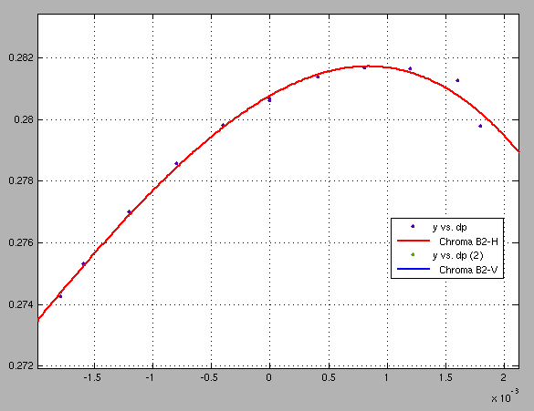
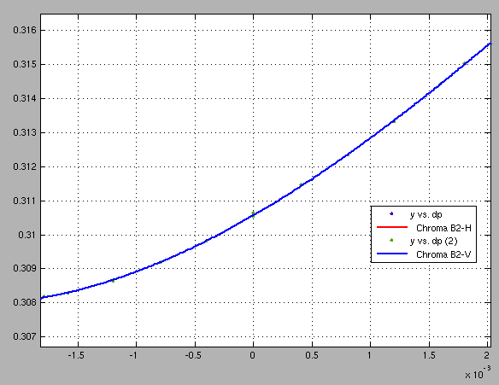
Wednesday 5.5.
Nonlinear chromaticity measurement in Beam2:

Slide 4
Wednesday 5.5.
Plan for the day:
Morning: Damper studies & abort gap cleaner
Noon-Early afternoon: BPM calibration with gauge changing in Pt6
Afternoon: collimation setup at 450 GeV in preparation for ramp with high intensities.
Physics fill for the night.

