Slide 1
MP3 report – week 16 12/4/2010 – 18/04/2010 14 interventions (up to 19/04 2h00)
MP3/QPS team in CCC

Slide 2
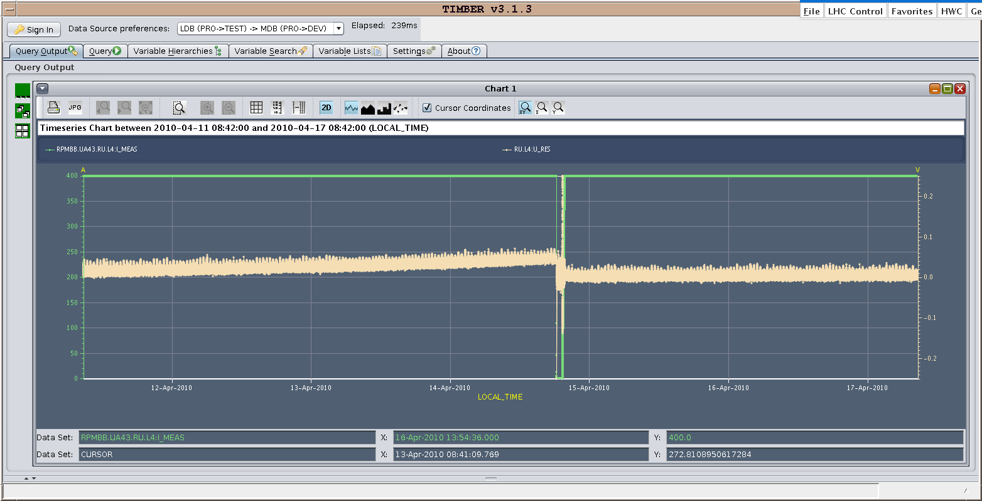
Undulator trip (RU.L4) on Wednesday (Again)
To be reset but at 0 current and not simply stable current ; also with low current in the mains. Fix: include reset in combo together with the ramp down of the undulator
Trip
Reset

Slide 3
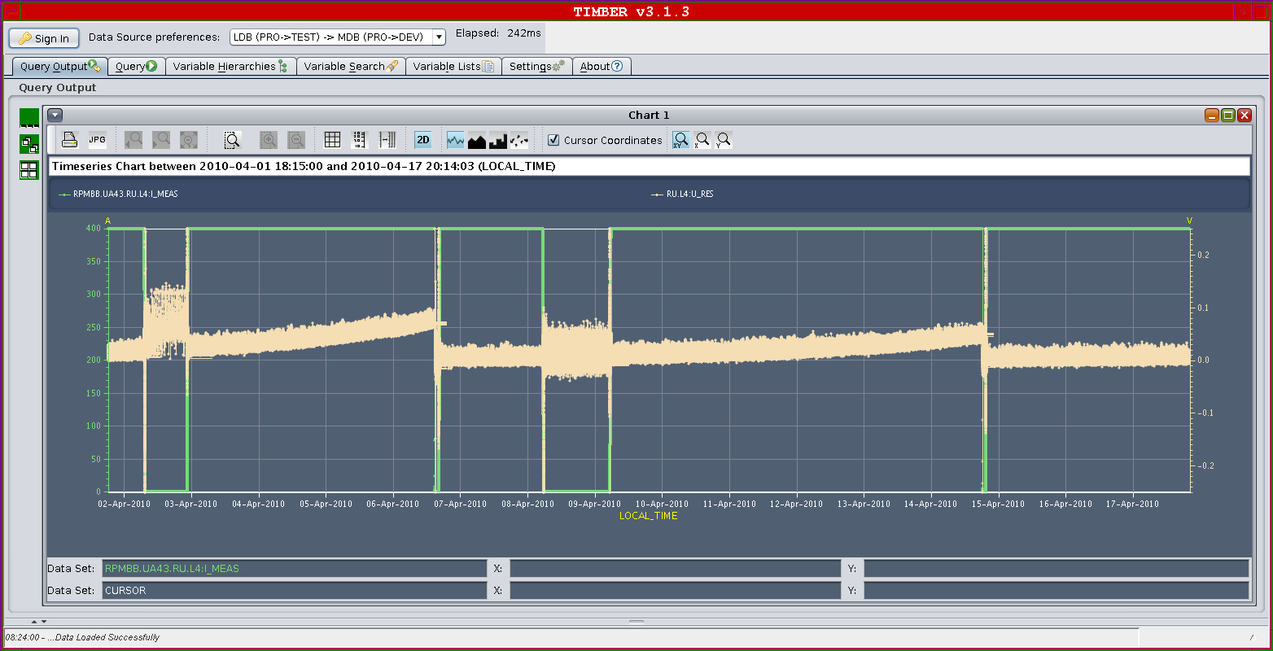
Undulator trip RU.L4
Long term behaviour : since 1st of April. Is it still drifting ?
Trip due to drift AND SPIKES
100 mV threshold

Slide 4
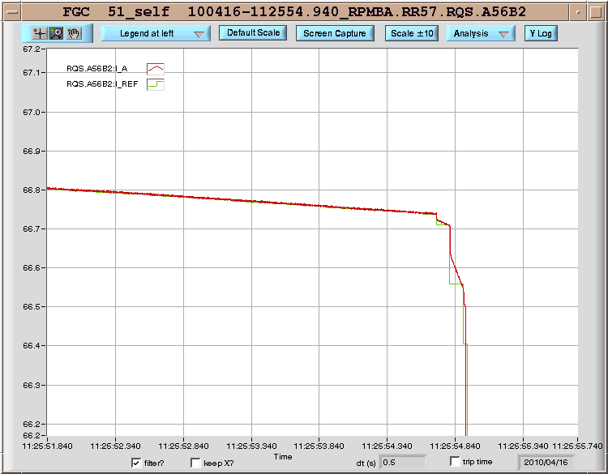
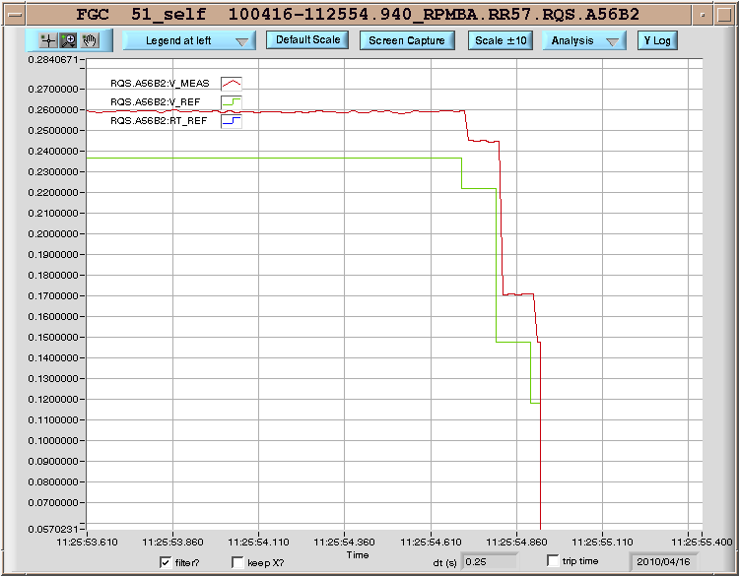
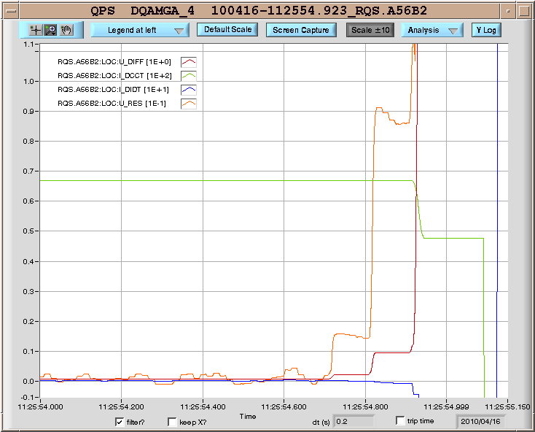
Skew quadrupole trips during squeeze
RQS.A78B2 (17/04) tripped 3 times due to steep current-ramp requests.
RQS.A56B2 (16/04) tripped once for the same reason
QPS inductive compensation does not have time to react.
V_REF translates directly into U_RES which goes above threshold.
Functions need to be adjusted / smoothened.

Slide 5
(Extended) DS (tuning) trim quadrupole
RQTL11.R2B1 :(15/04) : To squeeze @ 2m @IR2, it needed to be powered to 302 A - limit was increased from 200 A to 320 A ; the circuit was commissioned to 550 A. The limitation came from a possible lack of quench protection in case of loss of communication.
Similarly : RQT.13L8B1 (11/04) : To squeeze @ 2m @IR8, it needed to be powered to 352 A - limit was increased from 300 A to 352 A ; the circuit was commissioned to 550 A. The limitation came from the same reason.
This should not happen anymore in 2010 : “The successful squeeze to 2 m everywhere today should mark the full exploration of the operational settings space for this year” M. Lamont

Slide 6
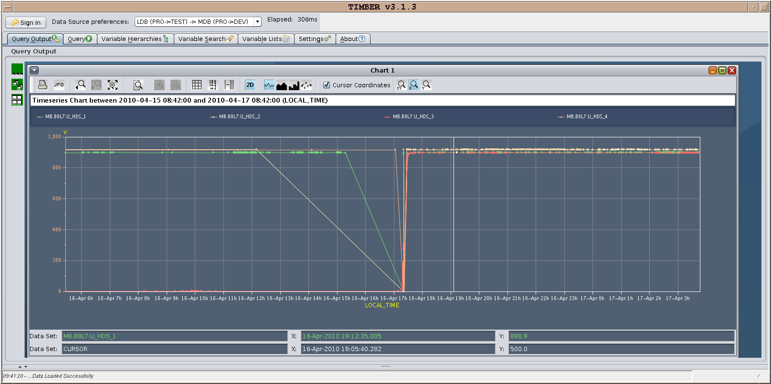
Other MP3 issues since 12th of April 2010 (1/2)
RB.A67: (14/04) : 1 QH power supply to be replaced (MB.B8L7) Can be tolerated temporarily @ 3.5 TeV Solved by QPS stand-by during access on 16/04.
Recharged QH
Discharged QH
Intervention

Slide 7
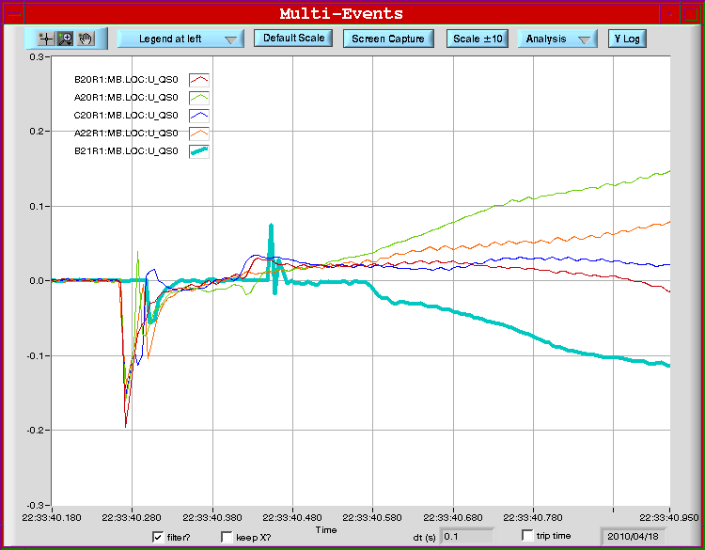
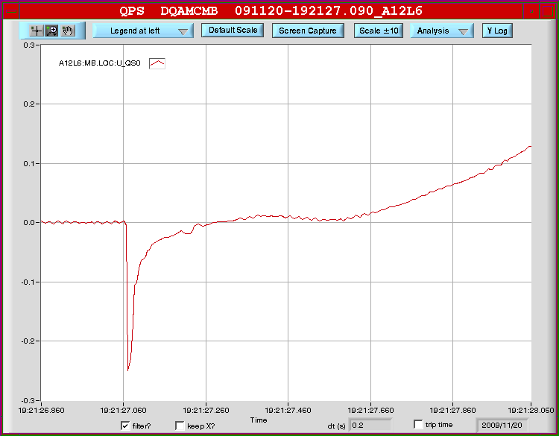
Beam-Induced Quench
4 magnets quenched by beam losses.
1 magnet quenched by quench heaters from symmetric quench protection.
Comparable event on Nov. 20, 2009 (as recalled precisely by J. Wenninger).
U_thres.
18/04/10
20/11/09

Slide 8
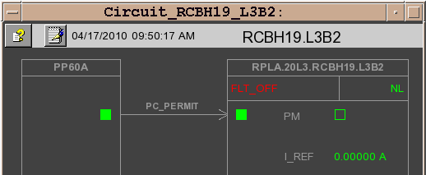
Other MP3 issues since 12th of April 2010 (2/2)
Some trips of circuits that were repowered after analysis:
RQTD.A56B1, RQ4.R5B1 (12/04)
RCBV12.L4B1 (12/04), RCBV17.L1B1 (13/04): Solved by EPC during access on 16/04
RQX.L8 (12/04) : communication between PIC & SIS: solved
RQT13.L6B2, RQT4.L3 [Warm circuit], RCBCH7.L3B2 (16/04) To be investigated (EPC?) : now working fine
RCBH19.L3B2 & RCBV19.L3B1 : Seems to have a PC issue EPC informed

