Slide 1
06h30: Machine ready again. Injection setup.
11h30: Start ramp.
12h00: Beams dumped due to RQTD, RQTF trips.
Q feedback was still On. No trims had been or were being done
The RQTF/D in A12 tripped. Looks as if the Q FB had sent a big trim. The U_RES signal went up very sharply, was zero before the trip.
The Tune-FB received and trimmed based on a bogus tune packet coming from the B2 Schottky system that has been enabled over the night.
We corrected the configuration and will investigate to block tune data packets coming from non-operational machines in the future.

Slide 2
S81 tripped in the middle of the rampdown
Resetting scetor 81 afetr confirmation of the trip: it was again due to an erratic bus-bar signal on RQF. Zinur has got a token to chage the threshold on that channel.
channel B22.L1_4 to 600 uV.
18:05 – end ramp
19:00 Start squeeze
Step through
tunes, orbit, coupling, chromaticity
tertiary collimators in at 5 m. all points
Couple of hard lifetime dips
Important coupling correction between 3.5 and 2 m
23:00 Squeezed to 2 m. all points

Slide 3
Apres Squeeze
Coupling
Beating measurement and correction
Lumi optimization – all Irs
Collimator optimization
- 2 IPs done in B1 (IP5, IP8), i.e. 4 TCTs
- 3 IPs done in B2 (IP2, IP5, IP8), i.e. 6 TCTs
- used refined method to setup collimators, i.e. readjusting reference primary collimators after each TCT setup
- 10 TCTs out of 16 done within about 2h
- we caused a beam dump by performing unintentionally a too large incremental step (4mm) during setting up IR2 in B1
5:50 rampdown
RF studies

Slide 4
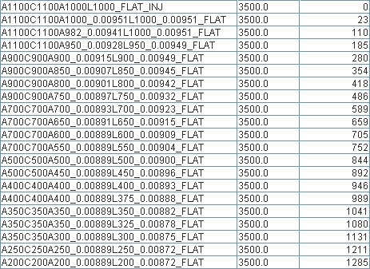
Squeeze
Lot going on out there
Einmal ist keinmal
Gabriel Muller Marek Strzelczyk Stefano Redaelli Xavier

Slide 5
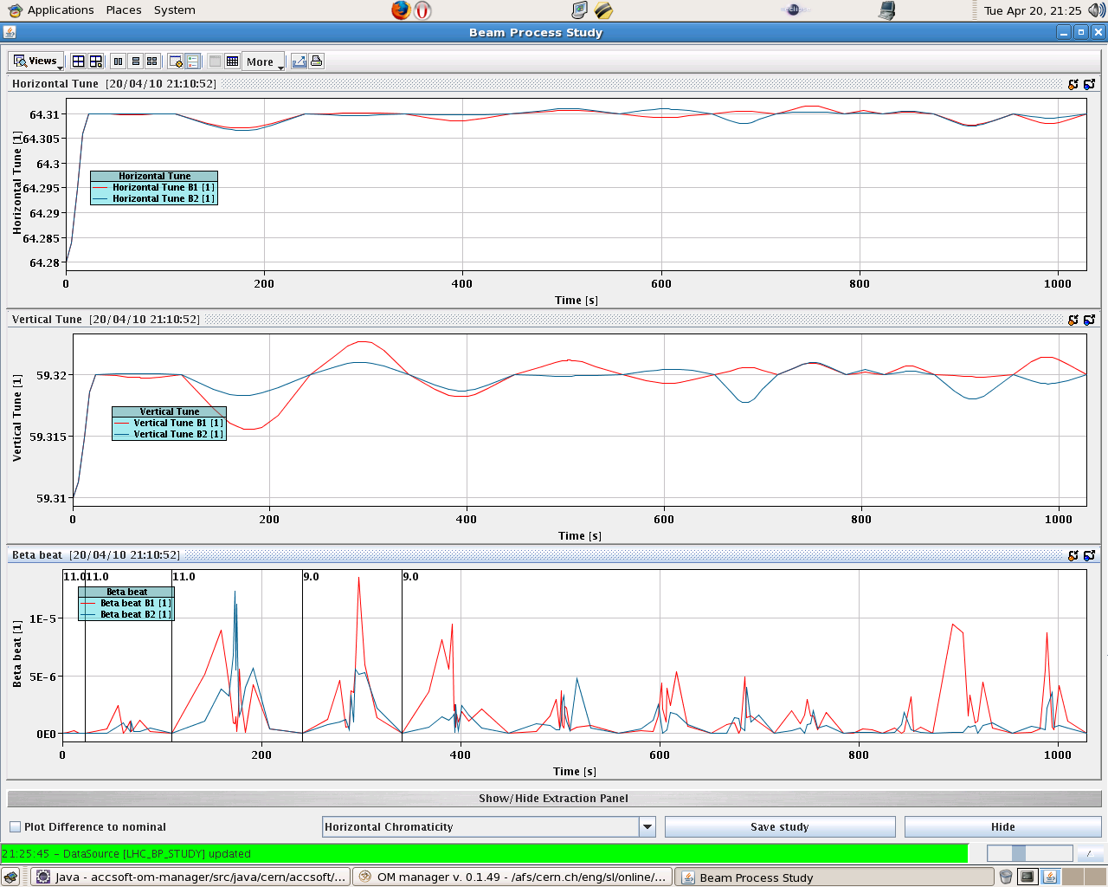

Slide 6
Lifetime – stepping through to 5 m

Slide 7
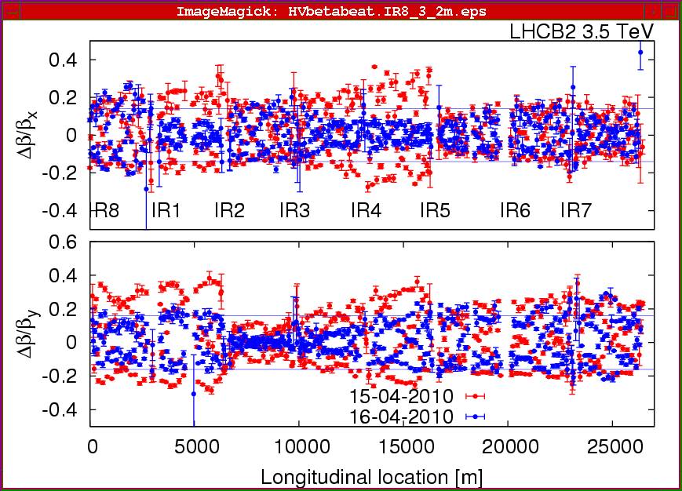

Slide 8
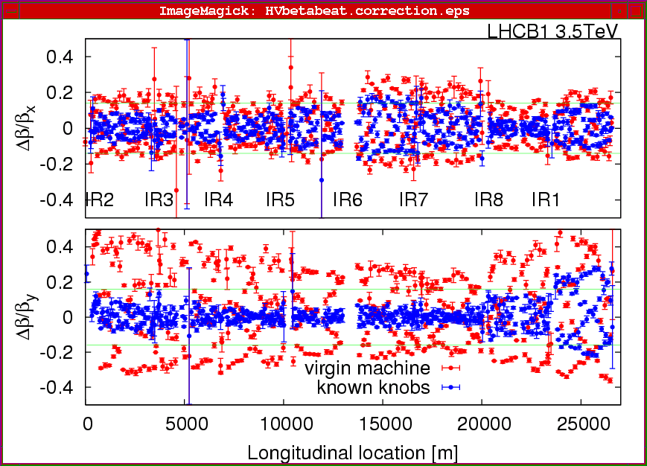

Slide 9
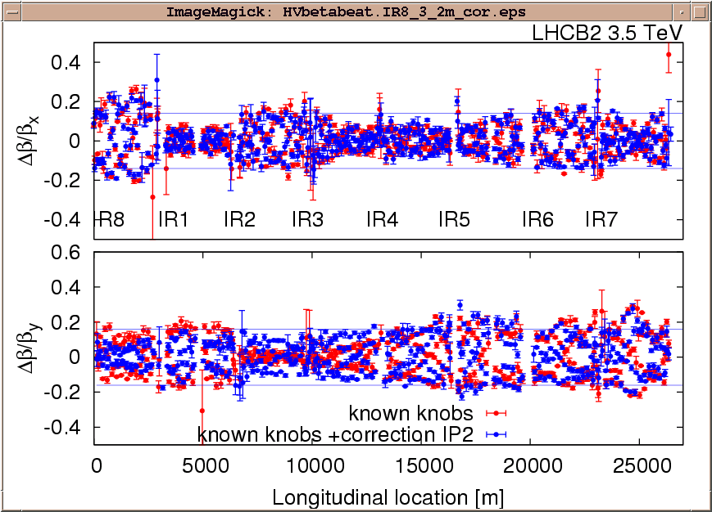

Slide 10
Today & Tomorrow
RF
Squeeze
finish TCT setup
qualification step 1/3 (loss maps, async)
7 pm Tranverse damper
Overnight - squeeze
Tomorrow – higher intensity injection and collimation

