Slide 1

Status of LHC Operations
R. Assmann
for the LHC commissioning team and LHC teams & groups
LPCC 23.4.2010

Slide 2
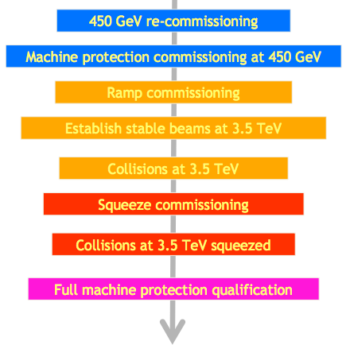
Commissioning Strategy Last Weeks
Mike Lamont et al

Slide 3
Outline
The squeeze story: Getting all 4 IR’s squeezed to 2m
  IR1 and IR5
  IR8
  IR2
  All 4 IR’s at once
  Qualification tests for machine protection
Higher intensity
  Storing 10 bunches at injection
  Storing nominal bunch charge
Feedbacks, emittance and operational issues
  Feedbacks
  “Hunt the Hump”
  Multiple beam-induced quench
Conclusion

Slide 4
PART I – Squeeze IP Beam Size @3.5 TeV
… a long story but with a happy ending…
This is one of the most complex stages of operation!
Change of beam optics to reduce beam size at the interaction points.
Goal for 2010 beam size reduction: factor ~2.2 for each plane
(factor 5 in IP beta):
➔ factor 5 higher luminosity
This is a change in β* by a factor ~5! Complex control of all IR power converters plus precision corrections.
At the same time the beam size at the triplets around the experiments increases significantly:
➔ triplets become aperture bottlenecks
Protection of triplets and experiments against beam loss must be carefully verified before stable beams.

Slide 5
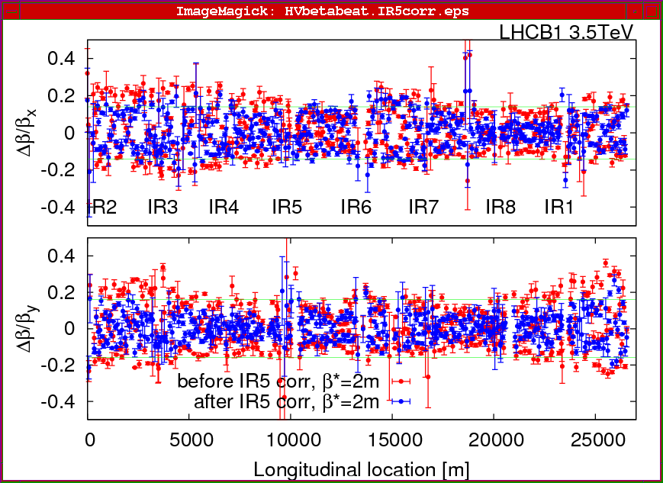
Step 1: Squeezing and correcting IR1 & IR5
β-beat for Beam1 @ β* = 2m after correction using IR5 Q2:
Rogelio Tomas et al

Slide 6
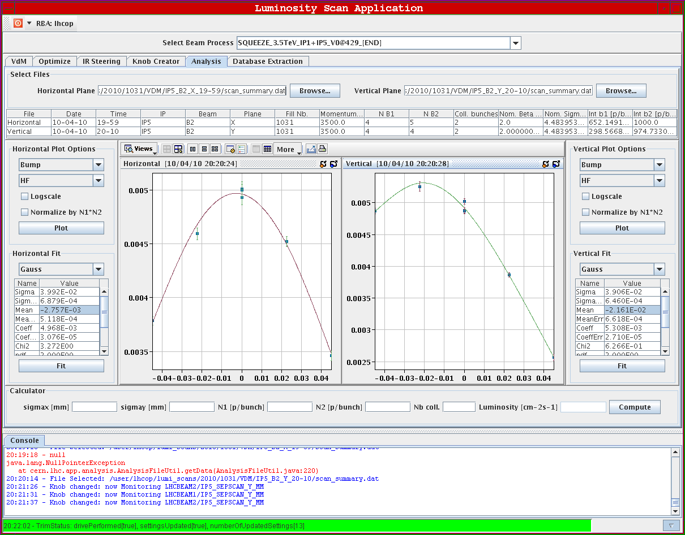
Example: CMS Luminosity Optimization
S. White

Slide 7
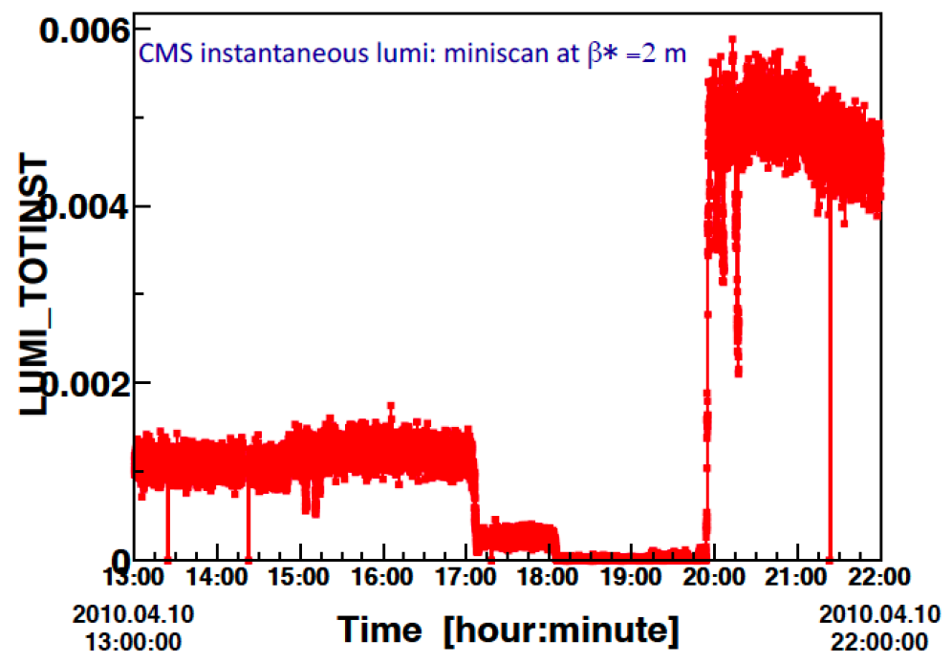
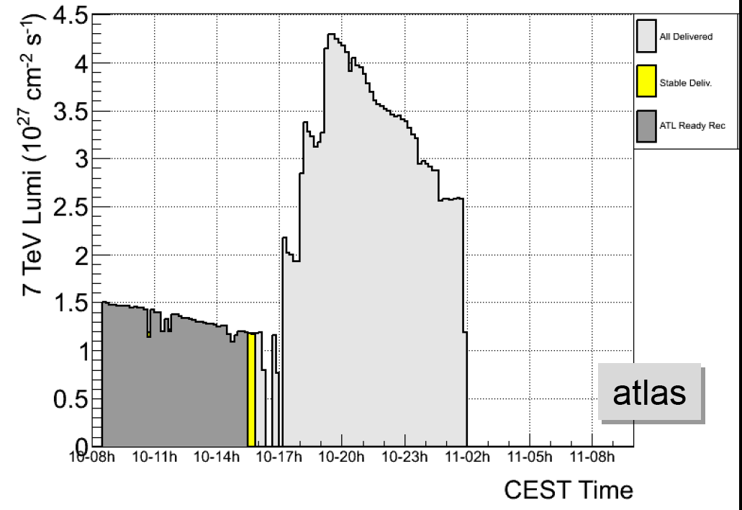
ATLAS and CMS Improvement
M. Ferro-Luzzi
Increase after squeeze: Factor 4-4.5 (to be compared with expected factor 5)
Luminosity up to 5×10²⁷ cm⁻² s⁻¹.

Slide 8
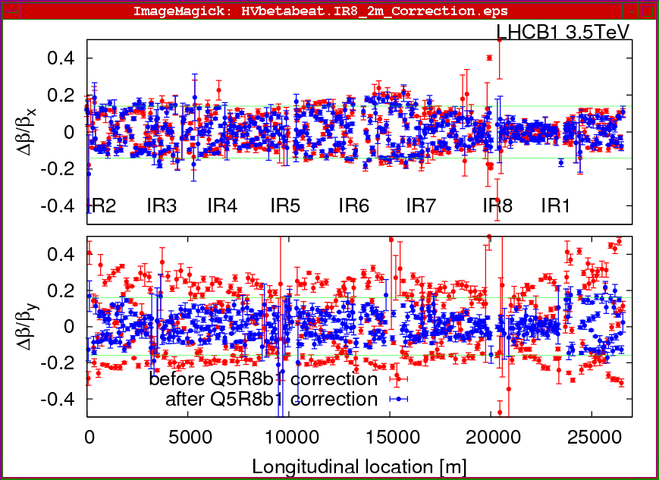
Step 2: Squeezing and correcting IR8
β-beat for Beam1 after squeeze and @ β* = 2m in IR8 after
correction of Q5:
Rogelio Tomas et al

Slide 9
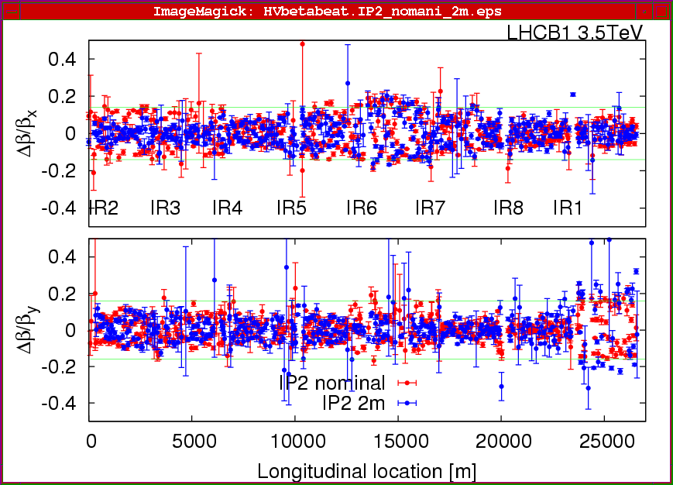
Step 3: Squeezing and correcting IR2
β-beat for Beam1 at β∗ = 2m in IR2 (all other IPS at β∗ = 2m):
Rogelio Tomas et al

Slide 10
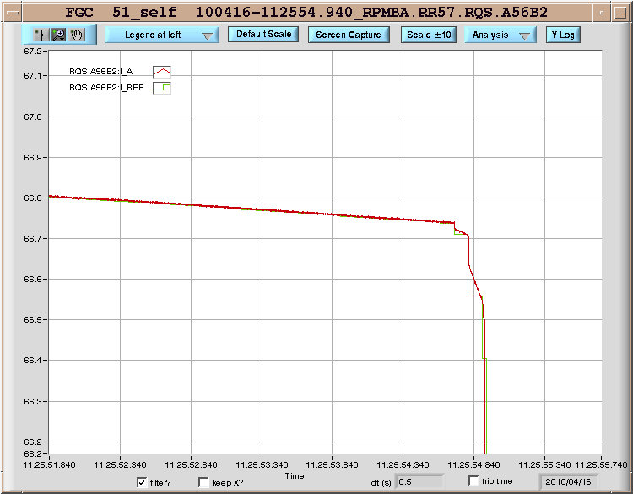
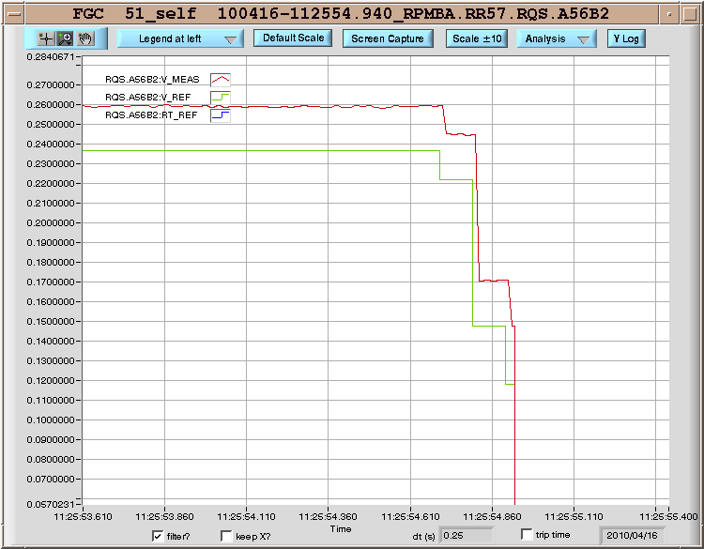
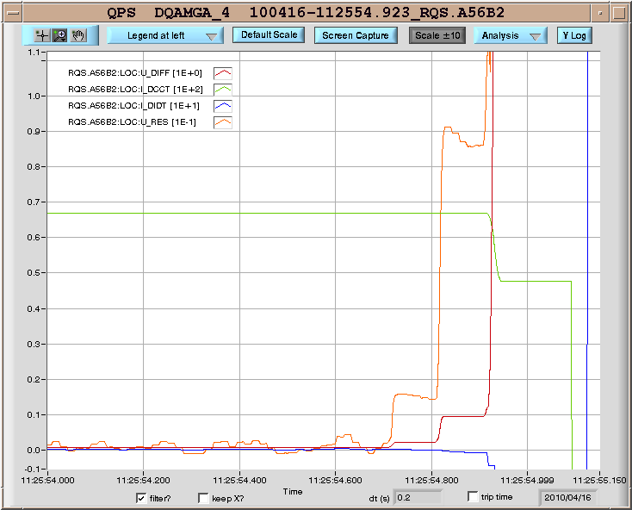
Problem Example I: Too steep current requests
RQS.A78B2 (17/04) tripped 3 times due to steep current-ramp requests.
RQS.A56B2 (16/04) tripped once for the same reason
QPS inductive compensation does not have time to react.
V_REF translates directly into U_RES which goes above threshold.
Functions need to be adjusted / smoothened.
Fixed as found…
Thanks to crucial help from MP3 team on shift!

Slide 11
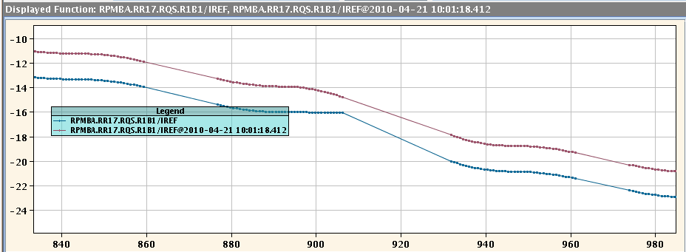
Problem Example II: Discontinuities after incorporation
➔ Fixed by new software

Slide 12
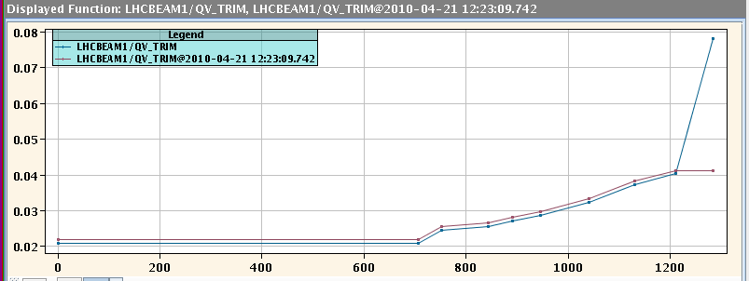
Problem Example III: Leftover trims incorporated
➔ Fixed by procedure…
Many small issues that require to be found and fixed. Each little issue costs 5-6 hours!

Slide 13
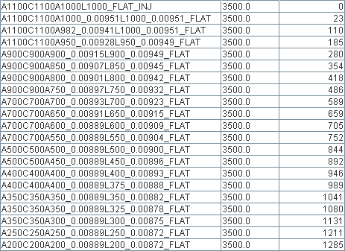
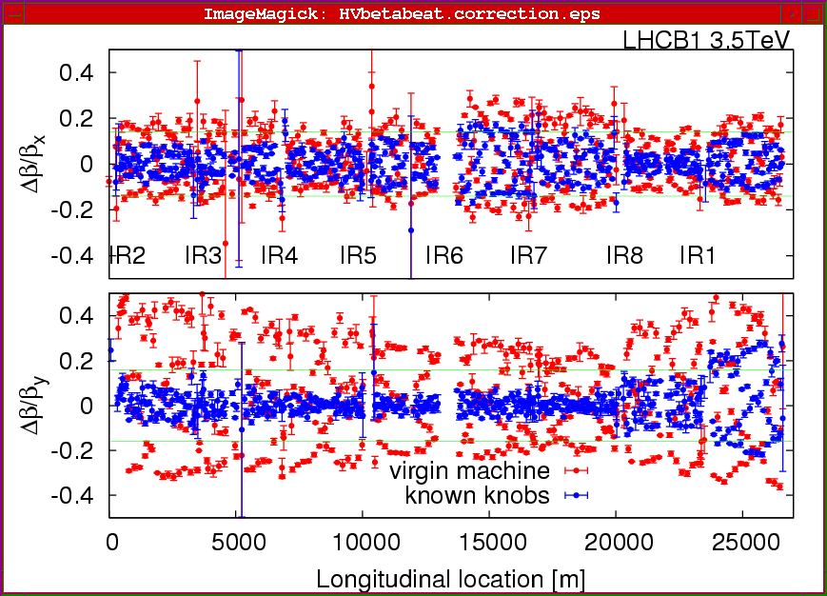
Step 4: Squeezing and correcting all 4 IR’s
Rogelio Tomas et al
21 optics steps!
Mike Lamont
Gabriel Muller
Marek Strzelczyk
Stefano Redaelli
Xavier

Slide 14
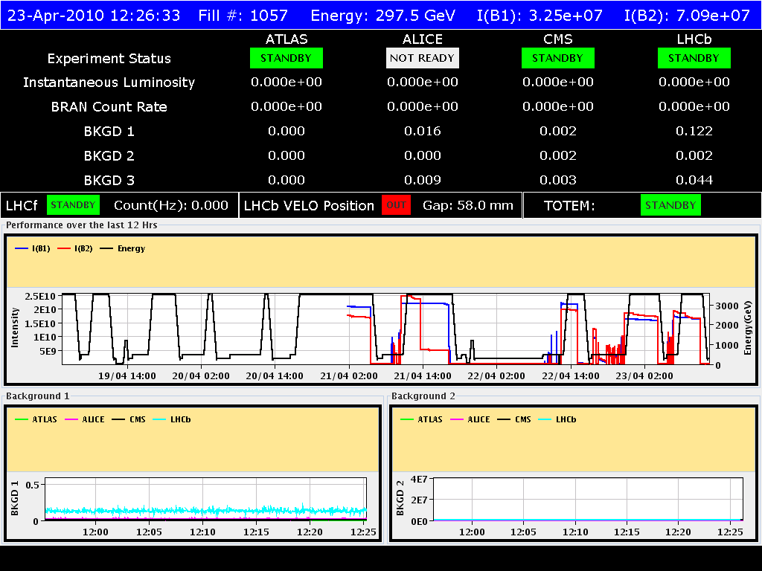
Squeeze now starts working smoothly!
Look at 4 most recent fills in last 48 hours!
All these fills made it to 3.5 TeV and 2m β*!
First two still affected by bugs (intensity loss) but used for qualification study!
Last two fills without any problem, very smooth!
Used for provoked loss tests in preparation for stable beams!

Slide 15
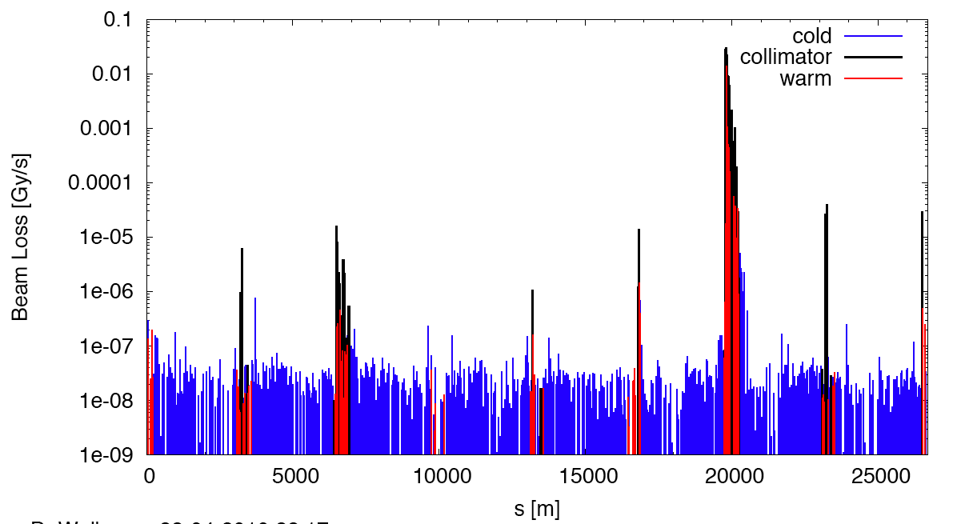
Provoked vertical beam loss on beam 1
Momentum Cleaning
Dump Protection Col.
IR2
IR5
IR8
IR1
Collimation Team
2m optics exposes IR’s as expected! Protected by tertiary collimators.

Slide 16
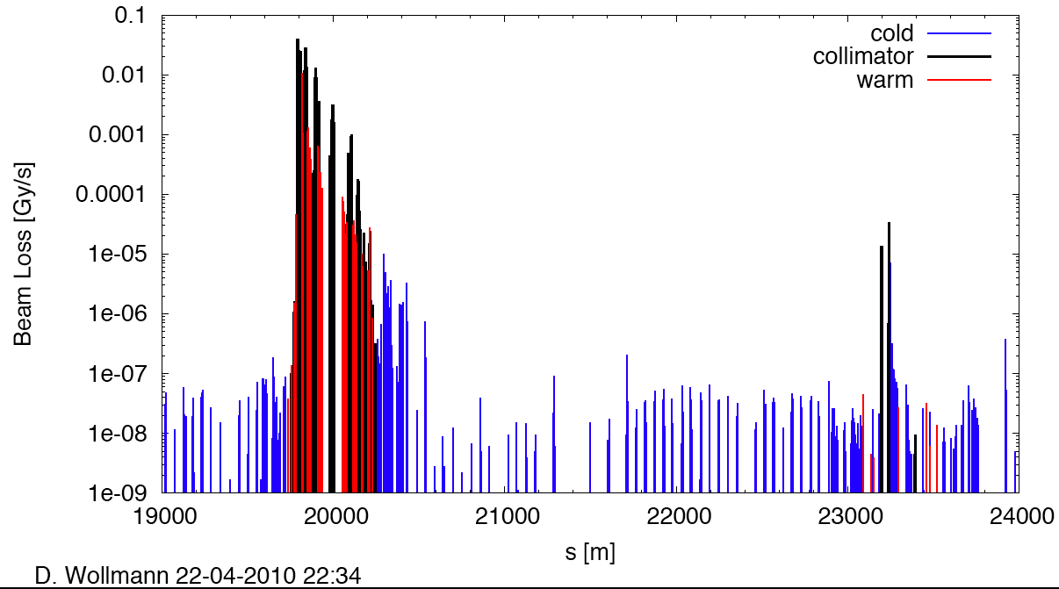
Zoom (vertical loss beam 1)
Betatron Cleaning
factor 4,000
factor 1,000
factor 600,000
IR8
Collimation Team
➔ OK for stable beams from collimation!

Slide 17
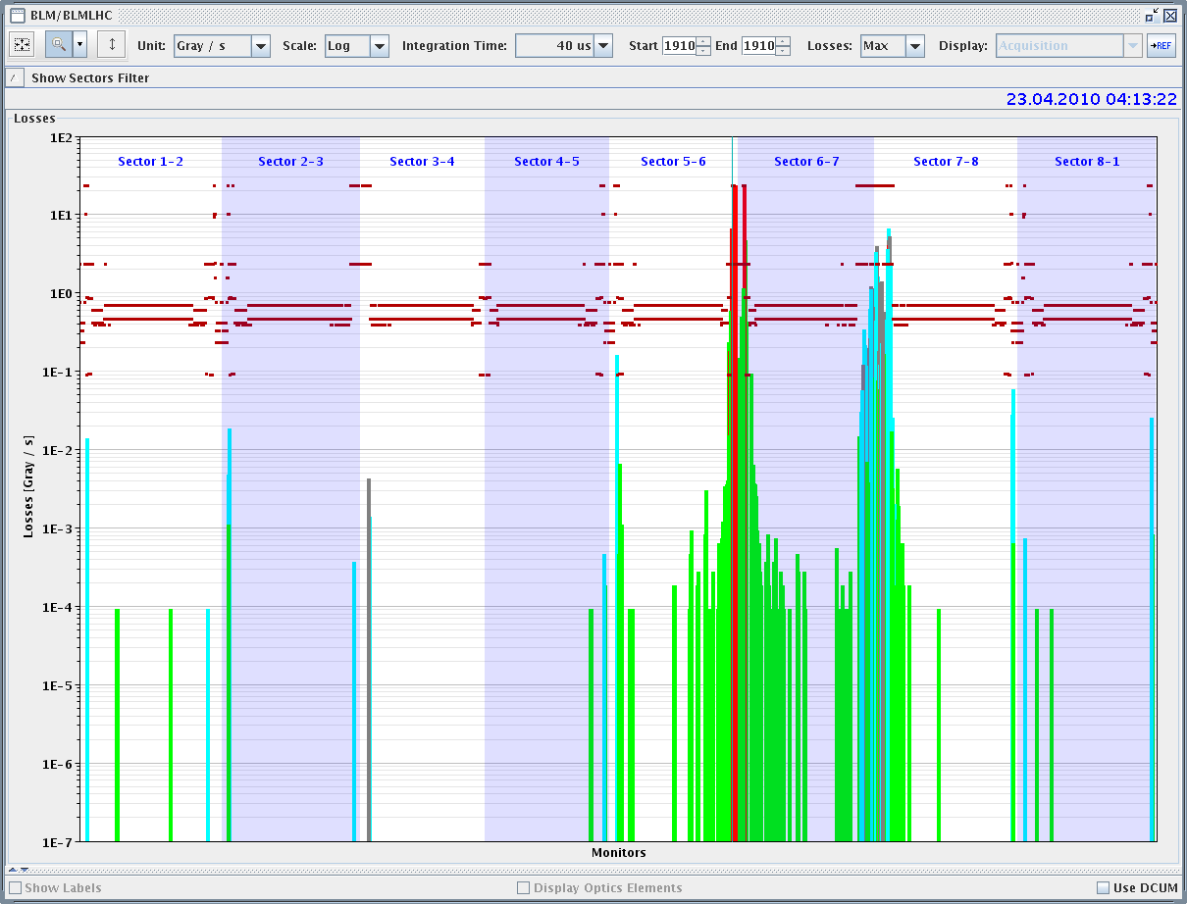
Provoked asynchronous beam dump
1e-3 leakage to tertiary collimators in IR’s
➔ OK for stable beams from beam dump!
Brennan Goddard et al

Slide 18
Status and Outlook Squeeze
Squeeze to 2m for all 4 IR’s established.
All IR’s steered into collision.
Golden orbit established.
All 16 tertiary collimators adjusted.
Squeezed optics fully qualified for protection.
Next: intensity from 2e10/beam to 3.5e10/beam
Next: Stable beams with 10 times luminosity:
10²⁸ cm⁻² s⁻¹ in reach
Still a lot to go but first steps are most difficult!

Slide 19
PART II – Increasing Intensity at 450 GeV
… will be a long story but so far very happy…
This will be the challenge of LHC!
Goal: Factor 10 at injection.

Slide 20
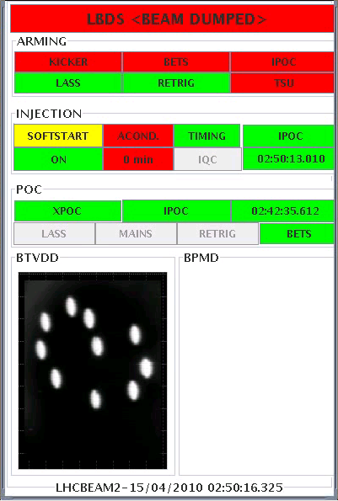
Increase Intensity: Number of Bunches
Dump of the 10 bunches
factor 10
T
Brennan Goddard et al

Slide 21
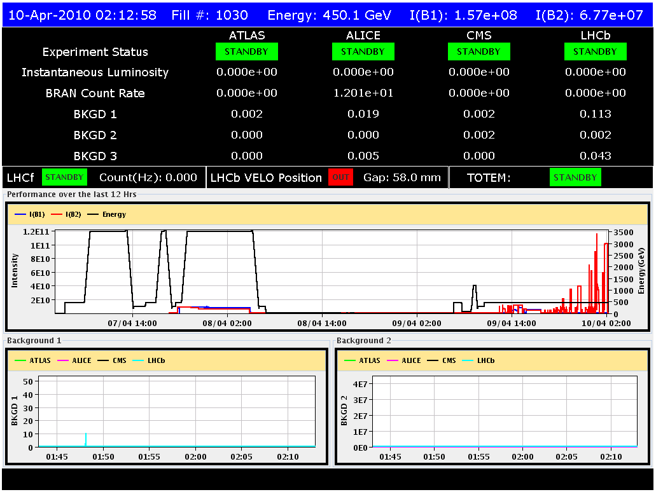
Increasing bunch intensity
factor 10
Major success for LHC: Nominal bunch charge at 450 GeV!
25 hours beam lifetime!
Means: No single bunch show stoppers from dynamic aperture, instabilities, …

Slide 22
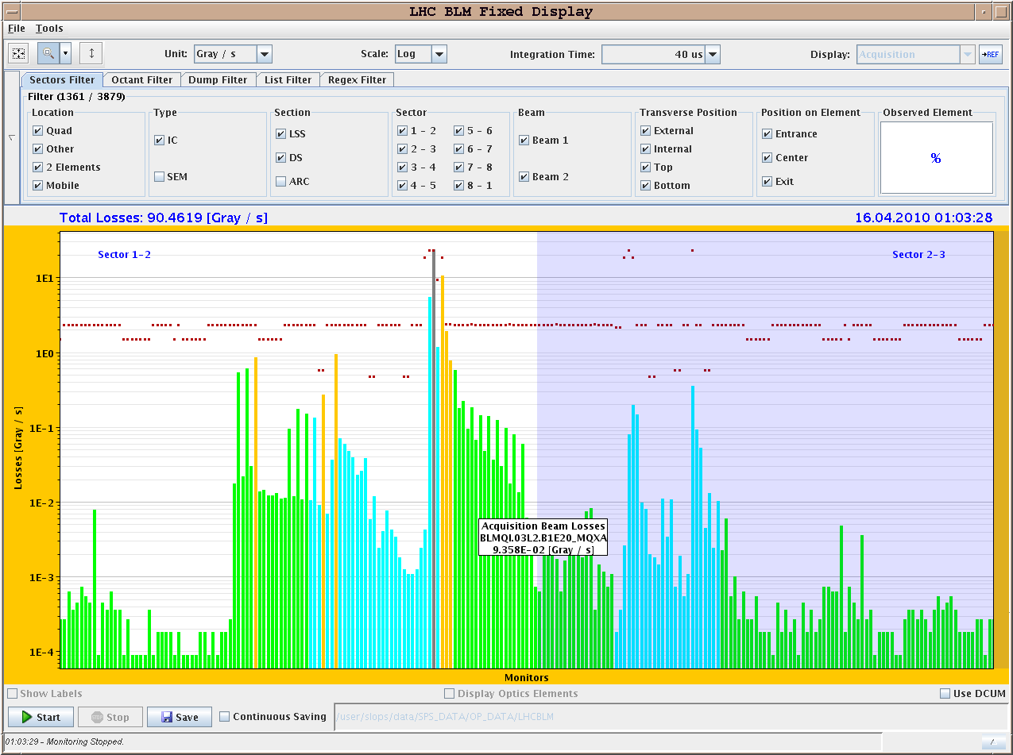
Increase Intensity: Over-Injection
Example of over-injection of 1E11 – 40 us integration
Losses from over-injection
Losses from TL
collimators (X-talk)
Brennan Goddard et al
TDI

Slide 23
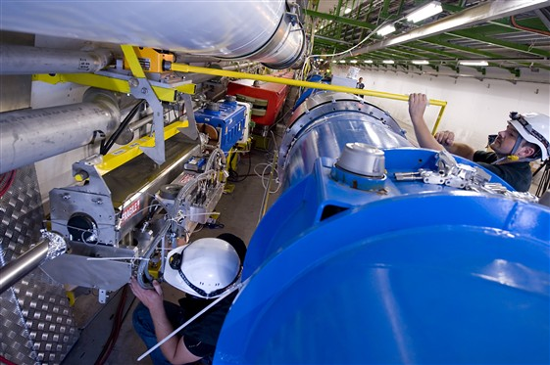
Tunnel View
Transfer line collimator
Ring magnets with beam loss monitors
Collimation Team

Slide 24
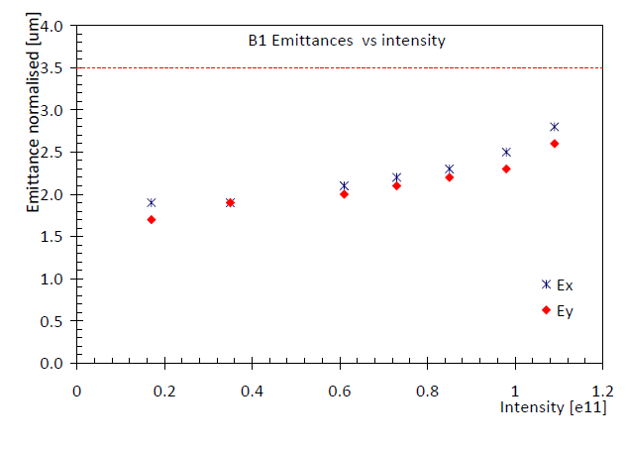
Increase Intensity: Emittance
Emittances versus bunch intensity:
Injection team
factor 10
beyond 1e10 pilot

Slide 25
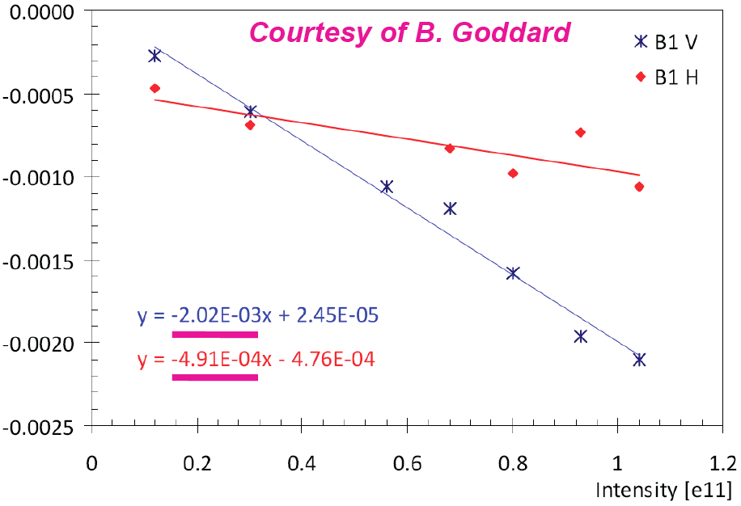
Increase Intensity: Tune Shift Beam 1
Injection team
ΔQ_{h} = 0.0005
ΔQ_{v} = 0.0015

Slide 26
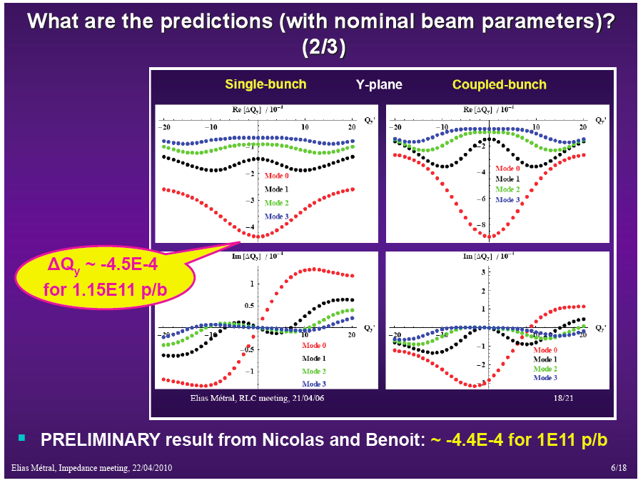
Tune shift: Measured versus Expected
 | B1 meas | B2 meas | Expected
Q_{h} tune shift | 5e-4 | 1.5e-3
Q_{v} tune shift | 1.5e-3 | 2.0e-3 | 4.5e-4
for 1e10 to 1e11 p
to be studied systematically:
impedance vs. collimator settings
other source?
Elias Metral et al

Slide 27
PART III – Feedbacks, Emittance & OP Issues
…the cure, some issues…

Slide 28
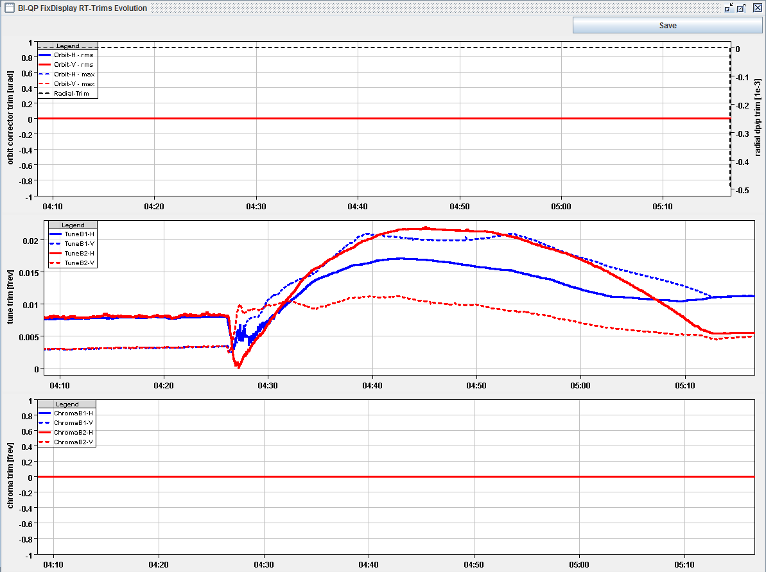
Tune Feedback in Operation
Tune feedback during ramp:
Ralph Steinhagen et al

Slide 29
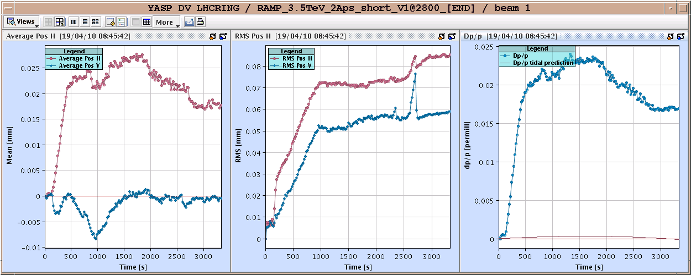
Orbit Feedback in Operation
Maximum orbit change during energy ramp: 0.08 mm
Ralph Steinhagen et al

Slide 30
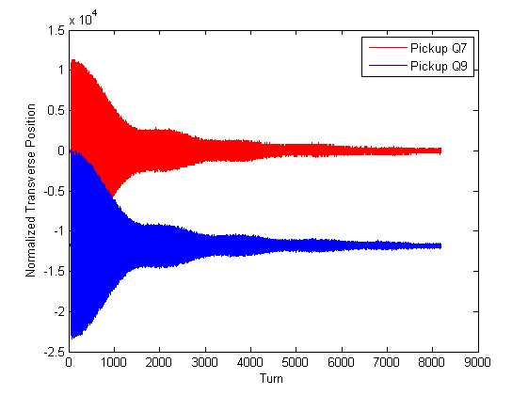
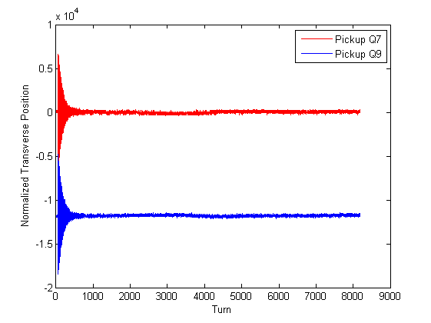
Transv. Damper: Damping Beam Excitations
Wolfgang Hoefle et al
OFF
ON
Crucial device to keep emittance growth under control!

Slide 31
Emittance Growth: Still a Problem
Emittance
factor 3
LHCb 2nd lumi-scan
Bumps collapsed
LHCb lumi-scan
ATLAS lumi-scan
CMS lumi-scan
Ramp finish
Ramp start
VELO in
Time
Mirko Pojer

Slide 32
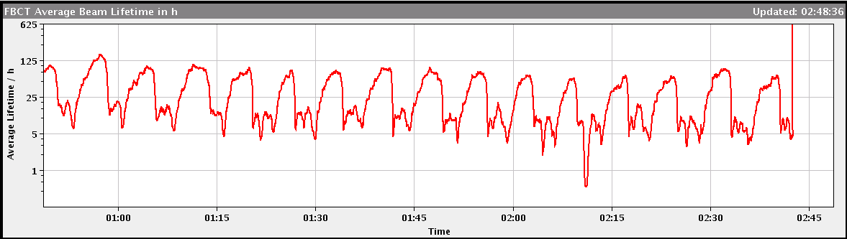
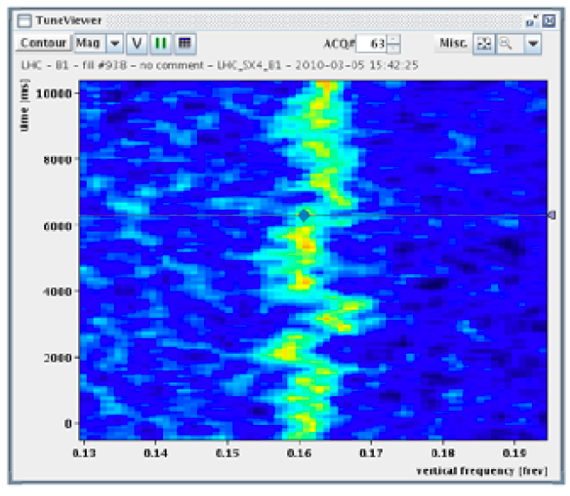
Lifetime Drops with “Quiet” Beam
Our friend the hump on the lifetime - ~ 7 minute period
Hunt the Hump!
The hump is a vertical excitation on the beam that has a fast frequency component (therefore visible as “hump” in the tune spectrum and a slow moving frequency component (7 min).

Slide 33
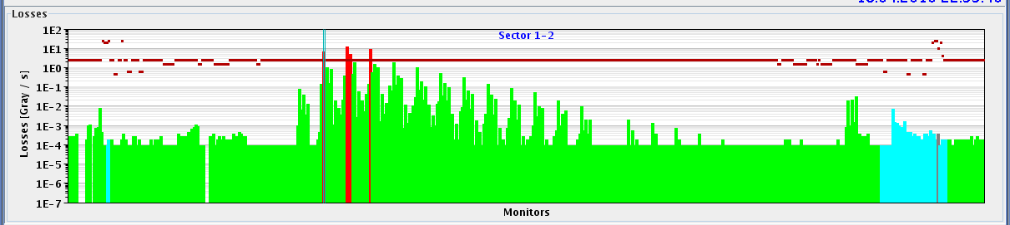
4 Magnet Quench from Injected Pulse
Losses in Sector12 at 450 GeV injection (1e10 p):
Debugging of operational procedures…
First injection into machine with some magnets mis-powered.
First injection always with pilot beam to exclude damage.
Collimation cannot protect for strong local kicks!

Slide 34
Conclusion
Our “baby” (the LHC) learns walking surprisingly fast:
  Routine ramps with 2e10 p to 3.5 TeV (just below safe beam limit).
  Squeeze in all 4 IR’s to 2m β* starts to run smoothly (smallest 2010).
  Squeezed optics fully qualified for protection ➔ IR’s protected by collimation as foreseen.
  Tonight/tomorrow:
  Stable beams: unsafe 3.5 TeV beam, all IR’s squeezed to 2m β*.
  Luminosity at 10²⁸ cm⁻² s⁻¹.
In parallel important progress towards higher intensities:
  Stored nominal bunch intensity at 450 GeV with excellent lifetimes.
  Multiple bunches stored.
  Various feedbacks running. Instrumentation, RF, cryo, … very good!
  Seeing and addressing issues: emittance growth, hump, thresholds, impedance, operational issues, …
Remember, LHC is still a baby (for beam). So we try to guide it carefully the first steps… (we do not want to fall)

Slide 35


Thank you for your attention!

