Slide 1
Status with Beam
R. Assmann
LMC 21.4.2010
Week 16 machine coordinators: M. Lamont, R. Assmann, M. Meddahi
Week 15 machine coordinators: O. Bruening, J. Wenninger
Thanks to EIC’s, system experts and other machine coordinators!

Slide 2
Reference Setup I
Tunes (h/v): 0.28/0.31 (inj/ramp) ➔ 0.31/0.32 (collision)
Chromaticity: 10 (inj) ➔ 3-4 (3.5 TeV)
Coupling: 0.001 – 0.002
Orbit: golden orbit established
Orbit peak change: ~1 mm during ramp
Orbit stability: ~130 μm over 12 h (uncorrected)
Collimation, TCDQ: mostly intermed. at 3.5 TeV: ≥ 6 σ
Intensity: 2.2e10 p in 2 bunches @ 3.5 TeV 1.1e11 p/bunch @ 450 GeV
Beta*: ~ 10 m ➔ 2 m in all 4 IR’s

Slide 3
Reference Setup II
Norm. h/v emittance: ~ 1 μm rad (@ injection)
RF voltage @ injection: 5 MV (was 8 MV) matched: 2.5 MV
RF voltage @ ramp: to 6.5 MV over 500 s
Longitudinal emittance: 0.35 eVs (injectors: 0.25 eVs)

Slide 4
Highlights
Getting all 4 IR’s squeezed to 2m
Injecting and storing single bunch with nominal intensity at 450 GeV

Slide 5
PART I – Squeeze IP Beam Size @3.5 TeV
… a long story but with a happy ending…
This is one of the most complex stages of operation!
Goal: All 4 IR’s to 2m (changed during the process)

Slide 6
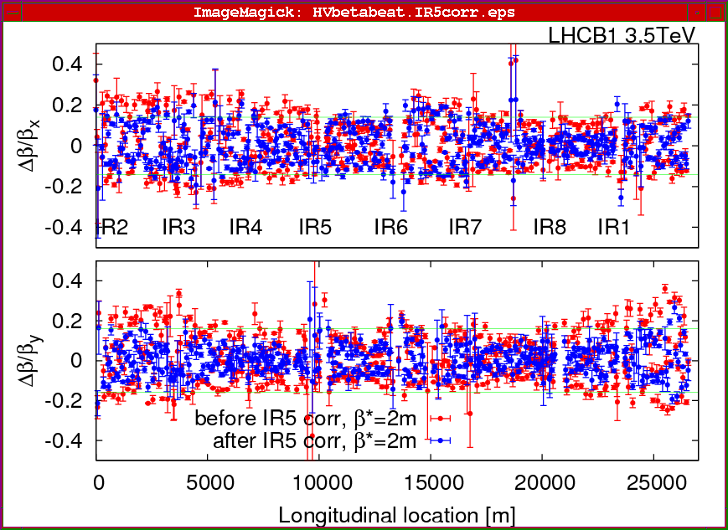
Squeezing IR1 & IR5 (Tuesday 13.4.)
β-beat for Beam1 @ β* = 2m after correction using IR5 Q2:

Slide 7
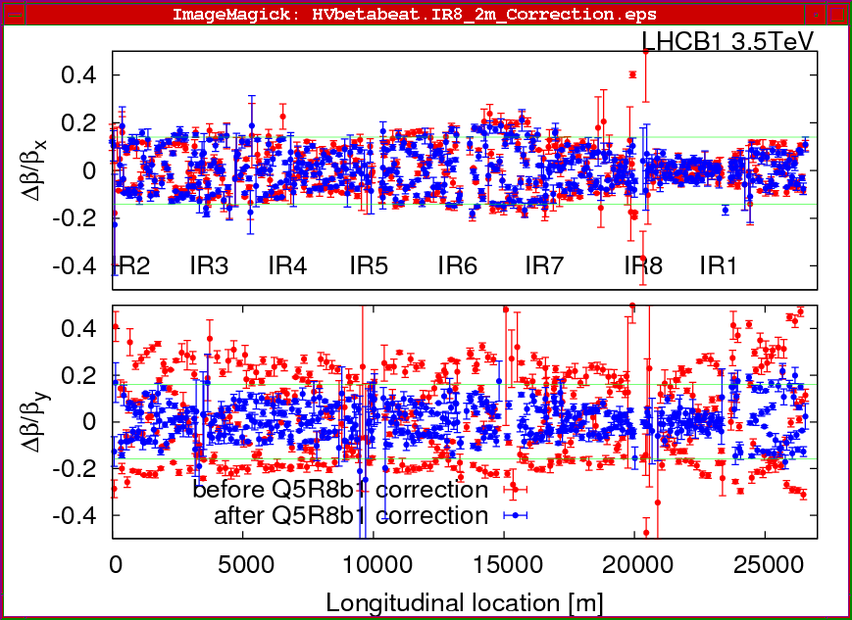
Squeezing IR8 (Tuesday 13.4.)
β-beat for Beam1 after squeeze and @ β* = 2m in IR8 after
correction
of Q5:

Slide 8
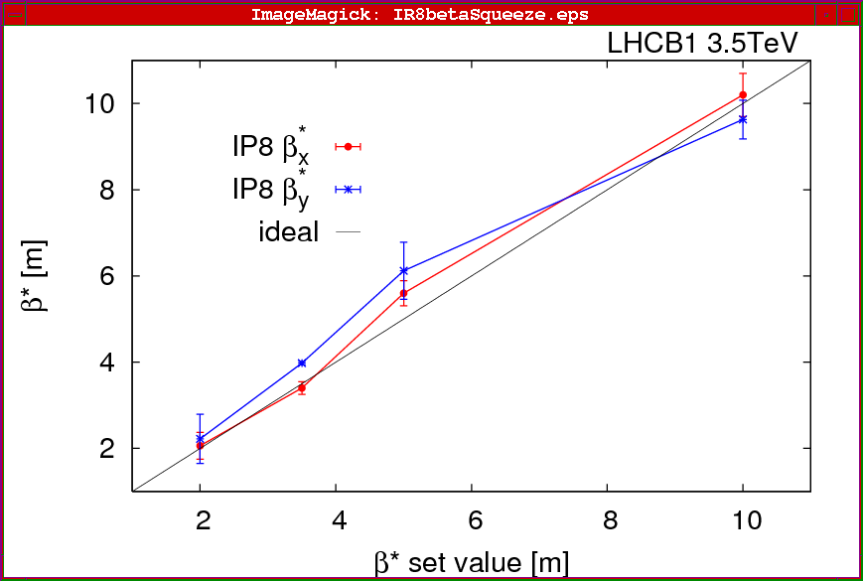
Squeezing IR8 (Tuesday 13.4.)
β∗ during squeeze to β* = 2m in IR8:
Rogelio Tomas et al

Slide 9
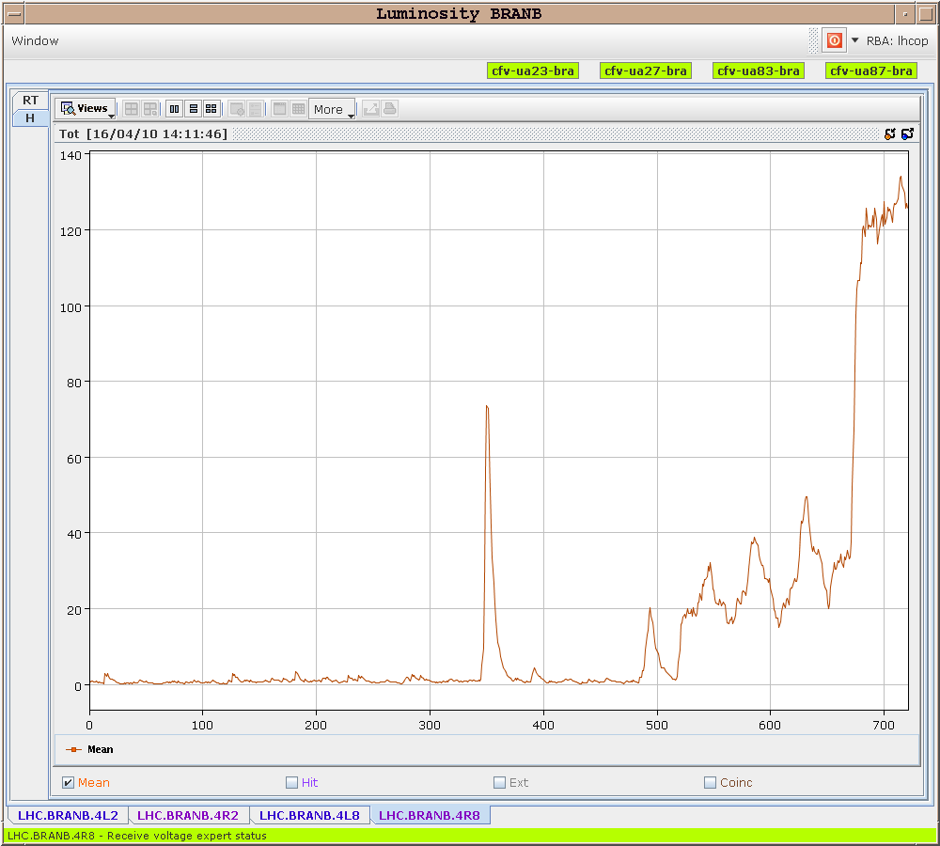
Optimizing IR8 Luminosity (Thursday 15.4.)
Luminosity scans
in IR8:
Simon White et al

Slide 10
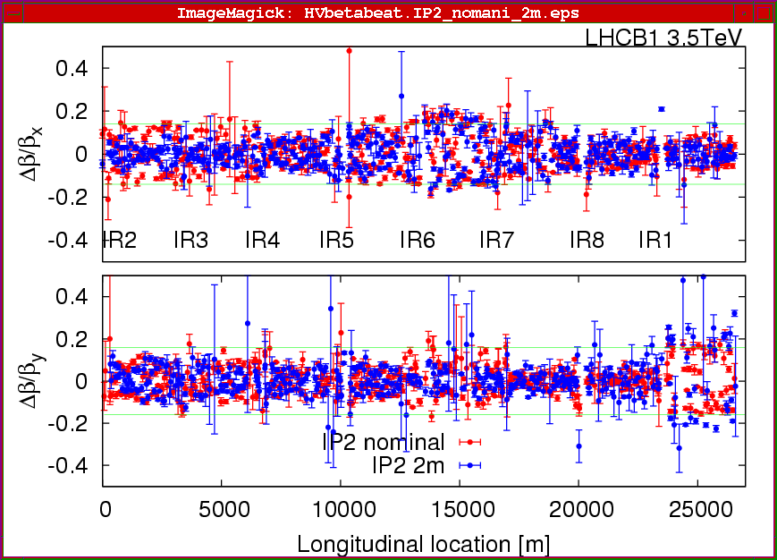
Squeezing IR2 (Saturday 17.4.)
β-beat for Beam1 at β∗ = 2m in IR2 (all other IPS at β∗ = 2m):
Rogelio Tomas et al

Slide 11
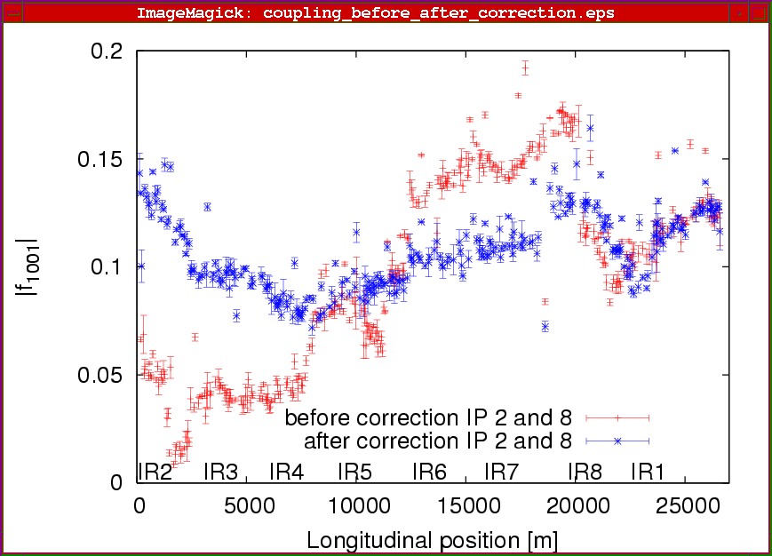
Squeezing IR2 (Saturday 17.4.)
Coupling for Beam1 at β∗ = 2m in IR2 (all other IPS at β∗ = 2m):

Slide 12
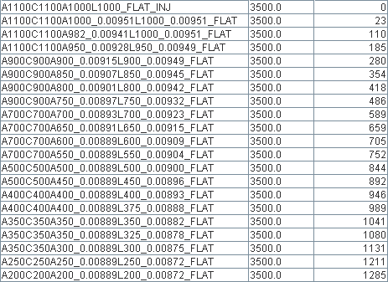
Squeezing all 4 IR’s (Tuesday 20.4.)
Lot going on out there
Einmal ist keinmal
Mike Lamont Gabriel Muller Marek Strzelczyk Stefano Redaelli Xavier

Slide 13
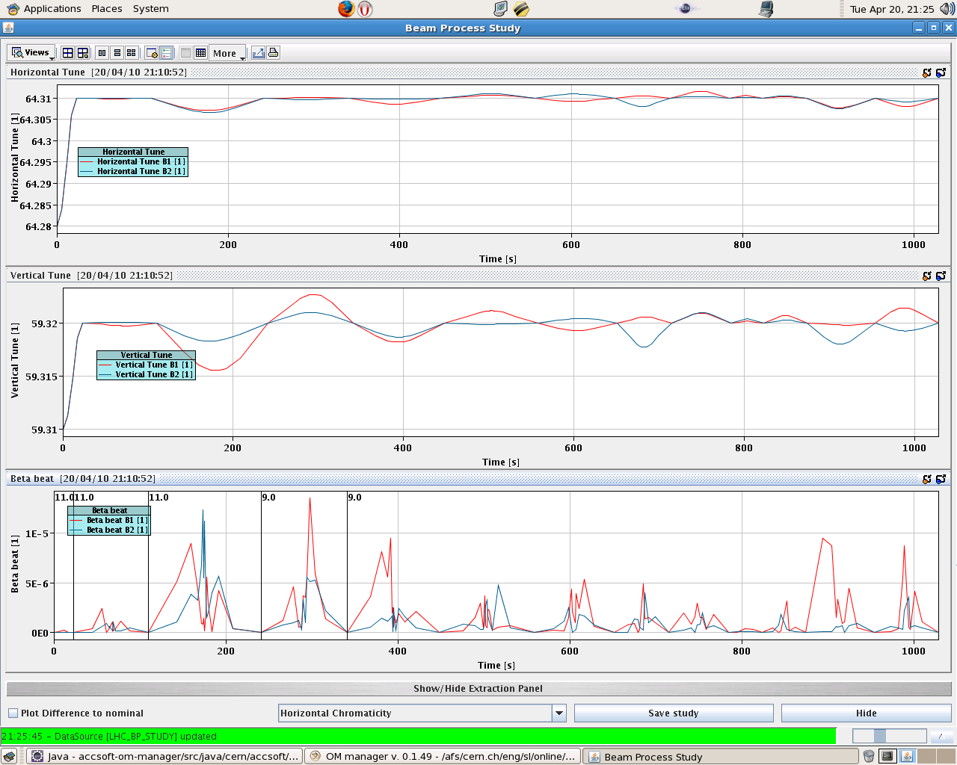
Squeezing all 4 IR’s (Tuesday 20.4.)
Tune Swings & Beta Beat

Slide 14
Squeezing all 4 IR’s (Tuesday 20.4.)
Lifetime – stepping through to 5 m
Squeeze for virgin (uncorrected) machine
Knobs from last week then dialed in

Slide 15
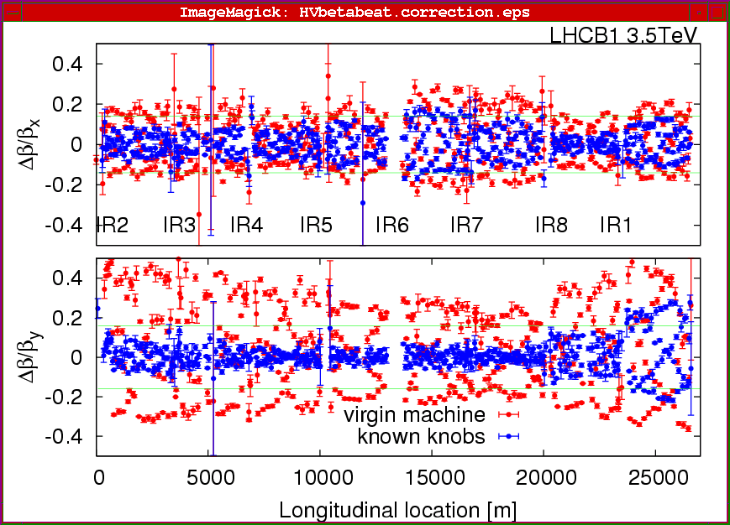
Squeezing all 4 IR’s (Tuesday 20.4.)
Rogelio Tomas et al

Slide 16
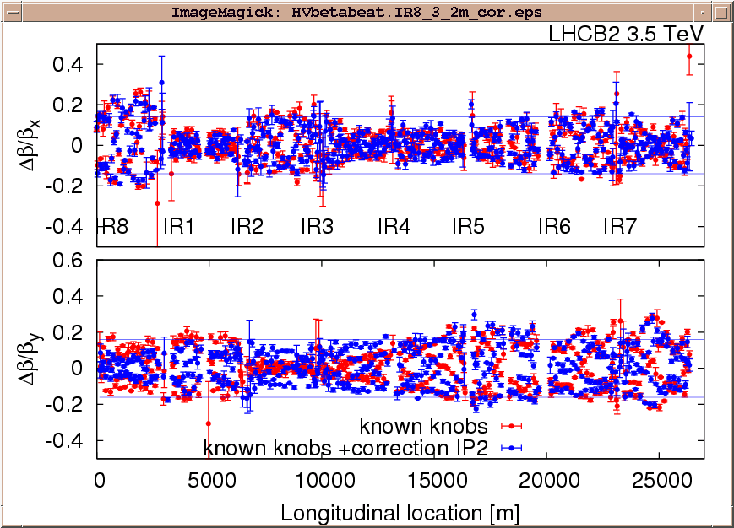
Squeezing all 4 IR’s (Tuesday 20.4.)
Rogelio Tomas et al

Slide 17
Status and Outlook Squeeze
Squeeze to 2m for all 4 IR’s established.
All IR’s steered into collision.
Golden orbit established.
10 out of 16 tertiary collimators adjusted.
To do: 6 missing tertiary collimators
To do: qualification for beam dump and protection
Then: intensity from 2e10/beam to 3.5e10/beam
Then: Stable beams with 10 times luminosity

Slide 18
PART II – Increasing Intensity at 450 GeV
… will be a long story but so far very happy…
This will be the challenge of LHC!
Goal: Factor 10 at injection.

Slide 19
Increase Intensity: Number of Bunches
Dump of the 10 bunches
factor 10
T
Brennan Goddard et al

Slide 20
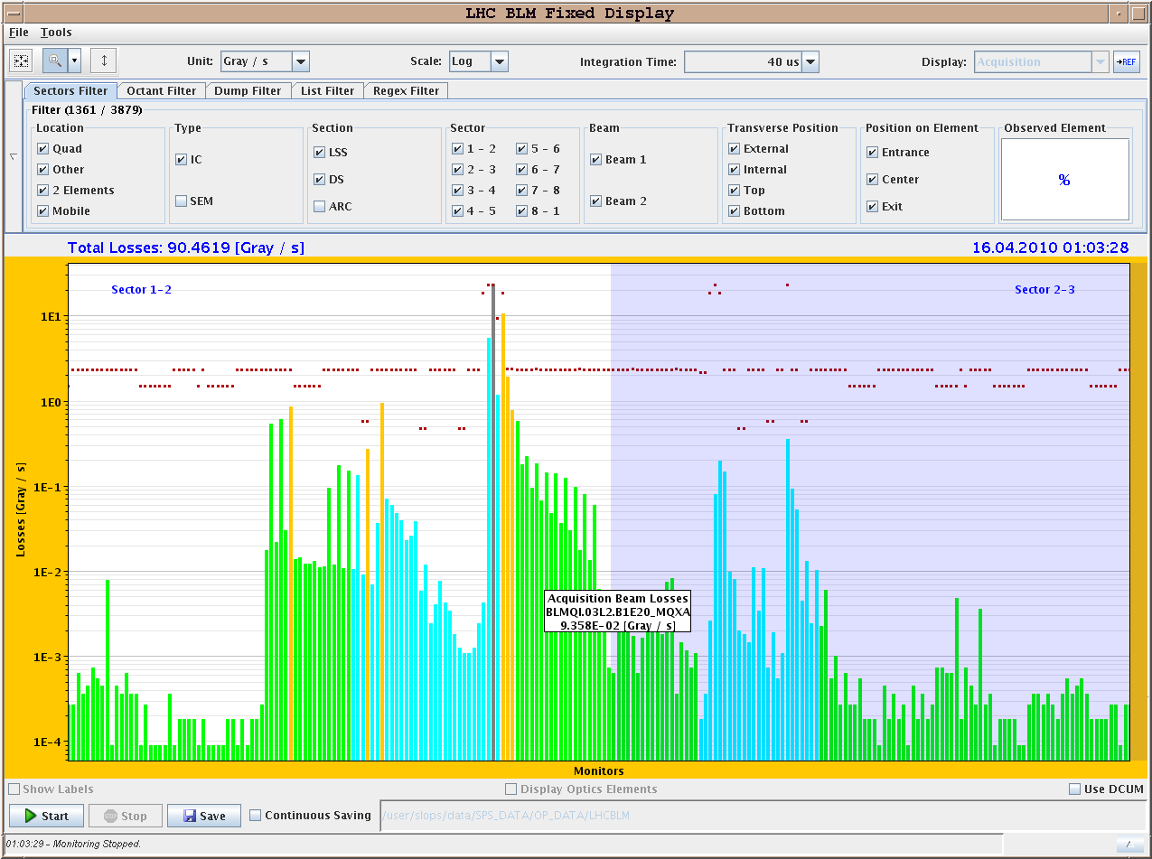
Increase Intensity: Over-Injection
Example of over-injection of 1E11 – 40 us integration
Losses from over-injection
Losses from TL
collimators (X-talk)
Brennan Goddard et al
TDI

Slide 21
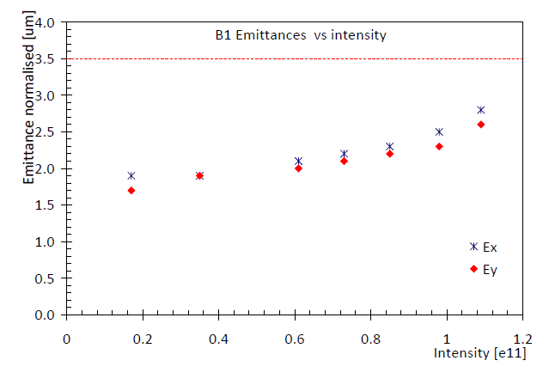
Increase Intensity: Bunch Intensity
Emittances versus bunch intensity:
Brennan Goddard et al
factor 10 beyond 5e9 pilot

Slide 22
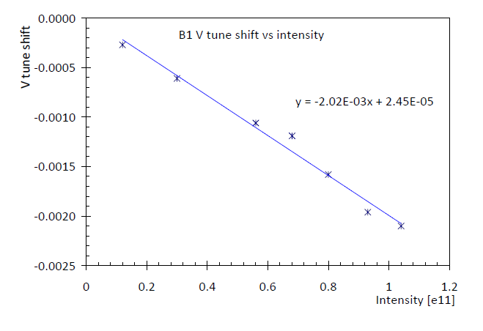
Increase Intensity: Bunch Intensity
Tune shift versus bunch intensity:
Brennan Goddard et al
factor 10 beyond 5e9 pilot

Slide 23
PART III – Observations &Achievements
… lot’s of things studied/achieved in parallel…

Slide 24
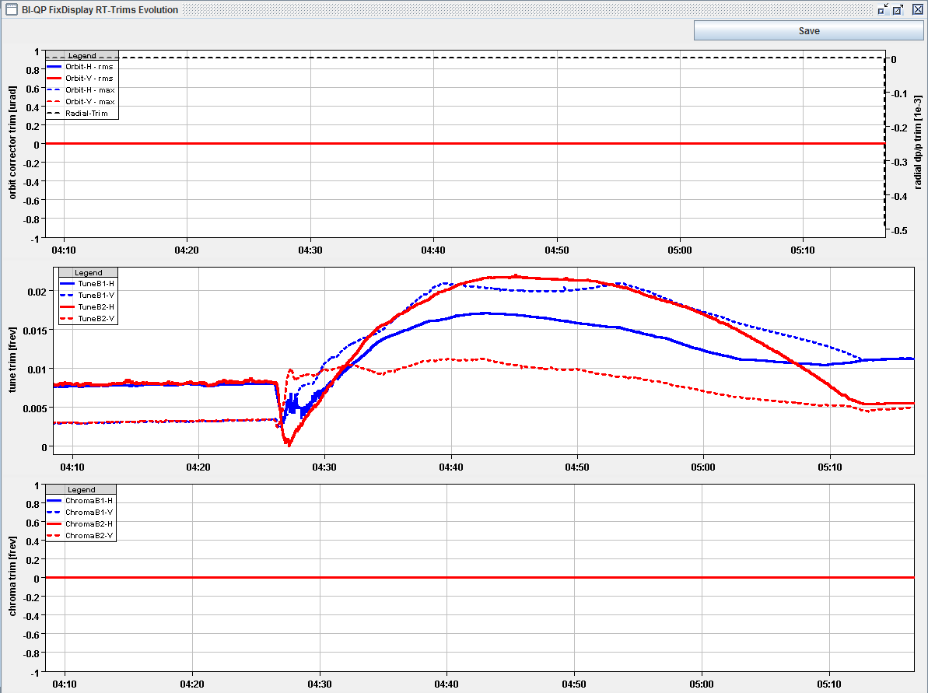
Tune Feedback Operational
Tune feedback during ramp:
Ralph Steinhagen et al

Slide 25
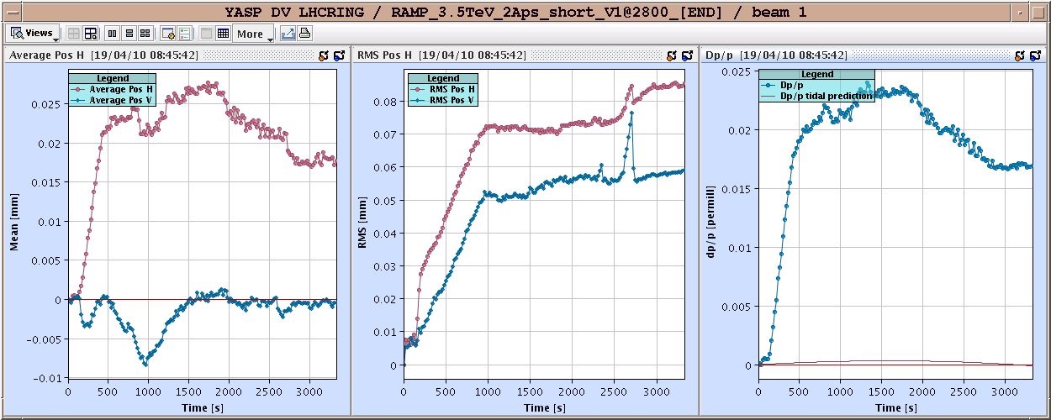
Orbit Feedback Operational
Ralph Steinhagen et al

Slide 26
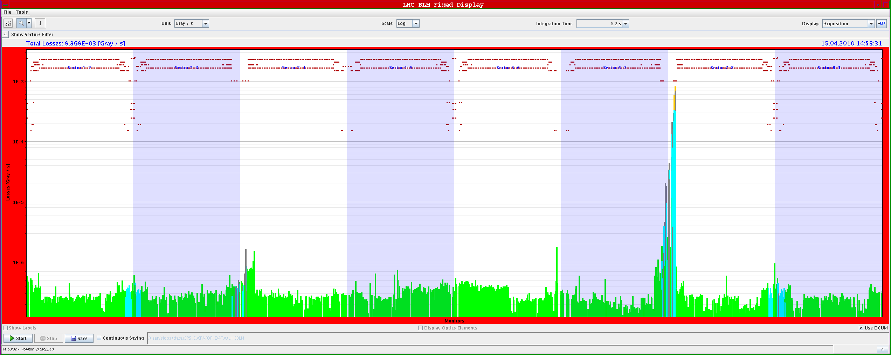
Collimation Operational
Losses during AC dipole measurements:
Can rely on protection of collimation against beam losses at 450 GeV and 3.5 TeV.
System stable and setup adequate for up to 100 kJ stored beam.

Slide 27
Lifetime Drops with “Quiet” Beam
Our friend the hump on the lifetime - ~ 7 minute period
Hunt the Hump!

Slide 28
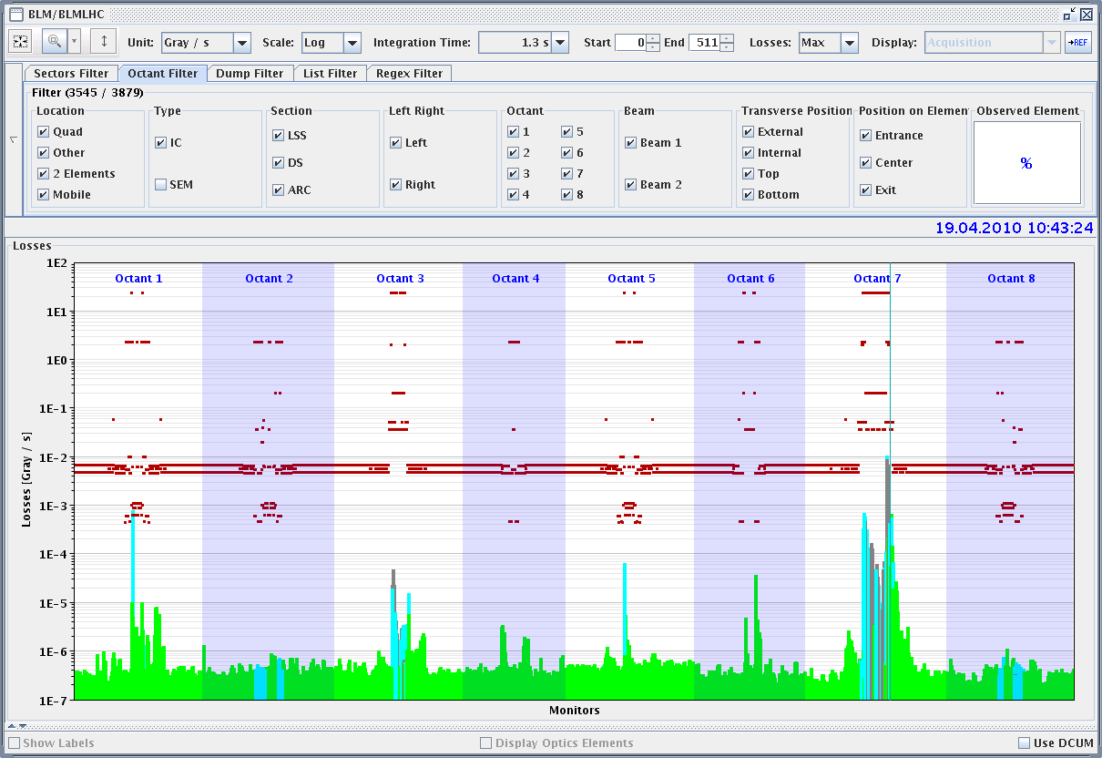
Collimation & BLM Threshold Studies
Also useful for IR1
threshold adjustments
with ATLAS

Slide 29
4 Magnet Quench from Injected Pulse
Losses in Sector12 at 450 GeV injection:
Debugging of operational procedures…
First injection into machine with some magnets mis-powered.
First injection always with pilot beam to exclude damage.
Collimation cannot protect for strong local kicks!

Slide 30
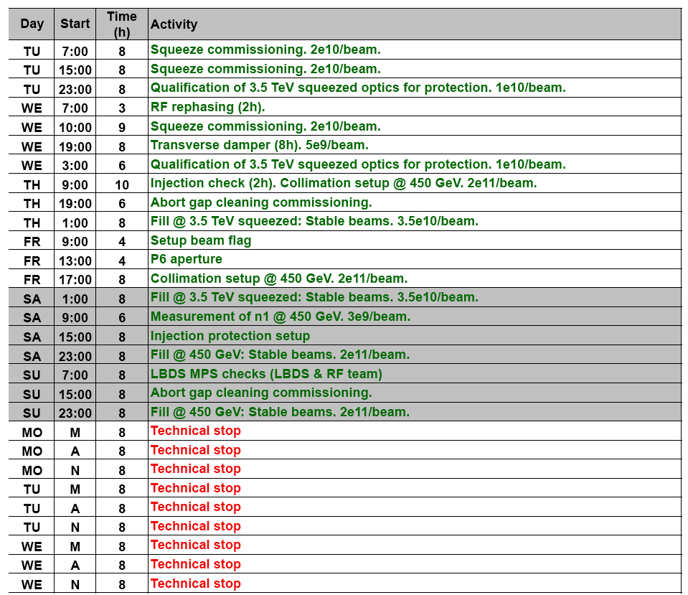
Program

Slide 31
Program

