Slide 1
Monday 19th April 2010
Main quads in SIS
SIS Orbit timeout increase to 1 hour
8:30 end ramp
orbit feedback on both planes
9:59 having squoozen to 5 m
Dump B2: internal trigger of the LBDS
Access required
Instead of beam dump we perform a short scraping test in IR7.
First TCLA collimator TCLA.A6R7.B1 for beam1 moved into the beam. Recorded loss maps will allow to adjust TCLA thresholds more accurately.
Beam dump triggered by BLM RS 655ms TCT collimator (TCTH.4L1) in IR1
Afternoon: access, pre-cycle, injection

Slide 2
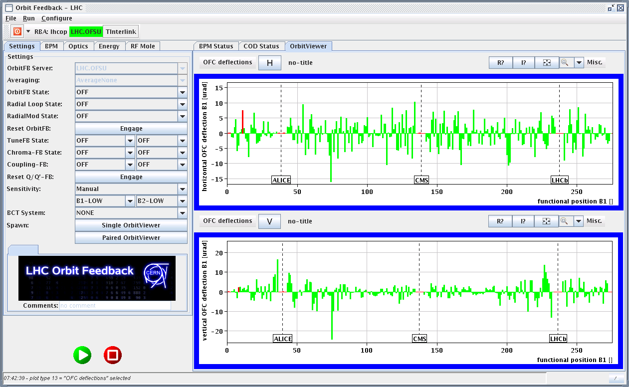
RT corrections at 3.5 TeV

Slide 3
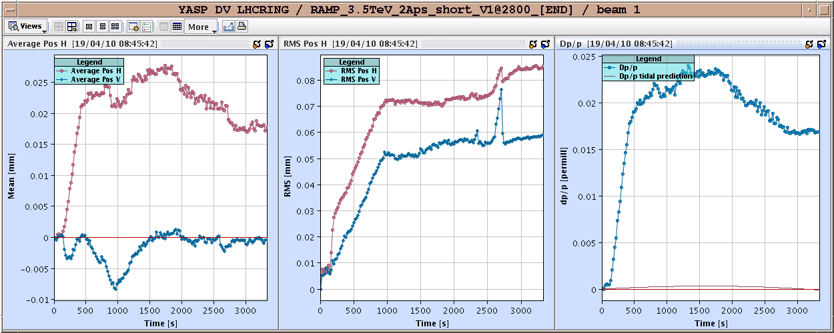
Orbit in ramp
Ralph Steinhagen owes me loads of beer for using more than a shift to commission OFB system

Slide 4
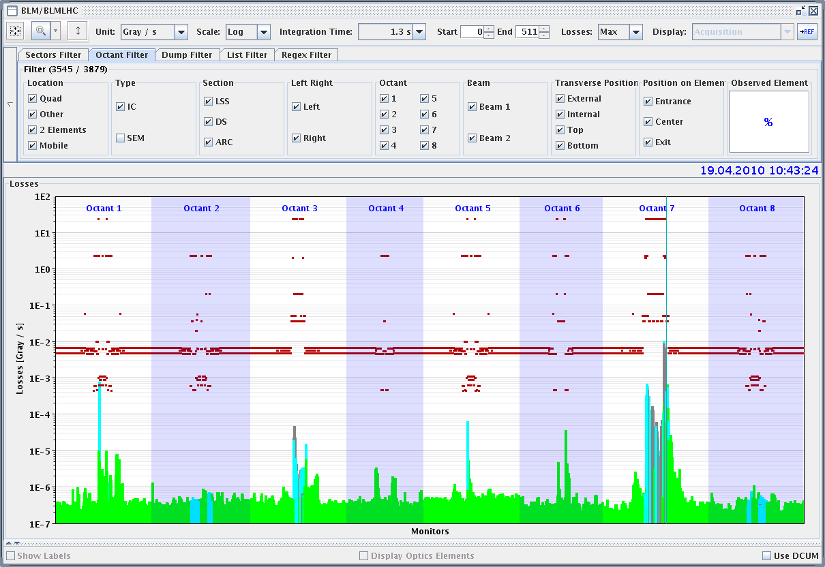
TCLA BLM calibration

Slide 5
Monday
17:30 start ramp
19:05 Start squeeze
moderate beam loses
21:30 Both beam dumped
23:30 Back at injection
SPS is shaky tonight, the mains went down once more. Also the PSB kicker has not been doing too well all day.
The optics retrieval from LSA by the orbit feedback service unit seems to be broken and stalled after requesting a 'fetching optics'. The process FesaShared_M went to 100% CPU load and subsequently blocked the feedback controller resulting in transient or no orbit data. Restart of the OFSU server alone or unrolling to the old version did not help. Finally resetting (/deletion) of OFSU persistent data (left a copy in ../data/savea) seemed to help the situation. To be further investigated.... On top of this (later): after rebooting the OFSU overrode all Q/Q' FB gains and matrices to zero... sigh... re-established them by hand. As collateral, the radial trim (Q' meas) may need to be reset/reconfigured as well...

Slide 6
Overnight
.. finally had to bootstrap the whole Tune-FB from scratch... now OK.....
next problem: continuous FFT systems are down and need to be restarted... sigh.
2:30 ramp started
2:33 Sector 78 tripped - beam dumped at 510 GeV
RQF was the first to go,
Likely reason of the beam dump of 2 30: a noisy splice signal
Recovery
07:00 Maskable and unmaskable BLM's in L2 are red and this prevents injection
BIS (Bruno Puccio) and BLM (Bernd Dehning) in action

Slide 7
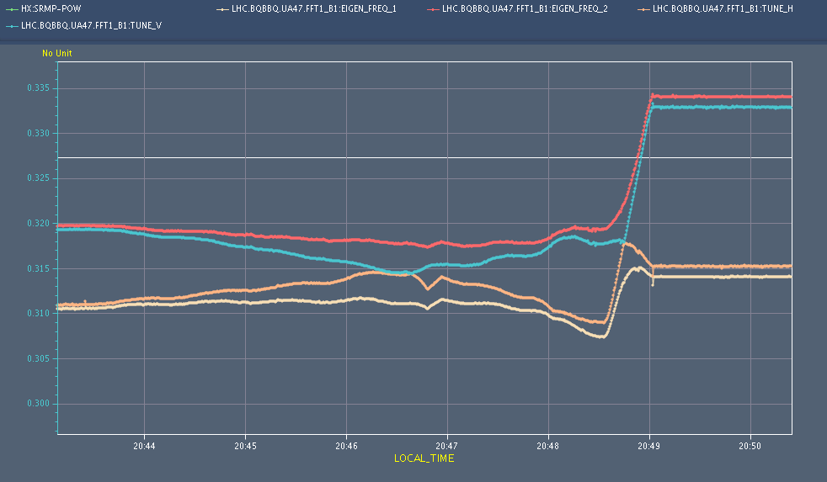
Beam 1 unperturbed tunes seems to touch/cross due to large coupling and is eventually pushed across the 1/3 order resonance with moderate losses

Slide 8
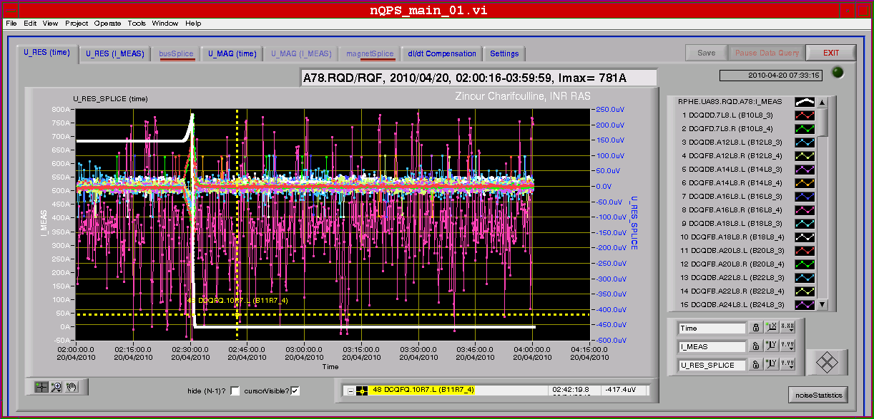
QPS – noisy splice signal

Slide 9
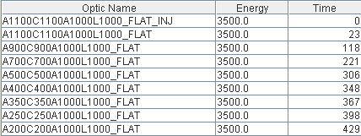
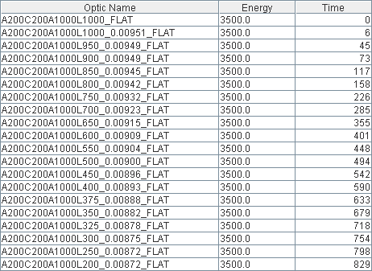
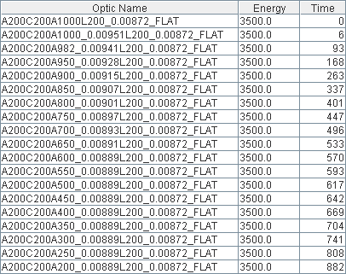
Squueze

Slide 10
Squeeze functions

Slide 12
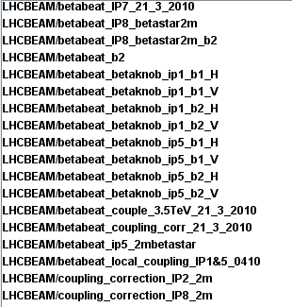
Plus

Slide 13
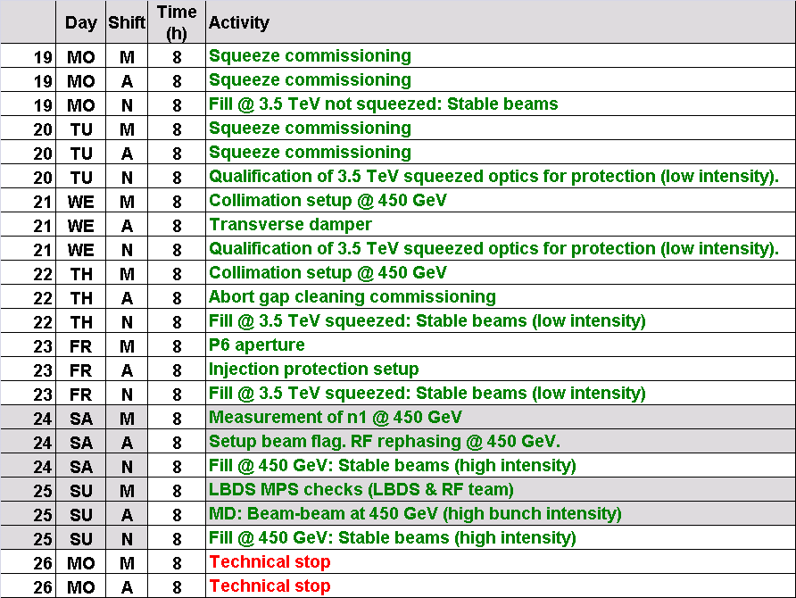
Program for the week

