Slide 1
Day 27.3.
3:00 Vacuum leak in TI2
bellow near TED
8:45: Access S45 and 56
investigate water problem in Pt4 ➔ cooling of ADT amplifier
fixed later in the morning
10:45: Leak in TI2 localized
TED bellow in TI2 ➔ repair with varnish in TED in position
13:00: Patrol finished of TI2
called VAC Piquet to test leak tightness when the TED is moved out
13:30: Sector 12 RB quench heater is loosing power
required access (exchange of heater power supply)
access started at 15:30

Slide 2
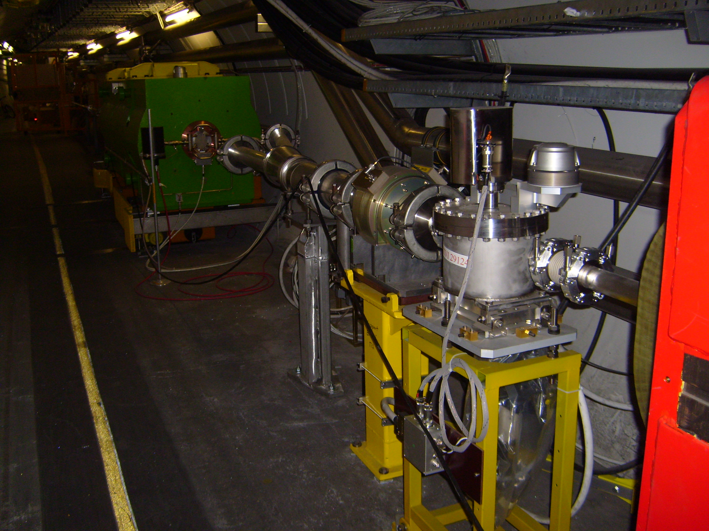
27.3.
TED bellow in TI2

Slide 3
Day 27.3.
13:30: Synchrotron light undulator fault
could be fixed via remote reset
15:30: Water cooling problem for energy extraction resistors in IR3
required access in S23
fixed at 16:30 (too low water flow)
16:30: Problem closing VAC valves in Point2
VVGSH.587.6L2.R
three vacuum sensors are not giving any reading; problem fixed by 17:00
17:30: Problem with temperature on current lead for RSD1.34B1
required access in tunnel and eventually condemnation of DFBAG L4 (launched at 20:30 after the problem could not be solved by Piquet for Cryo instrumentation); verified that problem is linked to able connections; took a long time to find technician who can open connectors (Mirko went in in the end with Markus)!; fixed by 00:30

Slide 4
Day 27.3.
17:45: Loss of Cryo OK for RQT13.R5B2 in S56 (fuse to be changed)
required access; finished by 20:30.
18:10: Temperature spikes for the 120 A circuits in S81
orbit corrector next to Q7
20sec long spikes in temperature readings; interlock will remove Cryo OK if temperature exceeds limits by more than 30sec
loss of Cryo OK in S81 at 20:30
launched intervention in shadow of RSD1.34B1 intervention; exchange of electronics card solved the problem; fixed by 22:20.
00:30: all problems finally fixed; closing machine
05:00: Beam back in the machine
05:30: Problems getting Injection permit from ALICE
06:00: Lost patrol box of ATLAS
beam dump and fast abort of RD34 ➔ patrol mode; fixed by 6:30

Slide 5
27.3.
06:30: start pre-cycle
08:30: Dump kicker problem for Beam1
requires access
continuing setup for Beam2 while waiting for LBDS intervention
Program for today:
Ramp to 3.5 TeV
Setup of collimators at 3.5 TeV
Setup of TCDQ at 3.5 TeV
5 end of fill tests to verify collimator hierarchy (ca. 4h per fill preparation):
one fill for horizontal resonance blow up of Beam1 and Beam2
one fill for vertical horizontal resonance blow up of Beam1 and Beam2
one fill for momentum (RF) change Beam1
one fill for momentum (RF) change Beam2
one fill with de-bunched beams to simulate asynchronous dump

Slide 6
27.3.
Still not finished:
High intensity beam setup at 450 GeV
RF tuning at 3.5 TeV?
damper studies
Open issues:
Bellow near TED in TI2
Instrumentation cable on current lead for RSD1.34B1

