Slide 1
Day 26.3.
09:00-14:00: Collimation setup 3.5 TeV
Slowed down by losses induced by tune hump.
48 collimators set up.
Beam dumped by ATLAS during IR1 TCT adjustment.
14:00-18:00: Prepare next fill
Orbit in the ramp now very good, < 0.28 mm both planes and beams.
18:00-21:00: Collimator setup
TCTs (re)done with collapsed separation bumps.
Issue with the setup procedure due to very low diffusion in the beams. The halo does not repopulate, the beam is slowed scraped down and become smaller → information of gap width cannot be used.
Beam dumped by ATLAS during IR1 TCT adjustment – strange event since the BCM was masked…

Slide 2
26.3.
21:00 Collimation summary
Beam 1: TCP: 4 out of 4 TCSG: 16 out of 16 TCT: 4 out of 8, to done: IR8 and IR5
Beam 2: TCP: 4 out of 4 TCSG: 16 out of 16 TCT: 3 out of 8, to be done: IR2, IR5, IR8 H
TCLAs: skipped for now.
TCDQs: to be done with dump protection team .

Slide 3
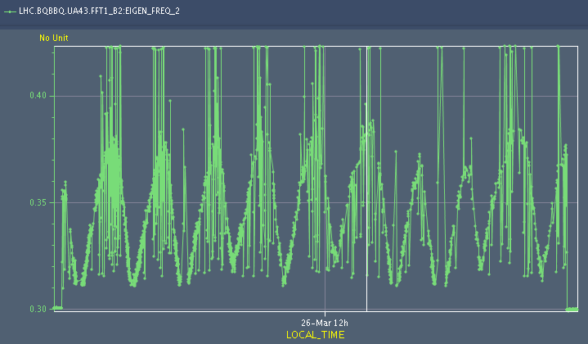
26.3
Hump frequency @ 3.5 TeV – periodicity of ~ 7 minutes

Slide 4
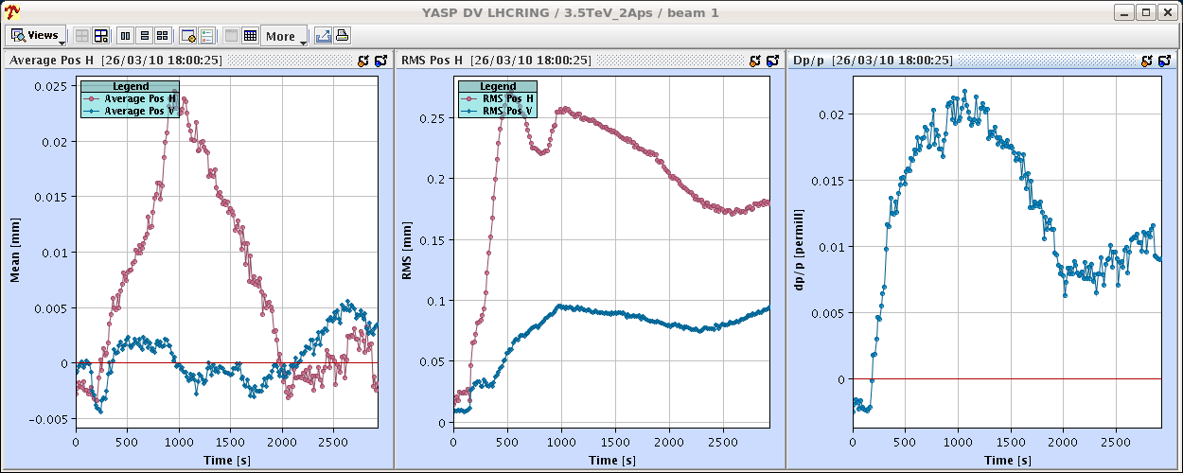
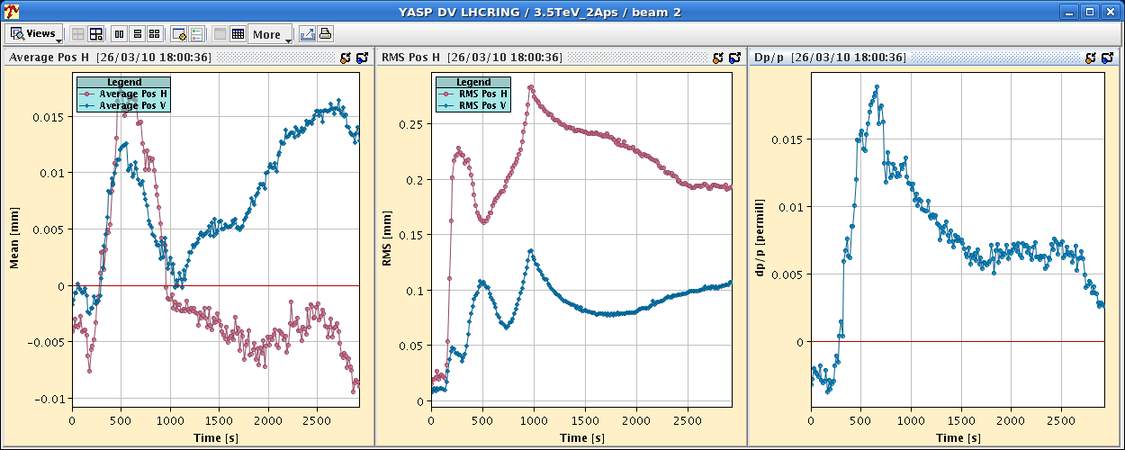
26.3
Orbit in the ramp

Slide 5
Day 26.3.
22:30 Preparing for STABLE BEAMS 450 GeV setup.
23:00 EPC finished tests of ALICE spectrometer.
23:20 Problems with diagnostics of extraction master BICs.
The BIC HW worked correctly.
Traced to a ‘Denial-of-Service’ type error (more than 1024 history buffer records/SPS cycle) due to a fast oscillating Beam Presence Flag (BPF) of the LHC rings (TRUE - FALSE) in the ABSENCE of beam. The main issue is that the BPF MUST NEVER be TRUE with no beam. ’Fact finding’ ongoing…
00:30 Vacuum valves in TI2 closed. Pumps off.
Vacuum leak in the region of the mobile dump (TED).
Leak detection starting (access from SPS BA7).
Waiting for news….

Slide 6
26.3
Protection/MP setup for 3.5 TeV - todos
Collimator setup
Dump protection (TCDQ) setup
Collimator setup test
H, V, dp/p → 4 destructive tests
Dump protection setup test
Debunch beams, dump (simulation of asynch. Dump)
→ 1 destructive test
Collimator + TCDQ ramp
TCDQ – beam Software Interlock (activate)
Orbit Software Interlock (activate)

Slide 7
26.3
Protection/MP setup for 450 GeV - todos
Collimator Setup
Dump Protection (TCDQ) Setup
Revisit….
Collimator setup test
H, V, dp/p → 4 destructive tests
Dump protection setup test
Debunch beams, dump (simulation of asynch. Dump)
→ 1 destructive test
TCDI (TL) collimator setup check
High(er) intensity injection tests – possible request to allow for injection of 5E10 in empty ring in inject & dump mode
Orbit Software Interlock (activate)

