Slide 1
Day 23.3.
8:45 pre-cycle all sectors
10am: trip of sector 78 (Cryo loss left of IP8) ➔ need to pre-cycle again MS
11:30: end of pre-cycle in S78; beams back in LHC
beam adjustments (tune, orbit, Q’)
minor problems loading ramp table (QTD and QTF settings)
13:30: start ramp
left accidentally TDI and TCLIs in during ramp. Still very good lifetime (70h to 100h) and no losses during ramp
14:30: end of ramp ➔ measurement of orbit, Q and Q’
orbit correction and IP steering & collapse of separation bumps
15:30: Start of collimation setup at 3.5 TeV

Slide 2
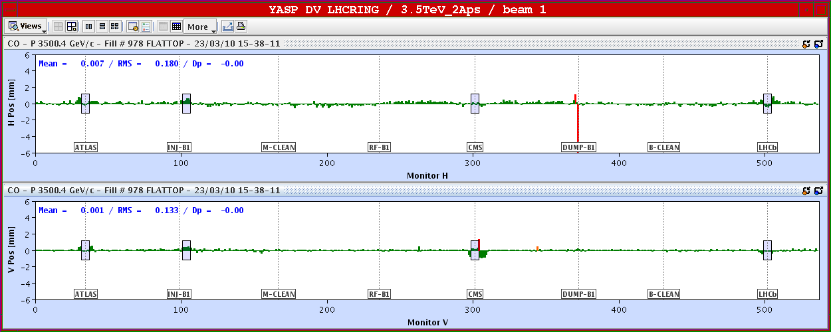
23.3.
Orbit at 3.5 TeV: difference between 450 GeV and 3.5 TeV
Beam separation on

Slide 3
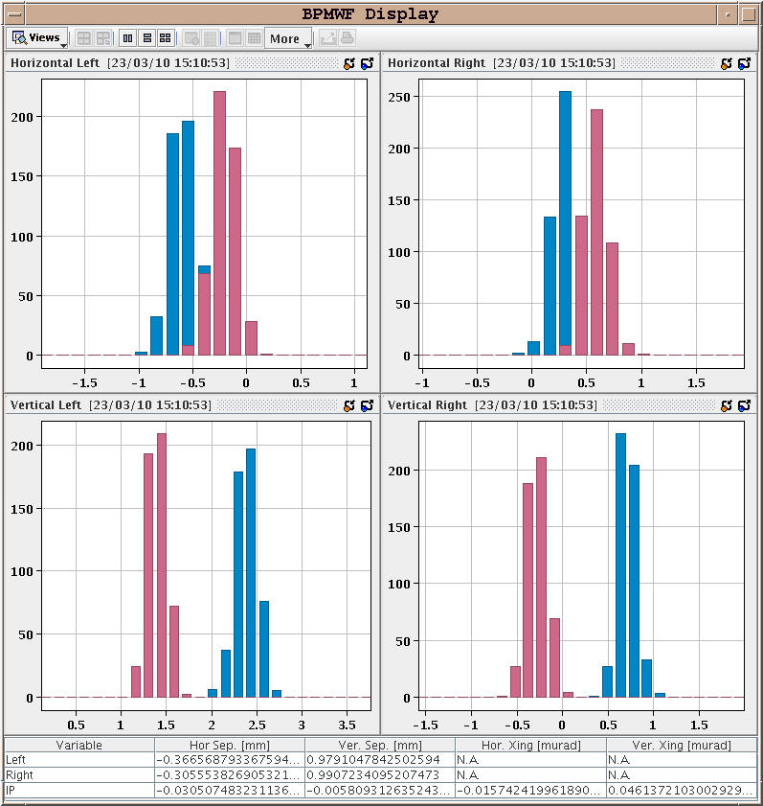
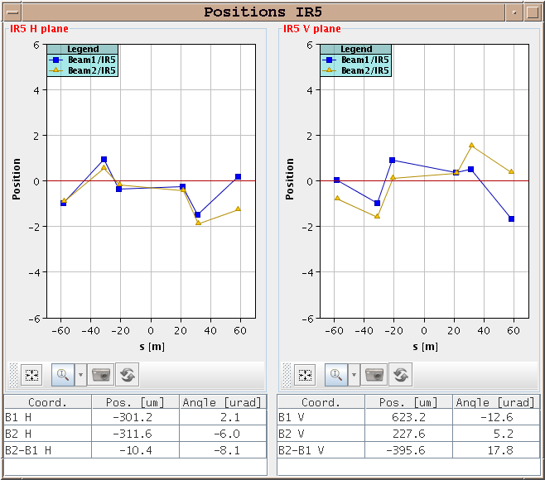
23.3.
Orbit at 3.5 TeV: IR steering
IR5

Slide 4
23.3.
Collimation setup at 3.5 TeV
Intermediate collimation setup summary (2.5h of beam at 3.5 TeV): - Golden orbit defined before collimation setup. - Emittance lower than nominal. - Had to close primary collimators to 4-5 nominal sigma (2mm) to see halo and define a halo edge. - Beam 1: 10 collimators out of 37 set up for 3.5 TeV beam. - Beam 2: 5 collimators out of 37 set up for 3.5 TeV beam.

Slide 5
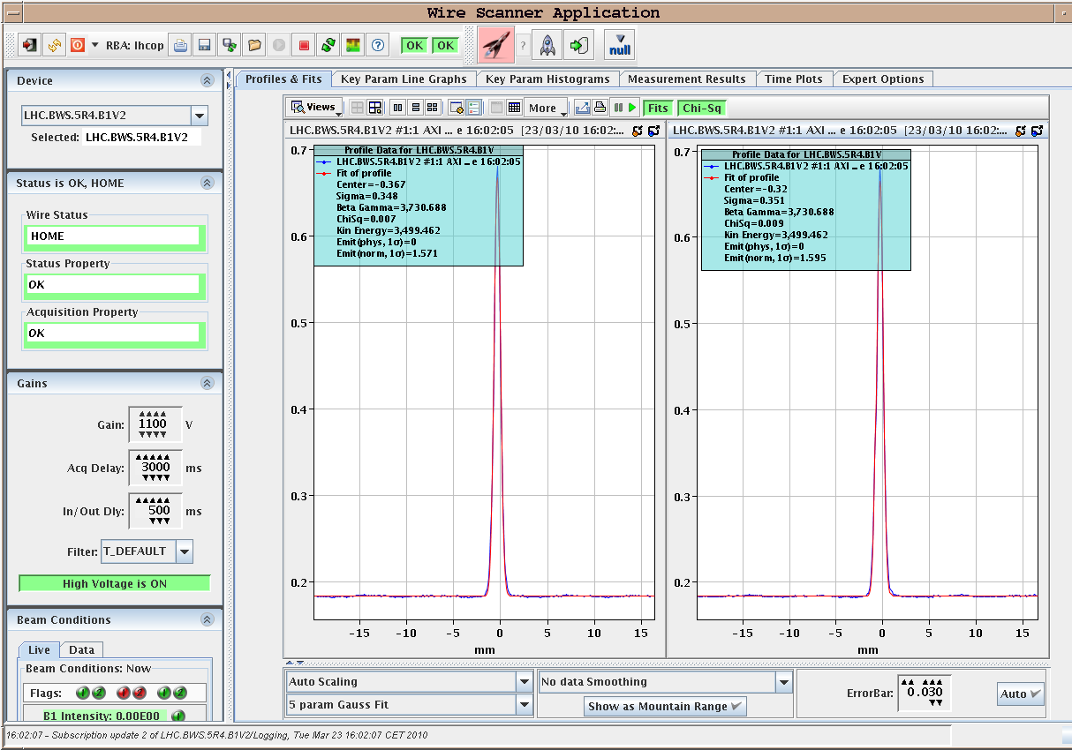
23.3
Collimation setup at 3.5 TeV
smaller than nominal beam sizes

Slide 6
23.3.
18:20 Beam dumped by ATLAS BCM
pre-cycle machine to prepare for new fill
machine BLMs only small minuscule losses (< 1% quench level thres.)
20:00: ready for beam
beam adjustments (tune, orbit, Q’)
wire scans & beta beat measurements
20:30: start LBDS setup at 450 GeV
Beam2 injected into wrong bucket: Piquet suspects timing system
re-synchronization with SPS solves the problem
some problems with ‘inject & dump’ mode at around midnight
injection of 10 bunches
beam dump at intermediate energy: 2 TeV

Slide 7
Night 23.3.
Summary LBDS studies:
14 out of 15 MKD kickers checked for B1 and B2
Beam centering in extraction channel checked for B1 and B2
Extraction with 15 MKD corrector knob not clean - to be checked
Measured beta functions at P6 elements - H betas at TCDQ for B1 are significantly larger than for B2.
Interlock BPMs in P6 set to +/-3.6 mm around golden orbit for B1 and B2. Should be recheck for higher bunch intensity.
Injected 10 bunches into B1 and B2 for total intensity of about 2-3e10 per beam, to check MKB kicker sweep. Both beam lifetimes very good.
Dumped both multibunch beams with operator switch to get PM data. Beams dumped with no detectable losses in the ring or in the dump lines. Sweep pattern looks good.
Beam dump at intermediate energy: 2 TeV

Slide 8
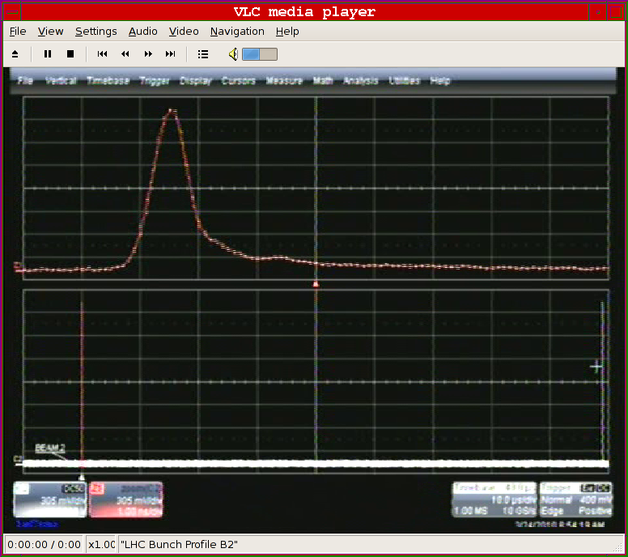
23.3.
Beam2 RF bucket:

Slide 9
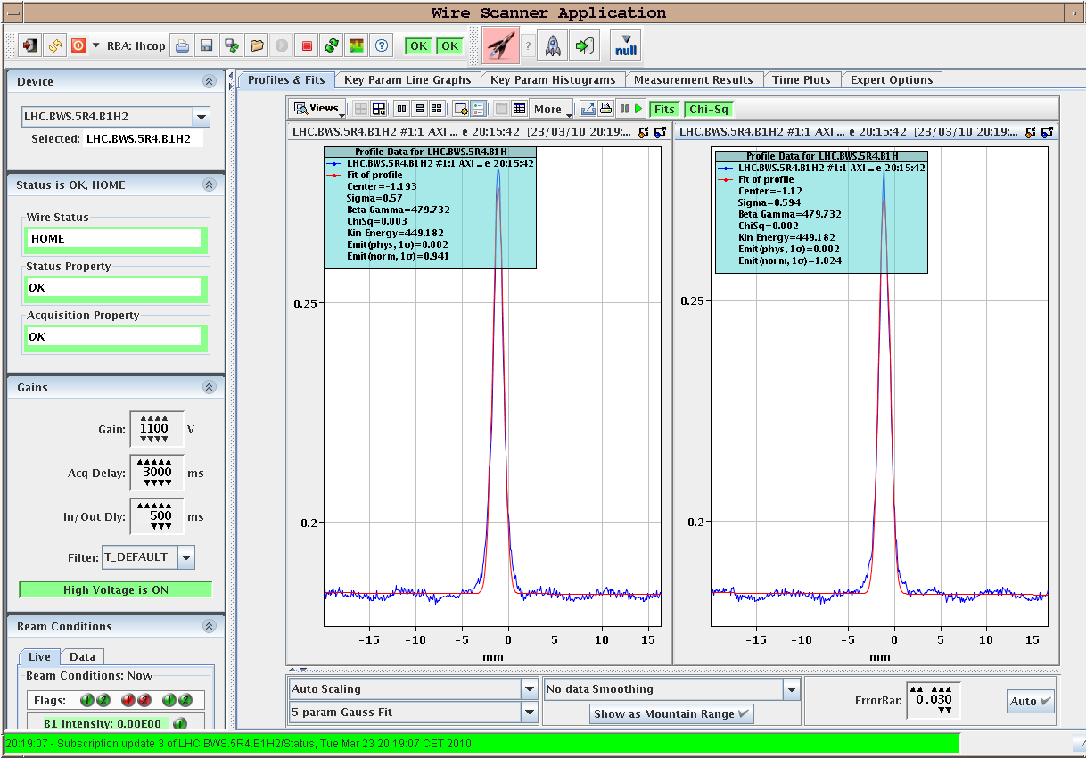
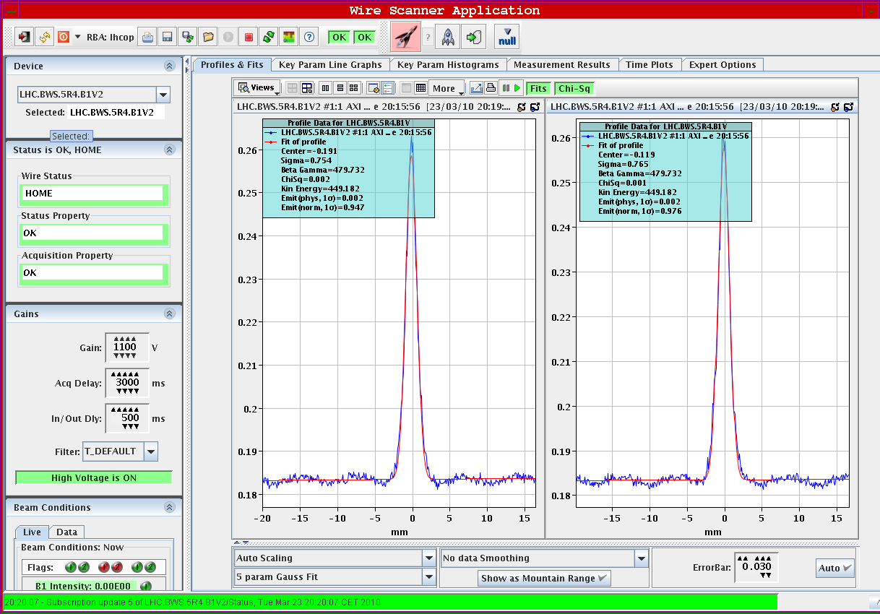
23.3.
Wire scanner Beam2:
H = 1.5
V = 1.0

Slide 10
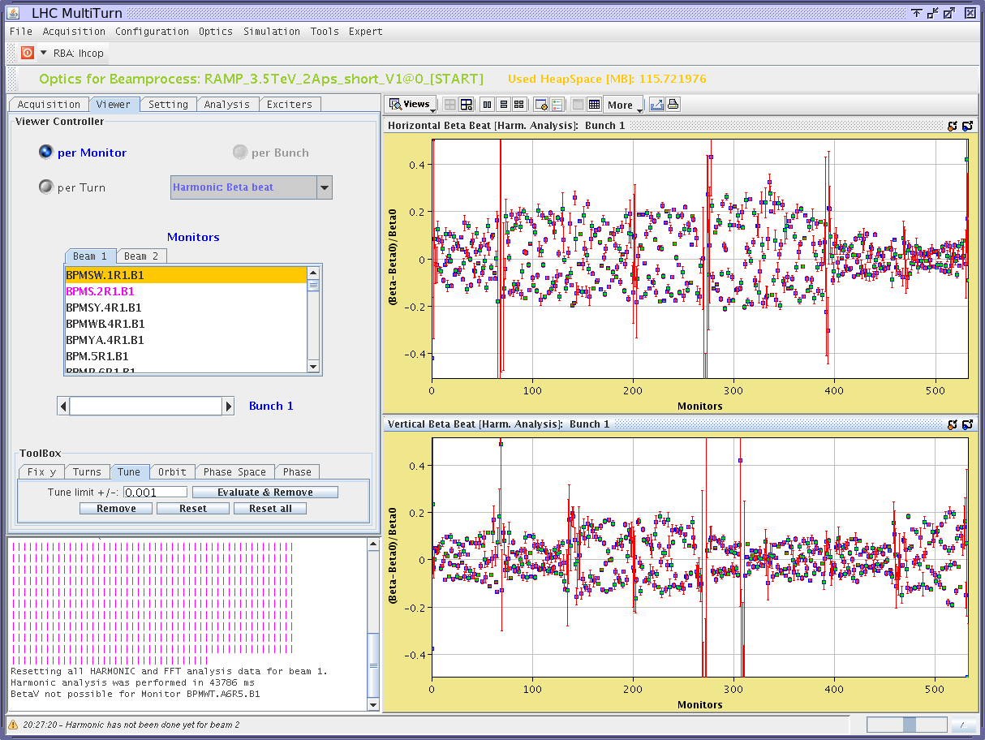
23.3.
Beta-beat Beam1:

Slide 11
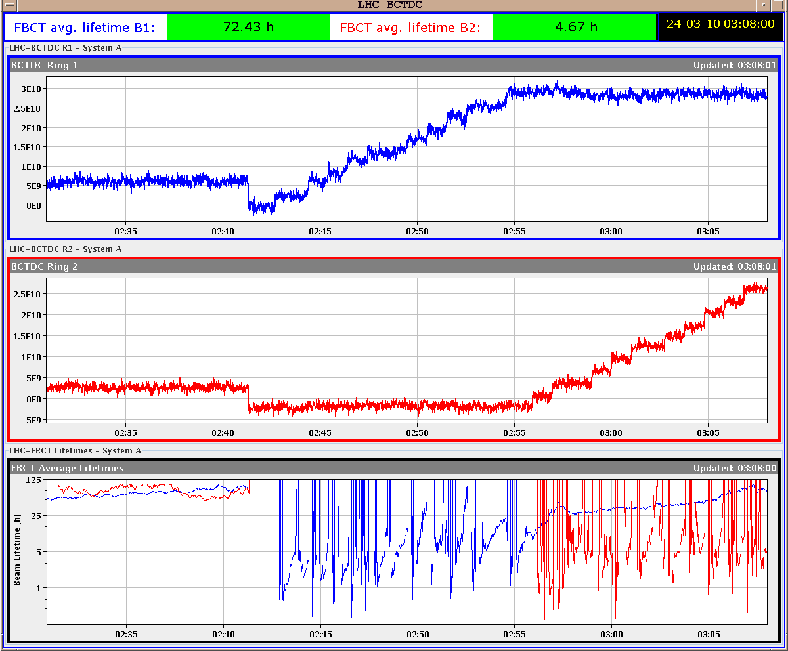
23.3.
Injection of 10 bunches: Beam lifetime 100 hours!

Slide 12
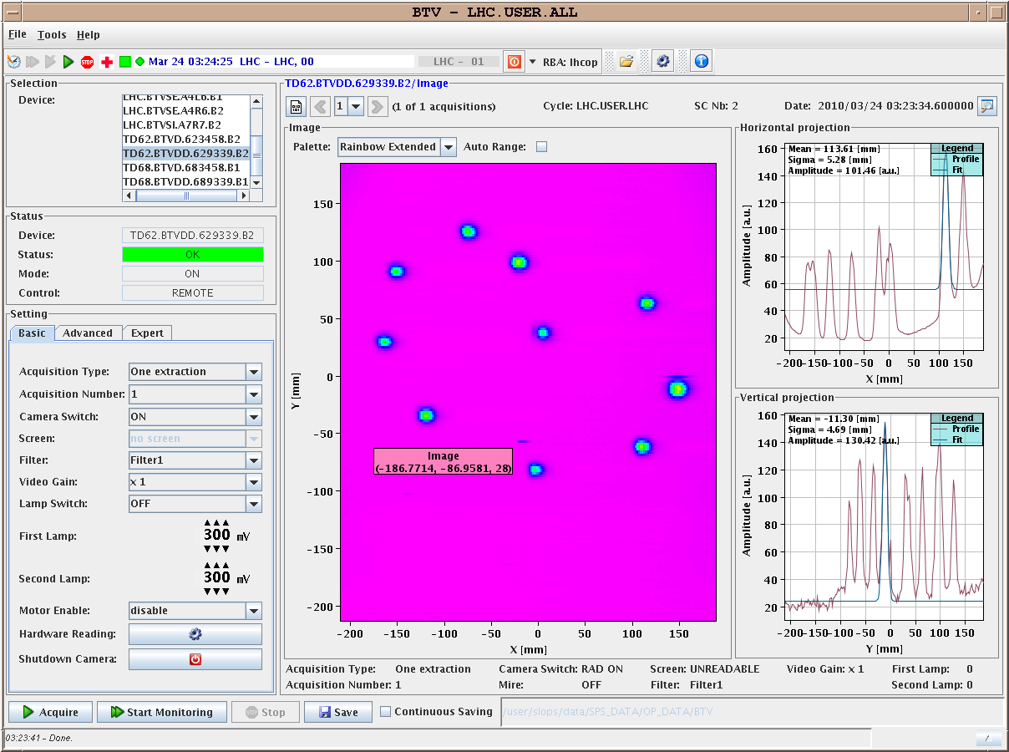
23.3.
Beam on dump:

Slide 13
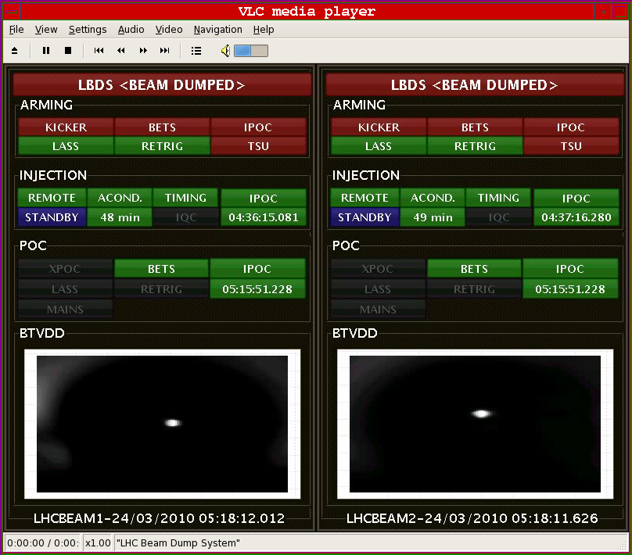
23.3.
Beam on dump at 2 TeV:

Slide 14
23.3.
21:00: In parallel to LBDS studies RF adjustments
Problem with RF cogging for Beam2
requires intervention in SR4
04:30: start ramp for 2 TeV dump
05:50: ramp down

Slide 15
24.3.
Tentative program:
Ramp to 3.5 TeV
Orbit and optics measurements
Collimation check and set up at 3.5 TeV
LBDS set-up (at 3.5 TeV)
Still not finished:
RF tuning
feedback studies
damper studies

Slide 16
24.3.
Open Issues:
Klystron in Pt4
BI needs access for synchrotron light monitor
RCBH22L2 B2 still requires intervention for PC communication
RCBH19.L3B2, RCBV19.L3B1 (problem with the cryo-valve control)
instability of the QPS controllers for RQT12.L5B1,RQTL11.L5B1/B2

