Slide 1
Day 22.3.
Morning spend in access (started around noon)
QPS: RQT12.L5B1,RQTL11.L5B1/B2
cryo-valve for RQTL9.R3B1
temperature reading in the current leads of RSS.A56B2
15:30: start-pre-cycle
16:00: SPS short of main magnet system
LBDS BIC test while we wait for the SPS
20:00: SPS ready but there is now a problem with the QPS in S12
requires intervention
21:45: Access finished; start pre-cycle

Slide 2
Night 22.3.
00:07: Finally preparing again for beam:
Trip of RCBH22.L2B2
Vacuum interlock in TI2 ➔ vacuum valve stayed open after access
RF ModuleM1B2, LINE 4B2 down again. Could be reset.
injection and RF tuning (injection phase).
00:30: beam back in the LHC:
Tune, chromaticity and coupling adjustments
LBDS Beam1 fails and can not be rearmed from CCC ➔ called Jan
RCBH22.L2B2 fails again (spurious loss of communication) ➔ called Piquet; requires access for repair
03:00: Feedback commissioning starts

Slide 3
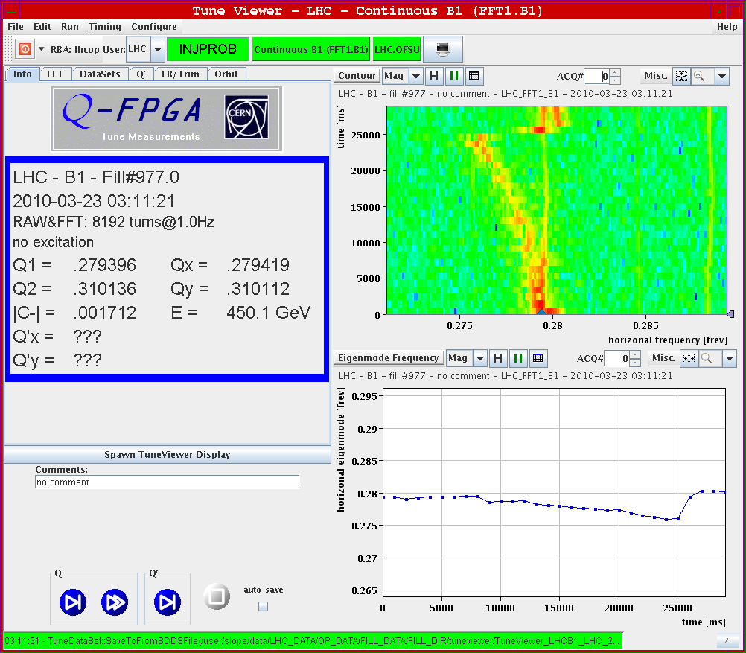
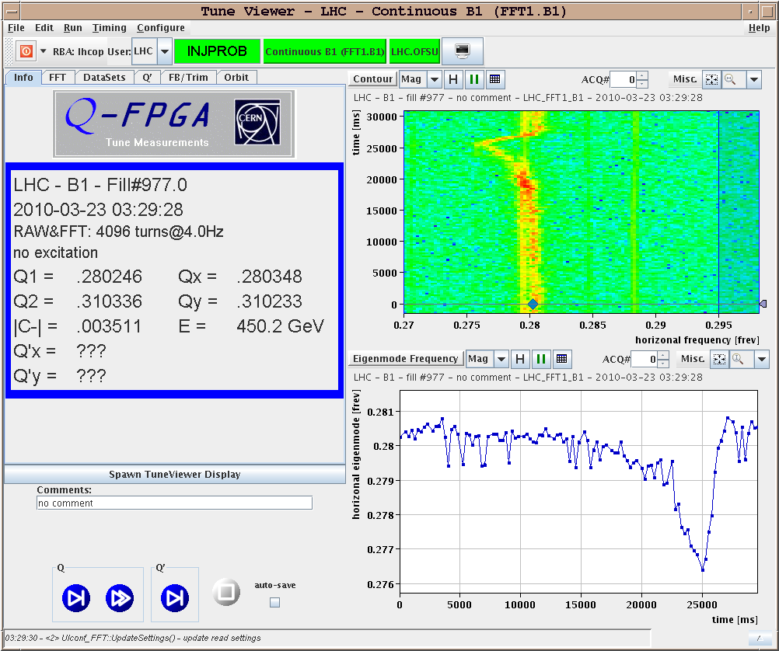
Night 22.3.
Tune feedback: reduced bandwidth from 0.1 Hz to 0.4 Hz; Beam1
should limit the maximum dV/dt and dI/dt values

Slide 4
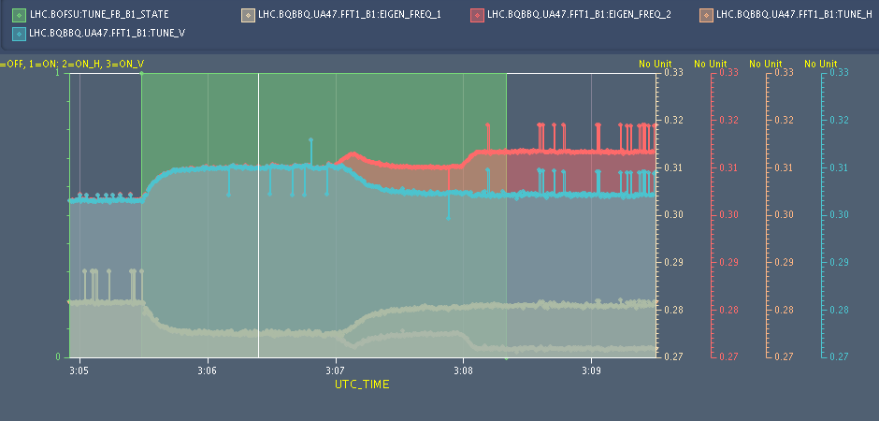
Night 22.3.
Tune feedback on with coupling adjustments

Slide 5
today
03:25: Fault on MKB for Beam2 (problem with power supply card)
➔ called Piquet but repair requires access; continue with Beam 1
Trip of B1 and B2 undulators
RQFA56: problem of resetting QPS controller ➔ could be reset MP3 expert
07:40: Beam back
Tentative program:
Ramp to 3.5 TeV
Orbit and TCT adjustments and optics measurements
Collimation check and set up at 3.5 TeV
LBDS set-up (at 450GeV and 3.5 TeV)
Still not finished:
damper studies
RF tuning

Slide 6
today
Open Issues:
Klystron in Pt4
BI needs access for synchrotron light monitor
BPMs in IP5?
RCBH22L2 B2 still requires intervention for PC communication

