Slide 1
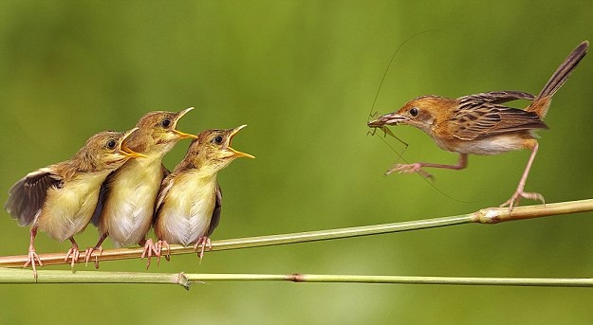
The future of the Large Hadron Collider
Mike Lamont
for the LHC team

Slide 2
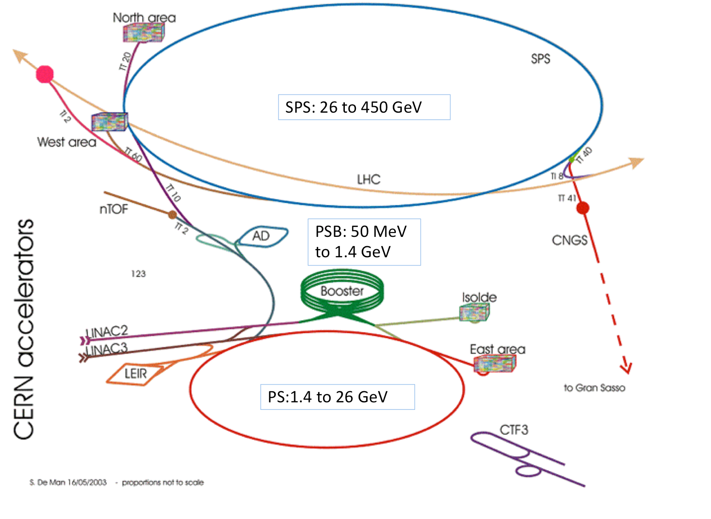

Slide 3
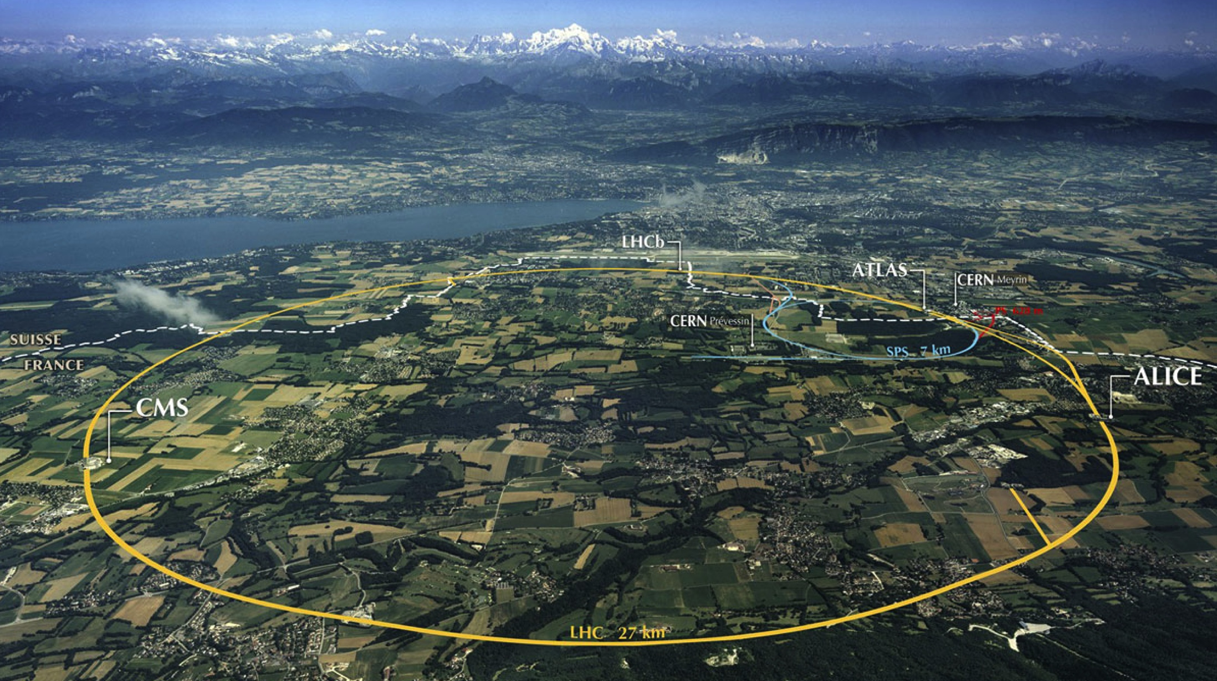
LHC: big, cold, high energy
Collimation
Injection B2
Beam dumps
Injection B1
Collimation
RF
1720 Power converters
> 9000 magnetic elements
7568 Quench detection systems
1088 Beam position monitors
~4000 Beam loss monitors
150 tonnes Helium, ~90 tonnes at 1.9 K
140 MJ stored beam energy in 2012
450 MJ magnetic energy per sector at 4 TeV

Slide 4
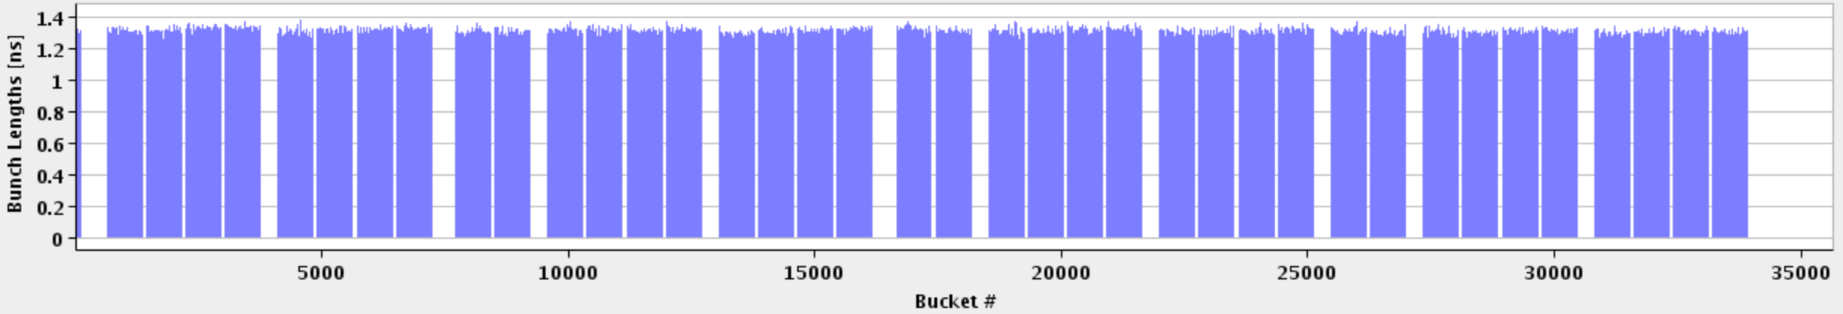
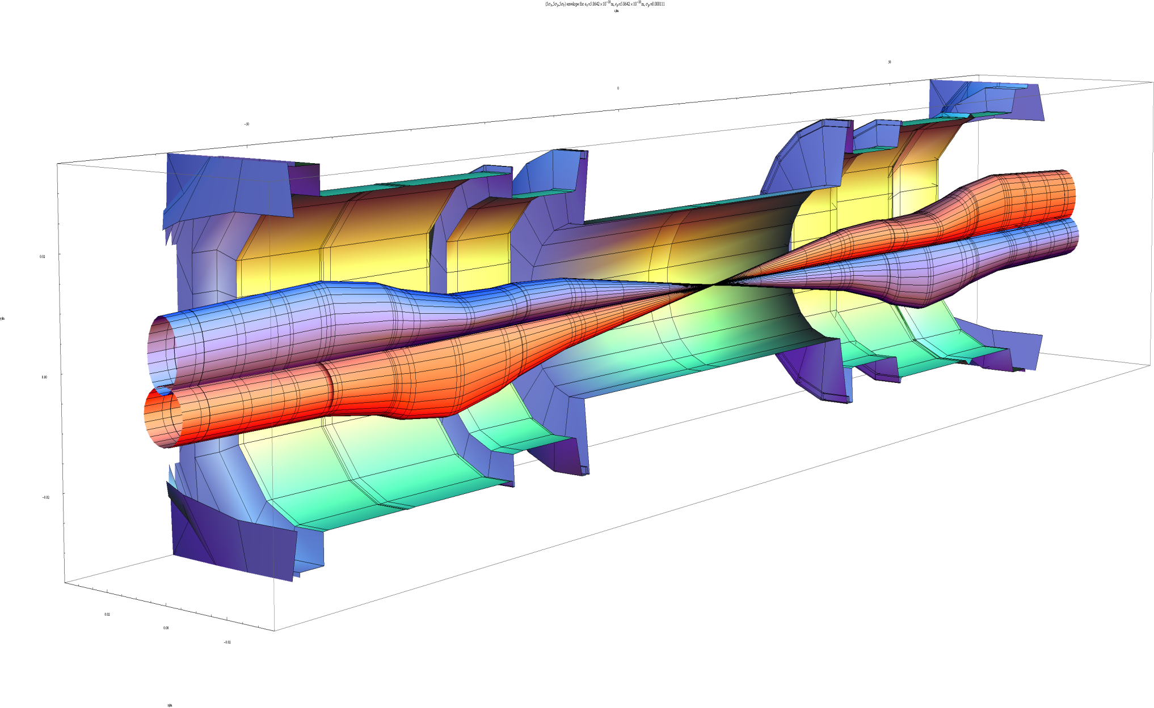
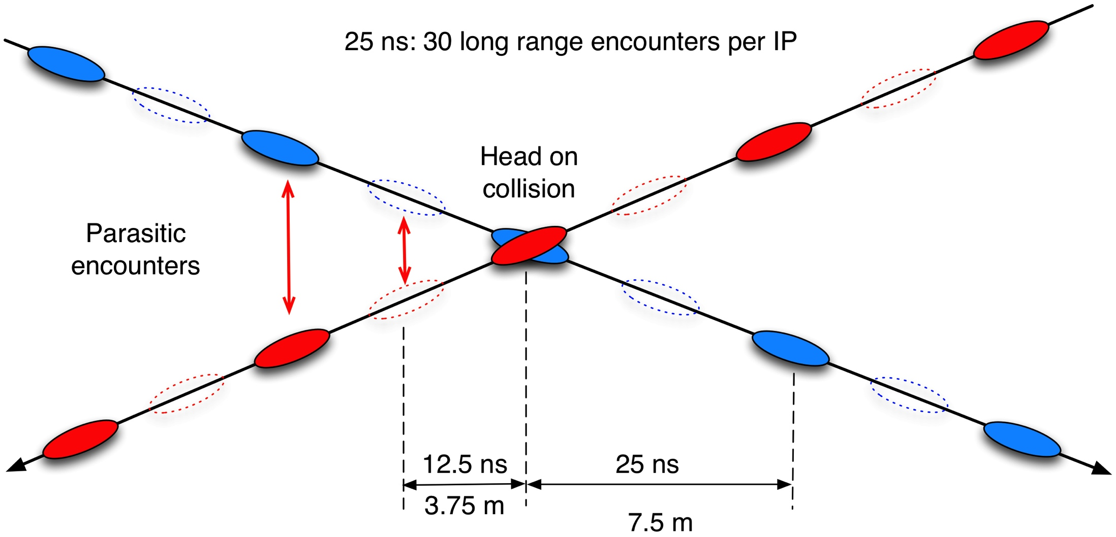
1 SPS injection
LHC bunch structure
Abort gap
27 km 1380 bunches
beta* 60 cm
beta_{max} ~4.5 km
John Jowett

Slide 5
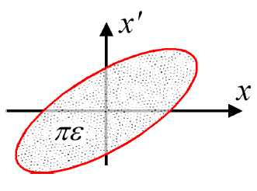
Luminosity
N | Number of particles per bunch
k_{b} | Number of bunches
f | Revolution frequency
σ* | Beam size at interaction point
F | Reduction factor due to crossing angle
ε | Emittance
ε_{n} | Normalized emittance
β* | Beta function at IP
Round beams, beam 1 = beam 2

Slide 6
Peak performance through the years
“What’s past is prologue”
 | 2010 | 2011 | 2012 | Nominal
Energy [TeV] | 3.5 | 3.5 | 4 | 7
Bunch spacing [ns] | 150 | 50 | 50 | 25
No. of bunches | 368 | 1380 | 1380 | 2808
beta* [m] ATLAS and CMS | 3.5 | 1.0 | 0.6 | 0.55
Max bunch intensity [protons/bunch] | 1.2 x 10¹¹ | 1.45 x 10¹¹ | 1.7 x 10¹¹ | 1.15 x 10¹¹
Normalized emittance [mm.mrad] | ~2.0 | ~2.4 | ~2.5 | 3.75
Peak luminosity [cm⁻²s⁻¹] | 2.1 x 10³² | 3.7 x 10³³ | 7.7 x 10³³ | 1.0 x 10³⁴

Slide 7
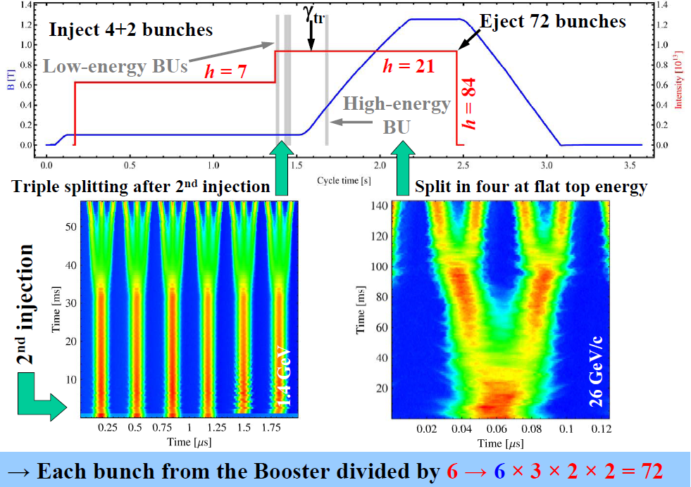
Performance from injectors 2012
Bunch spacing [ns] | Protons per bunch [ppb] | Norm. emittance H&V [μm] Exit SPS
50 | 1.7 x 10¹¹ | 1.8
25 | 1.2 x 10¹¹ | 2.7
25 (design report) | 1.15 x 10¹¹ | 3.75
Chose to stay with 50 ns:
I_{b}²
lower total intensity
less of an electron cloud challenge
High pileup as a result

Slide 8
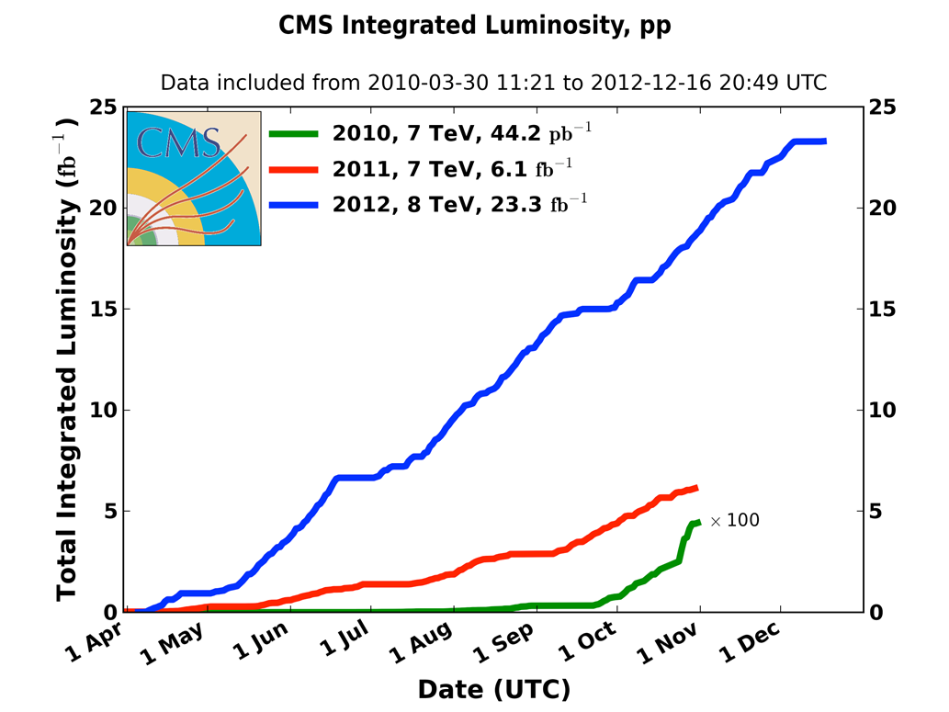
Integrated luminosity 2010-2012
2010: 0.04 fb⁻¹
  7 TeV CoM
  Commissioning
2011: 6.1 fb⁻¹
  7 TeV CoM
  Exploring the limits
2012: 23.3 fb⁻¹
  8 TeV CoM
  Production
 | 2010 | 2011 | 2012
Max. luminosity delivered in 7 days [fb⁻¹] | 0.025 | 0.58 | 1.35

Slide 9
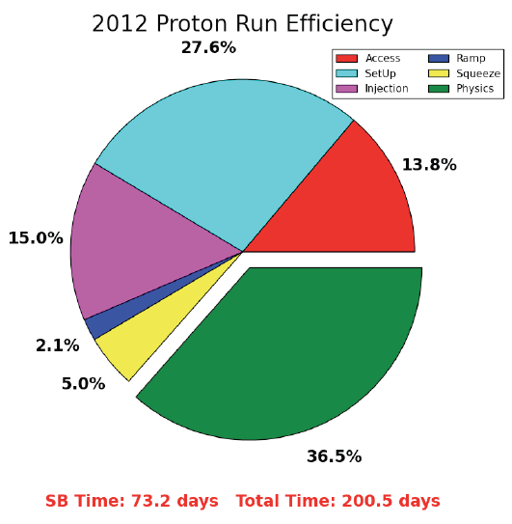
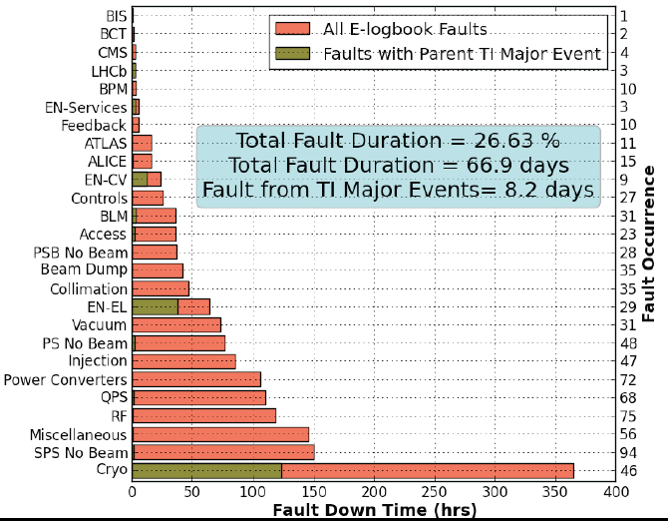
Availability
There are a lot of things that can go wrong – it’s always a battle
Pretty good availability considering the complexity and principles of operation
Stable beams
Cryogenics availability in 2012: 93.7%

Slide 10
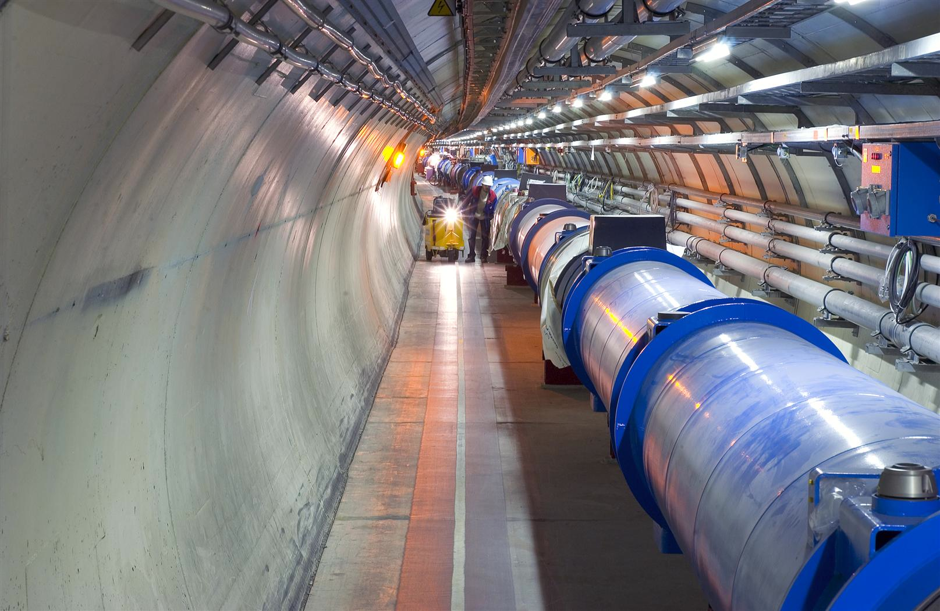
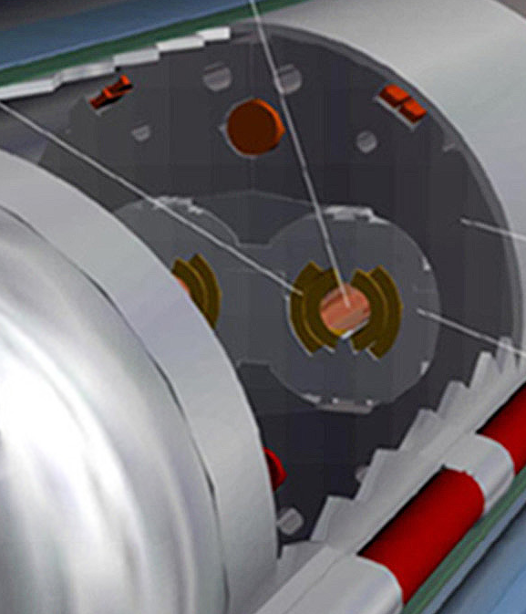
Machine protection
Beam
140 MJ
Not a single accidental beam induced quench at 4 TeV
… YET
11 magnet quench at 450 GeV – injection kicker flash-over
56 mm
SC Coil:
quench limit
15-100 mJ/cm³
Operations unpinned by superb performance of machine protection
Rigorous machine protection follow-up, qualification, and monitoring
R. Assmann

Slide 11
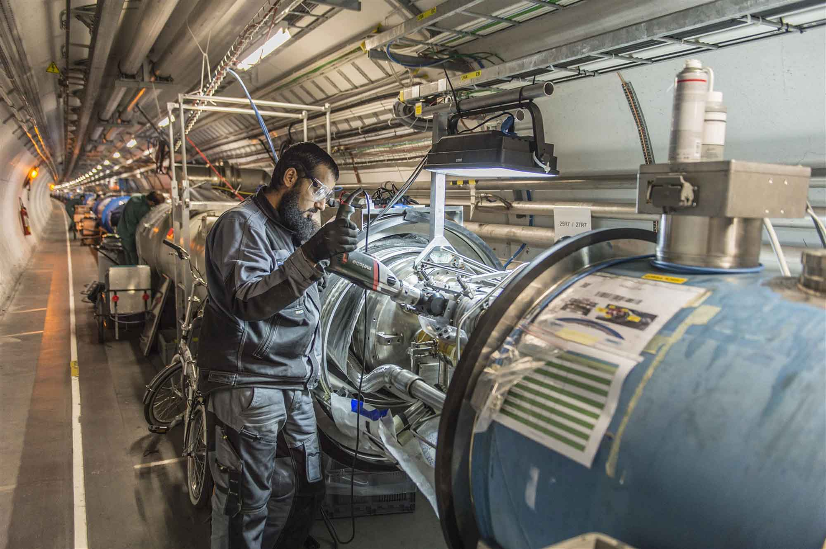
Long Shutdown 1

Slide 12
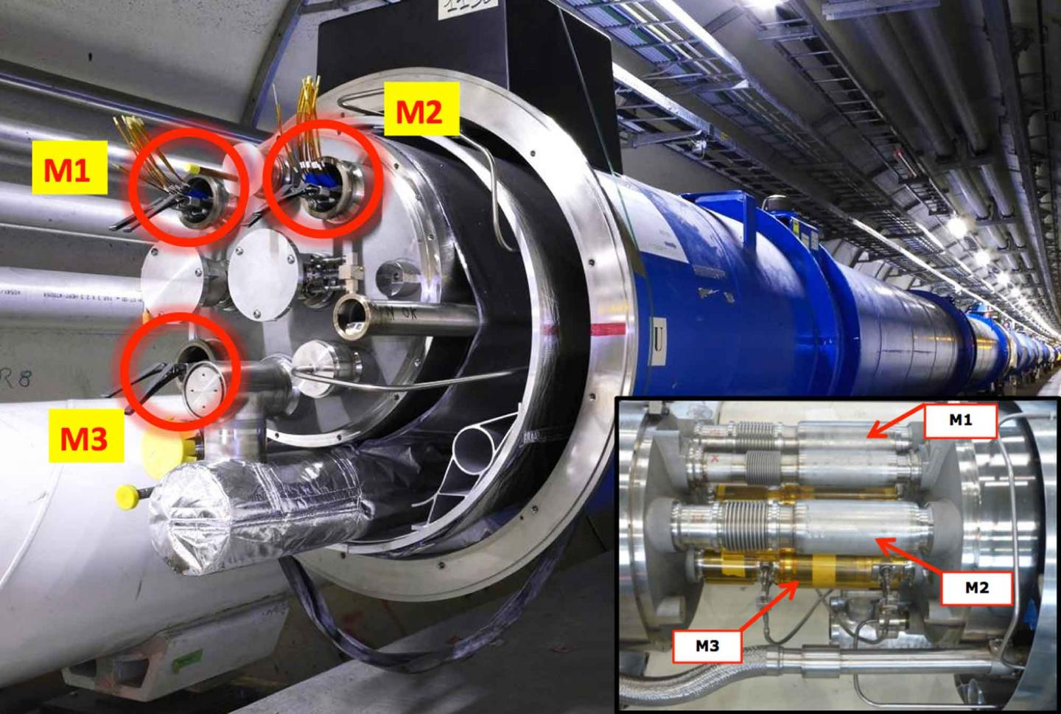

Slide 13
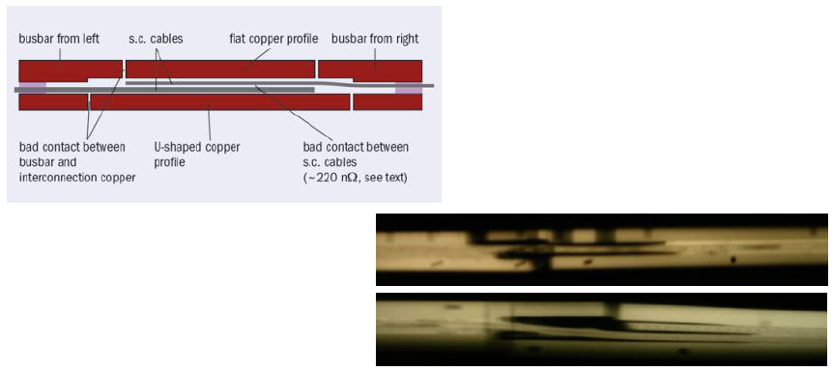
The Splices
gamma-rays of splices showing voids and bad contacts

Slide 14
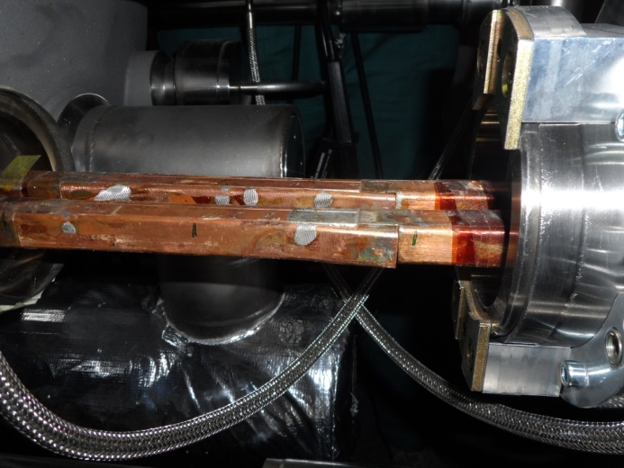
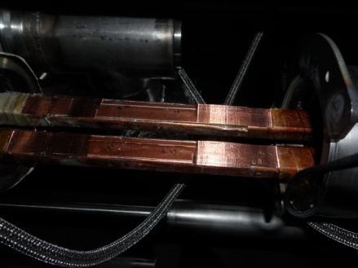
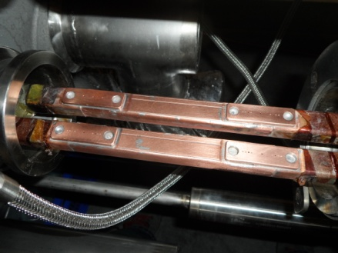
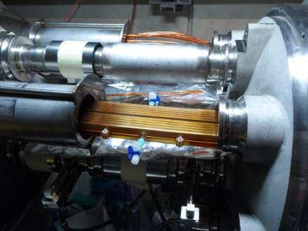
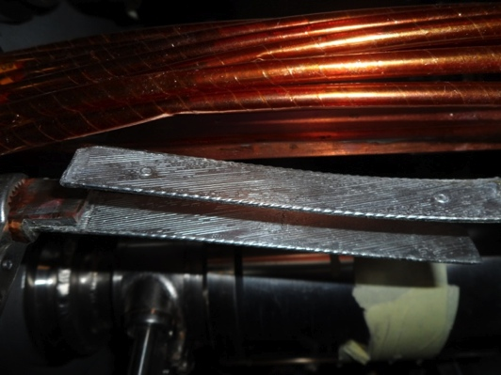
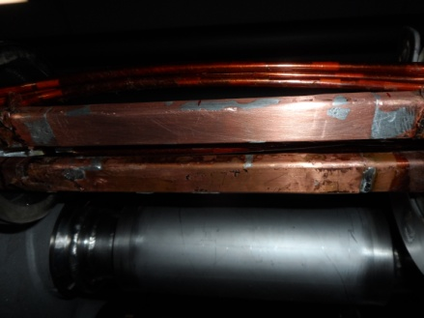
Splice Consolidation Process
Old splices
10170 splices
Machined splices
Consolidated splices including shunts
> 27000 shunts
30% of the splices
Initially estimated at 15%
~ 3000
Unsoldering of splice and superconducting cables
Reconstruction and soldering of splice and superconducting cables
Consolidated and insulated splices

Slide 15
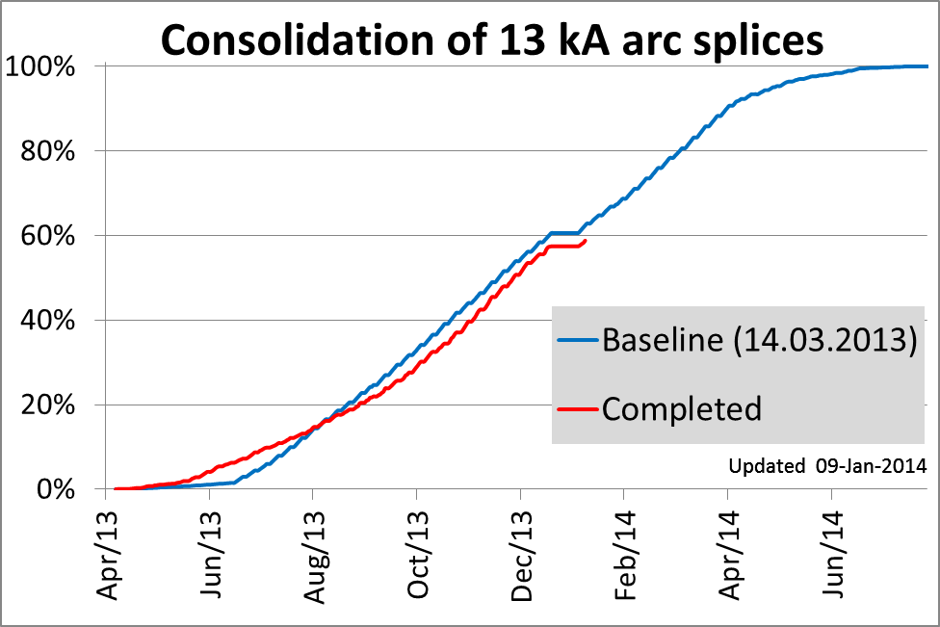
Baseline: 62.4 %
Completed: 58.8 %
Delay: 9 days
Delay stable
Jean-Philippe Tock

Slide 16
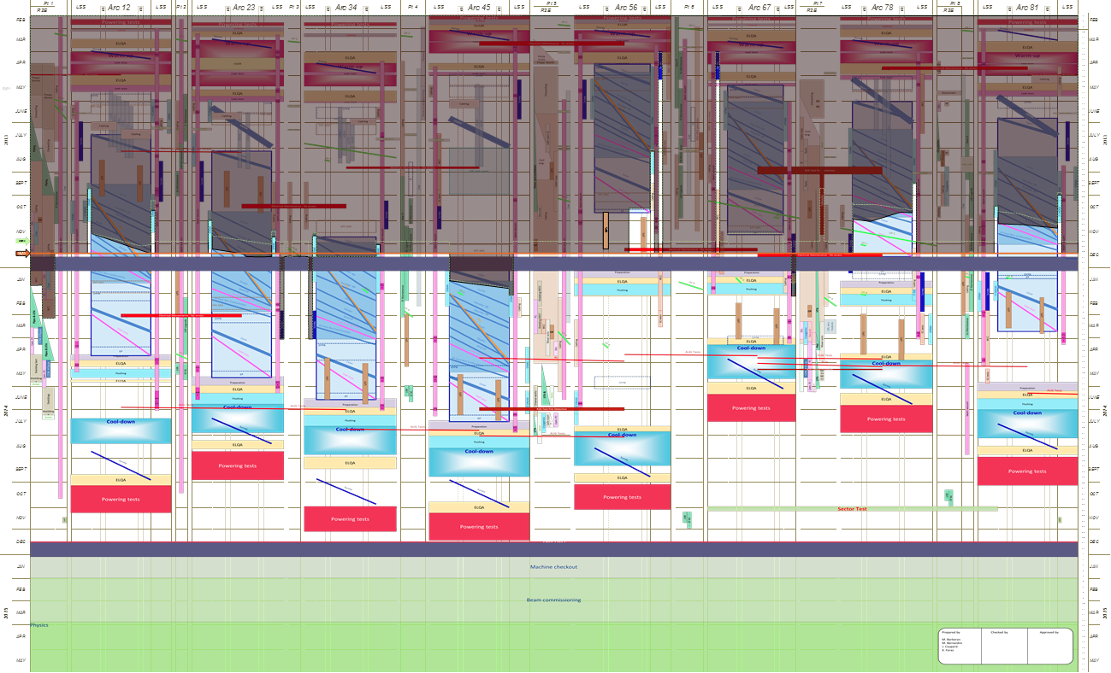
LS2 Overall Schedule
Warm-up & Preliminary tests
Status just before the Christmas break
2013
Completed
Consolidation & Maintenance Activities
Still to be done
Start of Cool-down
2014
Powering tests & HW commissioning
2015
Machine check-out & Beam commissioning

Slide 17
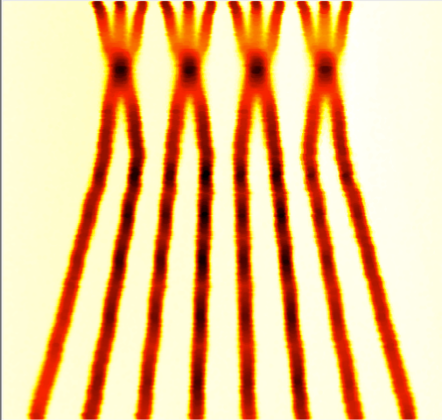
Run II – post LS1
Energy: 6.5 TeV
Beta*: 40 – 50 cm
Bunch spacing: 25 ns
  because of pile-up considerations
Injectors potentially able to offer nominal intensity with even lower emittance
BCMS = Batch Compression and Merging and Splitting
 | Number of bunches | Ib LHC [1e11] | Emit LHC [um] | Peak Lumi [cm-²s⁻¹] | ~Pile-up | Int. Lumi per year [fb⁻¹]
25 ns BCMS | 2590 | 1.15 | 1.9 | 1.7e34 | 49 | ~45

Slide 18
25 ns & electron cloud
200 eV
10 eV
2 keV
Beam screen
5 eV
25 ns
Typical e– densities10¹⁰–10¹² m^{–3}
Possible consequences:
  instabilities, emittance growth, desorption – bad vacuum
  excessive energy deposition in the cold sectors
Electron bombardment of a surface has been proven to reduce drastically the secondary electron yield (SEY) of a material. This technique, known as scrubbing, provides a mean to suppress electron cloud build-up.
Results from 2012 indicate that a scrubbing run will probably be insufficient to fully suppress electron cloud from the arcs for 25 ns beams.

Slide 19
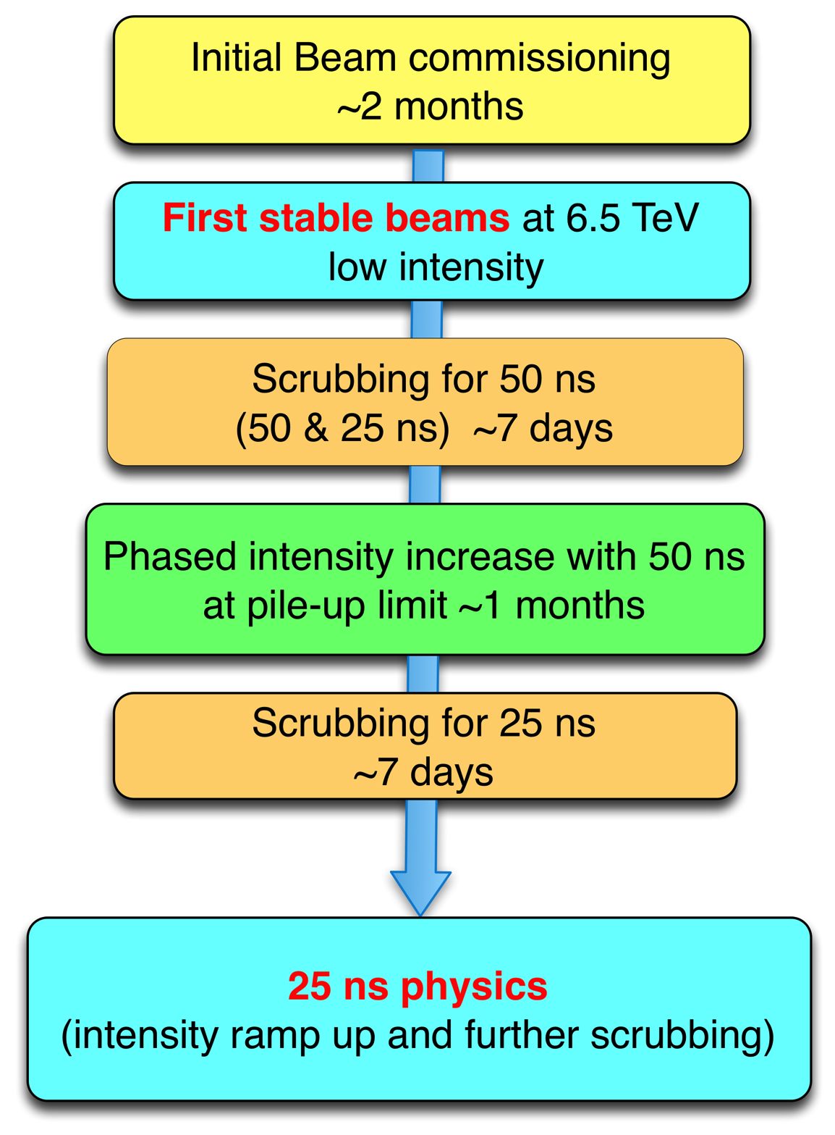
2015

Slide 20
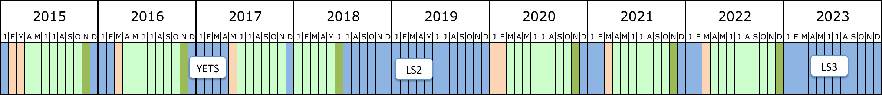
Next 10 years
Run 2
Run 3
6.5 to 7 TeV
Peak luminosity 1.7x10³⁴cm⁻²s⁻¹
7 TeV
Peak luminosity 2.0x10³⁴cm⁻²s⁻¹
LIU (Injectors)
ALICE
LHCb
HL-LHC
(Machine & expts)

Slide 21
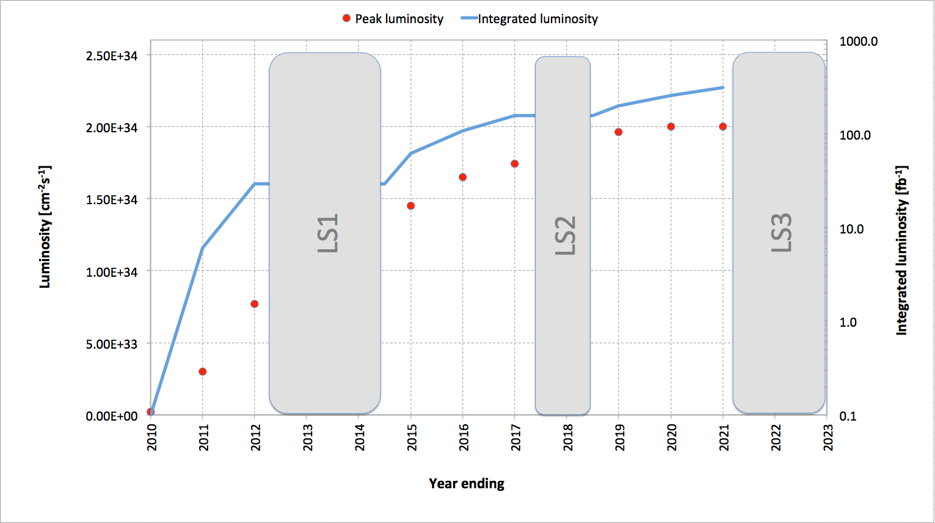
Luminosity evolution
~300 fb⁻¹
Usual caveats apply

Slide 22
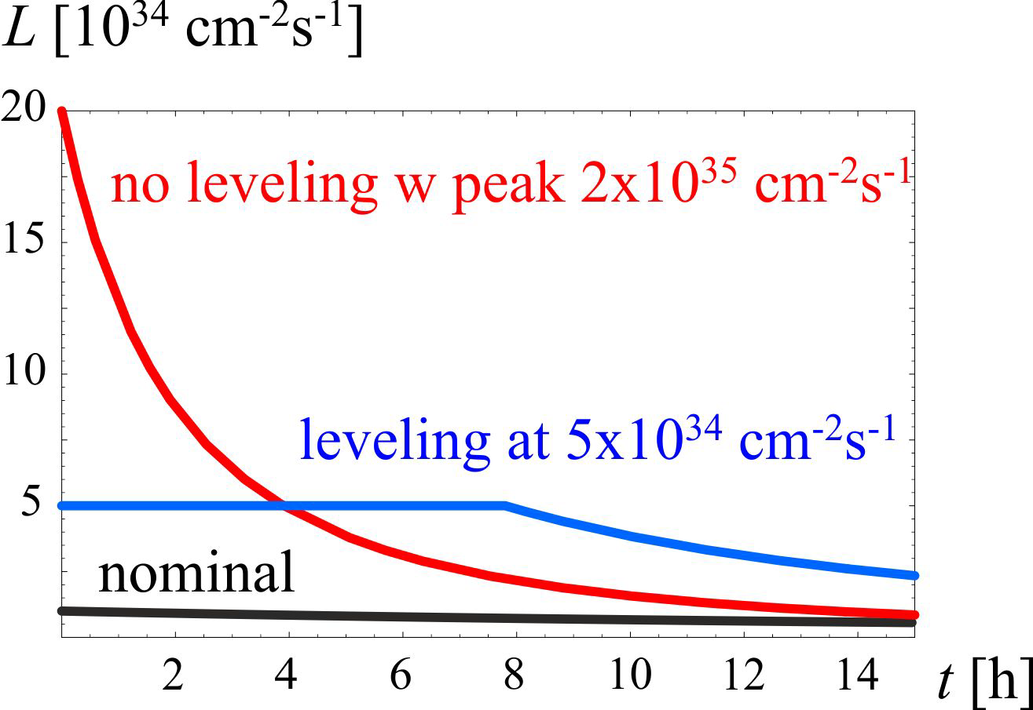
HL-LHC
3000 fb⁻¹ delivered in the order of 10 years
High “virtual” luminosity with levelling anticipated
Challenging demands on the injector complex
  major upgrades foreseen (Linac 4, Booster 2GeV, PS and SPS)
5 x 10³⁴ cm⁻²s⁻¹ levelled luminosity
3 fb⁻¹ per day
~250 fb⁻¹ /year

Slide 23
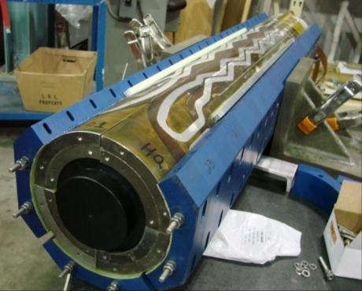
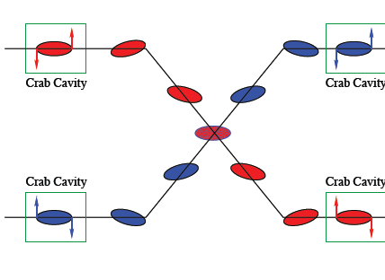
HL-LHC: main thrusts
Wide aperture Nb₃Sn quadrupoles
  Optics and layout: beta* = 15 cm
11 T Nb₃Sn dipoles
  Used to make room for collimation in dispersion suppression region
Large Aperture NbTi separator magnets
  First twin aperture magnets near interaction
Crab cavities
  Reduce the effect of the crossing angle
Enhanced collimation for 500 MJ beams
LARP: HQ02

Slide 24
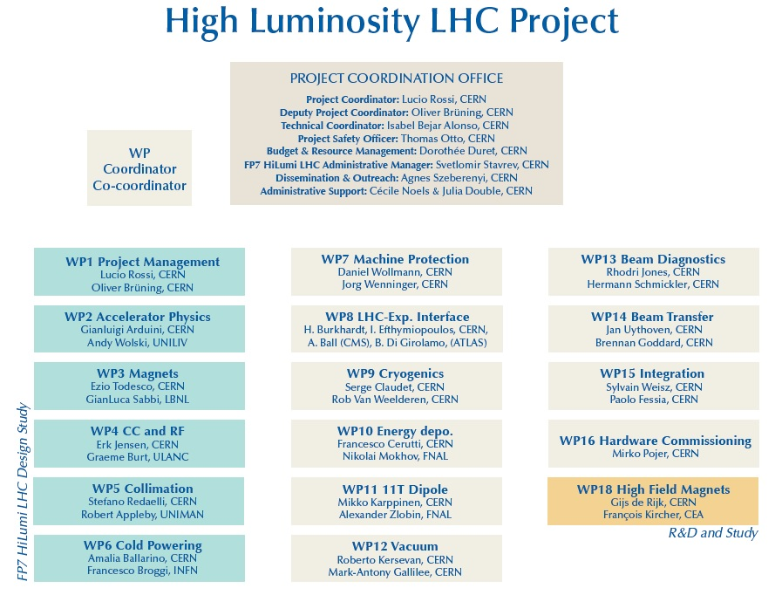

HL-LHC
Project firmly established under leadership of Lucio Rossi and Oliver Bruning
International collaboration with solid R&D program in place
Q4

Slide 25
HL-LHC: key 25 ns parameters
Protons per bunch | 2.2 x 10¹¹
Normalized emittance | 2.5 micron
Beta* | 15 cm
Crossing angle | 590 microrad
Geometric reduction factor | 0.305
Peak luminosity | 7.4 x 10³⁴ cm⁻²s⁻¹
Virtual luminosity | 24 x 10³⁴ cm⁻²s⁻¹
Levelled luminosity | 5 x 10³⁴ cm⁻²s⁻¹
Levelled <pile-up> | 140

Slide 26
BEYOND

Slide 27

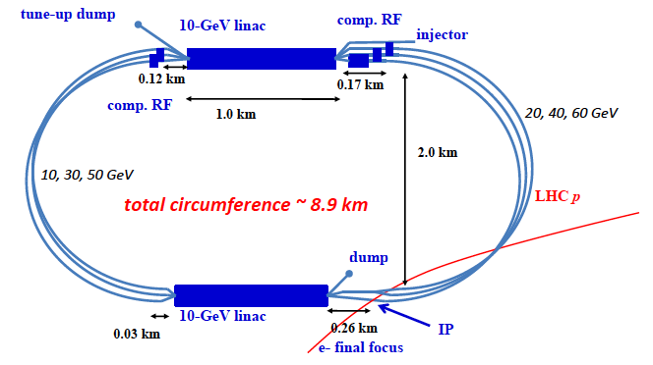
Large Hadron Electron Collider: LHeC
Foresees 60 GeV electrons on 7 TeV protons
Conceptual design report published in June 2012
Two e⁻ options: linac-ring (LR) and ring-ring (RR)
Linac-ring option: re-circulating linac with energy recovery
Oliver Bruning, Max Klein et al

Slide 28
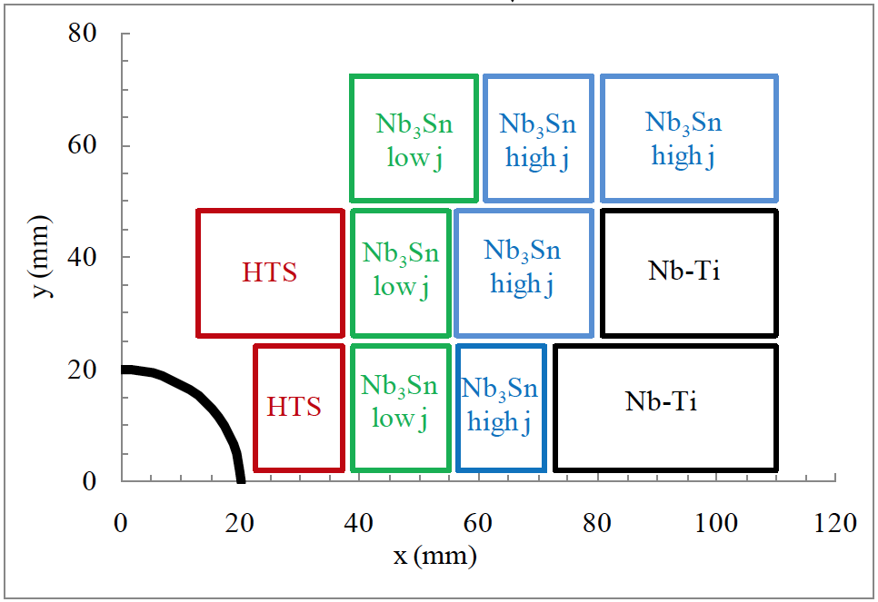

High Energy LHC: HE-LHC
Re-equip existing LHC tunnel with high field magnets
Conceptual layout of 20 T dipole magnet
(Nb₃Sn and HTS)
Intense R&D required
Circumference | 26.7 km
Maximum dipole field | 20 T
Injection energy from SC-SPS | 1.3 TeV
Maximum c.o.m. energy | 33 TeV
Peak luminosity | 5 x 10³⁴ cm⁻²s⁻¹

Slide 29
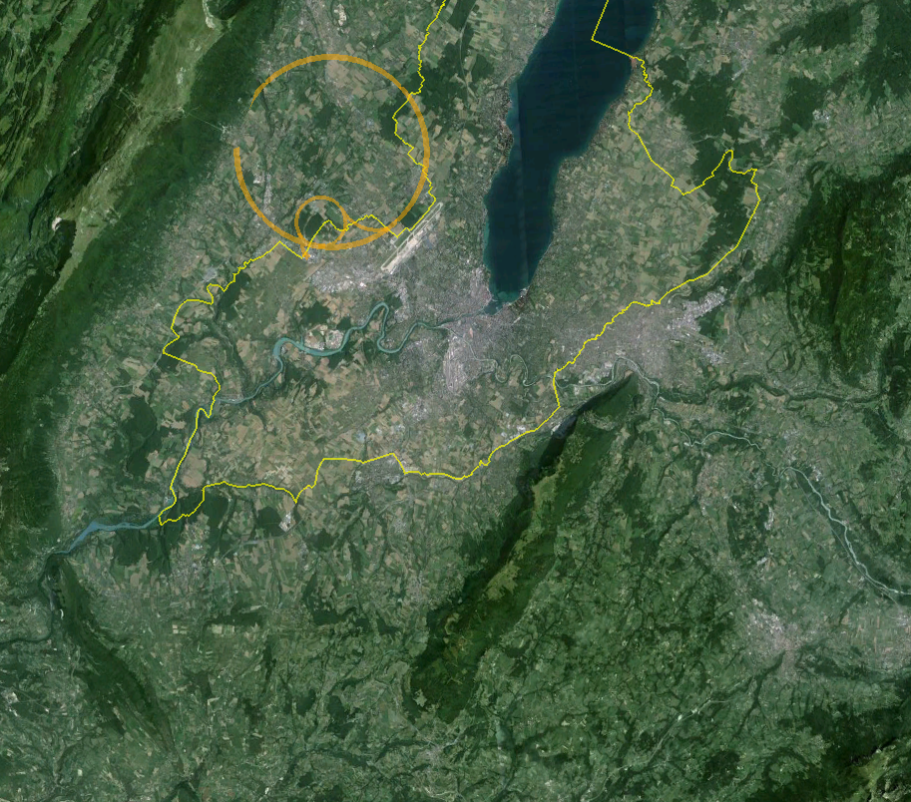
80 to 100 km Very High Energy LHC VHE-LHC
LHC
Pre-Feasibility Study for an 80-km tunnel at CERN
John Osborne and Caroline Waaijer, CERN, ARUP & GADZ
Jura
1
8
2
Geneva
7
3
Saleve
6
100 km
4
5

Slide 30
VHE-LHC
Circumference | 80 or 100 km
Maximum dipole field | 20 or 16 T
Injection energy | > 3.0 TeV
Maximum c.o.m. energy | 100 TeV
Peak luminosity | 5 x 10³⁴ cm⁻²s⁻¹
Stored beam energy | ~5500 MJ
Among the many challenges:
Synchrotron radiation heat load 33 W/m
Collimation!
IR quadrupoles
Arc quadrupoles (naïve scaling gives 1593 T/m at 50 TeV beam energy)

Slide 31
Injection into VHE-LHC
LHC
Jura
1
VHE-LHC-LER
8
SPS+
2
Geneva
7
3
Saleve
6
4
5

Slide 32
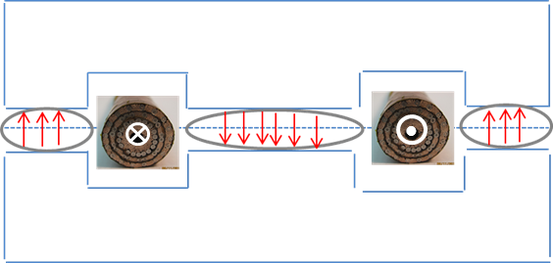
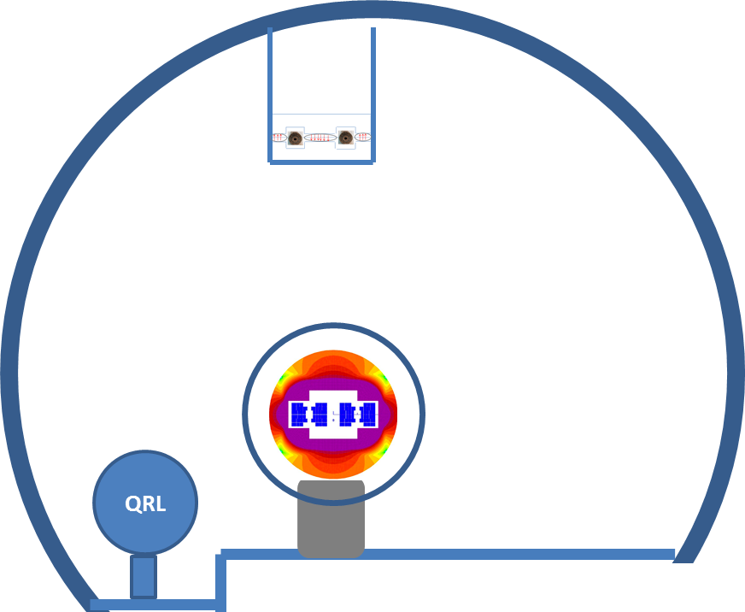
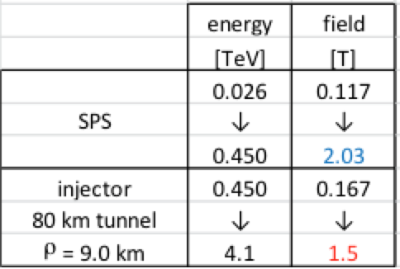
Possible VHE-LHC with LER
“Pipetron” using transmission line magnets (W. Foster, H. Piekarz)
Possible variant
Relatively cheap
Limited cryogenic power – HTS
Lucio Rossi
LER also suitable for e⁺/e⁻ …

Slide 33
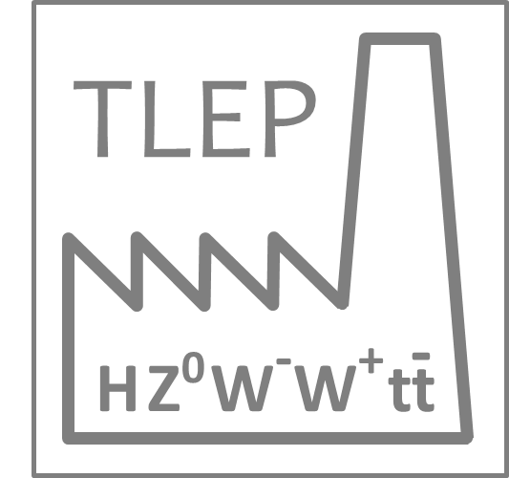
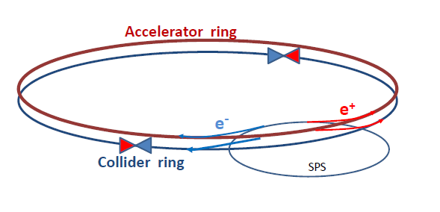
TLEP
Circular electron-positron collider in new 80 – 100 km tunnel
  Storage ring has separate beam pipes for e⁺ and e⁻ for multi-bunch operation up to 350 GeV c.m.
  top-up injection with an ancillary accelerator
  Very high luminosity at Z pole and above WW threshold with operation up to tt threshold
Using the tunnel before installation of the VHE-LHC

Slide 34
TLEP: parameters
Beam lifetime dominated by Bhabha scattering and bremstrahlung
 | TLEP Z | TLEP W | TLEP H | TLEP t
E c.m. [GeV] | 91 | 160 | 240 | 350
#bunches/beam | 7500 | 3200 | 167 | 160
Peak luminosity [x 10³⁴ cm⁻²s⁻¹] | 59 | 16 | 5 | 1.3
Beam lifetime to Bhabha [min.] | 99 | 38 | 24 | 21
Beam lifetime to bremstrahlung [min.] | > 1025 | >106 | 38 | 14
 | TLHeC |  | VHE-TLHeC
species | e± | p | e± | p
beam energy [GeV] | 60/120 | 7000 | 60/120 | 50000
Frank Zimmermann et al

Slide 35
Conclusions
Reasonably good performance from commissioning through Run 1
  Foundations firmly laid for Run 2
Run 2 and Run 3 will see exploitation at 6.5 to 7 TeV with 25 ns
  Target 300 fb⁻¹ by end Run 3
HL-LHC firmly established
  Target 3000 fb⁻¹ in ~10 years
Study team (Future Circular Colliders) has just been set up to look at more distant circular options

