Slide 1

The LHC from commissioning to operation
Mike Lamont for the LHC team

Slide 2
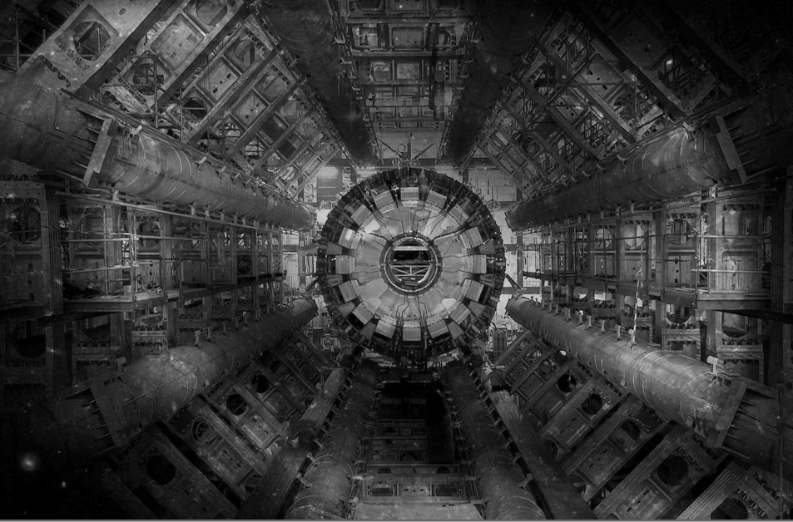
The LHC
Very big
Very cold
Very high energy

Slide 3
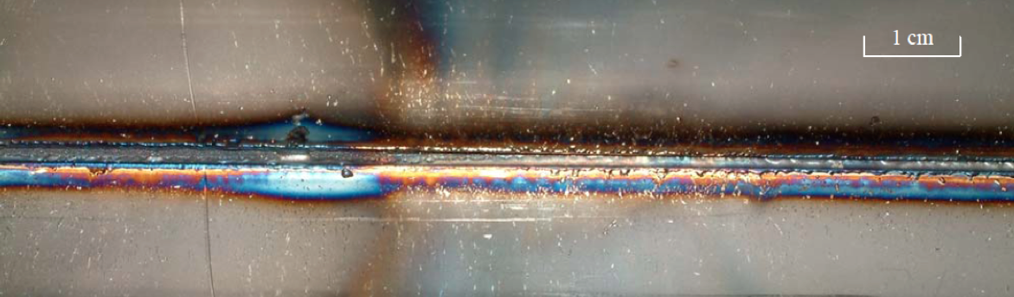
Energy
At 3.5 TeV with 1380 bunches – August 2011
~3 GJ of energy stored in the magnets
100 MJ stored in each beam ~21 kg of TNT.
Underpinned our thoughts during commissioning
During an SPS extraction test in 2004…
The beam was a 450 GeV full LHC injection batch of 3.4 10¹³ p+ in 288 bunches [2.5 MJ]

Slide 4
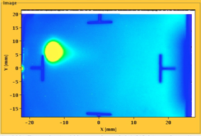
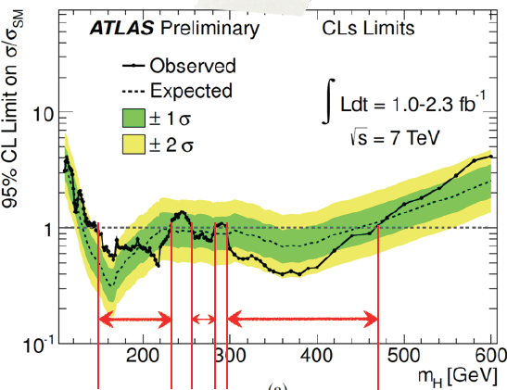
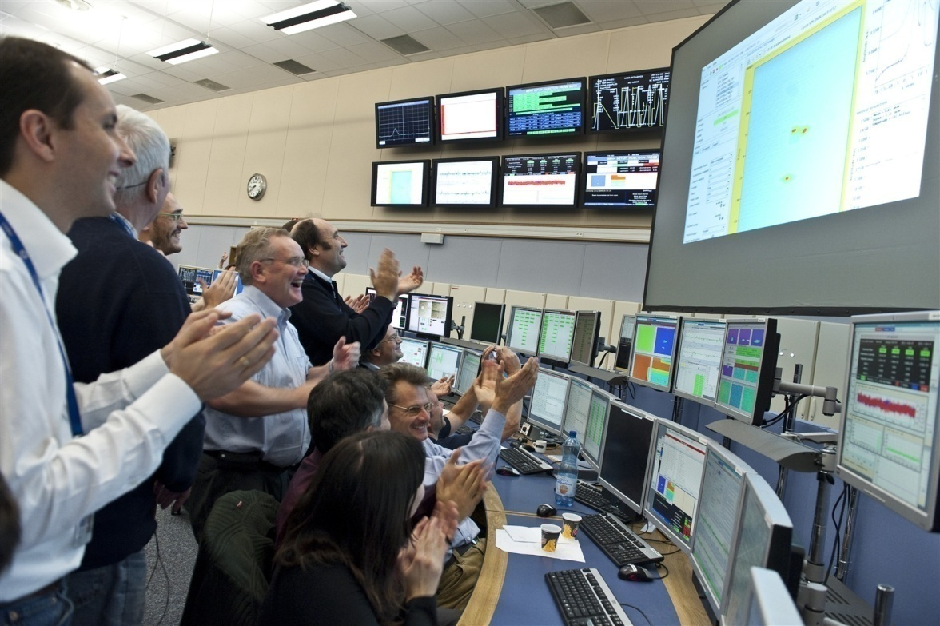

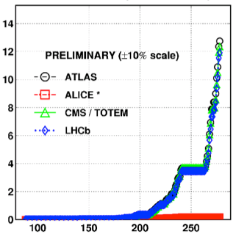

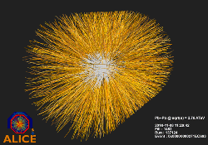
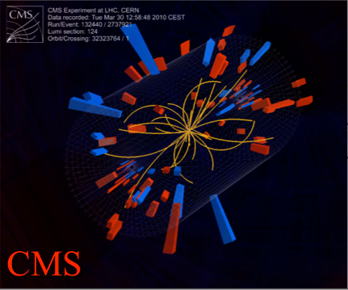
August 2008
First injection test
November 29, 2009
Beam back
August, 2011
2.3e33, 2.6 fb⁻¹
1380 bunches
September 10, 2008
First beams around
June 28 2011
1380 bunches
October 14 2010
1e32
248 bunches
1380
April 2010
Squeeze to 3.5 m
2008
2009
2010
2011
November 2010
Ions
March 30, 2010
First collisions at 3.5 TeV
September 19, 2008
Disaster
Accidental release of 600 MJ stored in one sector of LHC dipole magnets
LHC Timeline

Slide 5
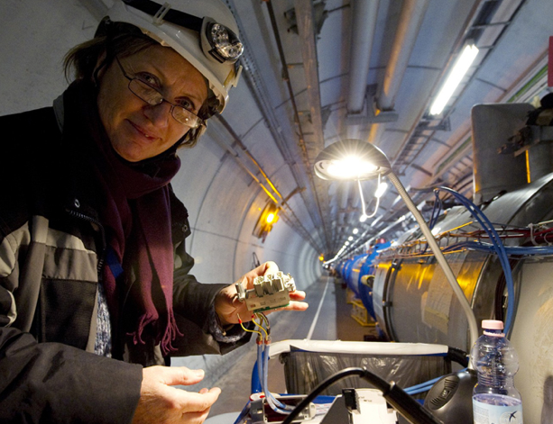

2009: besides massive repair and consolidation
Understanding the problem
Copper stabilizer issue identified
Measurement campaign warm and cold
Simulations
Test set-up (FRESCA)
Prevention
Deployment of new Quench Protection System (design, prototyping, production, deployment, testing)
Caution
Run at 3.5 TeV
TUPS071 Performance of the Protection System for Superconducting Circuits during LHC Operation

Slide 6
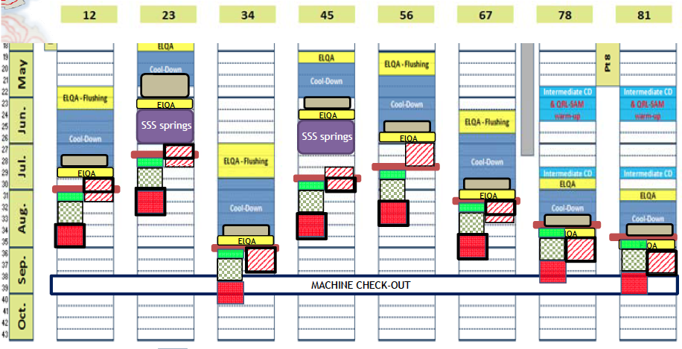
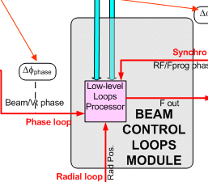

“Unprecedented state of readiness”
2009: That which does not kill us…
Beam based systems
Injectors & transfer lines
Instrumentation: BPMs, BLMs
Beam interlock System
RF
Collimators
Controls & software
Sequencer
Injection sequencer
Settings management
Middleware
Timing
Software interlocks
Magnet model
On-line model
Logging
Dry runs, system tests and hardware commissioning

Slide 7
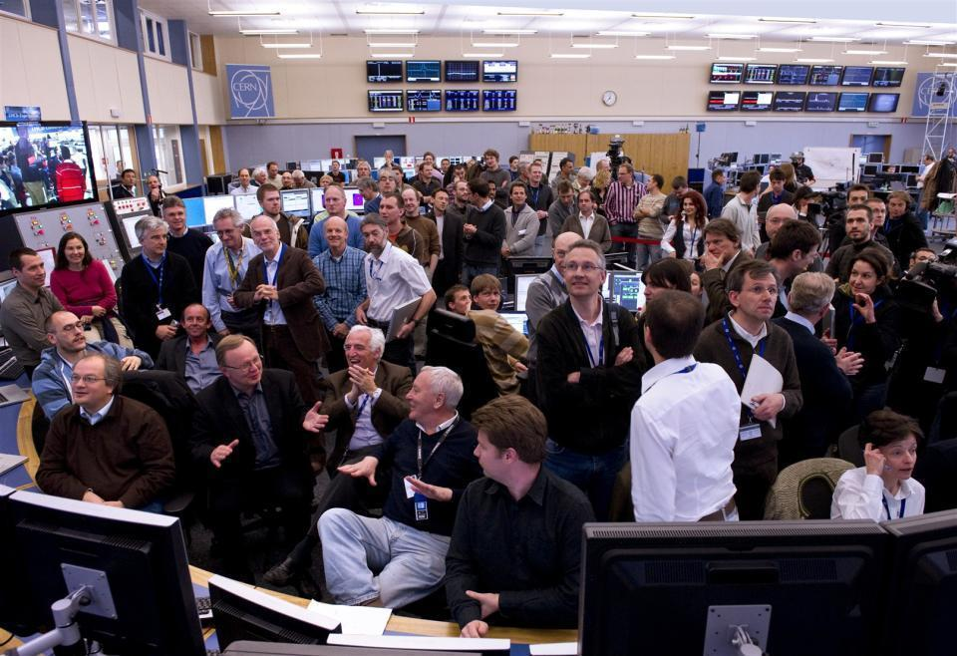
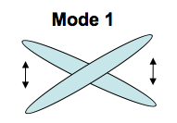
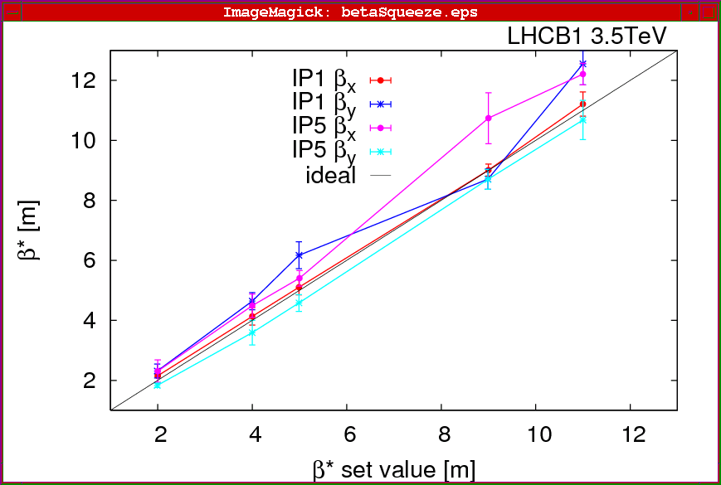
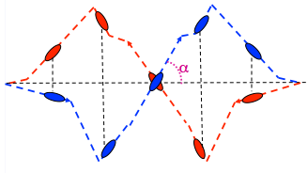
June
Commission nominal bunch intensity
November 4
Switch to lead ions
March 30
First collisions 3.5 TeV
Feb 27
Beam back
QUALIFICATION
February
March
April
May
June
July
August
September
October
November
April
Commission squeeze
September
Crossing angles on
October
Luminosity
production
A closer look at 2010

Slide 8
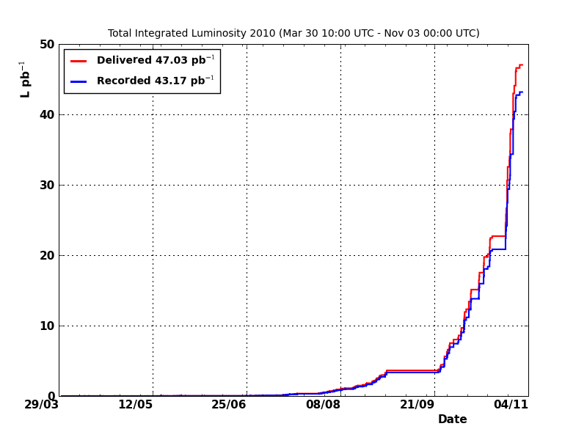
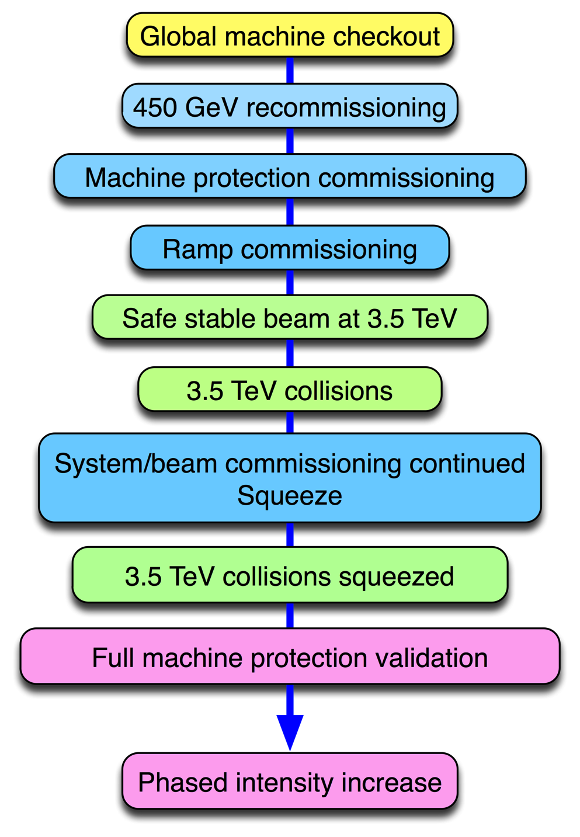
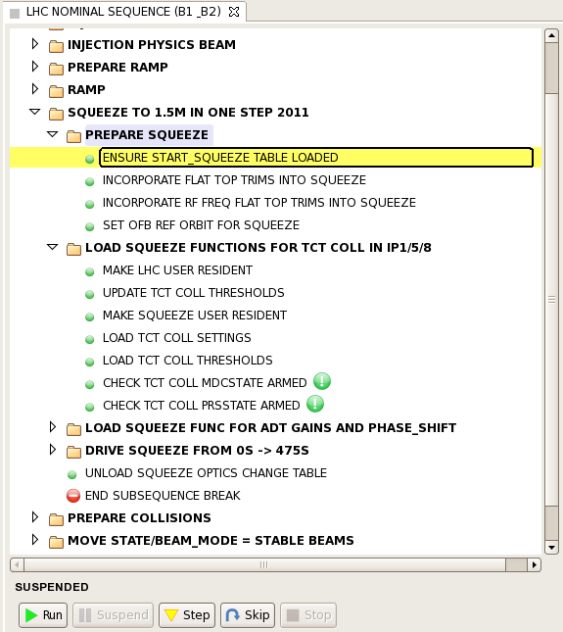
2010 – integrated luminosity
CONSOLIDATION
COMMISSIONING
and frantic debugging
EXPLOITATION

Slide 9
Transfer & injection
At present: 144 bunches of 1.3e11 ppb - 1.5 MJ
IR8
Injection kicker
Switching magnet
CNGS Target
Possibly the best studied, best optimized transfer lines in the history of accelerator physics
Fast extraction kicker
SPS
6911 m
450 GeV / 400 GeV
Transfer line
LHC
Injection kicker
IR2
Fast extraction kicker
1 km
Transfer line
HiRadMat

Slide 10
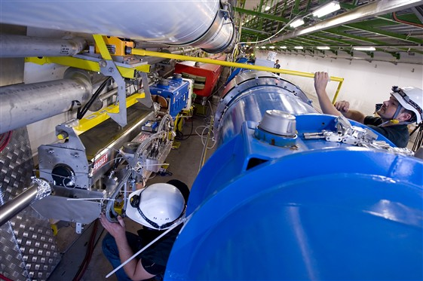
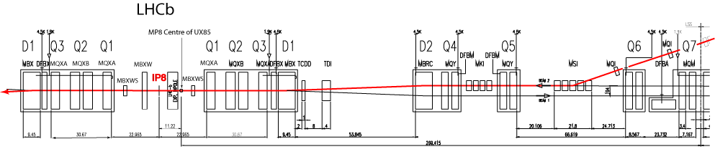
Injection
Complex process – wrestle with:
  Re-phasing, synchronization, transfer, capture
  Timing, injection sequencing, interlocks
  Injection Quality checks – SPS and LHC
  Abort gap keeper
  Beam losses at injection, gap cleaning
Full program of beam based checks performed
  Carefully positioning of collimators and other protection devices
  Aperture, kicker waveform
Transfer line collimator
SC magnets armed with beam loss monitors
TCDD absorber
TDI collimator
4 x KICKERS
5 x SEPTA

Slide 11
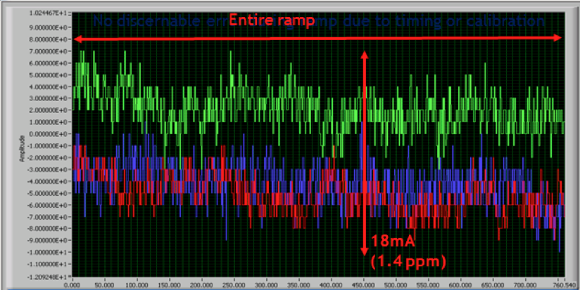
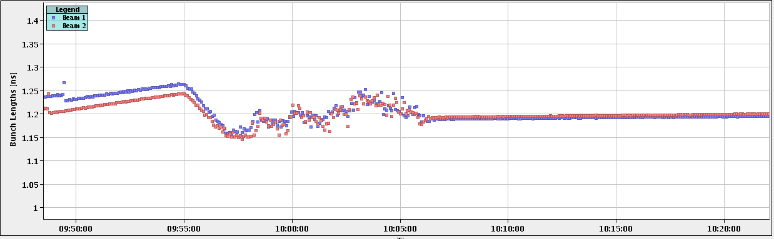
Ramp
Power converters (all magnet circuits), magnet model, RF, collimators, beam dump, transverse damper, orbit and tune feedback, BLM thresholds etc.
Reproducible and essentially without loss (after a lot of work)
Main bend power converters: tracking error between sector 12 & 23 in ramp to 1.1 TeV

Slide 12
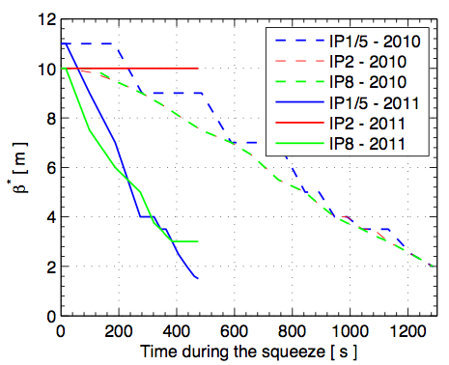
Squeeze
Programmed functions making smooth transition between matched optics
Tune and orbit feedbacks mandatory
Reproducible and essentially without loss (a.l.w.)
TUPZ028 Beam Based Optimization of the Squeeze at the LHC

Slide 13
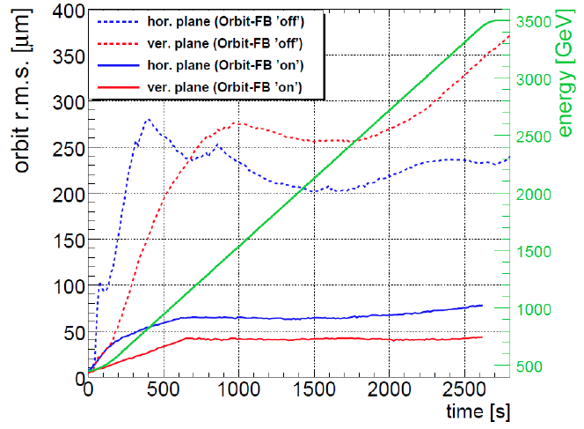
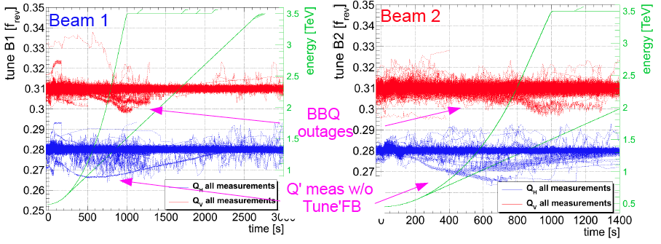
Tune and orbit feedback
Mandatory in ramp and squeeze
Commissioning not without some issues but now fully operational

Slide 14
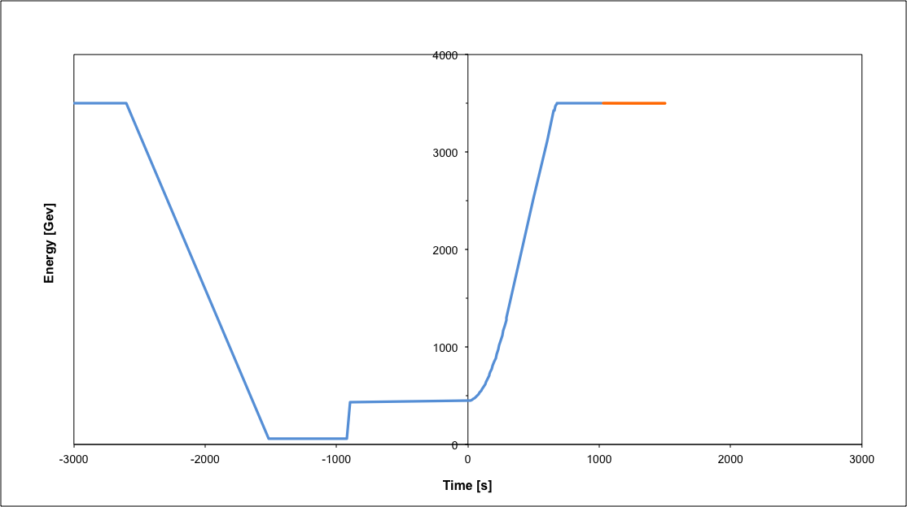
Nominal cycle
Beam dump
Squeeze
Stable beams
Collide
Ramp
Ramp down/precycle
Ramp down | 35 mins
Injection | ~30 mins
Ramp | 17 mins
Squeeze | 8 mins
Collide | 1 mins
Stable beams | 0 – 30 hours
Injection
Fastest turn around down from 3h40m in 2010 to 2h7m in 2011 after optimization

Slide 15
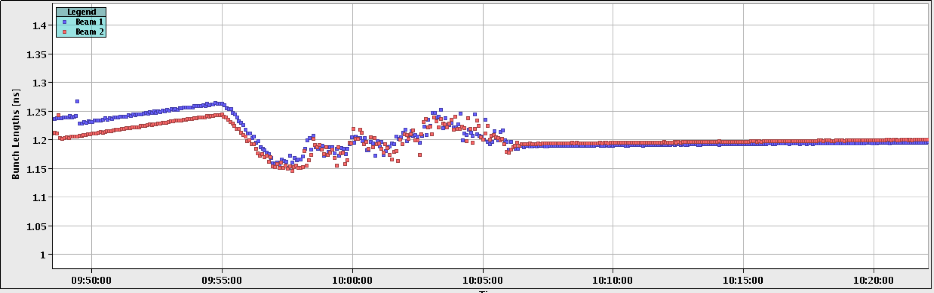
RF
RF noise & crossing of 50 Hz by Qs in ramp – no issue.
Capture losses under control
Longitudinal emittance blow-up, needed for ramping of nominal bunch intensity, rapidly commissioned.
Beam-induced voltage and load power:
  half nominal intensity – dump beam on 1 klystron trip - 5/43 fills to RF since July 2011
Bunch length in ramp
1.2 ns
MOPC054 The LHC RF System Experience with Beam Operation
MOPC057 Loss of Landau Damping in the LHC
TUPZ010 Longitudinal emittance blow-up in the LHC

Slide 16
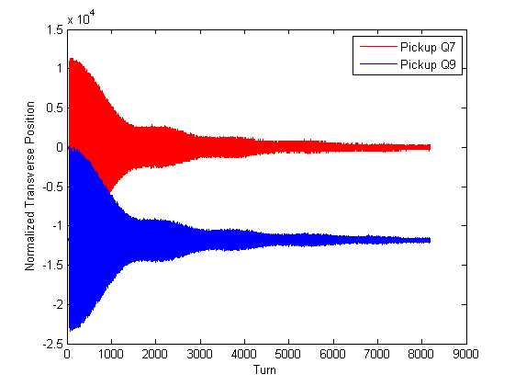
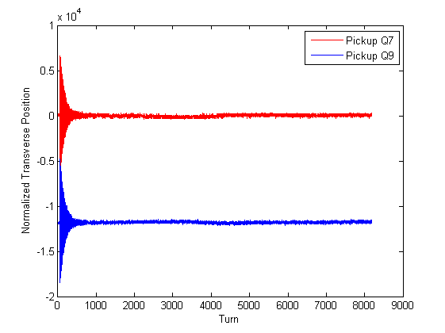
Transverse dampers
Injection oscillations
‘Hump’ suppression
Abort gap and injection gap cleaning
Coherent instabilities
(Blow-up for loss maps)
Vital and working well
Transverse position
OFF
ON
Injection oscillations
Turn number
MOPO012 LHC Damper Beam Commissioning in 2010

Slide 17
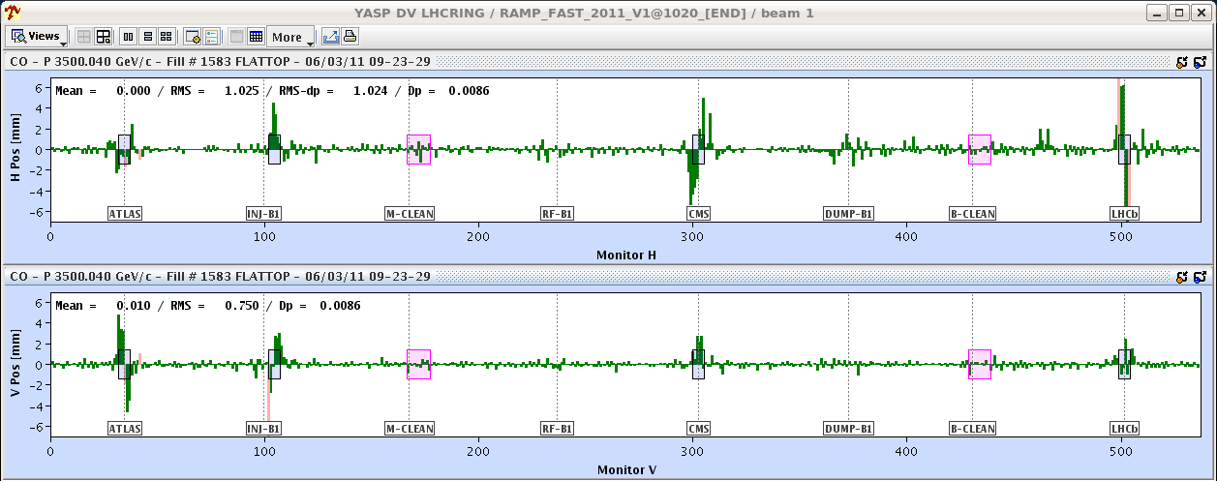
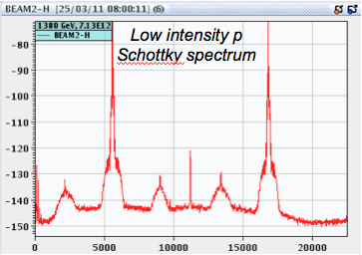
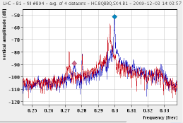
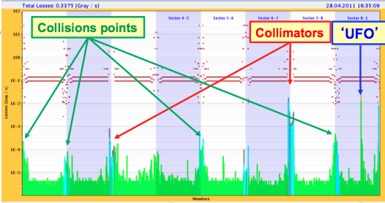
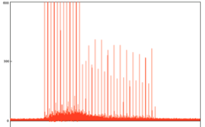
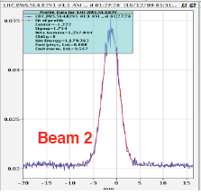
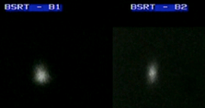
Beam Instrumentation: excellent performance
Beam Position Monitors
Beam loss monitors
Base-Band-Tune (BBQ)
Wire scanner
Longitudinal density monitor
Synchrotron light
FRXCA01 First Years Experience of LHC Beam Instrumentation

Slide 18
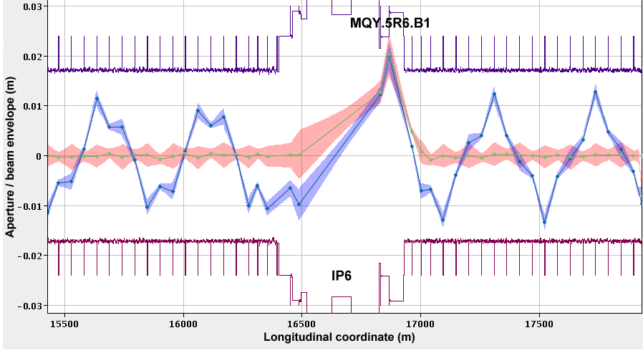
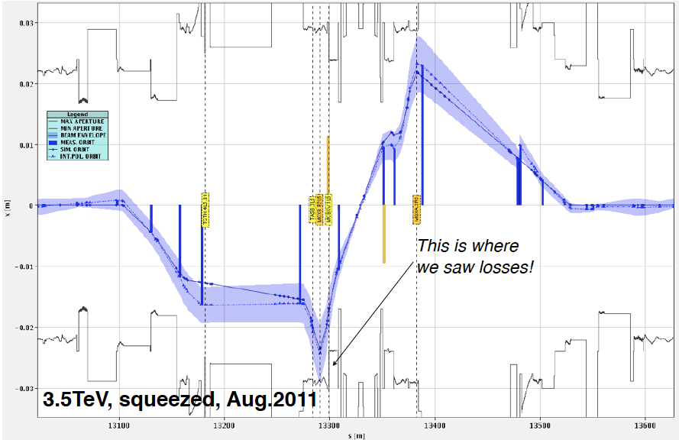
Aperture
Aperture systematically measured (locally and globally)
Better than anticipated w.r.t. tolerances on orbit & alignment
Aperture compatible with a well-aligned machine, a well centred orbit and close to design mechanical aperture

Slide 19
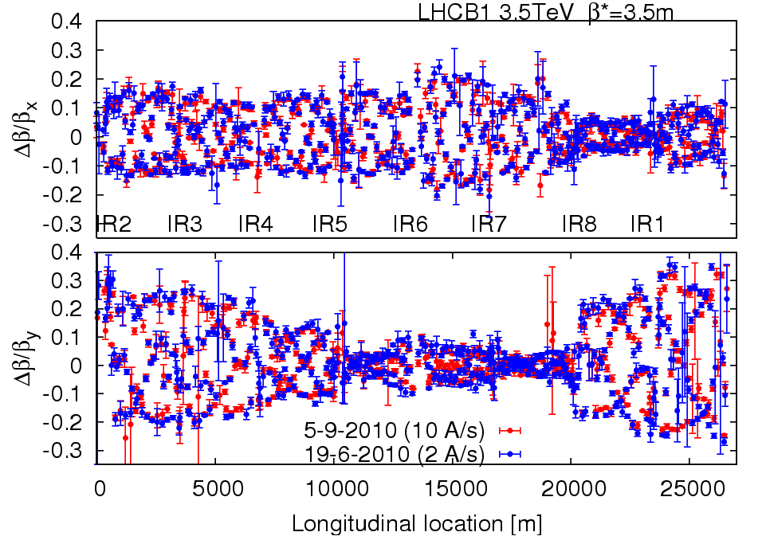
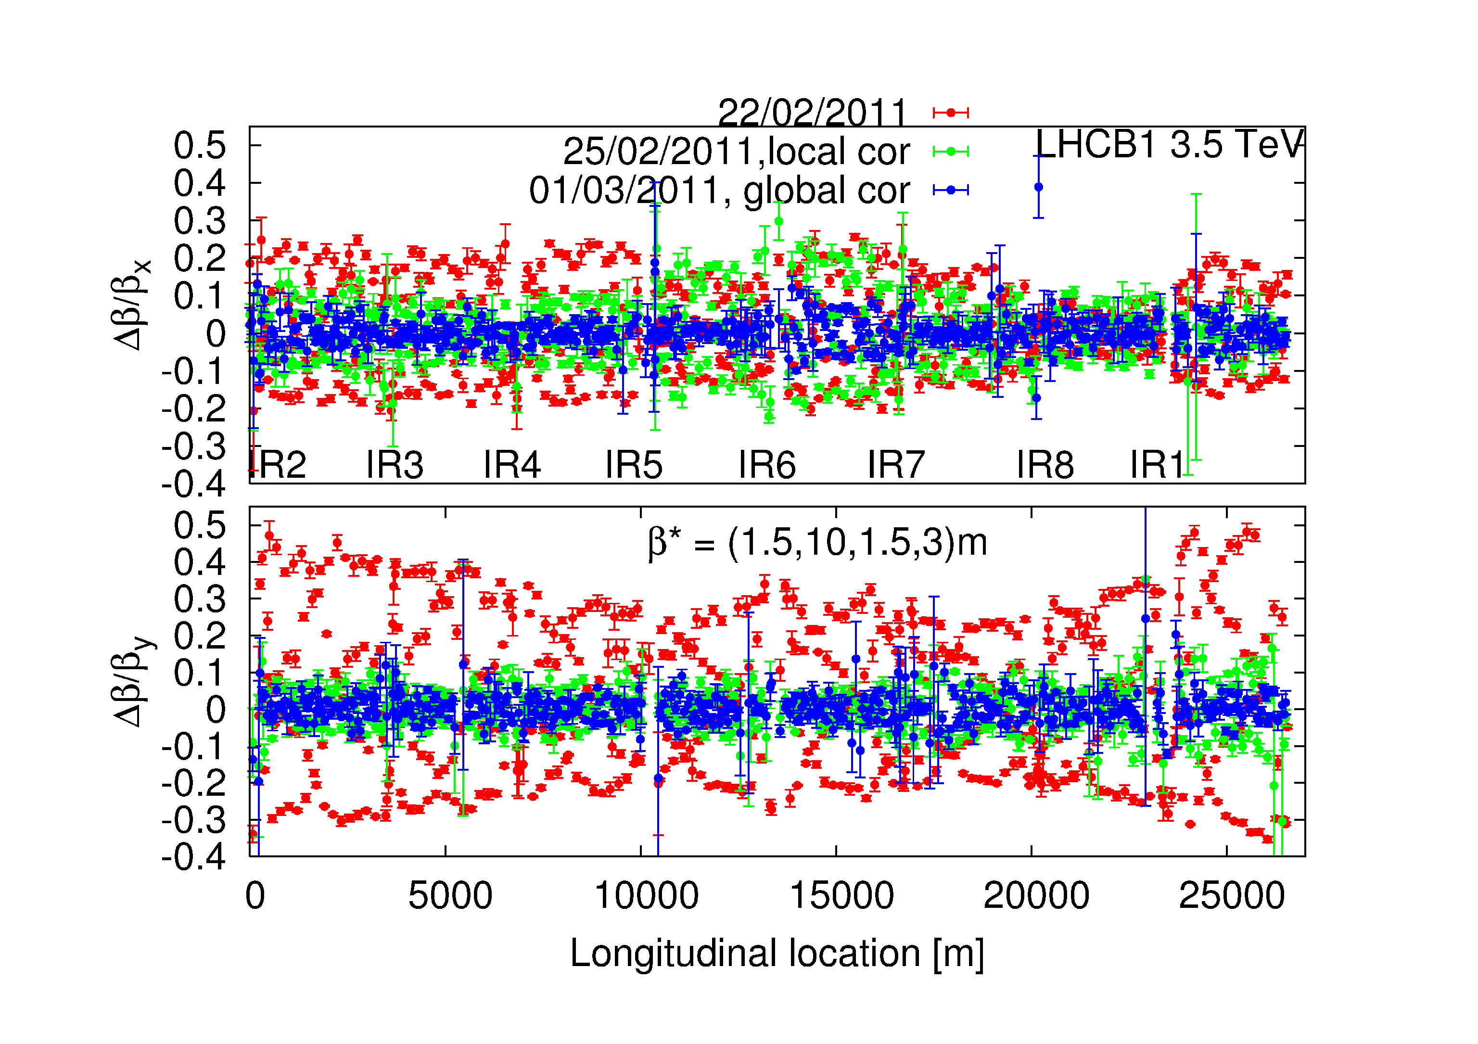
Optics
Optics stunningly stable
and well corrected
Two measurements of beating at 3.5 m
3 months apart
Local and global correction at 1.5 m
WEPC028 Record Low Beta-beat of 10% in the LHC(!)

Slide 20
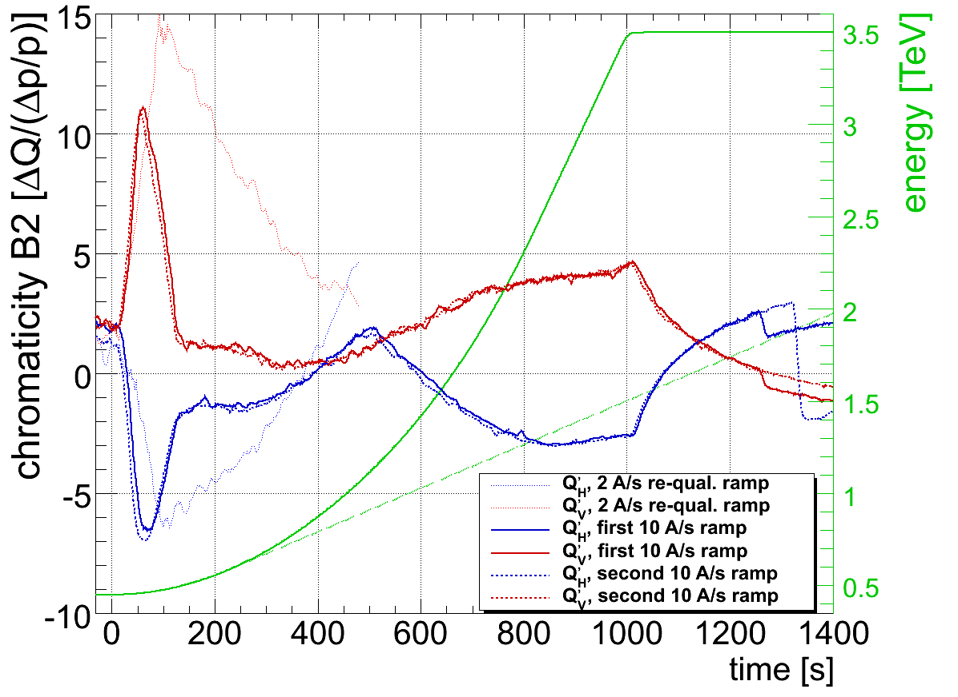
Magnet model
Knowledge of the magnetic machine is remarkable
All magnet ‘transfer functions’, all harmonics including decay and snapback
Tunes, momentum, optics remarkably close to the model
Model based feed-forward reduces chromaticity swing from 80 to less than 10 units

Slide 21
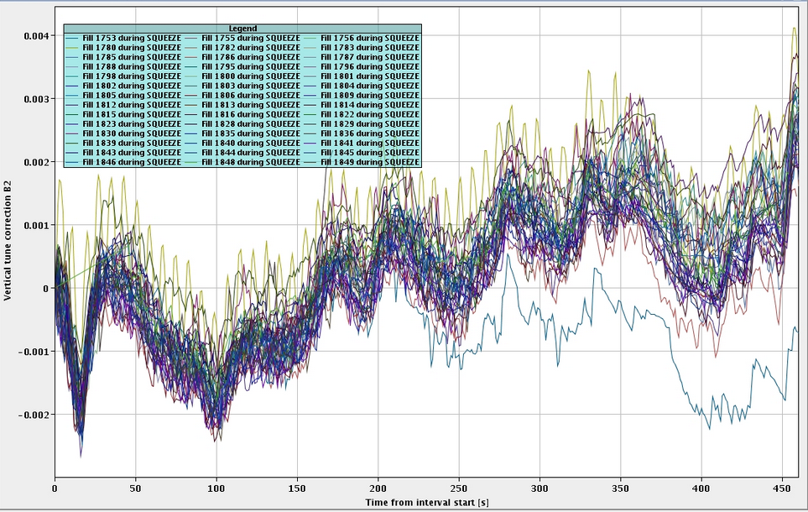
Reproducibility
LHC magnetically reproducible with rigorous pre-cycling - set-up remains valid from month to month
7 e-3
Tune corrections made by feedback during squeeze

Slide 22
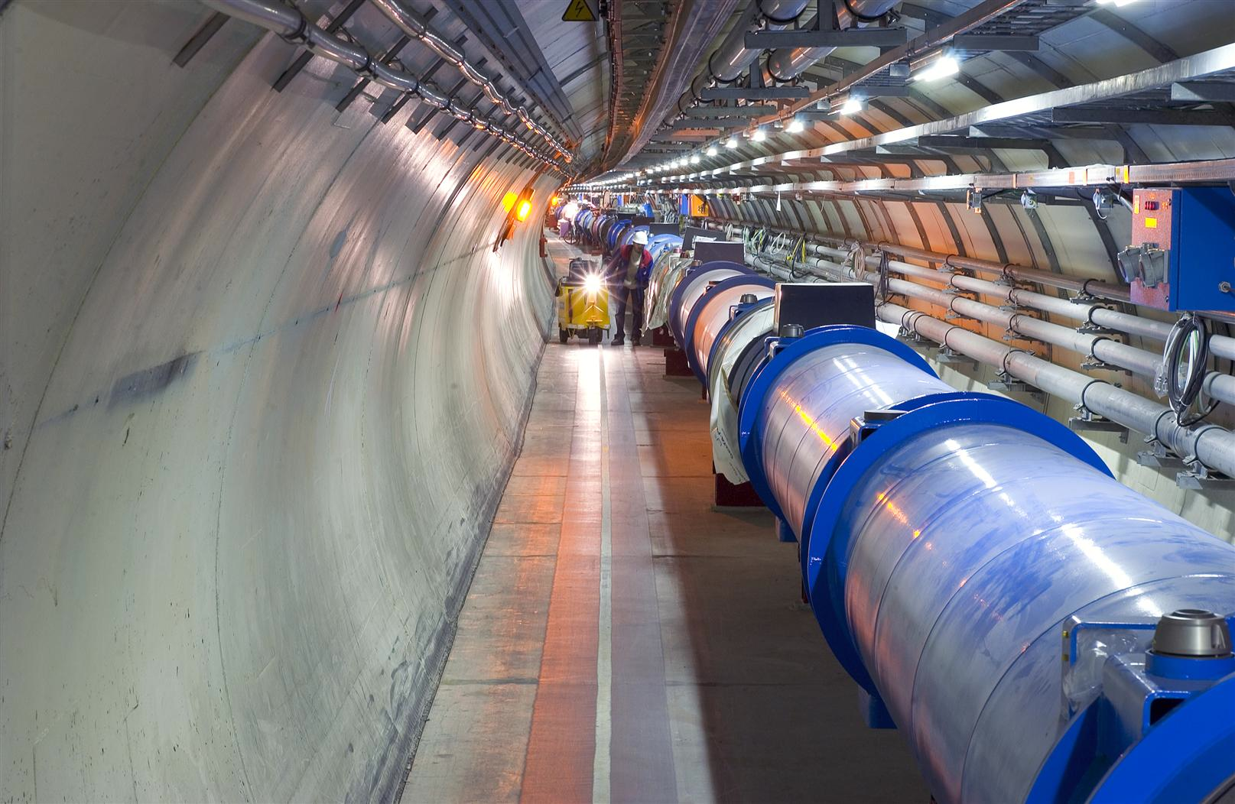
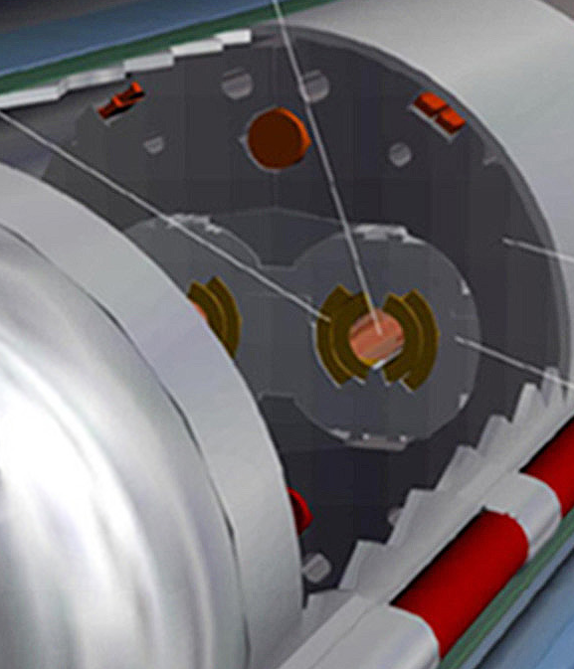
Machine protection – the challenge
Situation at 3.5 TeV (in August 2011)
Beam
100 MJ
Not a single beam-induced quench at 3.5 TeV
… YET
11 magnet quench at 450 GeV – injection kicker flash-over
56 mm
SC Coil:
quench limit
15-100 mJ/cm³

Slide 23
Beam Interlock System
Safe Beam Parameter Distribution
Jaw Position
Temperature
Special
BLMs
Safe
LHC
Parameter
Software
Interlock
System
Operator Buttons
CCC
Vacuum
System
Screens and Mirrors
beam observation
RF
System
(f_RF + P)
Access
System
Collimation
System
Beam Interlock System
Beam
Dumping System
Safe
Beam
Flag
Injection Interlock
Powering
Interlocks
superconducting magnets
Powering
Interlocks
normal conducting magnets
Fast Magnet Current
change Monitor
BPMs
LHC
Experiments
Beam loss monitors
BLM
Timing System
(Post Mortem Trigger)
Magnets
Power Converters
Beam Loss
Monitors
BCM
Monitors
aperture limits
(some 100)
Monitors in arcs
(several 1000)
Magnet protection system
(20000 channels)
Power
Converters
~1600
AUG
UPS
Cryogenics
some 10000 channels

Slide 24
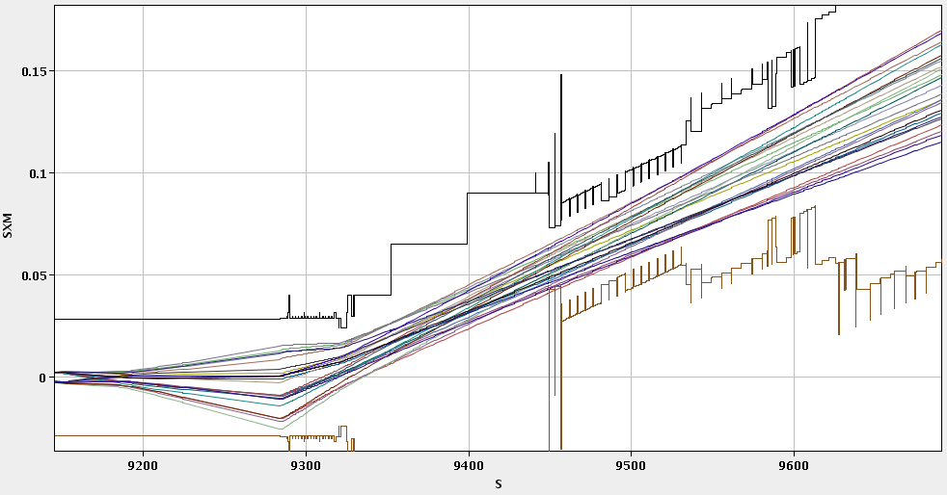
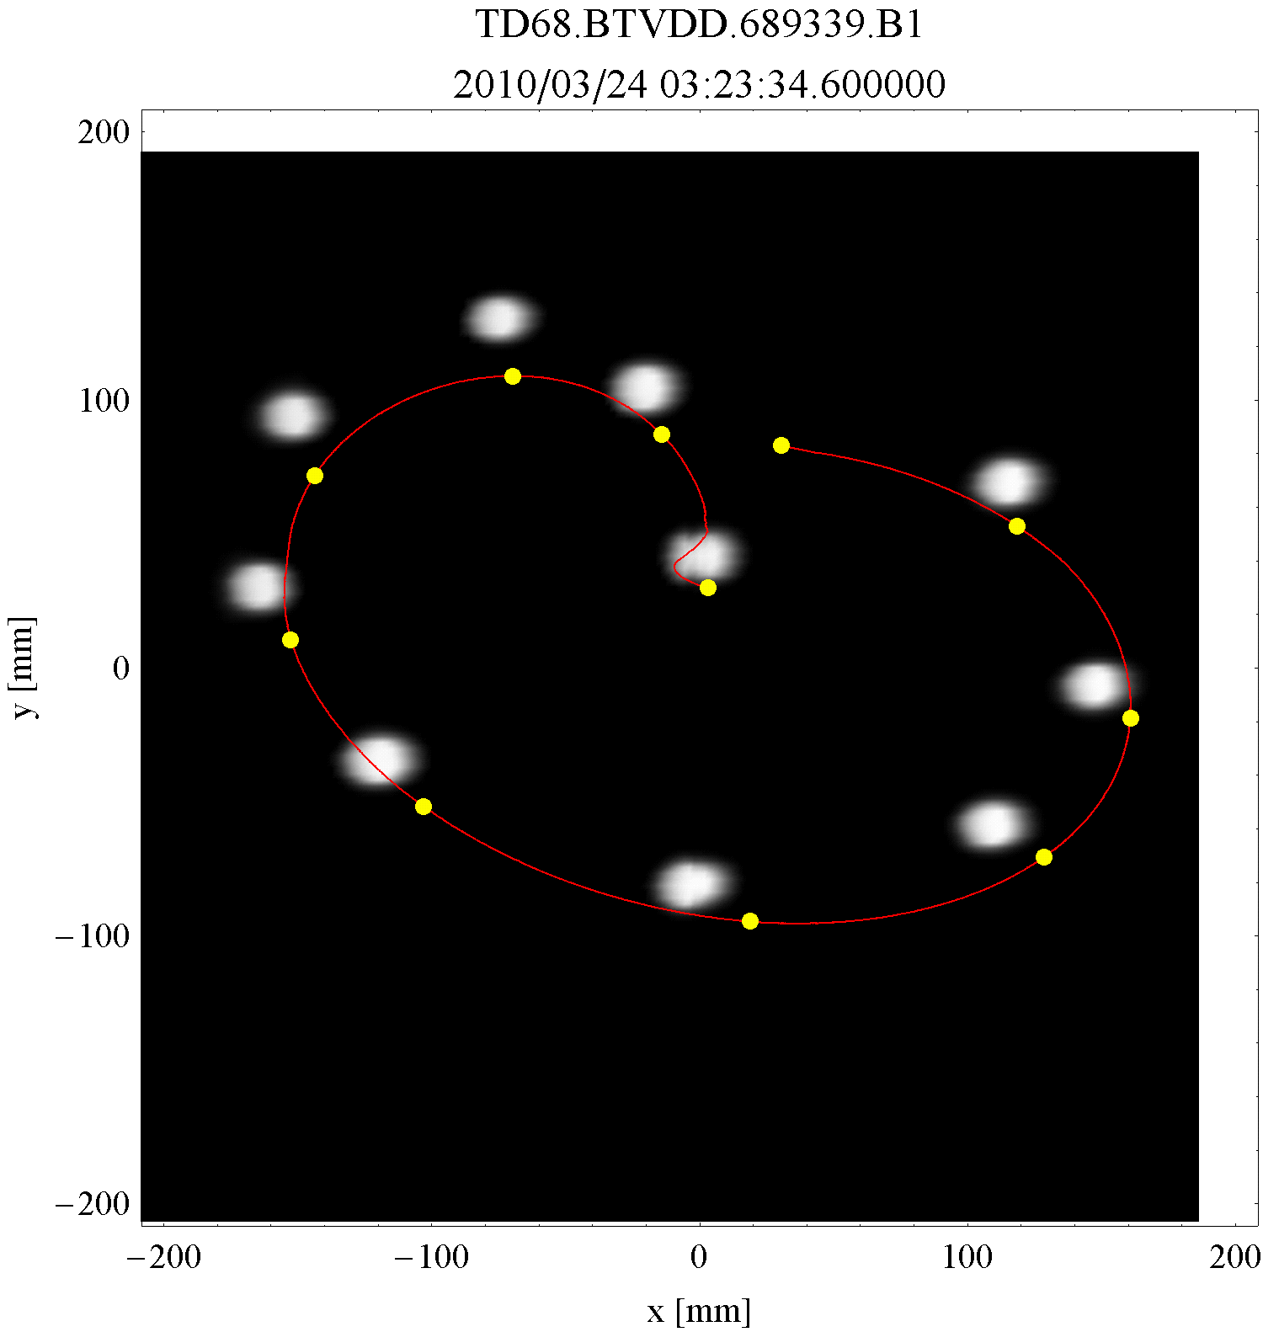
Beam Dump System (LBDS)
Absolutely critical. Rigorous and extensive program of commissioning and tests with beam.
Expected about two asynchronous dumps per year – one to date with beam
IR6 H Beam2, extracted

Slide 25
Safety critical aspects of the Dump System
Signal from beam interlock system and triggering
Energy tracking
Extraction kicker retriggering after single kicker erratic
Mobile protection device settings
System self-tests and post-mortem
Aperture, optics and orbit
Extraction – dilution kicker connection and sweep form
Abort gap ‘protection’
Fault tolerance with 14/15 extraction kickers
Number of unacceptable dump system failures:
1 every 1000000 years
“Eternal vigilance is the price of liberty”

Slide 26
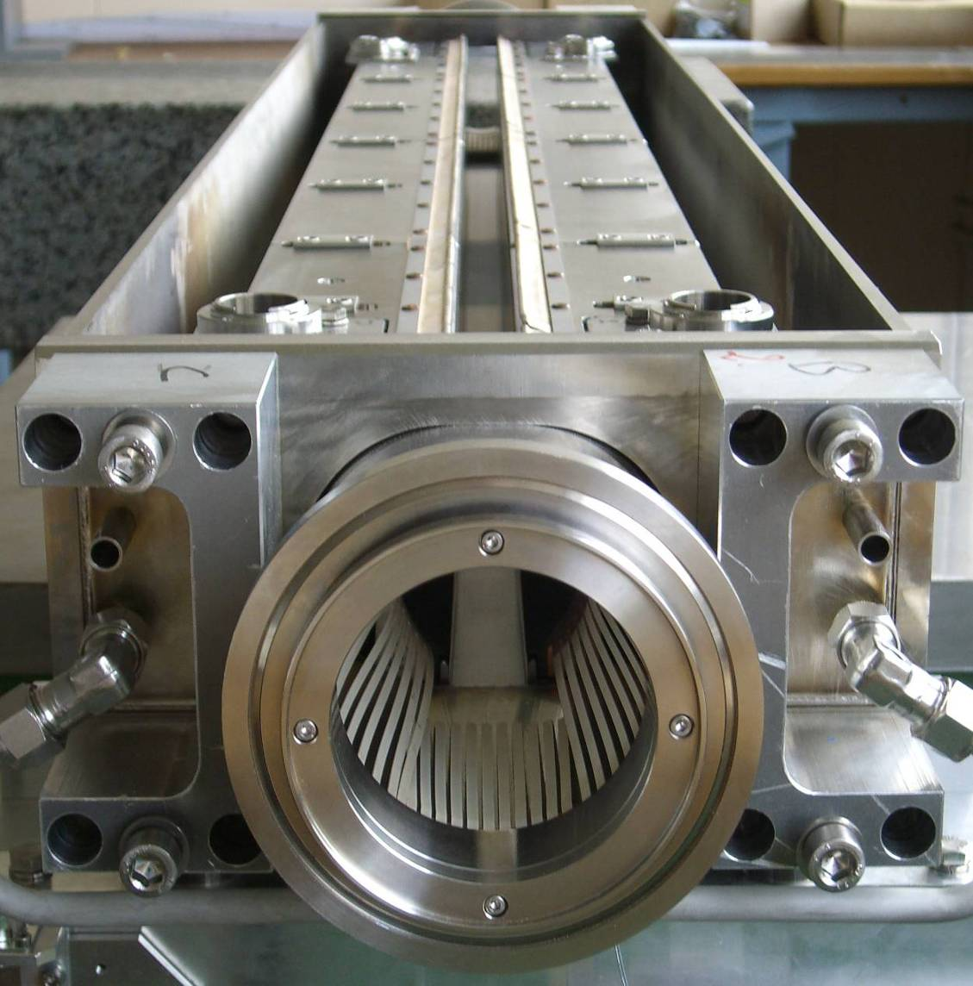
Collimation
Two warm cleaning insertions
IR3: Momentum cleaning
1 primary (H)
4 secondary (H,S)
4 shower abs. (H,V)
IR7: Betatron cleaning
3 primary (H,V,S)
11 secondary (H,V,S)
5 shower abs. (H,V)
Local IP cleaning: 8 tertiary coll.
1.2 m
Total = 108 collimators
About 500 degrees of freedom.
beam

Slide 27
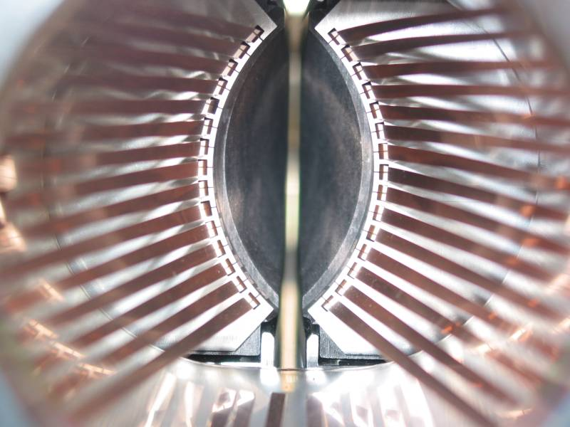
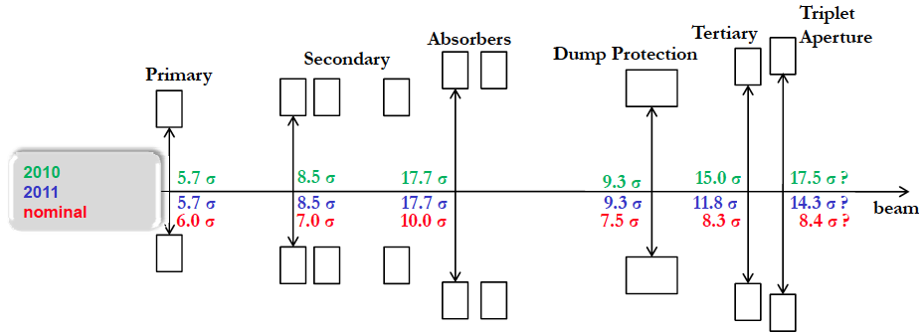
Collimation
Triplet aperture must be protected by tertiary collimators (TCTs)
TCTs must be shadowed by dump protection (not robust)
Dump protection must be outside primary and secondary collimators
Hierarchy must be satisfied even if orbit and optics drift after setup
  margins needed between collimators

Slide 28
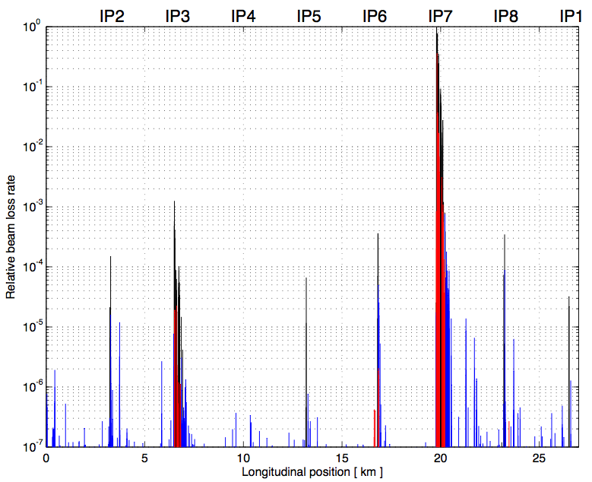
Collimation cleaning at 3.5 TeV
Generate higher loss rates: beam across the 3rd order resonance.
Beam 1
Betatron
Off-momentum
0.00001
Dump
TCTs
TCTs
TCTs
TCTs
Legend:
Collimators
Cold losses
Warm losses
0.000001
Outstanding performance:
No beam-induced quenches in 2010/2011

Slide 29
Exit 2010: beam parameters
 | 2010 | Nominal
Energy [TeV] | 3.5 | 7
beta* [m] | 3.5, 3.5, 3.5, 3.5 m | 0.55, 10, 0.55, 10
Emittance [microns] | 2.0 – 3.5 start of fill | 3.75
Bunch intensity | 1.2e11 | 1.15e11
Number of bunches | 368 348 collisions/IP | 2808
Stored energy [MJ] | 28 | 360
Peak luminosity [cm⁻²s⁻¹] | 2e32 | 1e34

Slide 30

Lead ion run 2010
Collisions within 54 hours of first injection
Experience and Lorentz’s law.
TUPZ016 First Run of the LHC as a Heavy-ion Collider

Slide 31

90 pb⁻¹/day
2.6 fb⁻¹

Slide 32

2011
75 ns
50 ns
Intermediate energy run, technical stop, scrubbing
Emittance
reduction
MD, technical stop
MD, technical stop

Slide 33
Beam from injectors
Higher than nominal bunch intensity
Smaller than nominal emittance
Bunch spacing | From Booster | Np/bunch | Emittance H&V [mm.mrad]
150 | Single batch | 1.1 x 10¹¹ | 1.6
75 | Single batch | 1.2 x 10¹¹ | 2.0
50 | Single batch | 1.45 x 10¹¹ | 3.5
50 | Double batch | 1.6 x 10¹¹ | 2.0
25 | Double batch | 1.2 x 10¹¹ | 2.7
At present: ~1.3 x 10¹¹ppb, 2.0 microns into collision
TUPZ019 Transverse Emittance Preservation through the LHC Cycle
MOPS009 Probing Intensity Limits of LHC-type Bunches in SPS with Nominal Optics

Slide 34

2011: (c/o Atlas & LHCb)
Peak stable luminosity | 2.37 x 10³³ cm⁻²s⁻¹
Max. luminosity in one fill | 100.71 pb⁻¹
Max. luminosity delivered in 7 days | 499.45 pb⁻¹
Longest time in stable beams | 26.0 hours
Longest time in stable beams for 7 days | 107.1 hours (63.7%)
Fastest turnaround | 2 hours 7 minutes
24% of design luminosity:
- half design energy
- nominal bunch intensity+
- ~half nominal emittance
- beta* = 1.5 m (design 0.55 m)
- half nominal number of bunches

Slide 35






Fill 2006: Luminosity lifetime
A “typical” fill that lasted 26 hours and delivered 100 pb⁻¹
100 hours
Lifetime beam 1
30 hours
Luminosity lifetime
Lifetime beam 2
H growth rate ~64 hours
V growth rate ~84 hours

Slide 36
2011 parameters – end August
Energy [TeV] | 3.5
Beta* [m] | 1.5, 10, 1.5, 3.0 m
Normalized emittance [microns] | ~2.0 start of fill
Bunch intensity | 1.2 – 1.3e11
Number of bunches | 1380 1318 collisions/IP1&5
Bunch spacing [ns] | 50
Stored energy [MJ] | 90 to 100
Peak luminosity [cm⁻²s⁻¹] | 2.37e33
Beam-beam tune shift (start fill) | ~0.023
beta* = 1 m commissioning ongoing
~50 days proton physics left in 2011

Slide 37

Availability - efficiency
Premature end to fills

Slide 38


UFOs in the LHC
Since July 2010, 35 fast loss events led to a beam dump.
18 in 2010, 17 in 2011.
13 around MKIs.
6 dumps by experiments.
1 at 450 GeV.
Typical characteristics:
  Loss duration: about 10 turns
  Often unconventional loss locations (e.g. in the arc)
The events are believed to be due to (Unidentified) Falling Objects (UFOs).
Spatial and temporal loss profile of UFO on 23.08.2010
TUPC137 Dust Particles in the LHC

Slide 39



Single Event Effects
Major campaign ongoing: shield and relocate

Slide 40

Dumps > 450 GeV July-August

Slide 41

Availability 2011
Beam in ~48% of the time

Slide 42
Conclusion
Very successful commissioning:
  Hard work plus experience, preparation, time, the injectors, collaboration, 21st century technology, engineering, hardware, teamwork, care, expertise, motivation, dedication, leadership, controls, diagnostics, tools, resources…
Good transition from commissioning to operations
  Cycle is solid
  Machine protection working very well
  Availability with high intensity acceptable with issues being addressed

Slide 43
Acknowledgements
The LHC is a beautiful machine. The superb progress so far is a real testament to the dedication of the CERN staff and the help we have received from our international collaborators.

